Slide 1

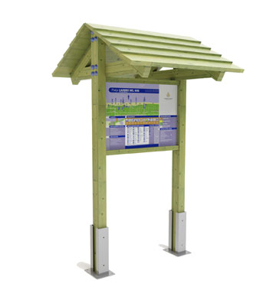
Briefing
In Trin (a small swiss village) we have a old fitness trail (with 12 fitness excercises). In order to make the old fitness trail more attractive we build now an additional yoga trail.
In order to inform the tourists and locals (who pass by) about the new service/attraction, we need a design for an information panel which motivates the people to stop and visit the yoga trail.
The panel should display:
A newly illustrated map about the trail, its accessability and its 9 yoga workout areas
Introduction Text
Short information about the 9 different yoga excercises (with picture).
Our own logo
Logo of our sponsors
The panel will be placed under a small roof

Slide 2
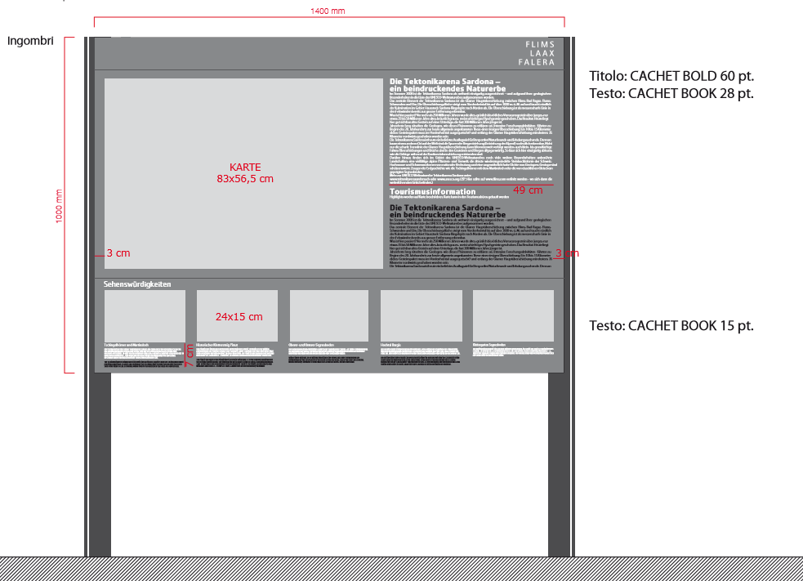
The design will be printed on a panel like this and have the following size:
1400 mm wide and and 1000 mm high.
Please make sure, that you leave in your design an empty frame of 3 cm
The layout you see here on the left hand side is just a filler. You are absolutely free how you arrange the map (in the given place) with the introduction text and the 9 excercise texts with pictures.
Please show me how you would design/arrange the yoga panel and make some proposals.

Slide 3

Somewhere I need to place 2-3 sponsor logos (maybe in the upper right corner) ?
In the upper left hand corner I want to place our logo:
We always use the following green colour:
Uncoated 326 U,
Coated 326 C (is a bit too light)
Please use the above mentioned color also for other elements on the information panel (for example headlines, nr. boubles etc.)

Slide 4
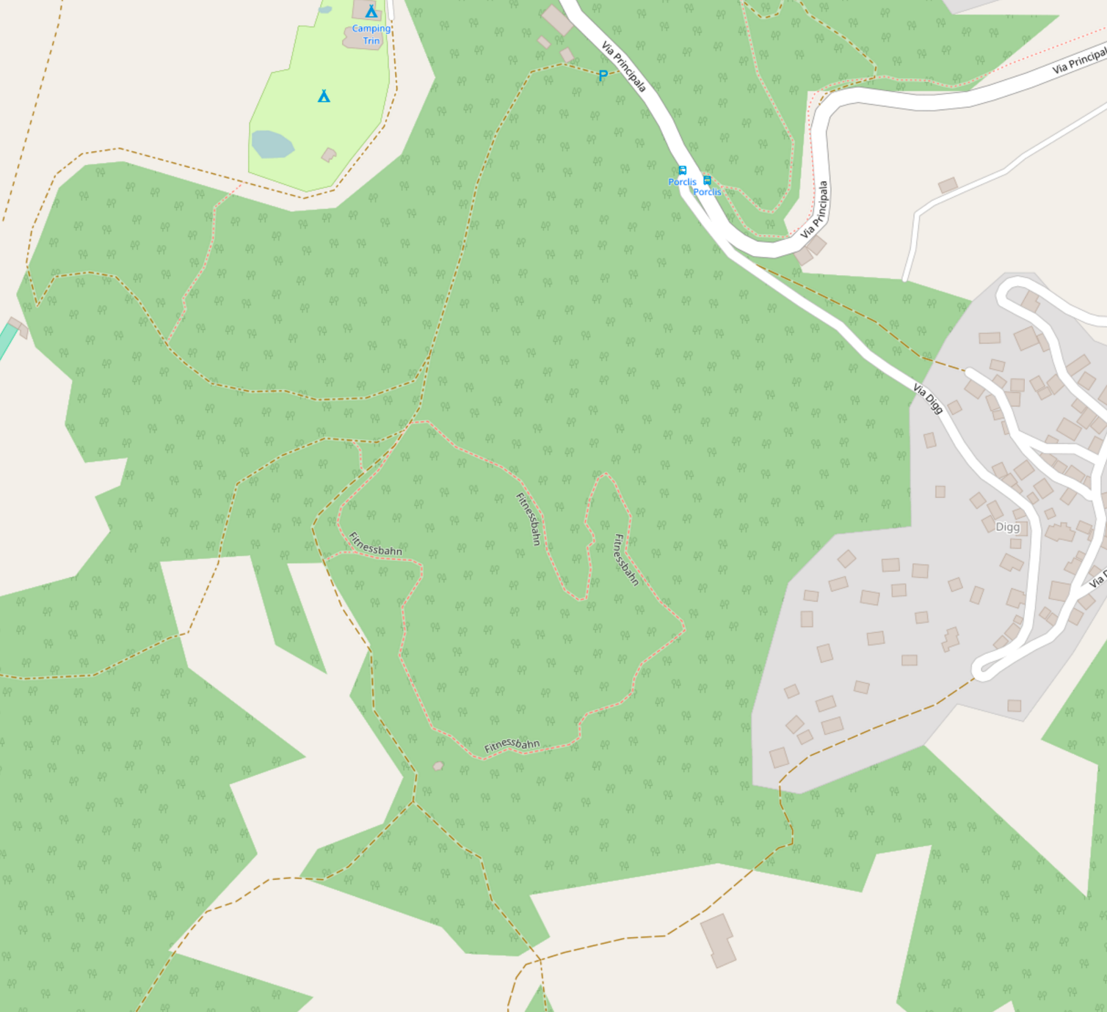
This is the real map you should
illustrate for the panel. The
illustrated map should display the
following information and
show the guest how he
can access the trail
and how it is situated
Add here a campground
icon and write Campingplatz
Add here a icon with a wooden
building and write Werkhof
Add here an arrow and write Trin Mulin
Add here a icon
for a parking
and write Parkplatz
Add here an arrow and write Trin
Add here a
icon for a bus
stop and write
Bushaltestelle Trin Porclis
Please highlight the
way from the parking to the trail
Add here an arrow and write Trin Digg
Illustrate here
a small village
and write Trin Digg
Please write here
Start Fitness- & Yoga Parcours
This is the Yoga-
and Fitness trail
Add here a
icon for a
picknick area
and write
Grillstelle Scrausch

Slide 5
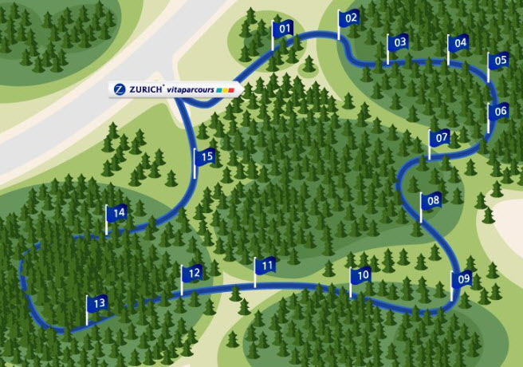
Could you illustrate the map somehow like this?
The exact place of the 9 excercises I will give you once we agree on the basic visualization.
Please word with some place holders.

Slide 6
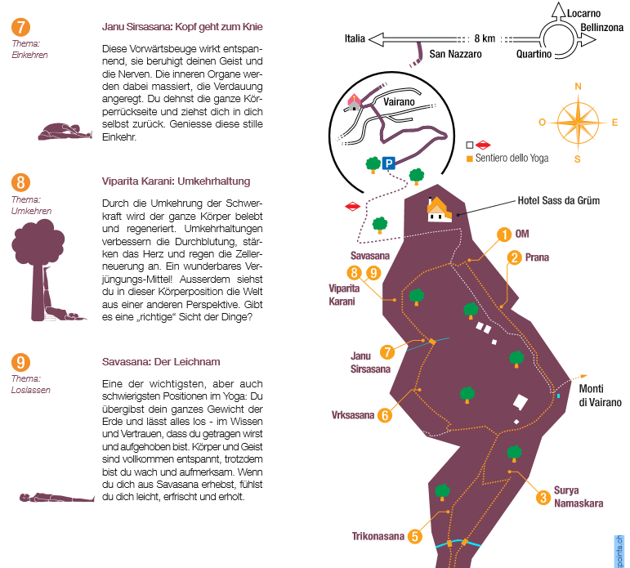
Each excercise on the map should have a nr.
and be explained with the short text (see text briefing) and the according picture.
Please make some proposals how you would arrange the texts and pictures and the map. We are open for your proposal.

