Slide 1
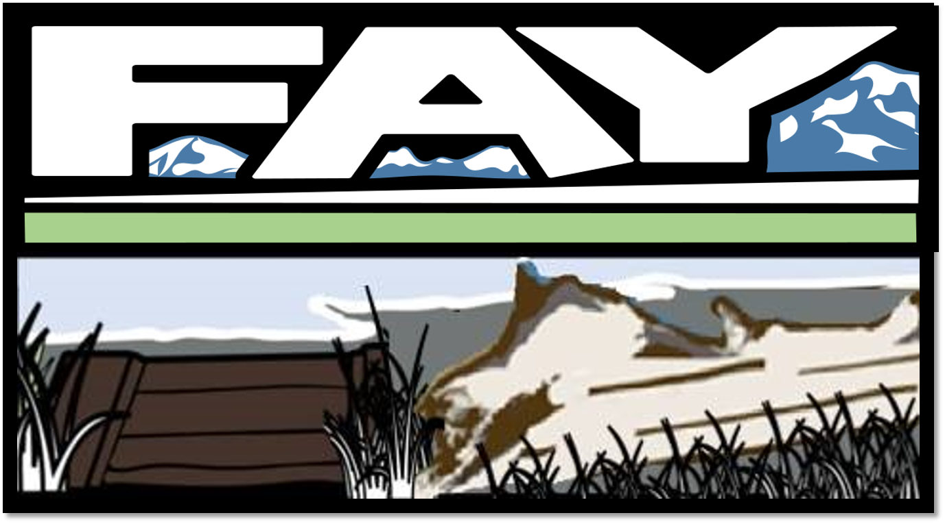
OBJECTIVE : REFINE MODERN LOGO OF FAY BAINBRIDGE BEACH FOR 2X1 DIMENSION EMBROIDERED PATCH FOR TRUCKER HAT

Slide 2

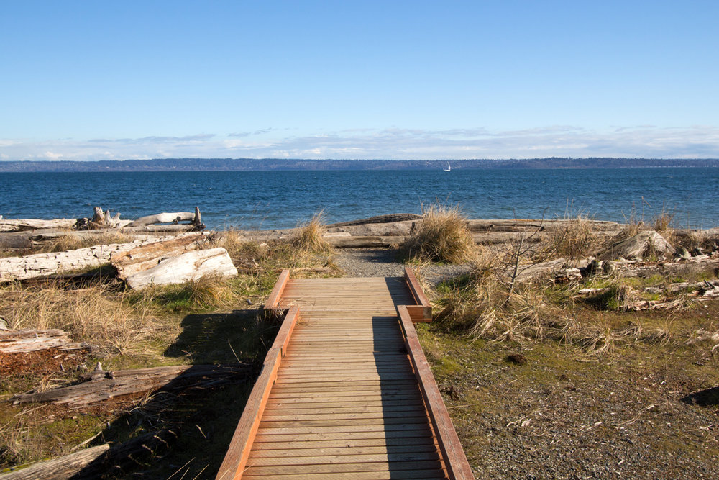
NEED TO BUILD BOTTOM OF CURRENT LOGO to include: (a) board walk in bottom left corner, below is picture of the board walk from this beach called Fay

Slide 3
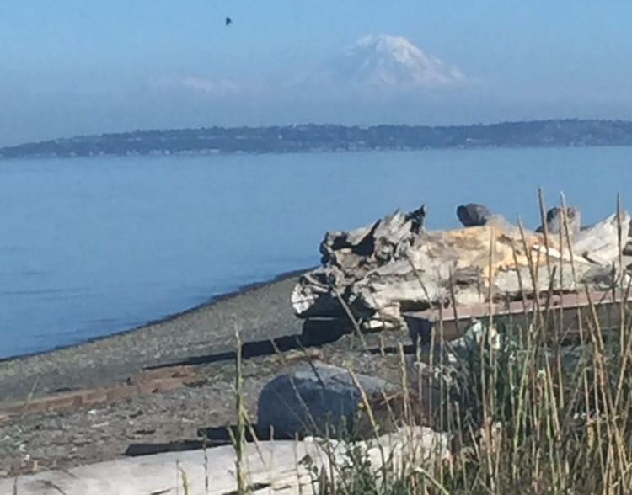
NEED REFINEMENT OF BOTTOM OF CURRENT LOGO to include: (b) grass and this large piece of drift wood in the bottom right corner

Slide 4
HERE IS MY MOCK UP:
I’d like to add in the sea with this light blue and a strip of white surf
I want to replace the board walk with (i) more narrow boards, (ii) straight lines in white & (iii) lighten up the board walk to something similar to photo

Slide 5
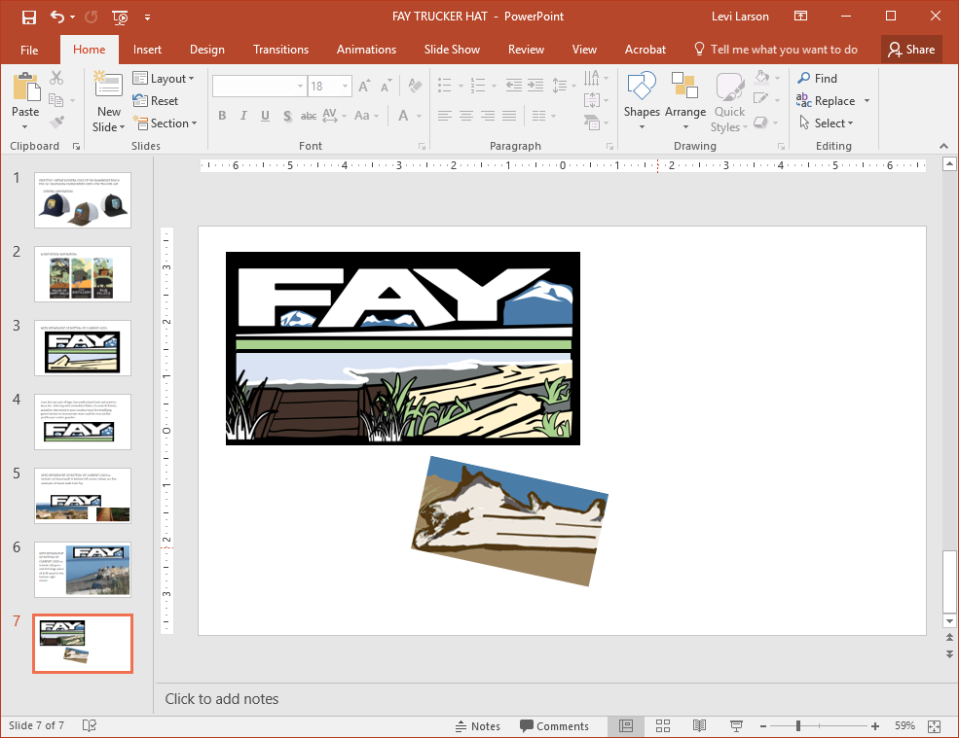
HERE IS MY MOCK UP:
This is a really distinctive old growth drift log on the beach, I’d like it to take up most of the bottom right corner

Slide 6
HERE IS MY MOCK UP:
I’d like the bottom right corner to just be drift wood and grass, i.e., no sand
I’d like the grass to be the same color as the green horizon strip and a little thicker and outlined in black, – I just found this grass on clip art, I don’t love it but something like this creating boarder underneath the log of varying height/style so it doesn’t just look like a copy and paste of the same clip art which is what I did here

Slide 7
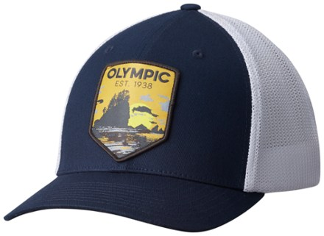
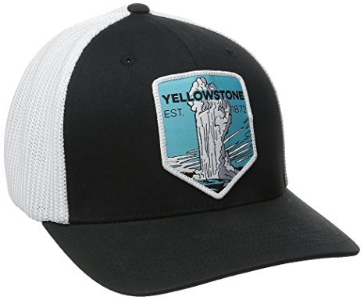
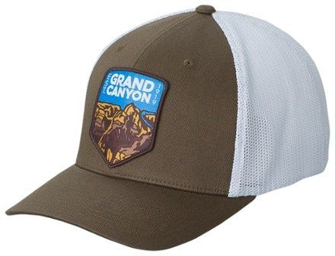
GENERAL INSPIRATION:

Slide 8
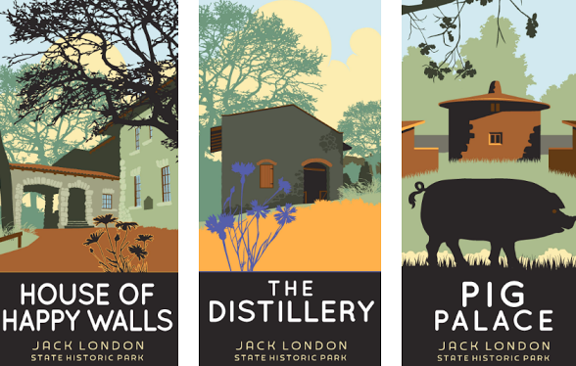
MORE DESIGN INSPIRATION:

