Slide 1
360◦ Feedback - why and how
Presented by
Andrew Marty
SACS Consulting

Slide 2
Objectives
360 – Why do it?
360 – What is it measuring?
Options for instruments
What works?
Best practice

Slide 3
360 – What is it?
It is performance management
Performance management is not objective
360 is at its weakest for objective measures, e.g. goal attainment – budget, quality levels, etc
At its strongest in the domain of impressions, where perception is reality
Good performance management causes people to change.

Slide 4
Why do it?
Leadership development
  Optimisation
  Performance deficits
Succession management
A unique capacity to deliver awareness of others’ perspectives
O wad some power the giftie gie us To see oursels as ithers see us.

Slide 5
Key points to consider
360 feedback is strong medicine – people can get hurt
Acceptable levels of trust are a prerequisite
Set up an appropriate governance structure – partnership and justice
  Instrument choice (development)
  Rater choice
  How we respond to scores, both good and bad
Research suggests that 360 is of limited value without an OD/coaching approach and support
Confidentiality and the power of the third party.

Slide 6
Key points to consider continued
Engagement processes – collaboration rather than consultation.

Slide 7
Instrument Options
Normative
  Standard items
  Compare to a population of other leaders
  Known measurement quality
  Know reliability and validity (if well developed)
Competency based
    Locally developed
    Focused on behaviours endorsed by the group to be assessed
    Individual competencies rather than scale scores
    Very high ‘face validity’
The choice depends on what you want to achieve.

Slide 8
Normative Approach

Slide 9
Normative
Items have been validated – reliability and validity
Items have been administered to large normative population
  Leaders from a range of sectors
  Norms do not vary much across sectors, or even populations
Results show, for instance, ‘I am at the 12 percentile for empowering staff.’
Hard to argue with!

Slide 10
Bakker 2011 – work engagement
Vigour
  High levels of energy and mental resilience
Dedication
  Strongly involved in work. A sense of significance, enthusiasm and challenge
Absorption
  Fully concentrated and happily engrossed in work such that time passes quickly. A sort of extended version of “flow” (Csikszentmihalyi 2002).
Notes:
Notes half page

Slide 11
SACS Leadership behaviour scale

Slide 12
Leader Behaviours predicting Engagement
Model Summary
Model | R | R Square | Adjusted R Square | Std. Error of the Estimate
1 | .497ª | .247 | .241 | .93058
Creates a learning environment
Supportive leadership
Fosters teamwork
Encourages autonomous decision making
Effective management of behaviours
Effective management of underperformance
Celebrates success
Optimism and positivity
Creates clarity of performance standards
Creates clarity of appropriate behaviours
Engagement
Best predictors of Engagement | Beta weights
Encourages autonomous decision making | .246
Optimism and positivity | .172
Supportive leadership | -.136
Creates a learning environment | .117
Notes:
Leave two pages of lined spaces after this slide

Slide 13
The Path to Engagement
LEADER BEHAVIOURS
COLLEAGUE BEHAVIOURS
.791
-.151
.807
ENGAGEMENT

Slide 14
360 Degree Feedback Questions
Factor | Questions |  | CFA results
1 | Creates a learning environment
 | (a) | ‘X’ creates a learning environment for staff | 0.927
 | (b) | ‘X’ is good at helping staff to learn | 0.949
 | (c) | ‘X’ tries to help staff acquire skills and knowledge | 0.943
2 | Supportive leadership
 | (a) | ‘X’ is helpful to staff | 0.891
 | (b) | ‘X’ is kind to staff | 0.909
 | (d) | ‘X’ tries to have good relationships with staff | 0.871
3 | Fosters teamwork
 | (a) | ‘X’ encourages us to work as a team | 0.889
 | (c) | ‘X’ creates a harmonious team environment | 0.941
 | (d) | ‘X’ creates cohesion | 0.943
4 | Encourages autonomous decision making
 | (a) | ‘X’ gives staff the freedom to decide things for themselves | 0.946
 | (b) | ‘X’ supports staff in choosing their own way to do things | 0.948
 | (c) | ‘X’ allows staff to make their own decisions | 0.957
5 | Creates clarity about performance standards
 | (a) | ‘X’ sets clear performance standards | 0.939
 | (b) | ‘X’ is good at making it clear to staff what standards of performance are expected | 0.955
 | (d) | ‘X’ makes sure I always know what standards of performance I need to reach | 0.944

Slide 15
360 Degree Feedback Questions
Factor | Questions |  | CFA results
6 | Effective management of underperformance
 | (b) | ‘X’ is good at giving performance feedback | 0.946
 | (c) | ‘X’ is good at giving guidance to people about whether they are doing a good job | 0.956
 | (d) | ‘X’ gives helpful performance feedback | 0.953
7 | Creates clarity about appropriate behaviours
 | (a) | ‘X’ makes it clear to staff what behaviours are appropriate | 0.942
 | (b) | ‘X’ is good at letting staff know what standards of behaviour are acceptable | 0.952
 | (d) | ‘X’ makes it clear to staff how they should behave | 0.943
8 | Manages behaviour
 | (a) | ‘X’ is effective at letting people know when they are misbehaving | 0.939
 | (c) | ‘X’ gives clear feedback when people’s behaviour is not appropriate | 0.958
 | (d) | ‘X’ is good at giving guidance when people’s behaviour is not up to the mark | 0.941
9 | Celebrating success
 | (a) | ‘X’ is good at celebrating success | 0.894
 | (b) | ‘X’ is good at recognising good performance | 0.942
 | (c) | ‘X’ congratulates people who perform well | 0.960
10 | Optimism and positivity
 | (a) | ‘X’ is an optimistic person | 0.919
 | (b) | ‘X’ creates a sense of optimism | 0.944
 | (d) | ‘X’ focusses on the positive | 0.911

Slide 16
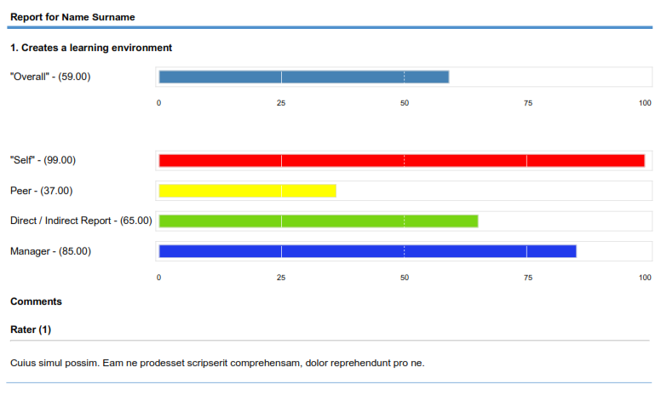
360 Degree Feedback Report – individual

Slide 17
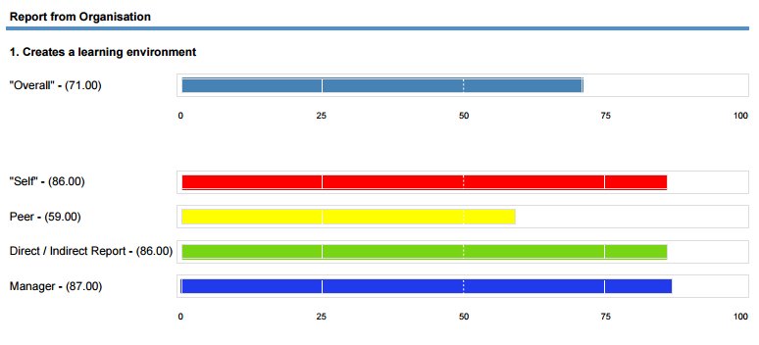
360 Degree Feedback Report - organisation

Slide 18
Competency based approach

Slide 19
Competency based approach
We are seeking to gain specific information for coaching
Local norms can be developed per item
‘Selfs’ can be ranked on dimensions – highest to lowest – targeted development
You are not creating scales – you leave the results at the item level
Organisation wide information:
  Development areas – low scores
  Confidence areas – low self scores, high staff scores
  Over confidence areas – high self scores, low other scores.

Slide 20
Stages in development
Assemble a representative group
of employees
Facilitate a discussion about outcomes (what) and behaviours (how)
Turn agreed behaviours into a survey instrument
Use the survey instrument after feedback on the draft version
The subject matter is behaviours which the group considers to be important

Slide 21
Or you can choose existing items
Competency based questions
31. X is focussed on the achievement of important outcomes.
32. X demonstrates the capability of taking personal accountability for delivering results.
33. X is creative in embracing new and better ways of doing things.
34. X is a capable active listener, truly paying attention to other people’s perspectives.
35. X collaborates with other members of the leadership team. X is a cohesive team player.
36. X respects the decisions of the leadership team he/she belongs to.
37. X focuses on the needs of the organisation as a whole.
38. X clearly explains and communicates decisions that the leadership team he/she belongs to makes.
39. X clearly explains his/her own decisions.
40. X communicates clearly and consistently.
41. X has the courage to constructively state an opinion, even on difficult issues.

Slide 22
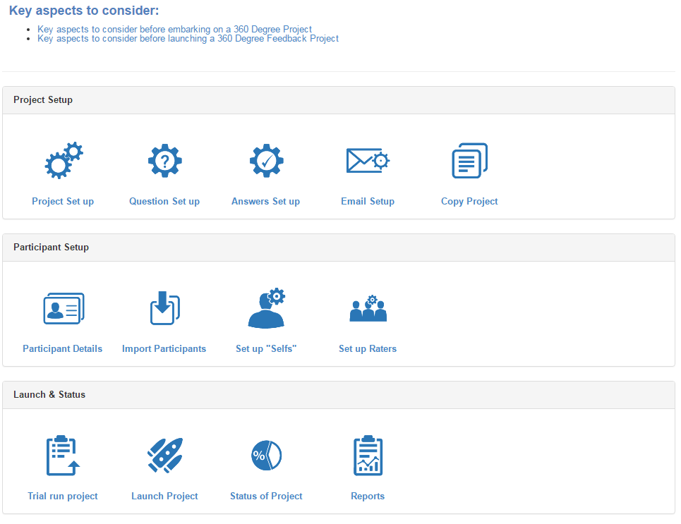
SACS 360 Degree Feedback Software
Home Page

Slide 23
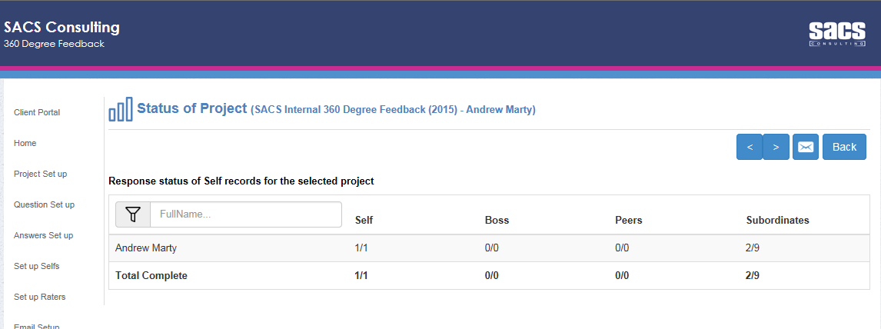
SACS 360 Degree Feedback Software
View the status of your project

Slide 24
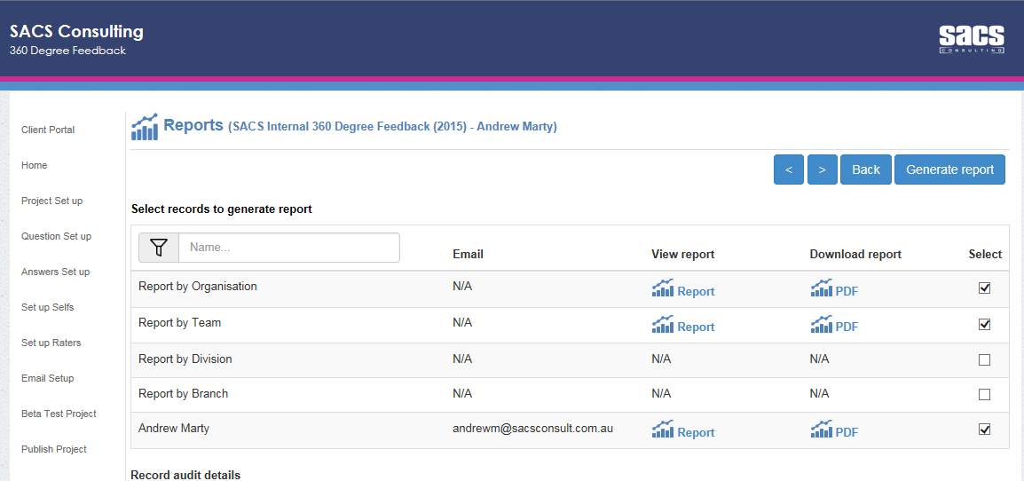
SACS 360 Degree Feedback Software
Download Reports

Slide 25
Measurement accuracy

Slide 26
Accuracy of raters
Leader | Accurate in assessing achievement of objective outcomes. Often very inaccurate in assessing leadership ability
Self | Accurate in assessing achievement of objective outcomes. Self awareness varies enormously – personality
Peer | Accurate in assessing objective measures. Inaccurate in respects of leadership
Staff | Accurate in respect of leadership, inaccurate (in most cases) in assessment of objective measures. On balance best predictor of outcomes
So, in a pure sense, aggregating these is questionable
measurement practice

Slide 27
How to start a 360 process
Whether normative or competency based, we need engagement
Get everyone together and set a destination. “If this works well, what will it look like? What will the outcomes be? What will we gain from the exercise?
Discuss the normative and competency based options
Agree an approach.

Slide 28
How to start a 360 process continued
Set up a governance structure
  Confidentiality
  Third party
  Ethics – informed consent or compulsory
  Choice of raters
  Who sees the outcomes?
  What happens after we have results?

Slide 29
Considerations for first time use
Training is crucial – training for the raters and training for the recipients of ratings. Training for the leaders of those who are being rated
It is a very good idea to get external debriefs, particularly in the first instance
Psychological first aid and support - EAP
The self ratings first up will be higher than any subsequent administration.

Slide 30
360 without coaching will rarely
occasion development
Emphasise that 360 degree feedback measures your behaviour, not your soul.
Rapid changes in behaviour lead to rapid changes in ratings, but more importantly, perceptions of leadership
A coaching framework:
  Destination setting. If I am the best leader I can be it will look like this ......
  Reality – this is how far I am from this ideal. What will be an acceptable outcome next survey?
  Options – things I can do (behaviours) in order to move toward this destination
  Planning. An agreed plan of activities to move toward the destination.

Slide 31
Summary and conclusions
It is an extremely valuable process.
It can be challenging for some people, so….
Justice and a partnership approach are key prerequisites for success
Choose a method which will meet your needs
Make sure you back it with development and support.
Assistance with debriefing results is very helpful as you develop internal skills in this area.

