Slide 1
Welcome
to
Sundae School

Slide 2
Sundae School lessons for Today
ice cream olden days
ice cream fun facts
about us at Timboon
ice cream about cows
ice cream how we do it
let’s do it!! make some, that is...

Slide 3
What is Ice Cream?
Well, Technically it is…
… a dairy confection made by whipping air into a mixture of milk fats and solids, sugar and stabiliser/emulsifier, plus flavours, at freezing temperatures.
Ice cream exists as a both an emulsion and a foam, in a complex microstructure of “ice crystals, air bubbles and fat globules in a viscous solution of sugars, polysaccharides and milk proteins”.
It is “an extremely complex, intricate and delicate substance and has been described as just about the most complex food colloid of all” and unlike any other frozen food, is normally eaten in the frozen state.
Notes:
OK, you are all here to learn about ice cream.
So, What is Ice cream
Read through Slide.
So, has everyone got that? No?
Oh, you just thought it was sweet, creamy stuff that made you feel good when you ate it…
Here at the Sundae School you will learn a bit about what those terms mean and what makes ice cream what it is….. And then you can help to make some…..
Sound like a plan?

Slide 4
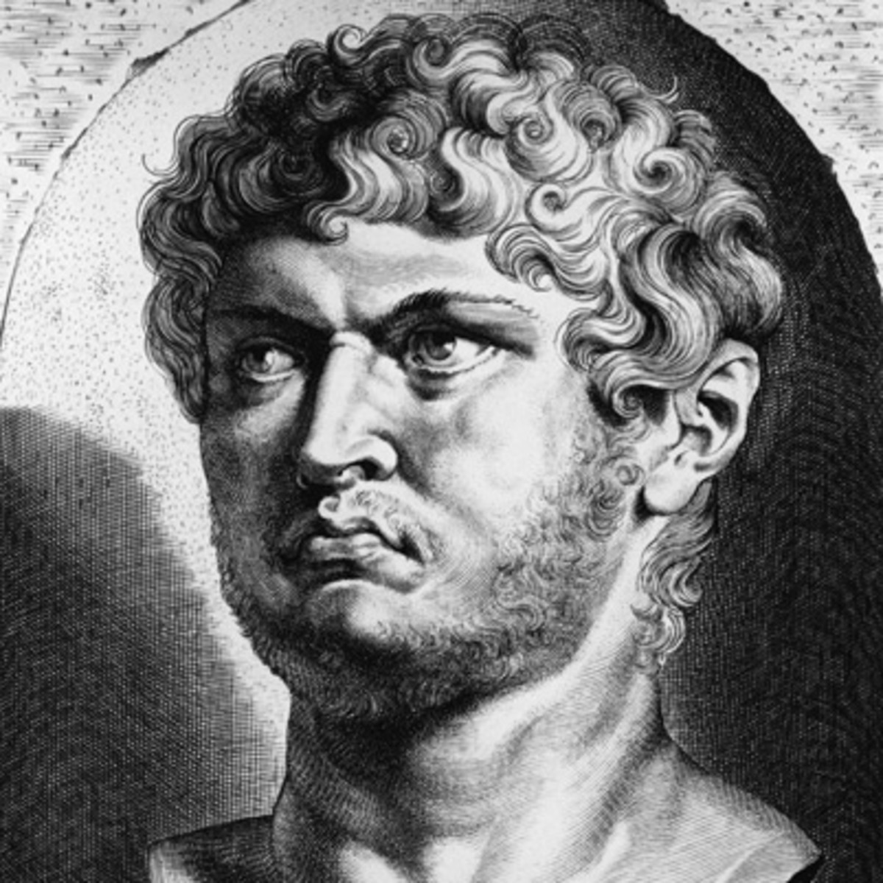
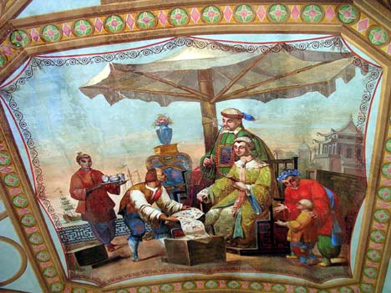
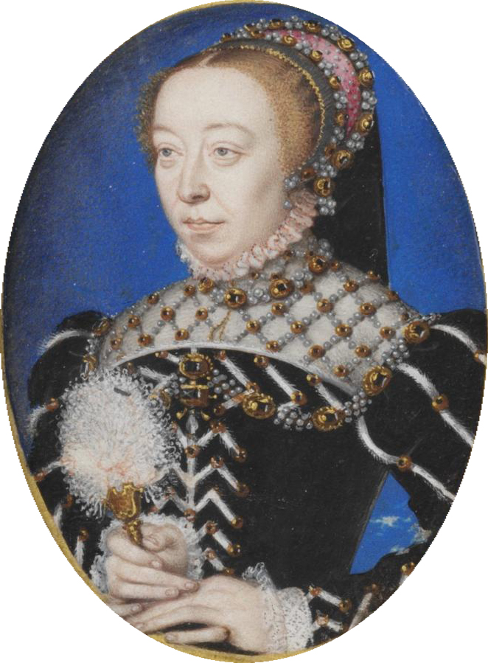
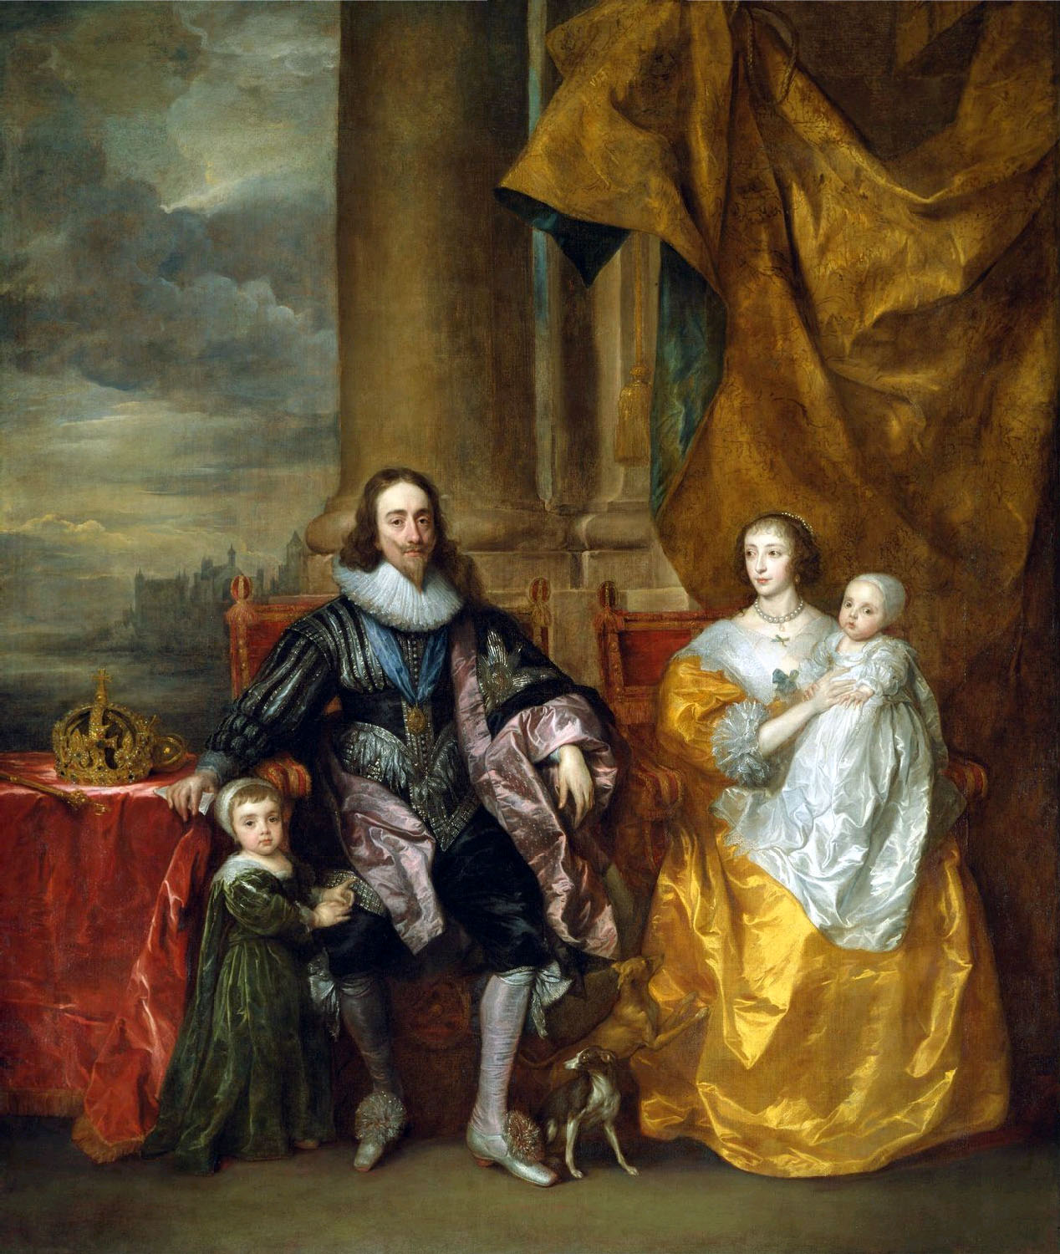
Ice Cream, way back when..
Notes:
Emperor Nero was said to have sent slaves into the mountains to collect snow that was then mixed with fruit drinks.
Marco Polo was said to have seen ice creams on his trip to China and introduce them to Italy when he returned.
This story continues in that Catherine de’Medici’s chefs took this recipe to France when she married in 1553.
Charles I is also said to have put on a banquet where sweet desserts mixed with snow were served.
Need to add comments regarding the invention of refrigeration – it took 500 years to go from frozen snow to basic ice cream but the invention of refrigeration has meant that we now can mass produce the stuff

Slide 5
Ice Cream, way back when..
Illustration of old ice cream chinese man eating ice cream in the snow??
Notes:
Emperor Nero was said to have sent slaves into the mountains to collect snow that was then mixed with fruit drinks.
Marco Polo was said to have seen ice creams on his trip to China and introduce them to Italy when he returned.
This story continues in that Catherine de’Medici’s chefs took this recipe to France when she married in 1553.
Charles I is also said to have put on a banquet where sweet desserts mixed with snow were served.
Need to add comments regarding the invention of refrigeration – it took 500 years to go from frozen snow to basic ice cream but the invention of refrigeration has meant that we now can mass produce the stuff

Slide 6
Ice Cream fun facts
illustration of brain freeze
Notes:
Tallest ice cream was scooped in Italy and was 9 feet tall.
A cow gives enough ice cream to make 11 litres of ice cream a day or 4012 lts per year
1 in 10 people admit to licking their bowl clean
1 in 5 share their ice cream with a pet
It takes 51 licks to finish a single scoop
Brain freeze occurs when ice cream touches the roof of your mouth
( it causes blood vessels in your head to dilate )

Slide 7
Ice Cream Fun Facts
Insert illustration – someone eating ice cream in pyjamas??
And one fun fact for the kids in us all……..
Ice Cream is the breakfast food of champions!
It’s a source of protein and has less fat and sugar than some popular breakfast cereals!!!
……… sorry Mum and Dad!
Notes:
Also….
A researcher from Kyorin University in Tokyo says that, according to clinical trials, people get a mental boost after consuming this sweet treat for breakfast
For the experiment, the subjects had to complete several tests on a computer.
Those who ate ice cream right after they woke up had more success on the tests than those who hadn't — even those who'd drunk cold water, which indicates the effect probably wasn't simply due to the cold temperature.
And one fun fact for the kids in us all……..
Ice Cream is the breakfast food of champions!
It’s a source of protein and has less fat and sugar than some popular breakfast cereals!!!
……… sorry Mum and Dad

Slide 8
Our History
Marwood Dairy History
TFIC beginnings
Philosophy
Provenance
The Business today
This slide will have 4 illustrations from the mural as talking points
- Marwood Dairy
- The start of the ice cream business
- Local ingredients/provenance – cow/strawberries etc
- Ice cream van
Notes:
History
Dairying for the Marwood family began in 1940 with Tim’s Grandfather, Norman, milking Jersey cows on his own farm at Nullawarre in 1940.
Tim’s father John purchased his own farm at Brucknell in 1969 and renovated a scrubby block into a high producing farm, one of the first farms in the region to stock 1 cow to the acre!
In 1994 Tim (and his wife Caroline) came back to the farm to work with his father on the land. In 1999 the reality of inconsistent milk prices and the inability to budget forward to buy a new tractor lead Tim to realise that they needed to add value to their milk in some form to get a guaranteed price for it. So he thought… what can we make??? Ice Cream
Research was done. Books bought from America. Secondhand equipment sourced. Bad ice cream was made.
Tim and Caroline eventually left the farm to concentrate on ice cream making.
To this day, it is a constant process of improvement of the process and product.
Approach
Keep a lid on the highs and a lid on the lows, do business with people that you like, minimise your regrets, enjoy the process. Have fun.
Provenance
The connection to the land is a big thing for Tim and Caroline. ‘The weather and landscapes in Victoria’s South West keep you very grounded.’ Tim says. Even though we are no longer on the farm I still have a very close bond to the land. Its something you can’t explain really.
Using the highest quality local fresh milk and cream and sourcing locally grown/made inclusions for ice cream flavours remain Tim and Caroline’s priority. ‘It’s about giving our customers a memorable experience when they taste our product’ Tim says. ‘ You can’t beat quality fresh local ingredients to help you do that!’
The Business today
Today Tim and Caroline employ over 20 staff to make sure you can enjoy Timboon Fine Ice Cream. .
1. Wholesale to retailers take home tubs
2. Supplying mobile vans
3. Eventing direct.
4. The Ice creamery
The Business tomorrow
Next steps for the business is to complete the build and relocation of their factory to the Ice Creamery site, develop some more dessert products. Maybe sell some ice cream overseas.

Slide 9
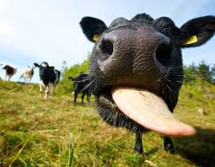
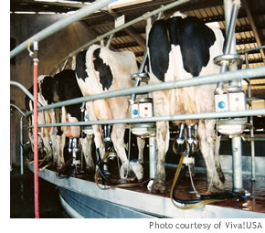
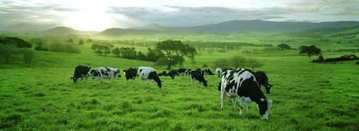
Happy cows make high quality fresh milk
We get our milk from our neighbours, The Doolans.
They have 500 free range cows that feed on grass, hay & silage
Notes:
Talk about Doolan Pastoral sustainable farm practices here.
The most important ingredients in Ice Cream are of course MILK and CREAM
We get our MILK from the Doolan’s Dairy Farm next door to the factory – about 6km from here and our CREAM from Camperdown Dairy.
There are 500 cows on the Doolan’s Farm.
They live free range and graze on grass, hay and silage and grain
Each cow eats approx. XXX kg of grass and makes about 20 litres of fresh milk every day
Do Cows have 4 stomachs?
Cows are social animals but they also have a hierarchy in the herd. There is always a queen and a cow will rise up the ranks in a herd depending on her age and size
Cows are creatures of habit and they learn quickly. They tend to arrive for milking in the same order every day – there are always the ones who want to be first and the ones who take their time!
Cows are very curious especially when they feel safe and in control. They will often come up to you in the paddock to see what is going on and what you are doing.
They also are keen lovers of music too and research has indicated that playing classical music in the dairy increases milk yield.

Slide 10
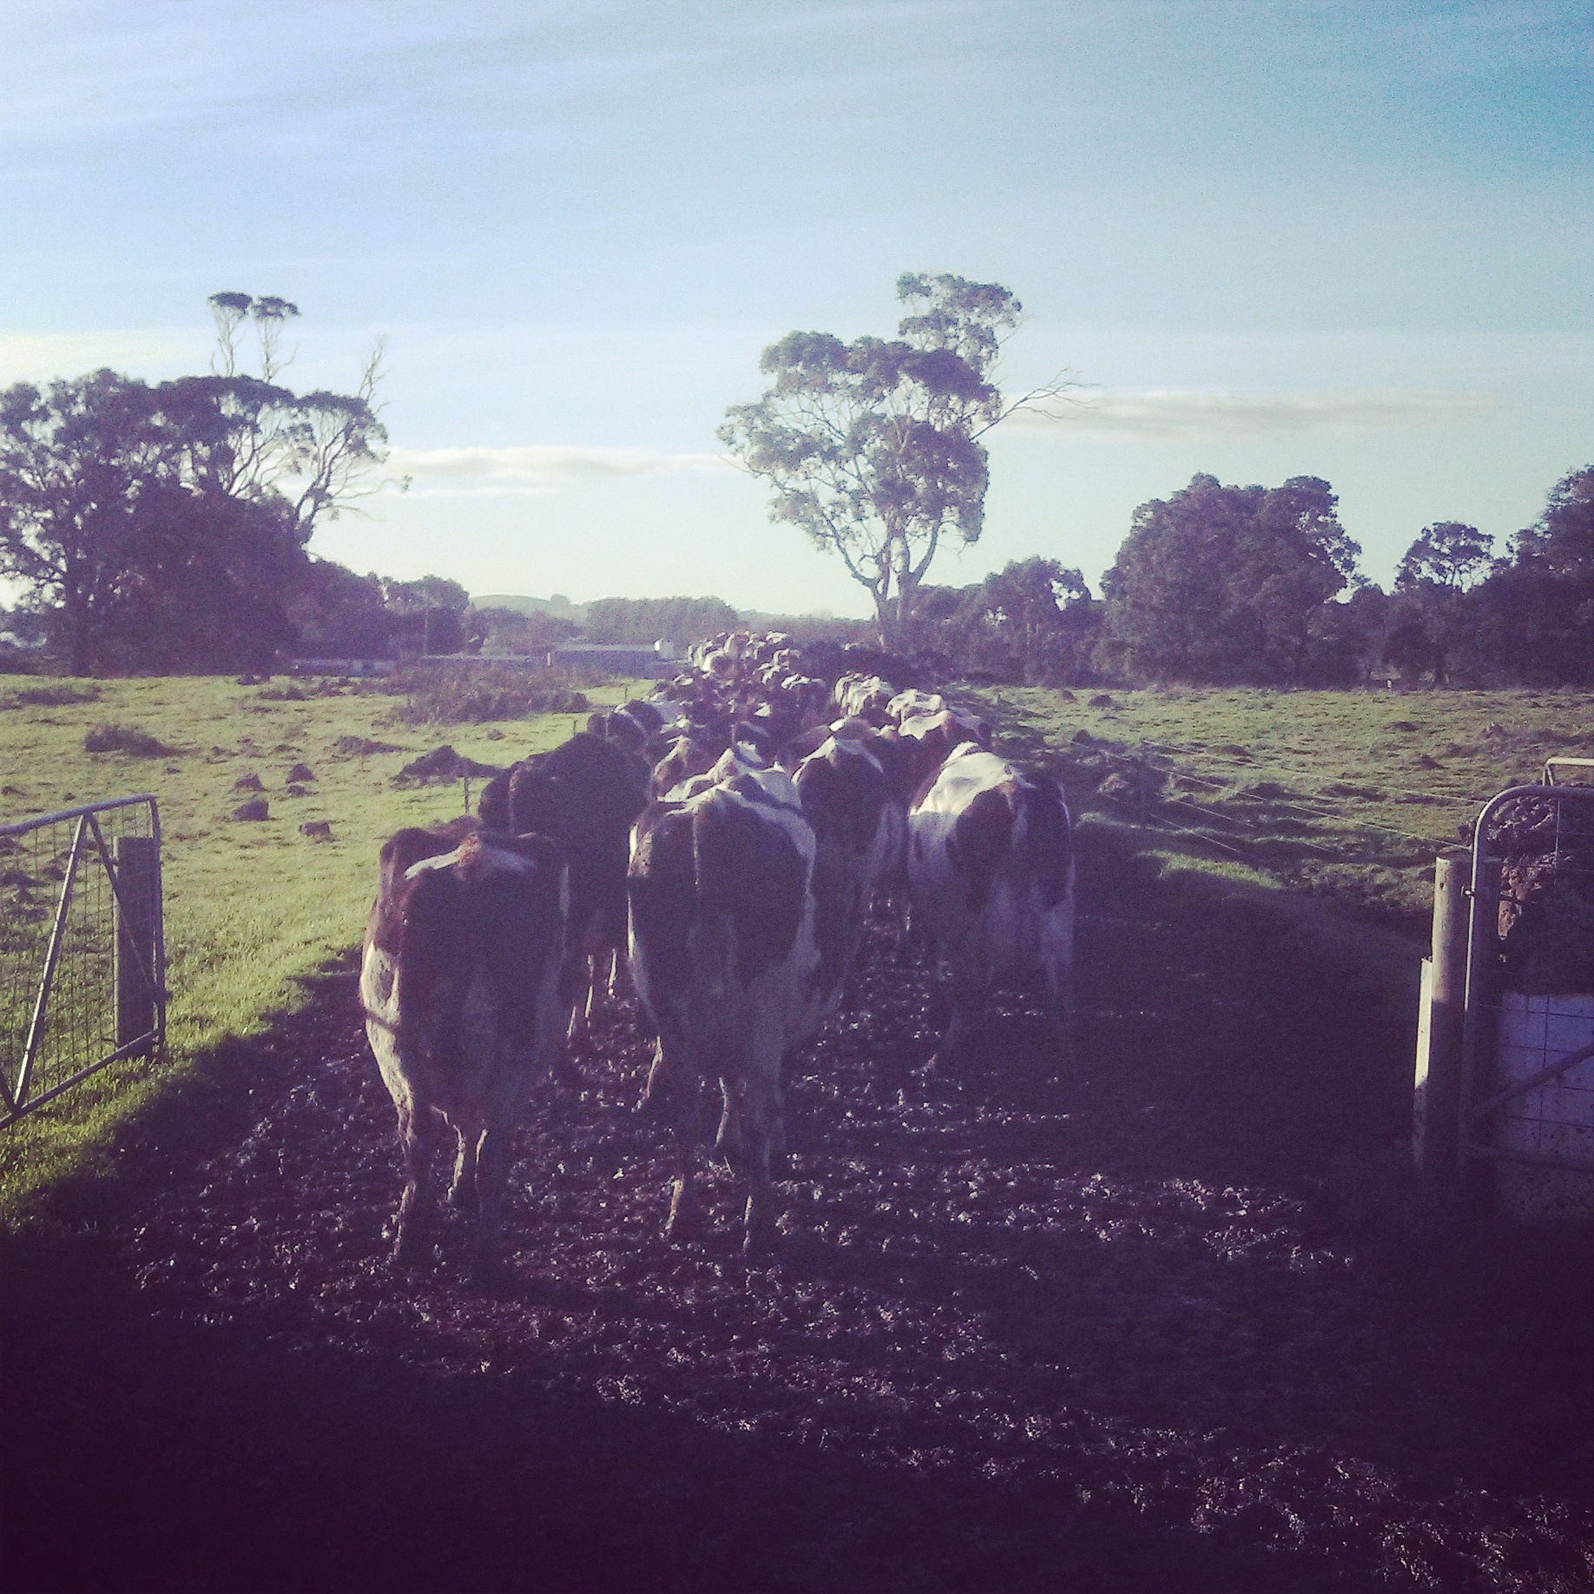
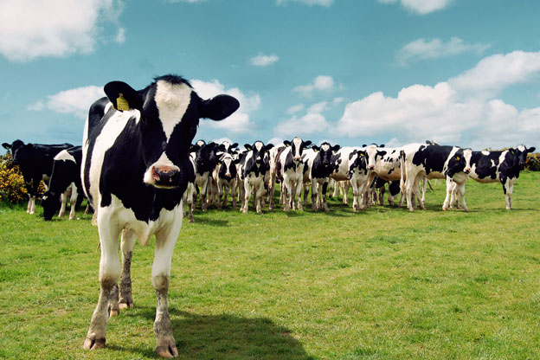
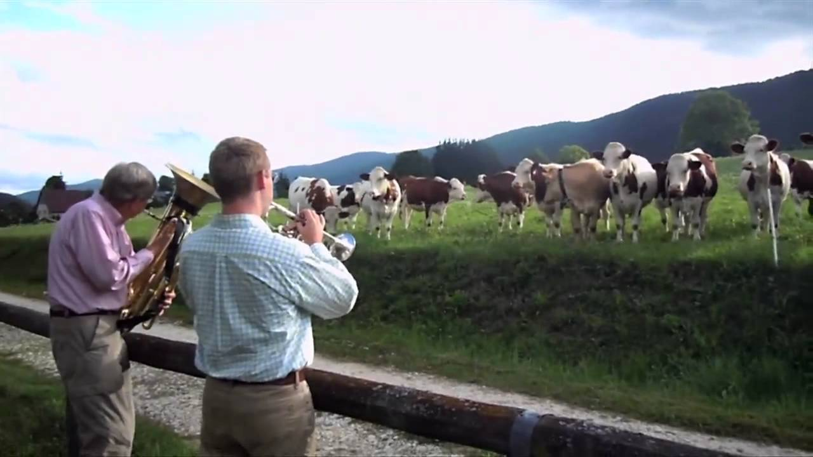
Fun Facts About Cows
Cows are very curious…
Cows are creatures of habit
Cows also like music!!
Notes:
Cows are creatures of habit and they learn quickly.
They tend to arrive for milking in the same order every day – there are always the ones who want to be first and the ones who take their time!
Cows are very curious. They will often come up to you in the paddock to see what is going on and what you are doing
Cows also like music!!

Slide 11
Ice Cream Facts - Favourite Flavours
Can you guess the 5 Most Popular Flavours of Our Ice Cream?
Vanilla
Salted Caramel
White Chocolate and Raspberry
Mint Choc Chip
Chocolate
Notes:
What’s your favourite flavour?? – ASK a couple of people in the Class
Can you guess the 5 most popular Timboon Fine Ice Cream Flavours?

Slide 12
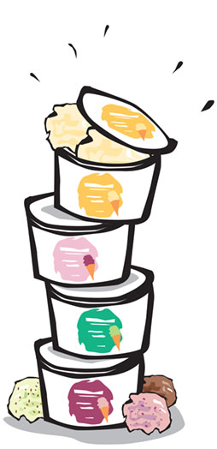
Who Eats the most Ice Cream?
Ice cream consumption – Litres per Person
Top 7 Countries
23
21
18
14
12
11
10
Denmark
Canada
Sweden
Finland
Australia
USA
New Zealand
Notes:
Who are the biggest eaters of ice cream in the world? – ask and reveal one by one
Interesting that they eat so much ice cream in very cold northern hemisphere countries
Data on consumption can be a bit varied but it is generally accepted that NZ, Australia and the US are the top 3.
While our Kiwi cousins eat the most ice cream per person.
Here in Australia we are eating about 400 million litres, while in the US they are tucking into a cool 6.7 billion litres of their favourite ice cream!!
Interestingly, in China, where consumption is only 2 litres per person, that still accounts for 2.7 billion litres – number 2 in the world.

Slide 13
What makes Ice Cream?
Milk
Cream
Sugar
Milk Protein (eg Skim Milk Powder)
Emulsifiers
Stabiliser
Inclusions. flavours
Notes:
Milk Fat – richness of flavour, creaminess of texture
Sugar – sweetness, reduced freezing point and providing texture, eating quality and scoop-ability when frozen
Milk Protein – flavour, body and texture
Emulsifiers – keeps the milk fat evenly dispersed in the ice cream during freezing. This helps stabilise the air whipped into the ice cream and gives a smooth texture
Stabilisers – control ice crystallisation, so small ice crystals don’t join together to form big ones
Inclusions, fruits, flavour yummy bits and pieces

Slide 14
Ice Cream Making Process
Making Ice Cream is a 7-Step process
Blending of the ice cream mix
Pasteurisation
Homogenisation
Aging the mix
Freezing the ice cream
Packing
Hardening
Notes:
Blending of the Ice Cream mix – Like Making a big Milk Shake!
Pasteurization – Making sure the mix is safe to eat
Homogenization – Blending it to make it creamy
Aging the mix – Cooling down and crystallising the milk fat
Freezing – Making a soft Serve
Packaging
Hardening – freezing it solid and developing the final texture of the ice cream

Slide 15
Mixing and Pasteurisation
Illustration of wooden spoon in big pot milk boiling on stove with thermo?
Notes:
Mix dry ingredients with milk and cream
The mix is heated to high temperatures to kill any harmful bacteria and make sure that the mix is safe to eat.
We use a batch pasteurizer – batches of mix are heated to 85°C and held for 15 seconds.
The high temperature kills harmful bacteria. The short time means that the mix doesn’t ‘cook’ and change in flavour.

Slide 16
Homogenisation
Illustration of homo valve here
Notes:
Use the sand prop to demonstrate the homogenisation of the fat
Homogenisation is a process that forces the mix through small holes under pressure
This breaks the milk fat down into small droplets and makes sure that it stays even in the ice cream mix
Homogenisation gives ice cream its creaminess and improves the microstructure of the ice cream, helping to improve the resistance to melting and increase shelf life

Slide 17
Cooling and Ageing
Old man and clock illustration here?
Notes:
Cool down to 4 degrees
An important period of time here for the little stabilser and emulsifier minons to do their work.
They need to soak up any extra water in the mix to stop it from growing big ice crystals.
They make this ice cream mix more viscous or thicker.
This helps the ice cream create structure and leads to quicker whipping during freezing

Slide 18
Overrun, whipping and freezing
Pic of ice cream coming out of our churn
Notes:
High overrun makes it light and fluffy
Premium ice creams have lower overrun – richer and creamier
Overrun is selling air! But, without the air, ice cream would not be possible to scoop and eat
Lots of commerical ice cream work on %120 overun thats 50 litres of mix and 70litres of air!
Overrun increases the volume of ice cream due to whipping and incorporating air
Overrun is essential to making ice cream soft enough to eat
At this point the ice cream is the same as soft serve
We use what’s called a ‘batch freezing process ‘ Ice cream is frozen by being scrapped off the sides of a frozen barrel by a rotating beater.

Slide 19
Hardening – the final Step
Picture of a scoop or tub of finished product
Notes:
After packing, ice cream is then hard frozen
The remainder of the water in the product is frozen
The more quickly it is frozen, the smaller the ice crystals in the product – gives a smoother, creamier and ‘warmer’ eating quality

Slide 20
Styles of Ice Cream
Gelato
Frozen Yoghurt
Milk Ice
Sorbet
Sherbet
Hard scoop
Soft Serve

Slide 21
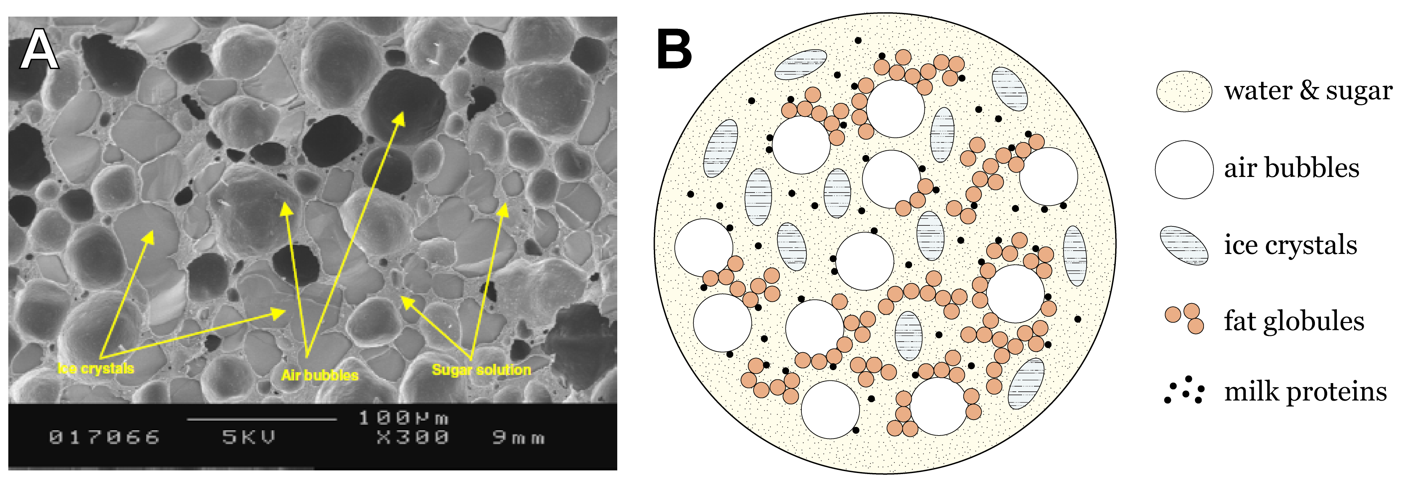
What is Ice Cream?
.
Notes:
AT the beginning of today’s lesson we discussed the fact that ice cream was a complex product....
Some more Technical stuff now – lets look at what ice cream looks like under a very powerful microscope.

Slide 22
What is Ice Cream?
Ice Cream has a specific definition in Australia – it must contain 10% milk fat and there is a limit to how much air it can have in it.
There are also definitions for Reduced Fat Ice Cream, Low Fat Ice Cream and Frozen Confection, which all have lower amounts of fat.
I think that a slide something like this needs to go back in here as it brings context to the comments about products that are/are not ice cream
Notes:
Ice cream also has a specific definition under the Food Standards Code, administered by Food Standards Australia New Zealand (FSANZ)
Read the ice cream definition
This sets specifications for the type and amount of ingredients used and the final overrun of the ice cream.
It must contain milk Fat (CREAM), not vegetable fats (In the UK it can contain vegetable oils)
It must have at least 10% milk fat
It can’t have too much air and be too fluffy! The maximum is 150% overrun (That is, every 1 litre of ice cream mix makes 2 ½ litres of ice cream containing 1 ½ litres of air!)
While it seems like a good trick to sell air, air is essential to make ice cream – it is important to have the right amount for the type of product that you make. Without some air in ice cream, it would be impossible to get a spoon into, but with too much, then the eating quality of the product is diminished compared to a good premium ice cream

Slide 23
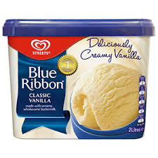
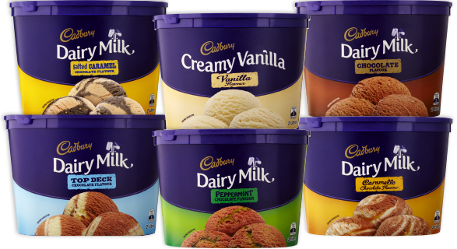
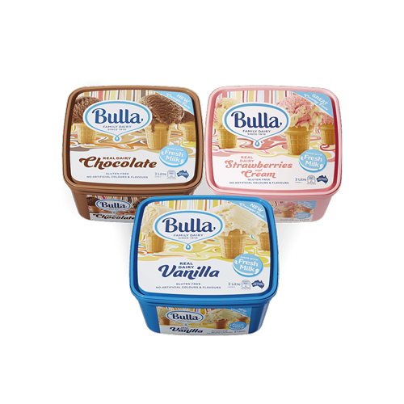
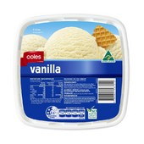

This isn’t Ice Cream
Notes:
Under the national code, whilst these tubs are yummy, they are not ice cream.
Why Not?
They don’t meet the FSANZ criteria – mostly as they don’t have the required amount of milk fat or cream to be called ice cream
Confusingly, some of these brands produce also have very similar products available that actually ARE ice cream

Slide 24
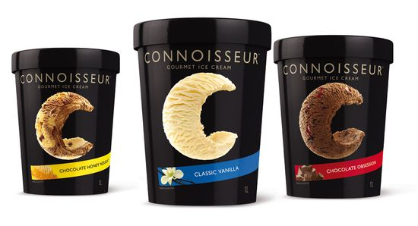
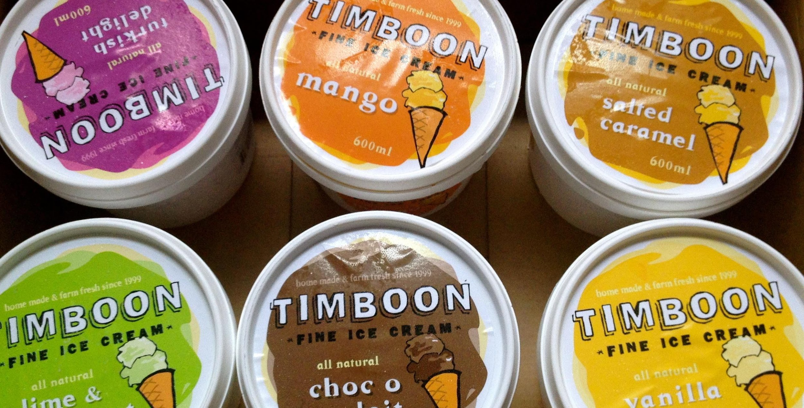
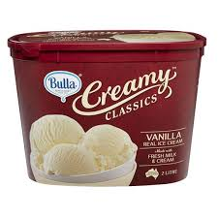
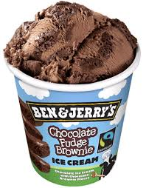
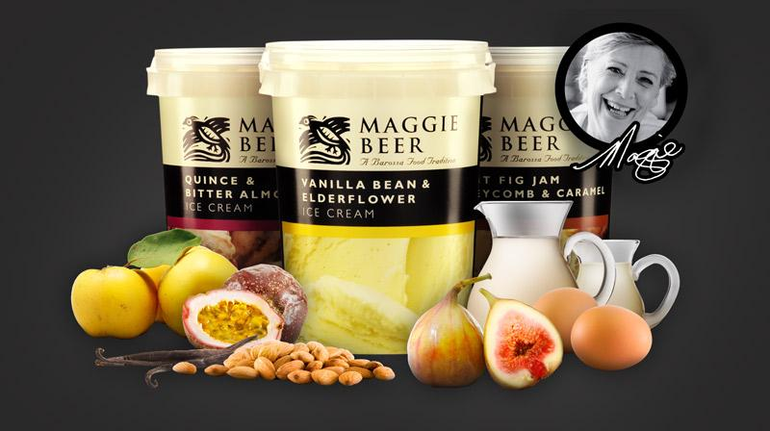
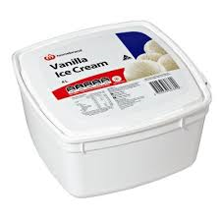
This is Ice Cream
Notes:
These products all meet the FSANZ criteria to be labelled ice cream
As, of course , does Timboon Fine Ice Cream

Slide 25
Styles of Ice Cream
Everyday
Premium
Super Premium
Notes:
What’s the difference?
Where does TFIC fit?
4-8% fat everyday - reduced fat ice cream
9-13% fat Premium
14% + Super premuim
The ‘noodle hut’ fat coating comparison.
Our tip…. you don’t need to eat a lot of ice cream. When you do make it a good one!

Slide 26
Now let’s make some!

