Slide 1

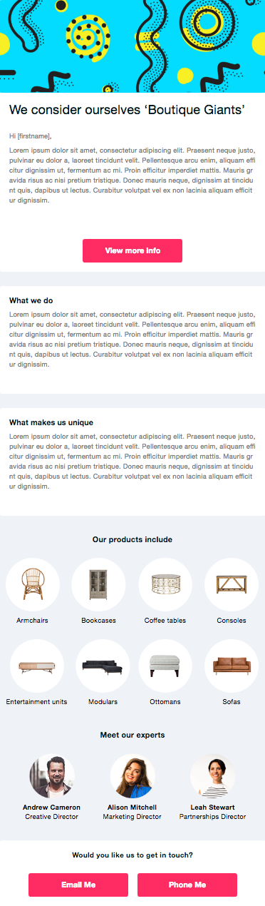
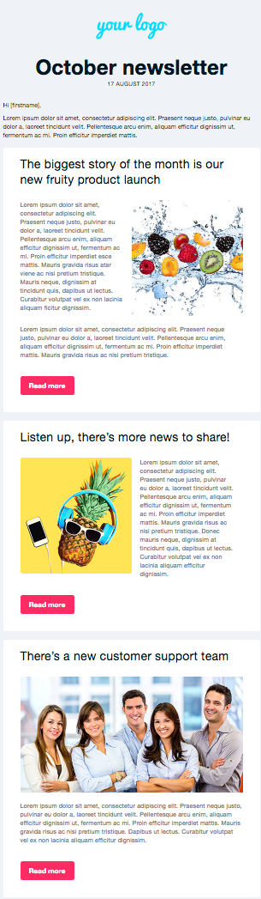

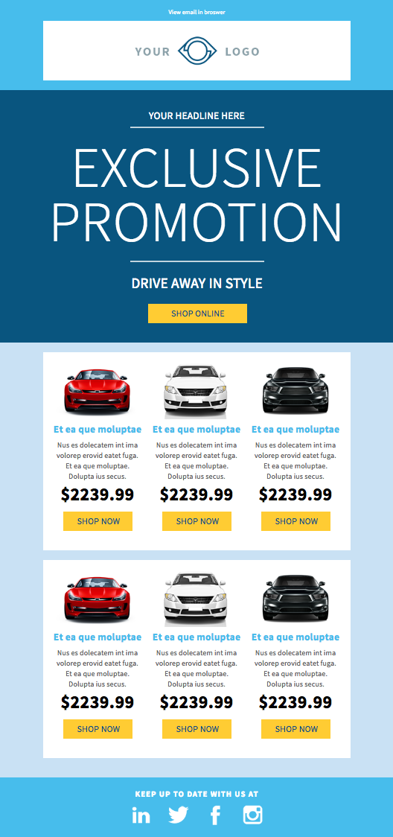
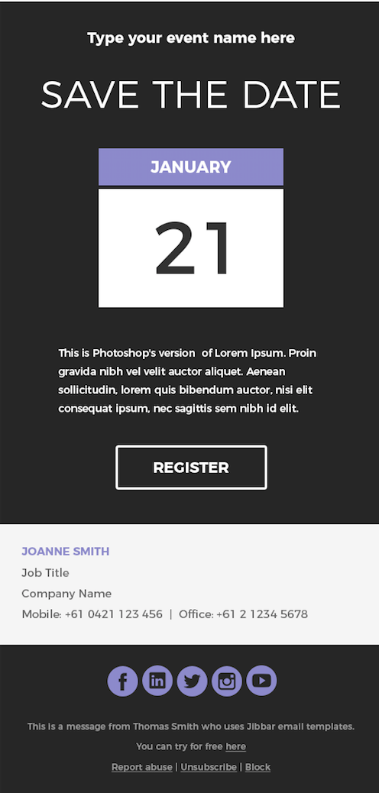
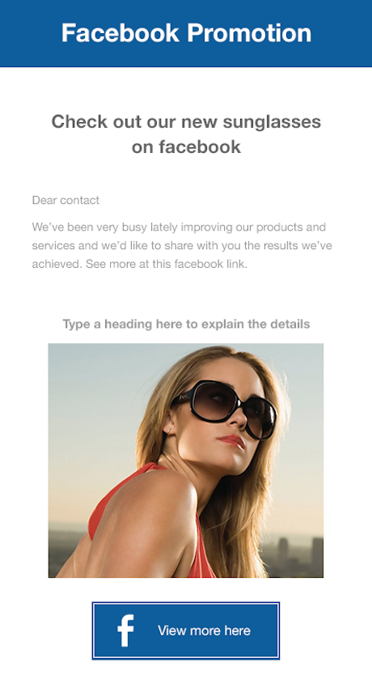

Pricing Create Account Sign in
Ready-To-Use Email Templates
Insert your images and links then send. It’s that quick and easy.
Beautiful emails deliver better results.
✔ Free image library ✔ 300 plus templates ✔ Email analytics
View Templates
FREE Trial
Message your Contacts
Announce
Events
Share
Social Media
Advertise Special Offers
Circulate
Information
Broadcast
Newsletters
Promote your
company

Slide 2
Pricing Create Account Sign in
Ready-To-Use Email Templates
Insert your images and links then send. It’s that quick and easy.
Beautiful emails deliver better results.
✔ Free image library ✔ 300 plus templates ✔ Email analytics
Font Family =
LATO Bold
Lato Light
View Templates
FREE Trial
These tags describe what type of template is available. They should not be too dominant on the page – but desirably more design finesse that we’ve used!
Message your Contacts
Announce
Events
Share
Social Media
Advertise Special Offers
Circulate
Information
Broadcast
Newsletters
Promote your
company

