Slide 1
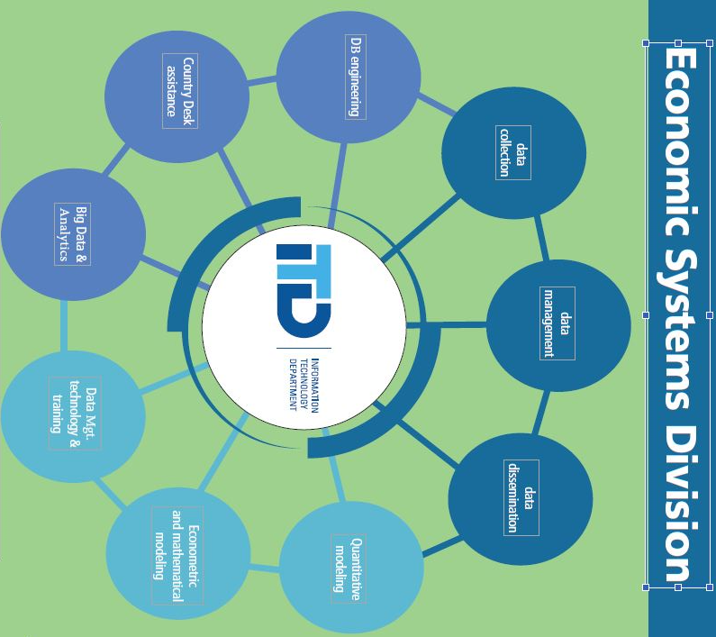
Becoming the division we want to be,
one action at a time.
We…
I support ITD’s values & principles
Are Innovative
Are Quality-oriented
Behave with Integrity & Respect
Are Collaborative
Are Technology Experts
Are Adaptable

