Slide 1
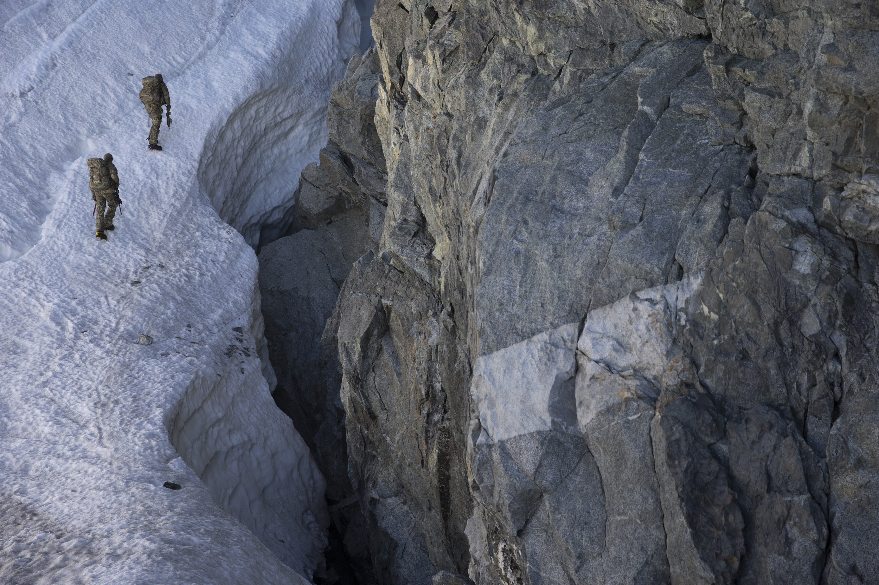
VÍKINGR
mountain / hunting / fishing
INTERNAL USE ONLY

Slide 2
VÍKINGR is the brand that people measure their lives against.
VÍKINGR was founded by Special Operations veterans as a brand that delivers an elite lifestyle and experience to its consumers.

Slide 3
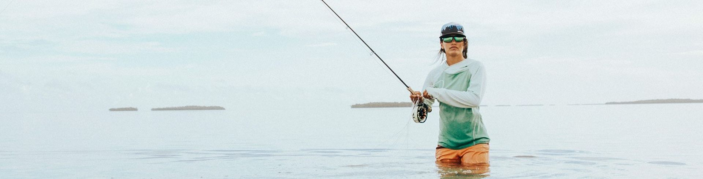
VÍKINGR
mountain / hunting / fishing

Slide 4
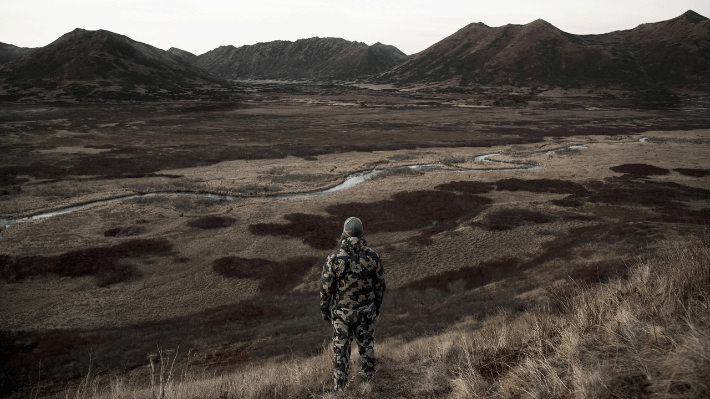
forged by adversity
Notes:
VIKINGR was founded by SOF vets. Our business, desing, and testing principles were forged in the fire of combat. We are a brotherhood that welcomes all that will stand with us.

Slide 5
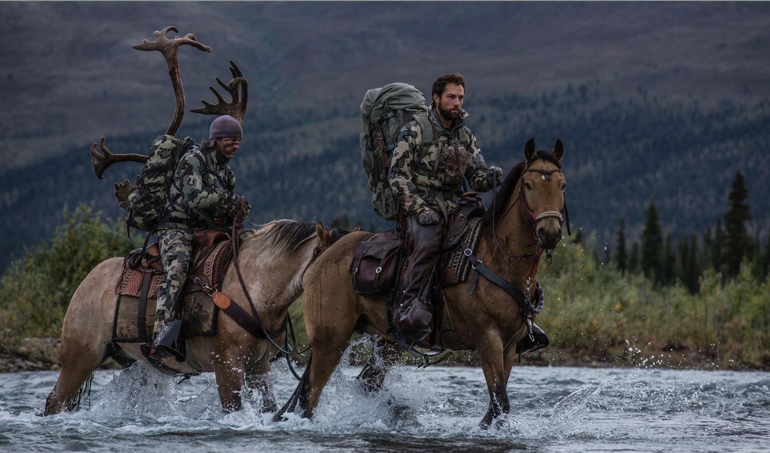
a different kind of company
Notes:
Direct to consumer for profit business that is committed to giving back to causes near to this country’s heart. Veteran, public land use,

Slide 6
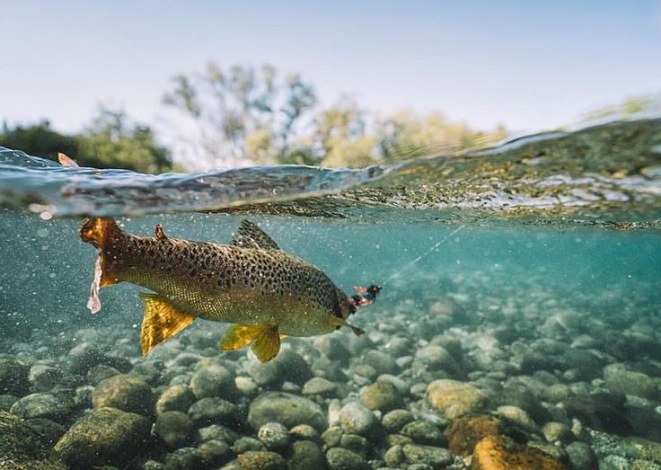
beholden only to the men & women that use our gear
Notes:
Because we sell directly to consumers that is who we design our gear for. We aren’t beholden to big box retailers price points and timelines. We can rapidly prototype a new idea or make design changes mid production stream. In the end we give customers to product they deserve and want.

Slide 7
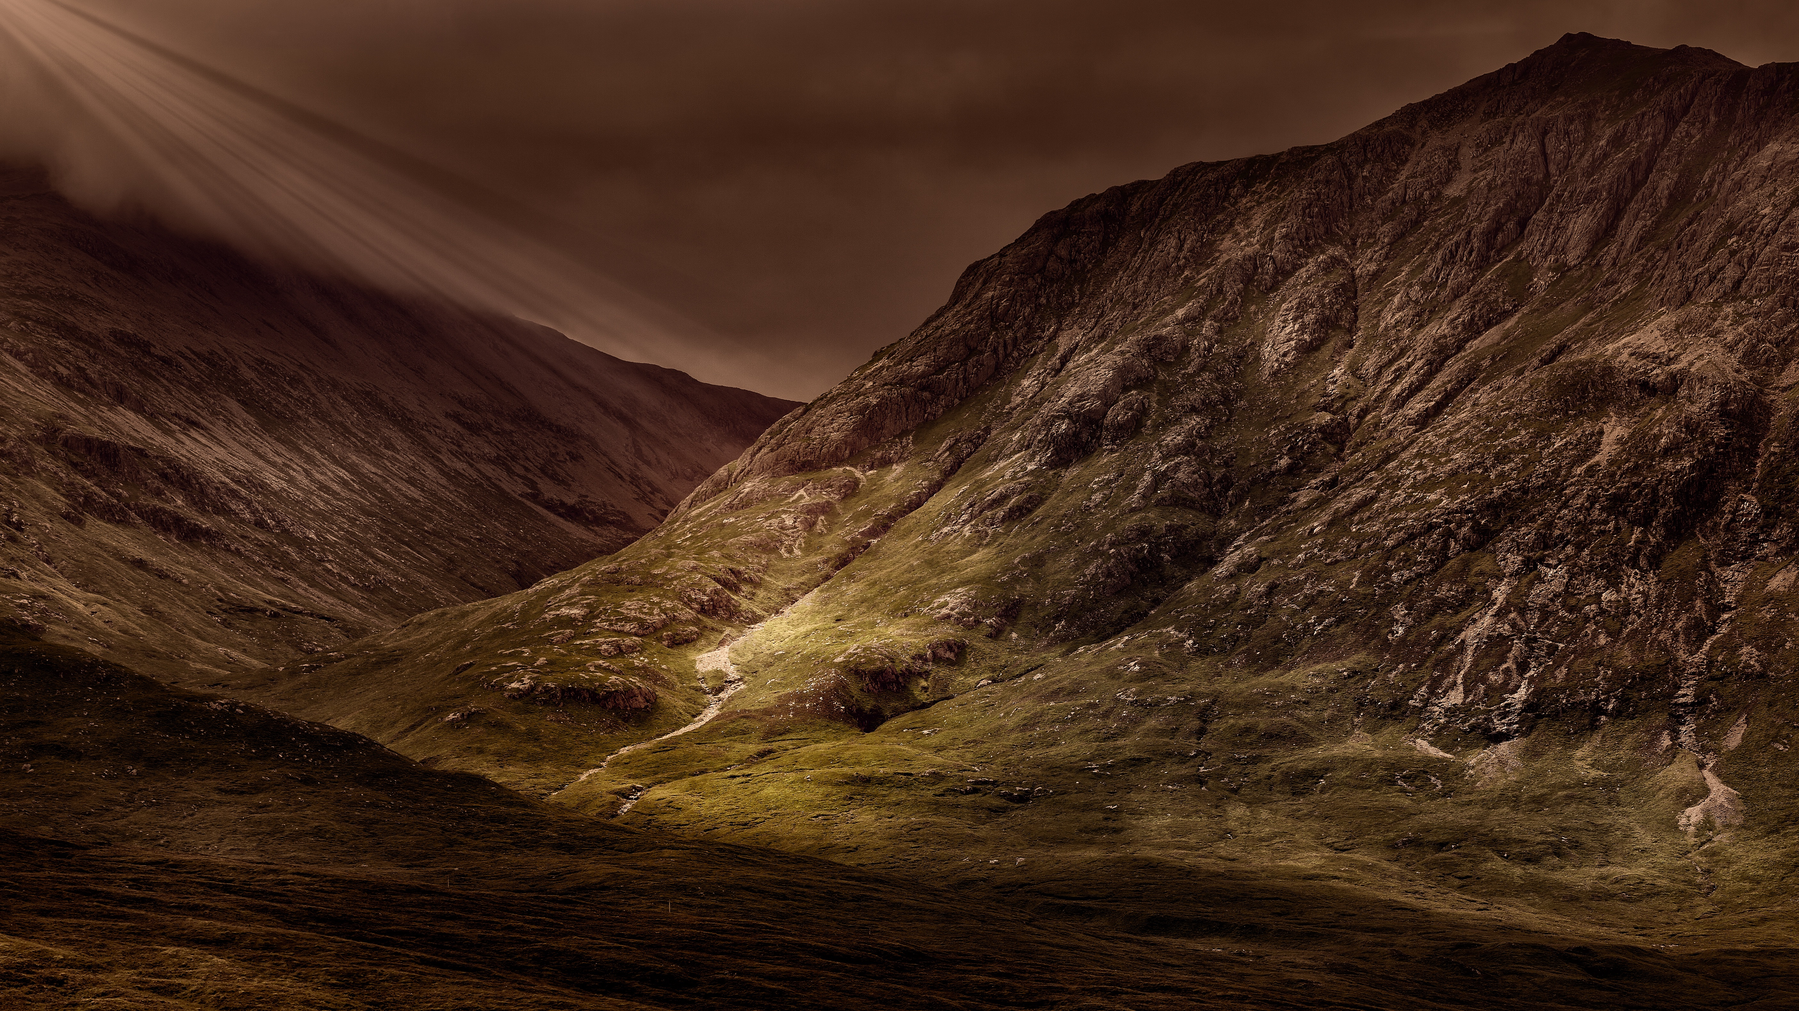
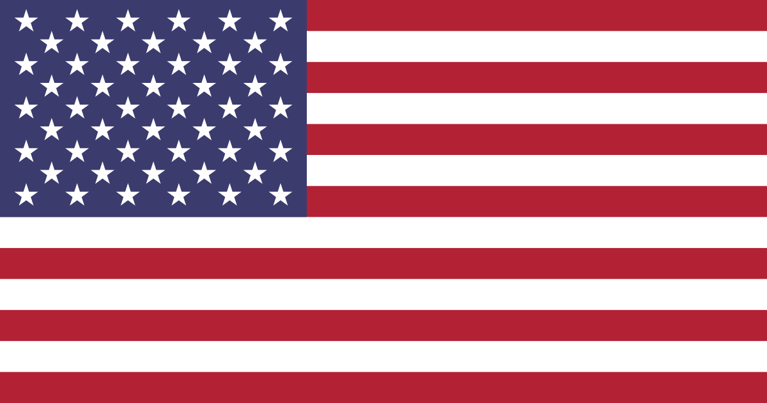
committed to a life of purpose
Notes:
At VIKINGR we have lived a life of purpose and vow to bring purpose to everything we do in life and in business. Some customers treat their customers as commodities at VIKINGR our customers are our brothers and sisters bonded by a common belief in hunting and fishing.

Slide 8
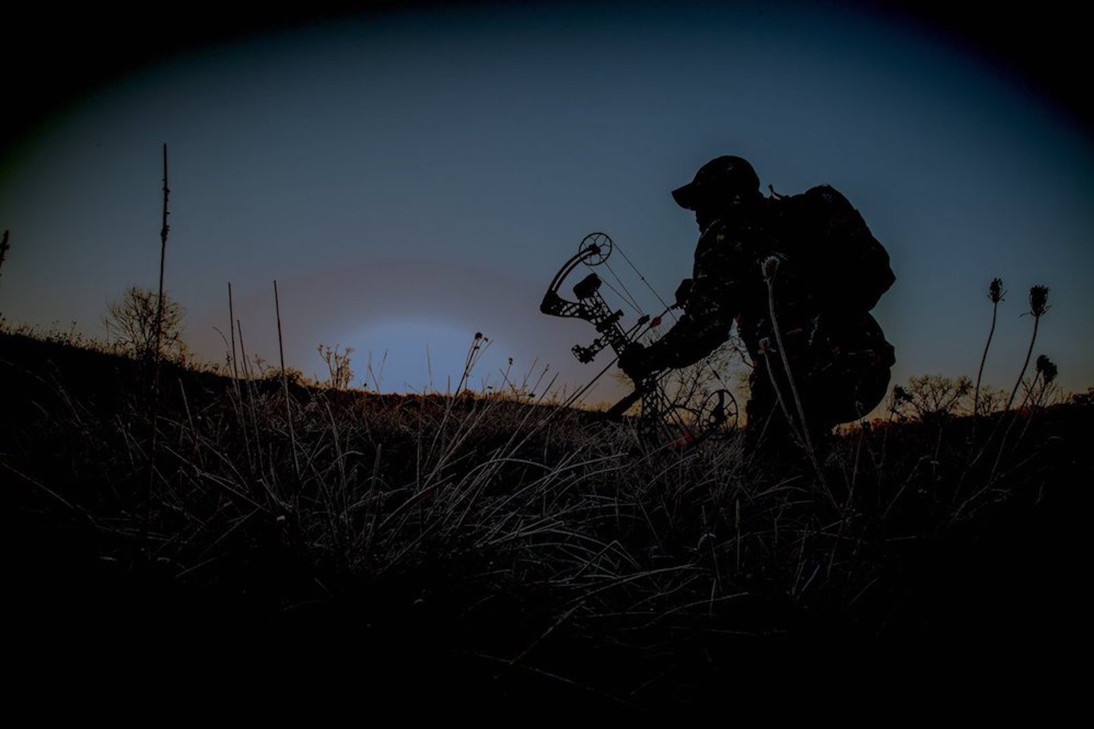
VÍKINGR
It’s the deed – not the glory
Veteran owned
Notes:
At VIKINGR we honor the deed itself not just the result and our gear is designed with this in mind. The end use starts at the trail head and extends back to it at the journeys end. The Deed is not when the arrow is loosed and the glory is not when you stand over your kill.

