Slide 1
CONTEXT
easyBOX is a smart locker box that allows you to solve without moving from your work or your house many errands and purchases that stole your free time.
Through the screen you can request purchases, services, errands and so on. You can leave your clothes for the dry cleaner at the locker and close it. The next day you receive a code and when you enter it, the locker is opened and you can pick up your clean suit. You can also pick up a perfume you have ordered, etc.
This way, the time you save is available for devoting it to more interesting tasks.
We need some icons for the app and screen software

Slide 2


ICON DESIGN CRITERIA
Rounded squares app style
Green image, same Green of the word BOX of easyBOX logo
Text in grey, same gray of the word easy of easyBOX logo
Green border

Slide 3

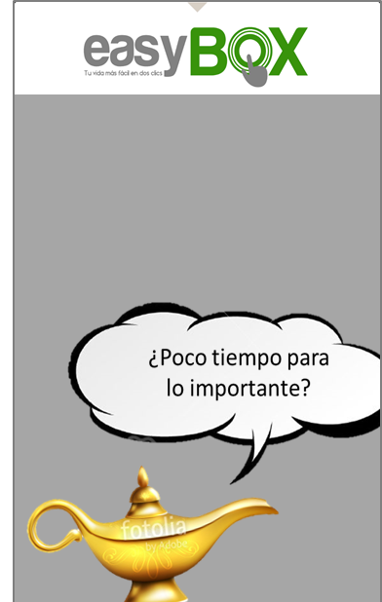


This is the way the box looks like.
Several screen-savers explain the service.
When you touch the screen, the clic leads you to the landing page.
See next chart

Slide 4
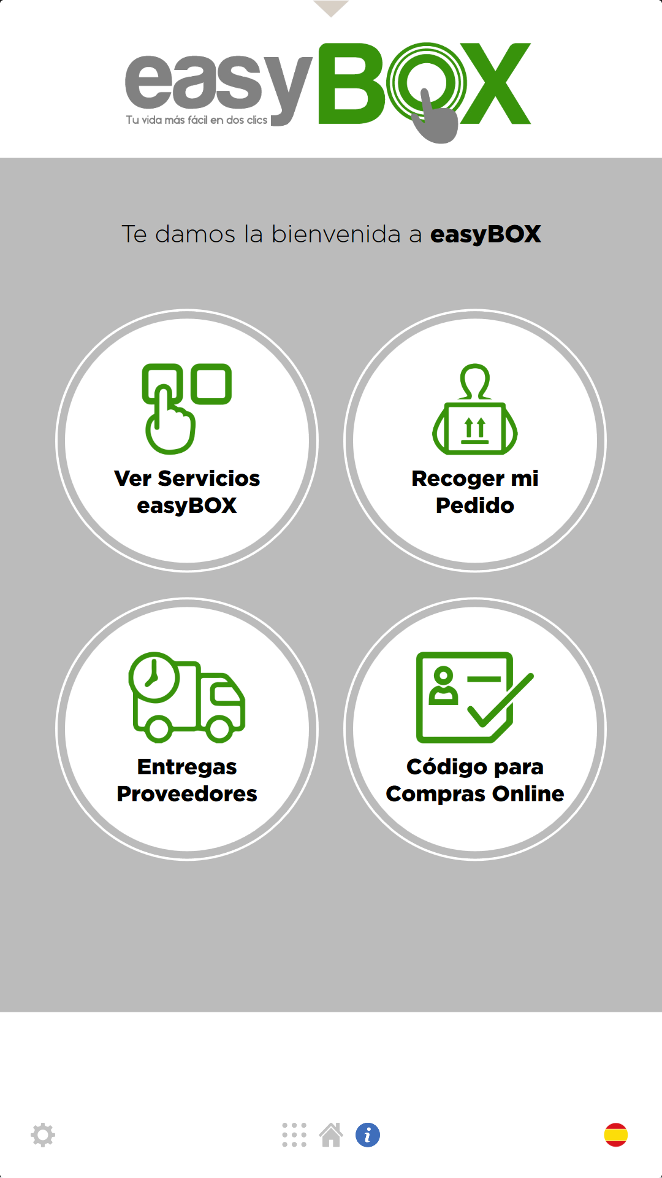






This is the way the landing page looks like
The Genius is being developed through other Project in DesingCrowd
So firstly we need this three icons you can see in the landing page
Those you can see here are just ideas.
Please feel free of proposing de images you like to mean the Icon action.
¿en qué puedo ayudarte?
TUS DESEOS SON ÓRDENES PARA MÍ
First Icon: Is for selecting easyBOX services.
VER SERVICIOS
Second Icon: Is for picking up your product or service
RECOGER PEDIDO
RECIBIR COMPRA ON LINE
Thirth Icon: Is for receiving online purchases through the locker…so it is like a mailbox.. Meaning “receiving”
Acceso Proveedores
CLIENT LOGO

Slide 5
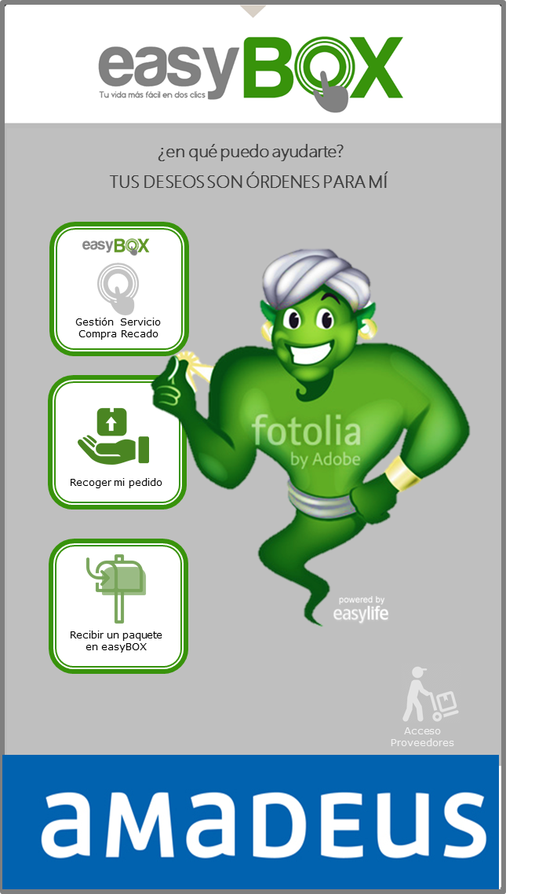


Fourth Icon: for easyBOX employees delivery
PERSONAL
PROPIO
Fifth Icon: For Online purchases delivery
ENTREGA
COMPRA ON LINE
If you choose the Little courrier Icon…then you go next

Slide 6



We also need this four Icons to select the size of the locker you need.
ENTREGA
COMPRA ON LINE
PEQUEÑO
ENTREGA
COMPRA ON LINE
MEDIANO
ENTREGA
COMPRA ON LINE
GRANDE
ENTREGA
COMPRA ON LINE
ROPA
COLGADA
We need at least these 9 icons, and we value some others navigation ones as forward, back, home…

Slide 7



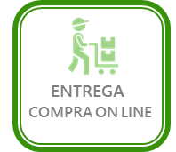
ENGLISH TEXT
(SAME ICON YOU DESING OR PROPOSE
ICON TEXTS
SPANISH ICON
SERVICES
PICK UP
RECOGER PEDIDO
RECEIVE HERE ON LINE PURCHASE
STAFF
ON LINE PURCHASE DELIVERY

Slide 8
SMALL
ENTREGA
COMPRA ON LINE
PEQUEÑO
MEDIUM
ENTREGA
COMPRA ON LINE
MEDIANO
LARGE
ENTREGA
COMPRA ON LINE
GRANDE
HANGING CLOTHES
ENTREGA
COMPRA ON LINE
ROPA
COLGADA

