Slide 1


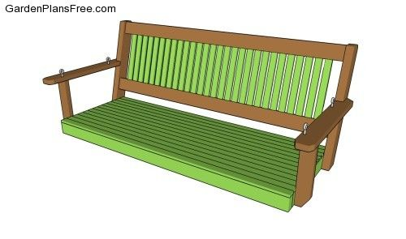

Here are some photos we found online that we feel represent PORCCH
We like the idea of it looing hand drawn, but doesn't have to be.
Here is the CCHCSP logo. The modules will be hosted on our website. We want something more fun for this project as we want it to appeal to child patients and their families. Our logo is more serious.

