Slide 1



The Best Way to Collect Rent
Online rent collection by Schedule My Rent
PRESORTED STD
US POSTAGE
PAID
ALBUQUERQUE NM
PERMIT NO. 123
Hi Sue. This is a reminder that your next payment for $950.00 is scheduled on May 3rd. You don’t have to do anything…we’ll automatically make the payment.
√
Date: April 30th
From: ScheduleMyRent.com
To: Sue@yahoo.com
Subject: Rent reminder
Hi Sue,
This is a reminder that your next payment for $950.00 is scheduled on May 3rd. You don’t have to do anything…we’ll automatically make the payment from your account as agreed.
Thank you,
ScheduleMyRent.com
Sample
          Joe Landlord
          123 Main St
          Anytown, NM 87111
Automated Rent Reminder
Joe Landlord
123 Main St
Anytown, NM 87111

Slide 2

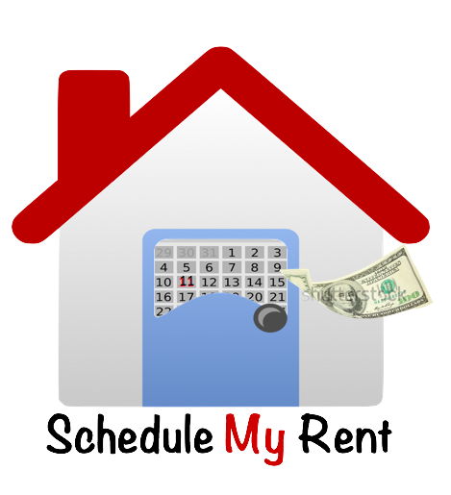
The Best Way to Collect Rent
Online rent collection by Schedule My Rent
PRESORTED STD
US POSTAGE
PAID
ALBUQUERQUE NM
PERMIT NO. 123
√
Date: April 30th
From: ScheduleMyRent.com
To: Sue@yahoo.com
Subject: Rent reminder
Hi Sue,
This is a reminder that your next payment for $950.00 is scheduled on May 3rd. You don’t have to do anything…we’ll automatically make the payment from your account as agreed.
Thank you,
ScheduleMyRent.com
Sample
          Joe Landlord
          123 Main St
          Anytown, NM 87111
Automated Rent Reminder

Slide 3
The Best Way to Collect Rent
Online rent collection by Schedule My Rent
PRESORTED STD
US POSTAGE
PAID
ALBUQUERQUE NM
PERMIT NO. 123
√
Hi Sue. This is a reminder that your next payment for $950.00 is scheduled on May 3rd.
Date: April 30th
From: ScheduleMyRent.com
To: Sue@yahoo.com
Subject: Rent reminder
Hi Sue,
This is a reminder that your next payment for $950.00 is scheduled on May 3rd. You don’t have to do anything…we’ll automatically make the payment from your account as agreed.
Thank you,
ScheduleMyRent.com
Sample
          Joe Landlord
          123 Main St
          Anytown, NM 87111
Automated Rent Reminder

Slide 4



Schedule My Rent
Online rent collection for landlords
Schedule My Rent is your Personal
Sign-up Today
www.ScheduleMyRent.com
Assistant who automatically:
Sign-up Today
Reminds tenants every time a payment is due
Collects rent from tenant’s bank account or tenant can pay with cash at a retailer
Stops the hassle of lost mail and risk of cash
Splits rent between roommates
Sends rent to your bank account
Manages late rent, returns, and fees
Keeps you updated every step of the way with email summaries and an awesome dashboard
Clear and Simple - Low Cost:
- $2.00 each: first 5 payments per month
- $1.00 each: additional payments for the entire month
- $1.00 Return or NSF fee
NO setup fee
NO monthly fee
NO minimum fee
NO long-term contract…stop at any time
Save Time Every Month
Free Trial – All payments free for the first 45 days!
Bank payments are free for tenants and cash payments at retailers have a convenience fee
www.ScheduleMyRent.com
It’s So Easy – You can setup an account and first property in less than 10 minutes!

Slide 5

Schedule My Rent
Online rent collection for landlords
Schedule My Rent is your Personal
Sign-up Today
www.ScheduleMyRent.com
Assistant who automatically:
Sign-up Today
Reminds tenants every time a payment is due
Collects rent from tenant’s bank account or tenant can pay with cash at a retailer
Stops the hassle of lost mail and risk of cash
Splits rent between roommates
Sends rent to your bank account
Manages late rent, returns, and fees
Keeps you updated every step of the way with email summaries and an awesome dashboard
Clear and Simple - Low Cost:
- $2.00 each: first 5 payments per month
- $1.00 each: additional payments for the entire month
- $1.00 Return or NSF fee
NO setup fee
NO monthly fee
NO minimum fee
NO long-term contract…stop at any time
Save Time Every Month
Free Trial – All payments free for the first 45 days!
Bank payments are free for tenants and cash payments at retailers have a convenience fee
www.ScheduleMyRent.com
It’s So Easy – You can setup an account and first property in less than 10 minutes!

Slide 6
Do you own 1 to 100 rental units?
Have your tenants asked to pay rent online?
Do you spent too much time collecting and tracking rent?
The Best Way to Collect Rent
Sign-up Today
www.ScheduleMyRent.com
Automatically remind tenants every time a payment is due
Tenants love it – never forget to pay rent or worry about mail
Automatically collect rent from tenant’s bank account or tenant can pay with cash at a retailer
Split rent between roommates
Safer than mailing checks or collecting cash
Money sent to your bank account
Automatically manage late rent, returns, and fees
Stay updated every step of the way with email summaries and an awesome dashboard
Sign-up Today
Clear and Simple - Low Cost:
- $2.00 each: first 5 payments per month
- $1.00 each: additional payments for the entire month
- $1.00 Return or NSF fee
NO setup fee
NO monthly fee
NO minimum fee
NO long-term contract…stop at any time
Save Time Every Month
Free Trial – All payments free for the first 45 days!
Bank payments are free for tenants and cash payments at retailers have a convenience fee
www.ScheduleMyRent.com
It’s So Easy – You can setup an account and first property in less than 10 minutes!

Slide 7

Schedule My Rent
Online rent collection for landlords
Postcard is:
8.62” X 5.62”
The Best Way to Collect Rent
Sign-up Today
www.ScheduleMyRent.com
Sign-up Today
Automatically remind tenants every time a payment is due
Tenants love it – never forget to pay rent or worry about mail
Automatically collect rent from tenant’s bank account or tenant can pay with cash at a retailer
Split rent between roommates
Safer than mailing checks or collecting cash
Money sent to your bank account
Automatically manage late rent, returns, and fees
Stay updated every step of the way with email summaries and an awesome dashboard
Clear and Simple - Low Cost:
- $2.00 each: first 5 payments per month
- $1.00 each: additional payments for the entire month
- $1.00 Return or NSF fee
NO setup fee
NO monthly fee
NO minimum fee
NO long-term contract…stop at any time
Save Time Every Month
Free Trial – All payments free for the first 45 days!
Bank payments are free for tenants and cash payments at retailers have a convenience fee
www.ScheduleMyRent.com
It’s So Easy – You can setup an account and first property in less than 10 minutes!

