Slide 1

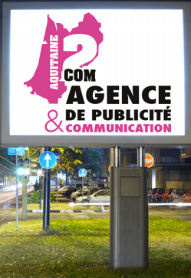
Texte ,design& backgrounds
Excellence Through Education
Continuity of the design even for the
Bottom of the support

