Slide 1
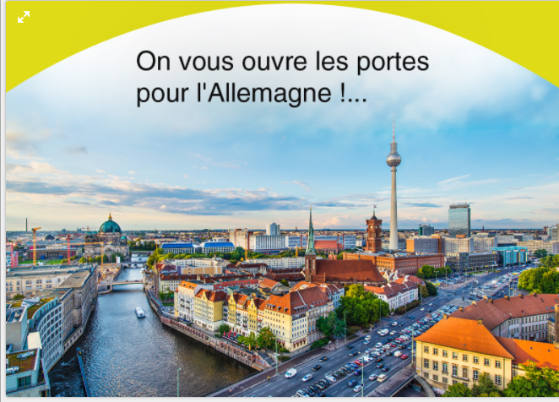
Ok for this

Slide 2

Please remove the sentence
- Please just keep :
ETUDES EN Allemagne instead of ACOOMPAGNEMENT POUR LES ETUDES EN ALLEMAGNE.
-Remove the point
- We can as well make bigger Etudes en Allemagne &Cours de langue as we will have more space
Keep it
Keep it

