Slide 1
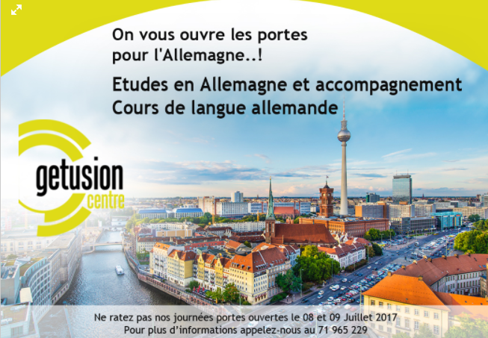
Please remove the surrounded part
-Have the same size
for these 3 sentences
-Please have more appealing
And impactful front.
Please replace this sentence in red by :
Accompagnement pour des études en Allemagne
Could you propose for us some
Points or designs that can be like the exemple below :
….sentence
….Sentence
In order to structure more our
offer

