Slide 1
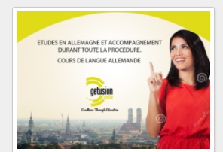
1/ Teaser
Keep this green
part
Remove this part in red
On vous ouvre les portes
pour l'Allemagne !
Just keep this message
With a nice front please
Remove this picture in red
Have another picture with beautifull colors and monuments of germany

Slide 2
2/ Reveal
Add this sentence please
Keep this green
part
Keep these to sentences, and need to align them like below in green
Etudes en Allemagne et accompagnement
Cours de langue allemande
On vous ouvre les portes
pour l'Allemagne !
Please remove only this line
Please put in this space our Getusion logo
Please put these 2 sentences in smaller character :
- Ne ratez pas nos journées portes ouvertes le 08 et 09 Juillet 2017.
- Pour plus d’informations appelez-nous au 71 965 229
Remove this picture in red
Have the same picture that you will choose for the teaser

