Slide 1
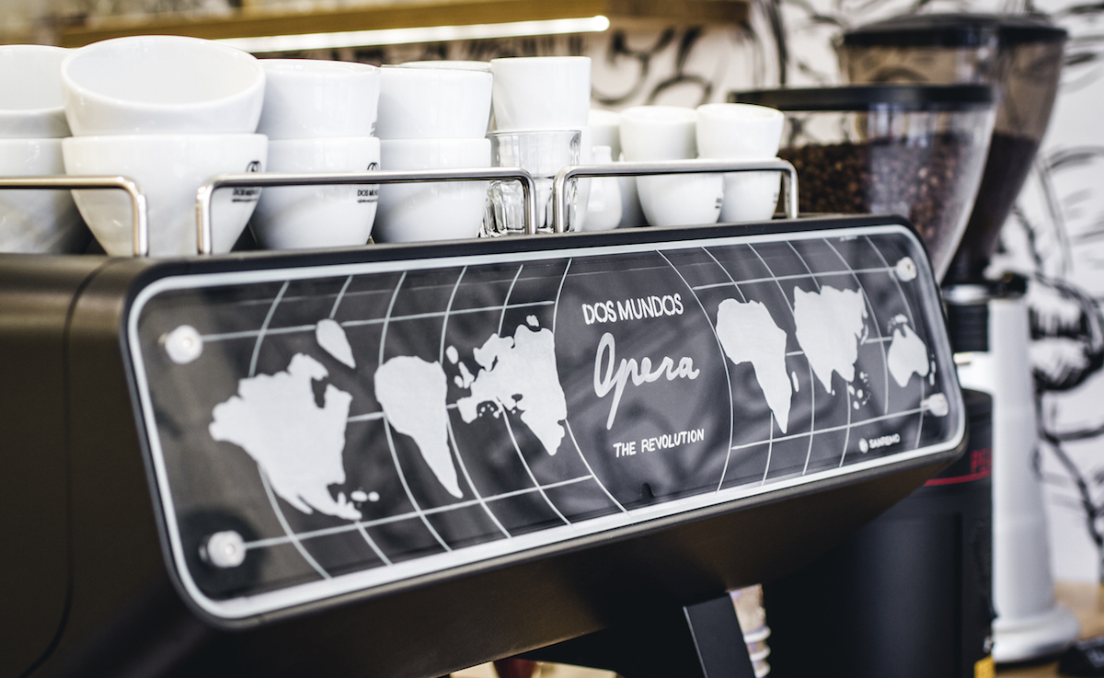
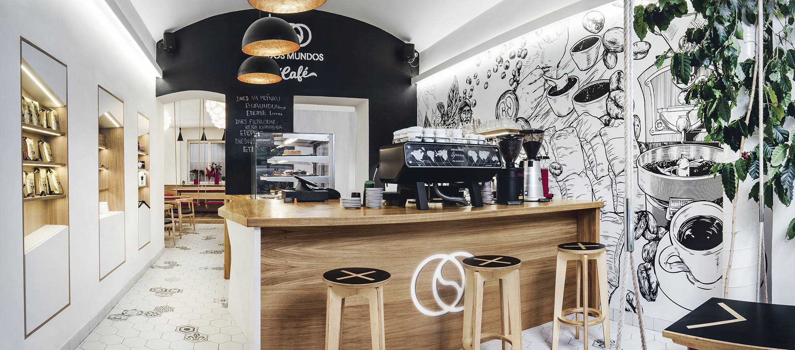

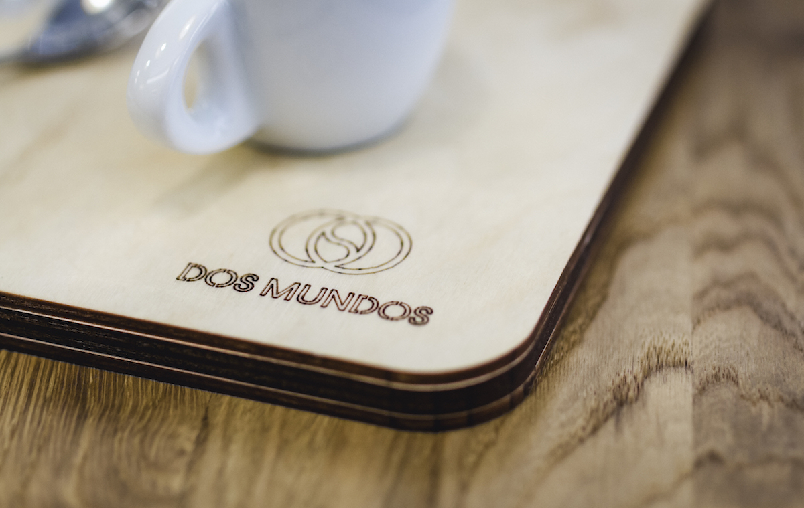
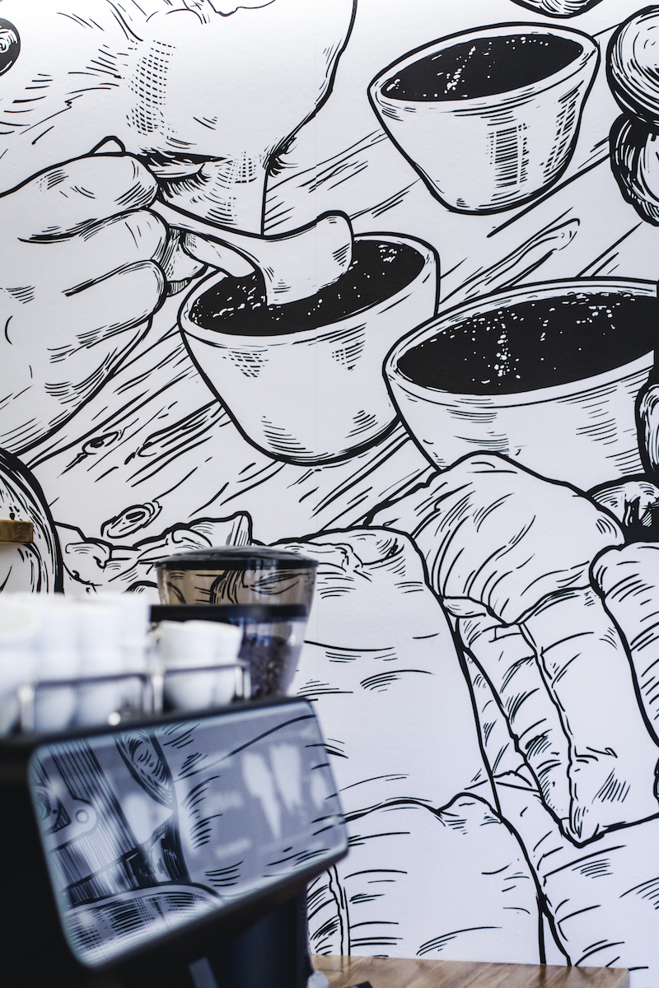
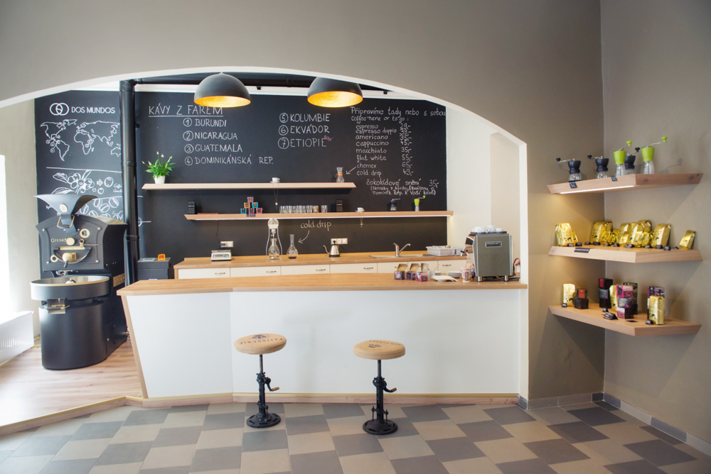
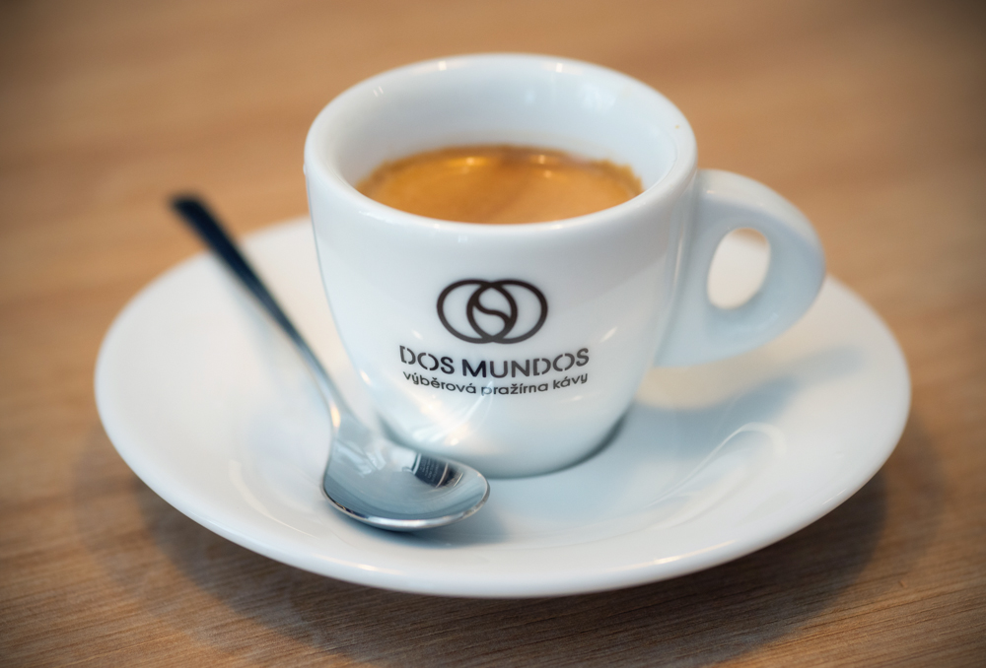
Information brief for new packaging design

Slide 2
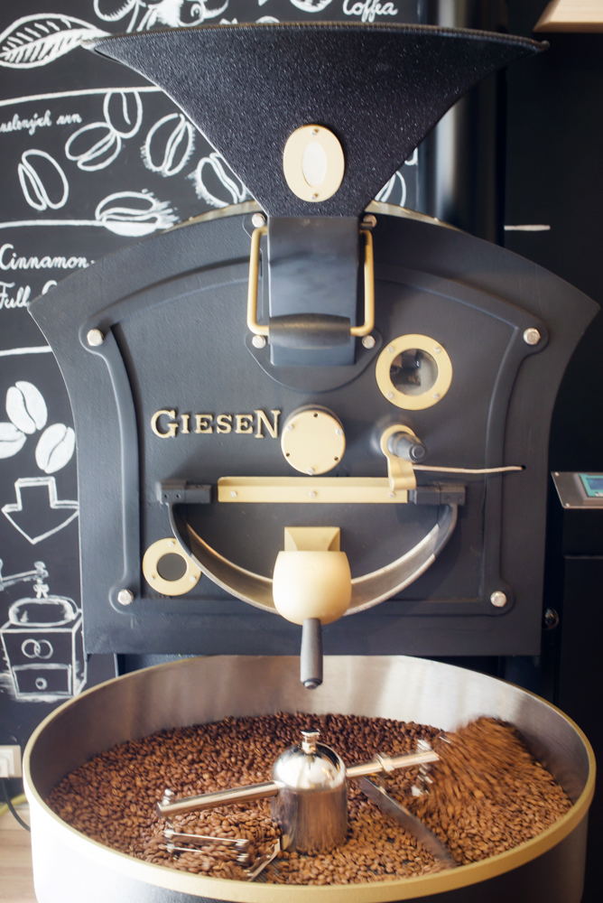
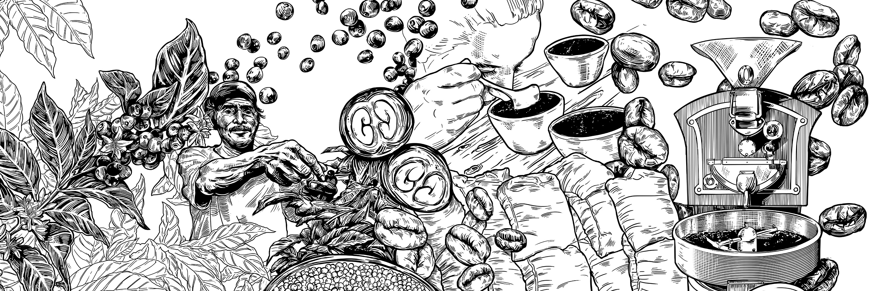
Who we are and what we are looking for?
Dos Mundos is a premium brand of specialty coffee roasters based in Prague in the Czech Republic.
We sell coffee beans to other coffee shops (wholesale channel) or to final consumers in our own coffee shops (retail)
We are roasting only specialty grade coffee that we source either directly or through specialty coffee merchants.
We have usually 6-8 coffees on our offer list. Each coffee stays with us 2-7 months based on their harvest season.
We pack our coffee for retail purposes in 250g bags that we sell in our cafés, roastery and clients.
We are now changing our bags from side gusset bags with valve closed by tin ties to flat bottom bags with zipper and valve.
We want evolution of our packaging design (not revolution)
Our current bags are decorated by front and back stickers.
New bags will be custom printed with general information and logo (e.g. Manufacturer information, contact, size etc.) and we want to have paper sleeve with customized information (e.g. Name of the Coffee origin, farmer, taste profile, farm info etc.)

Slide 3
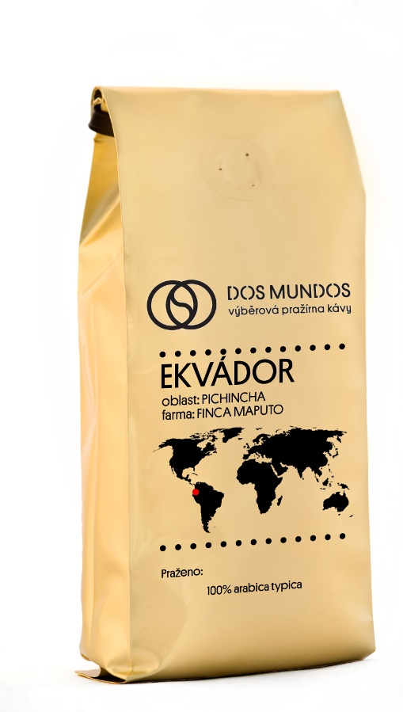
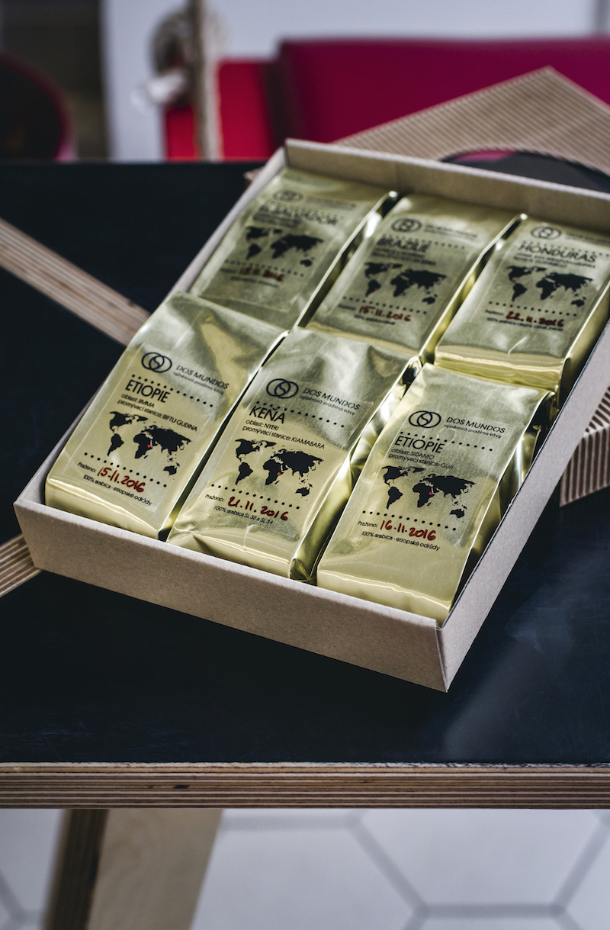
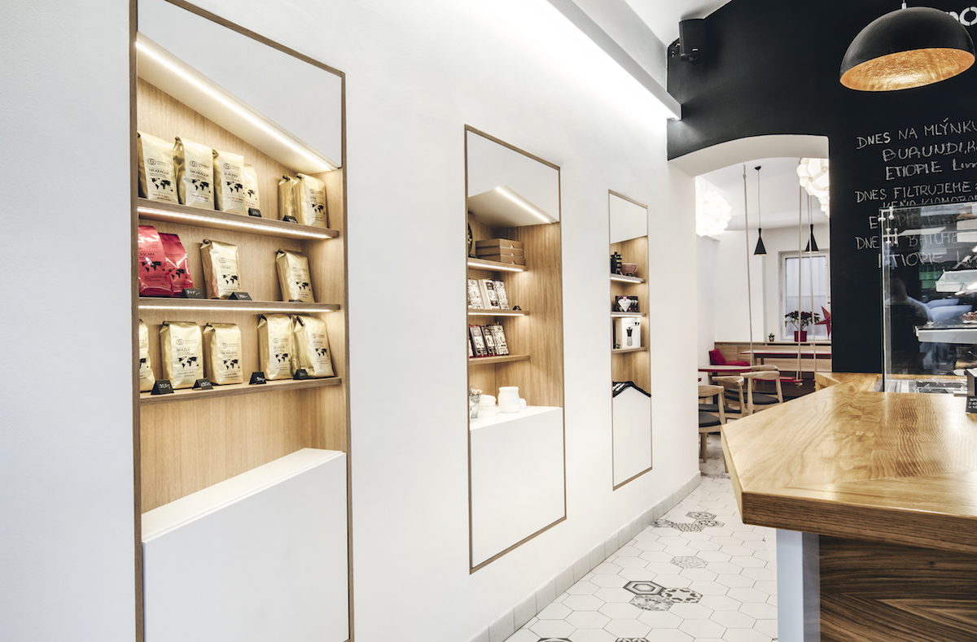
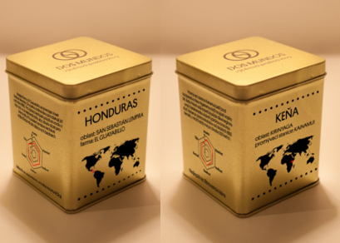
Our current packaging range
We have:
1kg golden side gusset bags
250g golden side gusset bags – THIS IS WHAT WE ARE CHANGING NOW
50g golden side gusset sample bags
150g metalic golden gift boxes

Slide 4
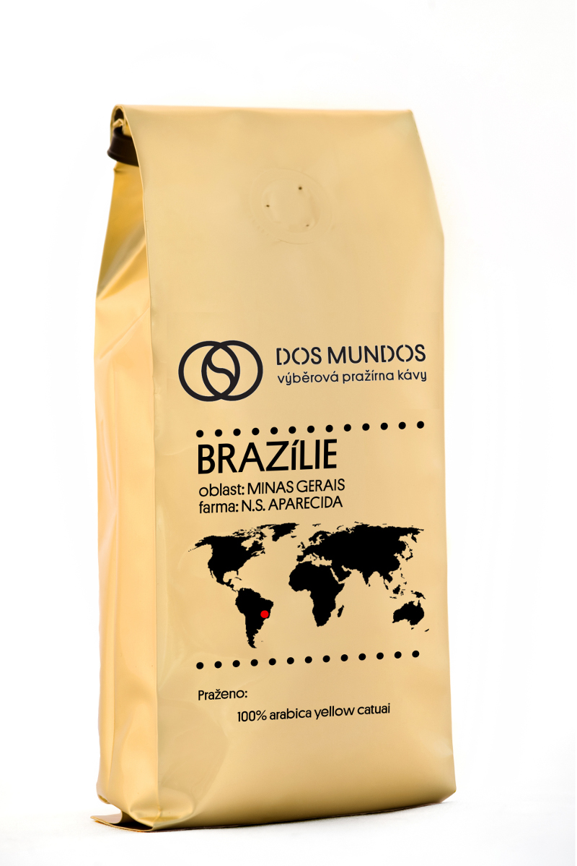
Why we do this change:
Premiumisation of our pack after 3 years in business
Competition elevated their bags and we need to keep innovating as well
Going from side gusset bag to bottom bag with zipper (keeps better coffee quality longer)
Easier manipulation during packaging
Less manual work during packaging (currently we have to cut front and back label, put it on the bag and after sealing the bag close it with a tin tie)
No tin ties just sealing
Keeps better shape on the shelf (stands alone)
Current design
Side gusset bag, gold color,
We want to keep:
Gold- black design of the bag
Platform regular as a font
Country of Origin as the strongest element of each bag
What we want to change:
Logo usage – from horizontal to vertical and leaving out descriptor („výběrová pražírna kávy“)
We want to use all sides of the bag for information common for all coffees we sell and use a paper sleeve for changing information

Slide 5
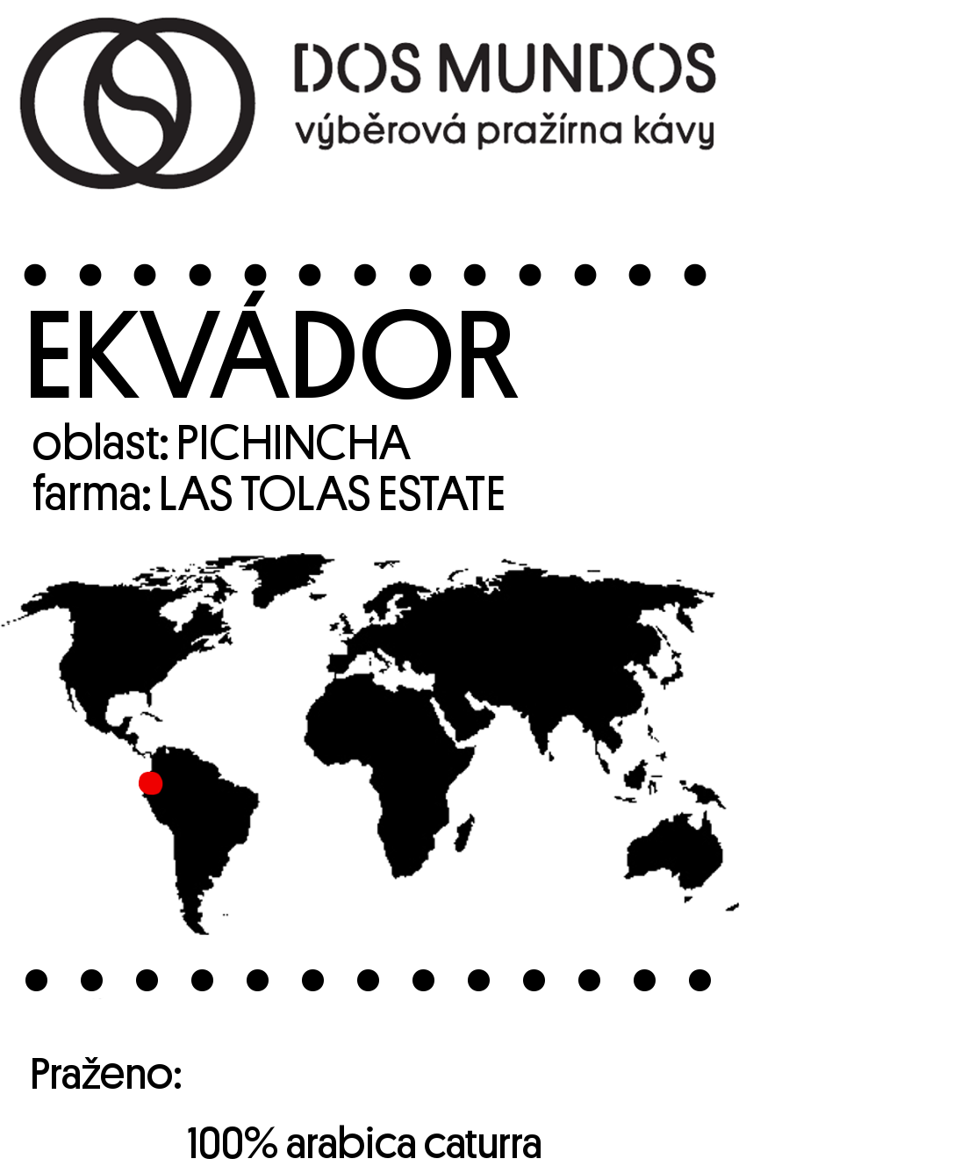

Current design
Front and back labels
Ekvádor
Oblast: Pichincha Farma: Las Tolas Estate
Čerstvě pražená zrnková káva. Jsme velmi hrdí, že tato káva se prezentuje v naší pražírně již počtvrté. V ruce držíte čerstvou sklizeň odrůdy caturra a pacas. Tato káva roste ve výšce kolem 1700 metrů nad mořem na svazích sopky Pichincha ve specifické biodiverzní oblasti mezi pralesem a Andami. Sklizeň této kávy probíhala mezi červencem a říjnem 2016 a byla sbírána výhradně ručně. Rok od roku také vidíme zlepšující se třídění a balení kávy. Kvalita je jednoduše hlavní prioritou farmáře Arnauda Causse.
Charakteristika kávy: Mléčná čokoláda, javorový sirup, lískové oříšky, dlouhá dochuť
Zpracování kávy: promytá
Příprava: Ideální na espresso a moka
Dejte nám vědět jak vám chutnalo!
www.dos-mundos.cz, facebook.com/prazirnadosmundos
Minimální trvanlivost do: 3 měsíce od data pražení
Nejlepší chuti dosáhnete do 30 dnů od pražení kávy.
Výrobce: Dos Mundos s.r.o., Žerotínova 59, 130 00 Praha 3, ČR
Tel: +420 731421002, kava@dos-mundos.cz,
Hmotnost: 300 g 1 kg 1,25 kg
Story of particular coffee farm
Taste and preparation description
Compulsory information
We hand write roast date on the front label

Slide 6
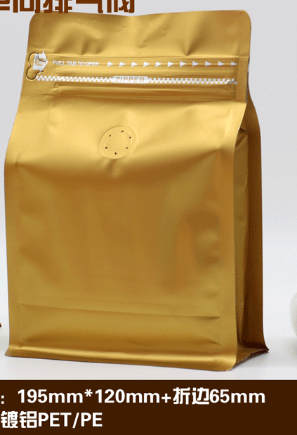
New bag design
250g bottom bag, gold matte with zipper and valve
Custom printed with logo and general information (bag will be printed by black color only)
Paper sleeve with detailed information about particular coffee (have to be easily adaptable to different coffee - every year we produce about 25 different coffees)
Front side is the one without valve, back side is the one with valve
We are looking for both bag and sleeve design – you should offer solution for sleeve design and size.
Details about this bag (size, lines) are in separate file and guidelines from the bag manufacturer.

Slide 7
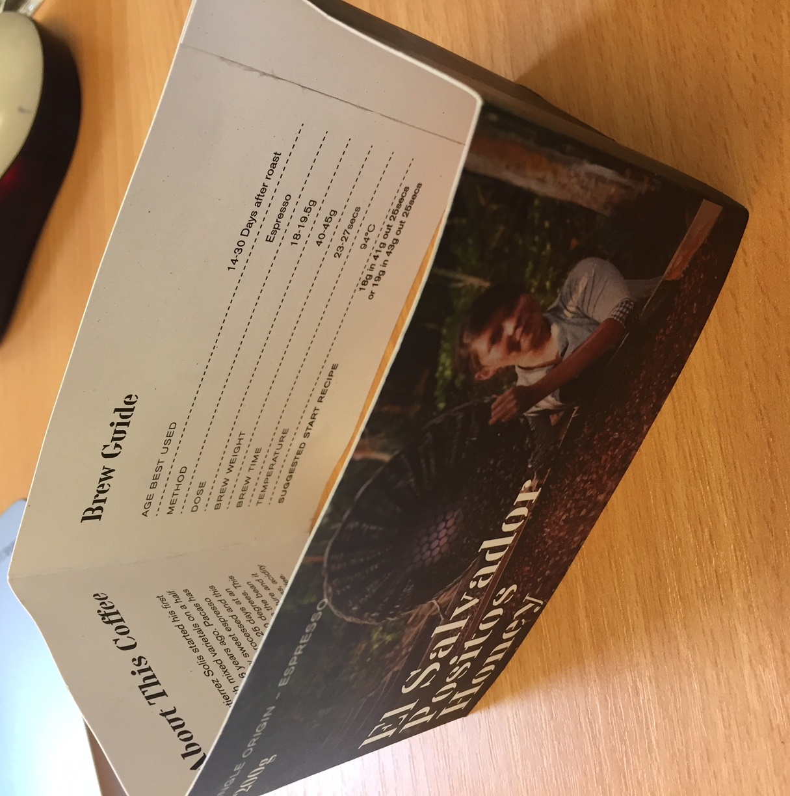
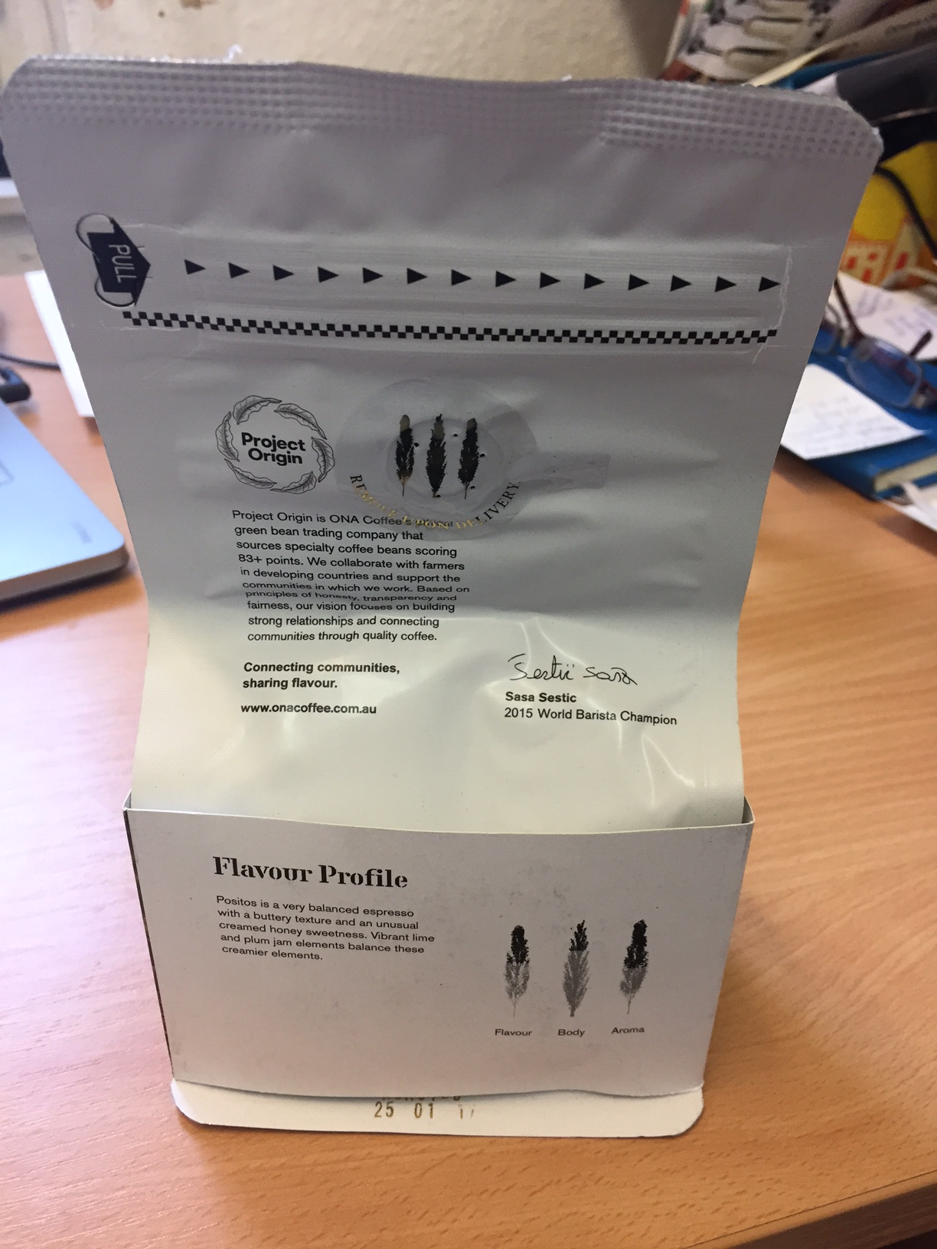
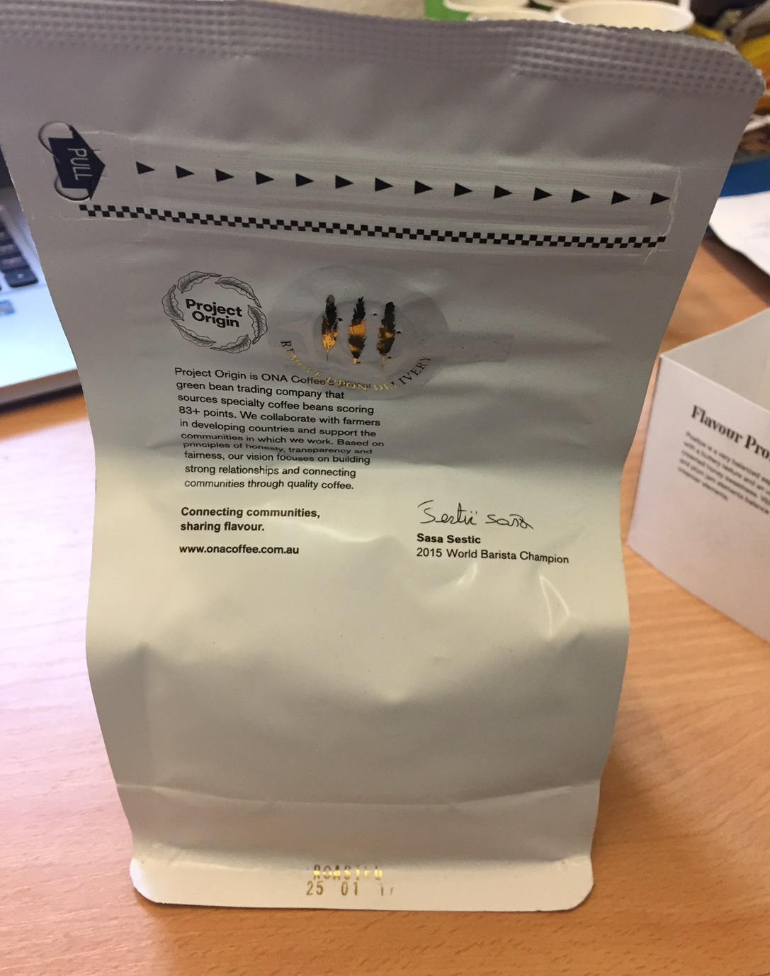
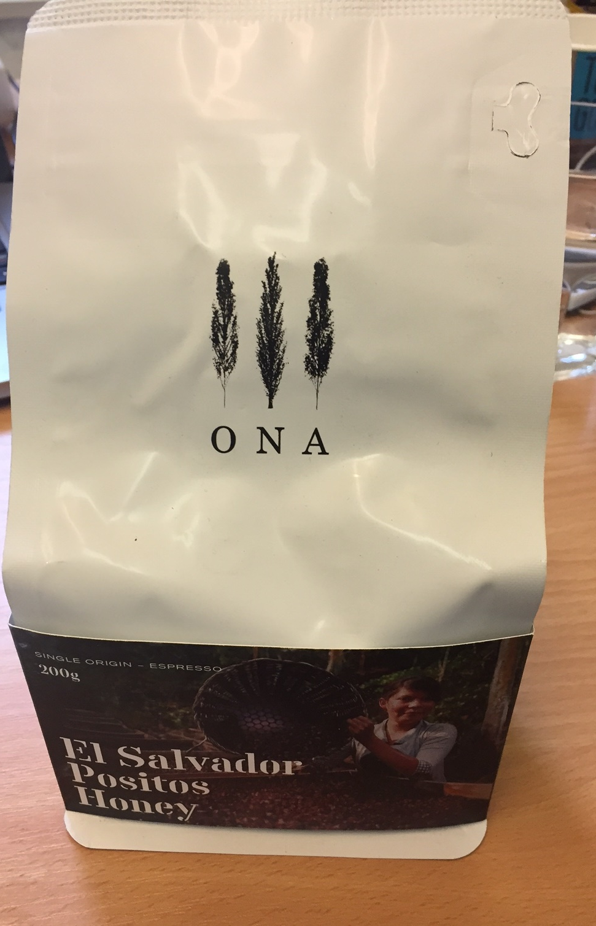
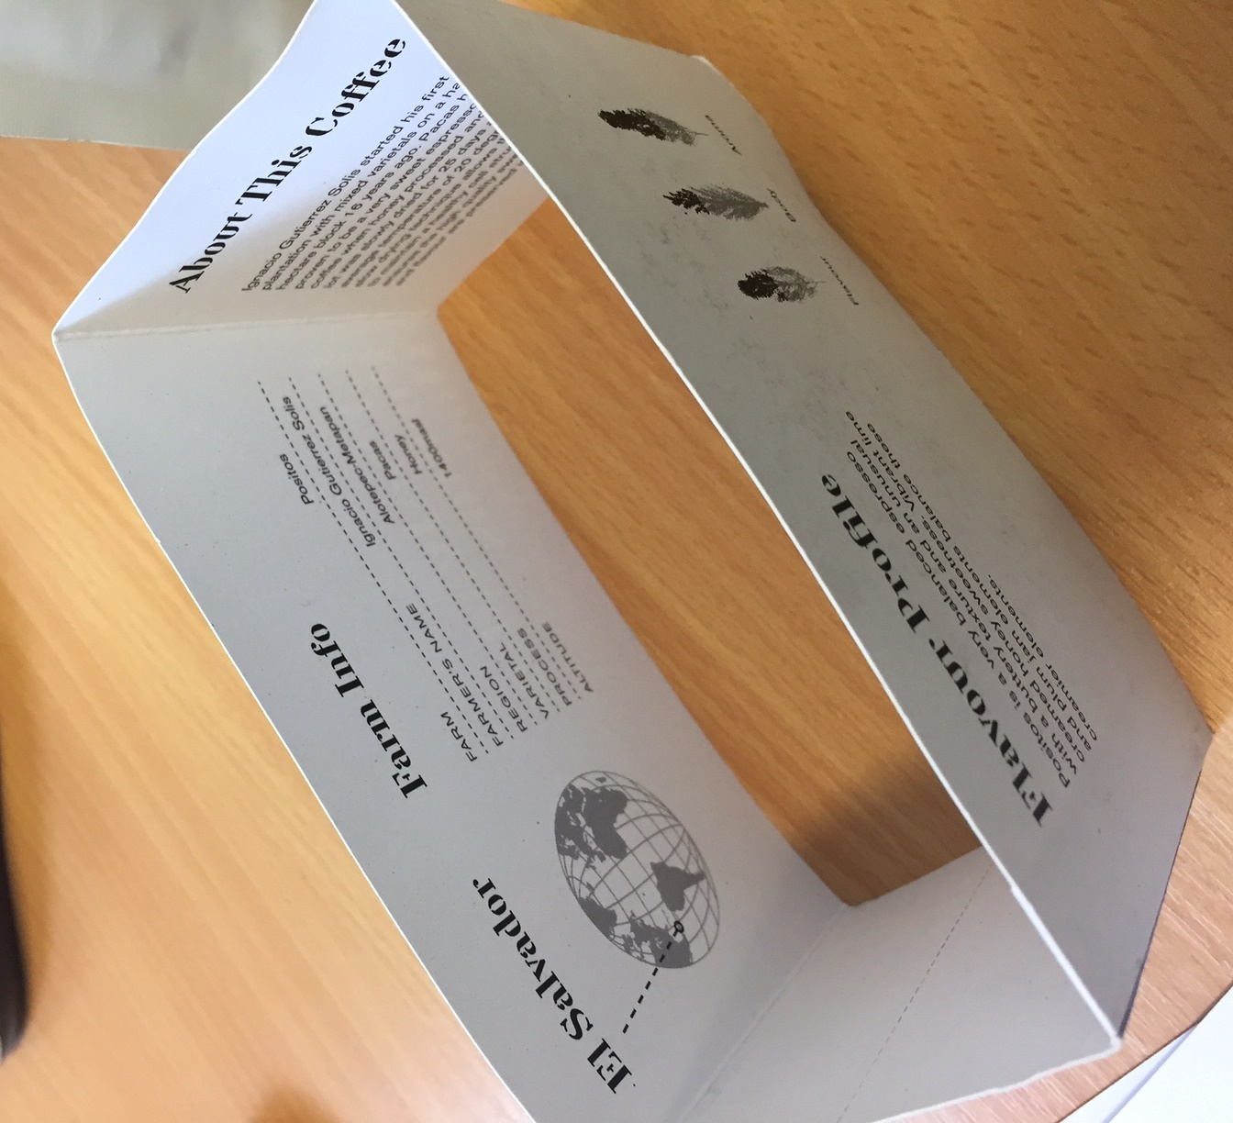
Examples of what we like
ONA coffee – we like the way they treated the sleeve and information on it

Slide 8
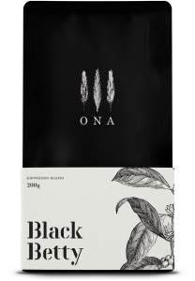
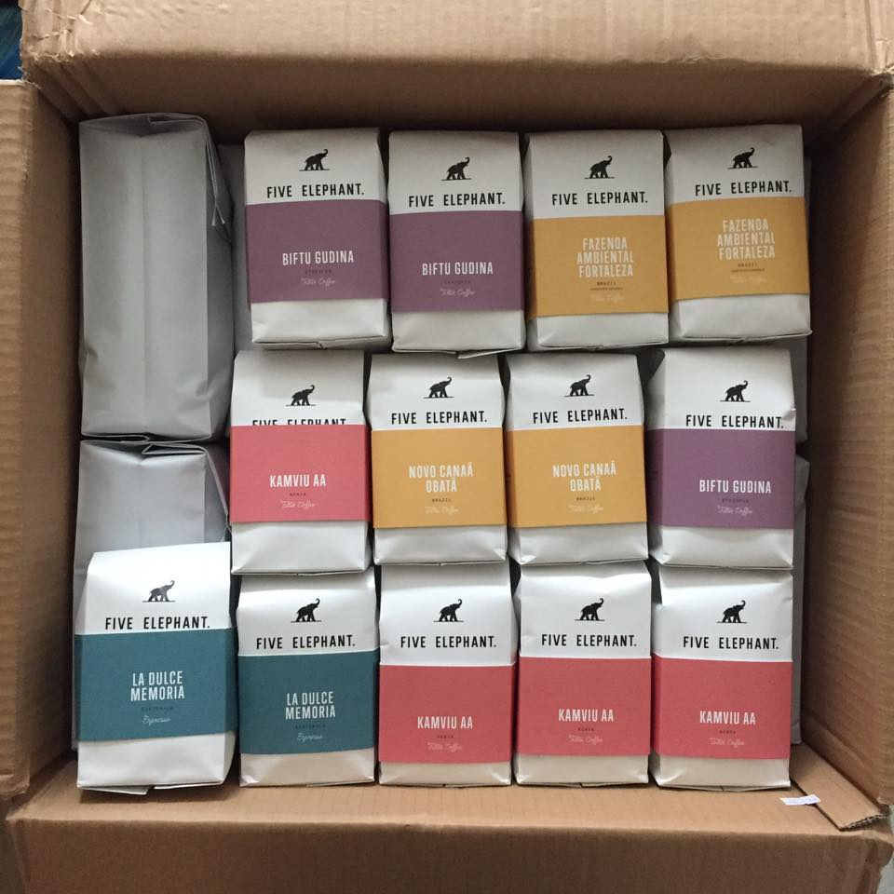
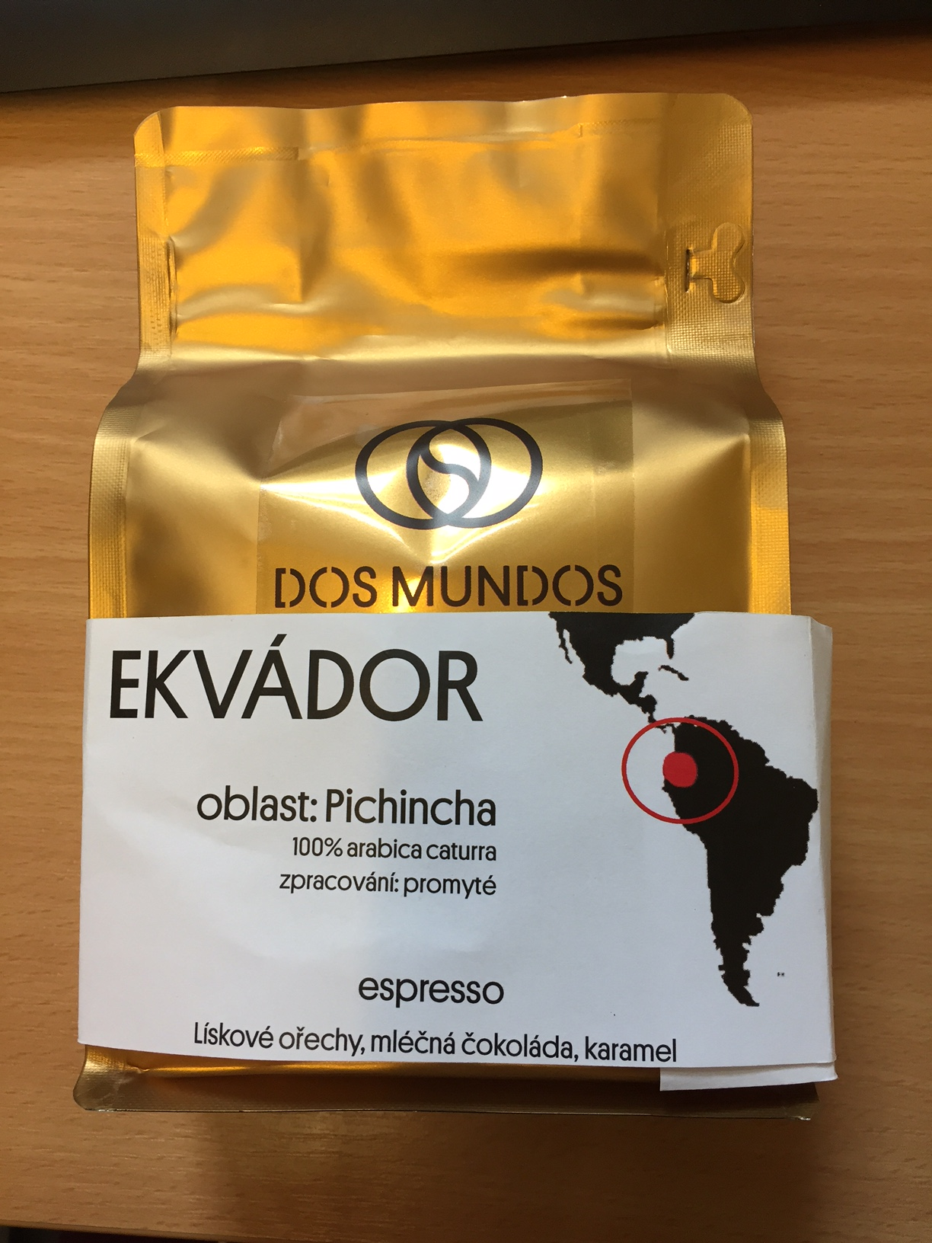
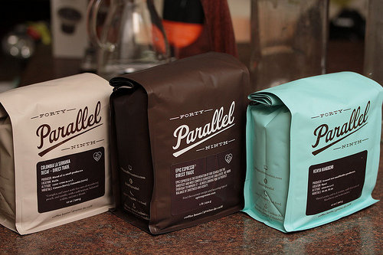
Examples of what we like
Mockup idea how it could work

Slide 9

Logo and font usage
Font: Platform regular ( or similar looking one), minimal font size is 7
Logo:
current
We want this one to be used in the packaging
Logo and font are in separate file

Slide 10
Must have information on the BAG
USE only black color – no multiple color!
Other colors may be used on the sleeve
Please use following text in brackets for your design
Back side (this side includes valve) or side of the bag (this information can be covered by the sleeve excluding the weight information- this one should be visible :
weight information: (Hmotnost: 250g)
producer: („Výrobce: Dos Mundos s.r.o., Žerotínova 1663/59, 130 00, Praha 3, ČR “)
social connections –facebook, instagram, website info: (www-dos-mundos.cz @dmroastery FB/prazirnadosmundos )
date of use info ( Minimální trvanlivost 90 dní od data pražení uvedeného na zadní straně obalu)
Quality inf (Nejlepší chuti dosáhnete do 30 dnů od pražení kávy.)
What is inside the bag information (V ruce držíte čerstvě praženou zrnkovou kávu. Pracujeme výhradně s výběrovými jednodruhovými arabikami, které získali 85+ bodů. Káva se sbírá na farmách ručně a my navazujeme, co nejpřímější, někdy i zcela osobní vazby na farmy. To vše, abychom vám mohli přinášet, to nejlepší, co se z aktuálních sklizní nabízet dá a podporovat přitom farmáře, kteří odvádí na svých farmách velmi tvrdou práci.)
Front side:
Logo (see slide about logo usage) – cannot be covered by sleeve
Optional graphical elements - conneted with coffee (e.g. leaves, cherries, handpicking, cupping, roasting, roasting machine Giesen W6) or with logo design – can be covered by sleeve

Slide 11
Information on the SLEEVE part 1
Multiple colors may be used on the sleeve
Sleeve can be printed on both sides
Please use following text in brackets for your example design
Front side:
Name of the country (Ekvádor)
Name of the farm or washing station ( farma: Las Tolas)
Some kind of map featuring the country of origin - we source from central america, south america, africa, indonesia –this time show Ecuador
3 flavour descriptors of the coffee (Lískové ořechy, mléčná čokoláda, karamel)
Front or back (outter part of the sleeve)
Varietal (100% arabica caturra)
Process (zpracování: promyté)
Region (Pichincha)

Slide 12
Information on the SLEEVE part 2
Multiple colors may be used on the sleeve
Sleeve can be printed on both sides
Please use following text in brackets for your example design
Back side and side of the sleeve (outter part)
Roasting date (Praženo: ) – we need some space to handwrite date in the format of DD.MM.YYYY We roast fresh and this information is a big plus of our brand so visibility of the roast date should be good
Few words about the coffee farm and coffee usually about 6 sentences (Jsme velmi hrdí, že tato káva se prezentuje v naší pražírně již počtvrté. V ruce držíte čerstvou sklizeň odrůdy caturra a pacas. Tato káva roste ve výšce kolem 1700 metrů nad mořem na svazích sopky Pichincha ve specifické biodiverzní oblasti mezi pralesem a Andami. Sklizeň této kávy probíhala mezi červencem a říjnem 2016 a byla sbírána výhradně ručně. Rok od roku také vidíme zlepšující se třídění a balení kávy. Kvalita je jednoduše hlavní prioritou farmáře Arnauda Causse. )
We usually have a photo of the farm, but not every single time. You can use the design including photo, but if you choose to do so, you have to show alternative when no photo is available. Sample photo is attached in separate file.

Slide 13
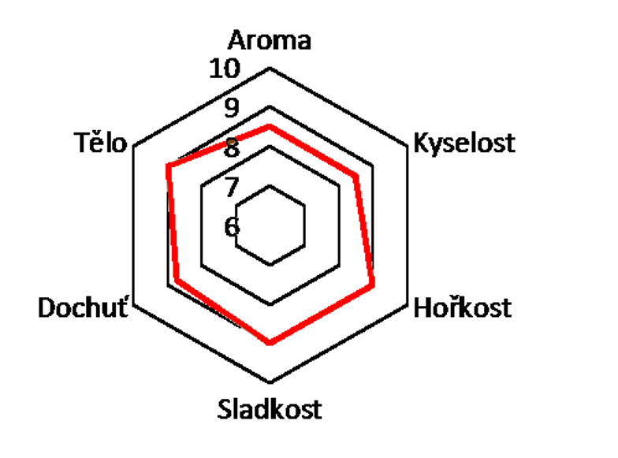
Information on the SLEEVE part 2
Multiple colors may be used on the sleeve
Sleeve can be printed on both sides
Please use text in brackets for your example design
Back side (this side includes valve) and side of the sleeve (outter ir inner part of the sleeve)
optional – taste profile showed on hectagone
Optional – brewing recipe (can be showed on the inner part of the sleeve):
Brewing recipe
Doporučený recept na espresso
Gramáž kávy do portafilteru | 18g
Cílová hmotnost espressa | 40g (extrakční poměr 45%)
Celkový čas extrakce | 28 sekund
Chuťový projev espressa: | Ekvádor je na espressu krásné vybalancovaný s vůní pralinek a medu. V chuti se pak projevuje převážně chuť čokolády a másla s jemnou oříškovou dochutí. Díky tomu se hodí i na přípravu cappuccina a dalších mléčných variací.

