Slide 1

Creative brief for a company website
1

Slide 2
Creative brief - background
We need a website design (and eventually working website) for our company.
Who are we and what do we do?
We have a product called Factbase. This is our on-demand, software-as-a-service to capture, learn and target our client’s website visitors and turn them into loyal customers. Because of the easy and quick setup clients can in a record time start targeting their visitors instead of doing a large investment in new technology and data science. We help our clients to identify their potential customers with the help of data science. We therefore consider ourselves a data science company.
Our core services are orchestrated around the Factbase platform and are:
Advisory
Insights
Targeting and optimization
Data engineering
Data privacy and security
Our head office is in Amsterdam, The Netherlands.

Slide 3
Creative brief - requirements
Primary goal (obliged):
Primary purpose of the website is branding and lead generation (contact form).
It should be accessible on all platforms (mobile, tablet and desktop) and from all parts of the world and work in all major browsers and have acceptable loading times
It should be ready for integration with a leading CMS platform like Wordpress (preference)
1 single, vertical scrolling page with different sections is fine for our purposes
The design should be fresh, innovative, daring yet professional.
No cliches, no smiling ladies.
Secondary goal (not obliged):
Secondary, it will also have a closed part for clients that use our product. The content of that part will be reference documentation. We therefore need to mix code and a description, like this: https://developer.piwik.org/guides/tracking-javascript-guide
This secondary part will be extended at a later stage into a full web application, therefore a mood board for web elements (button, text box, general form layout) is greatly appreciated, but not obliged

Slide 4
Creative brief – potential clients / target groups
Our website should serve the following purposes and groups:
Confirmation of existing clients that they chose a respectable and serious company
Quick insight of the main services and product features
The main purpose is to get the potential client to leave their contact details. The disclosed content will be written accordingly (no long stories, only introductions and high-overs)
Potential clients can be from any vertical (e.g. retail, logistics, FMCG, insurance, finance, travel)
Our products and services are all B2B (business-to-business)
Our potential clients already have a website that can generate large enough quantities of data in order to find significant patterns in it. We therefore aim at website with medium to large amounts of visitors
Examples of business goals we can solve for our clients:
optimizing the campaign strategy with data-driven conversion attribution (which campaign really lead to which transaction)
identify high-potential audiences to target
identify underperforming campaigns to reduce cost
cross-device, intra-device identification
detailed insight in the performance of your website

Slide 5


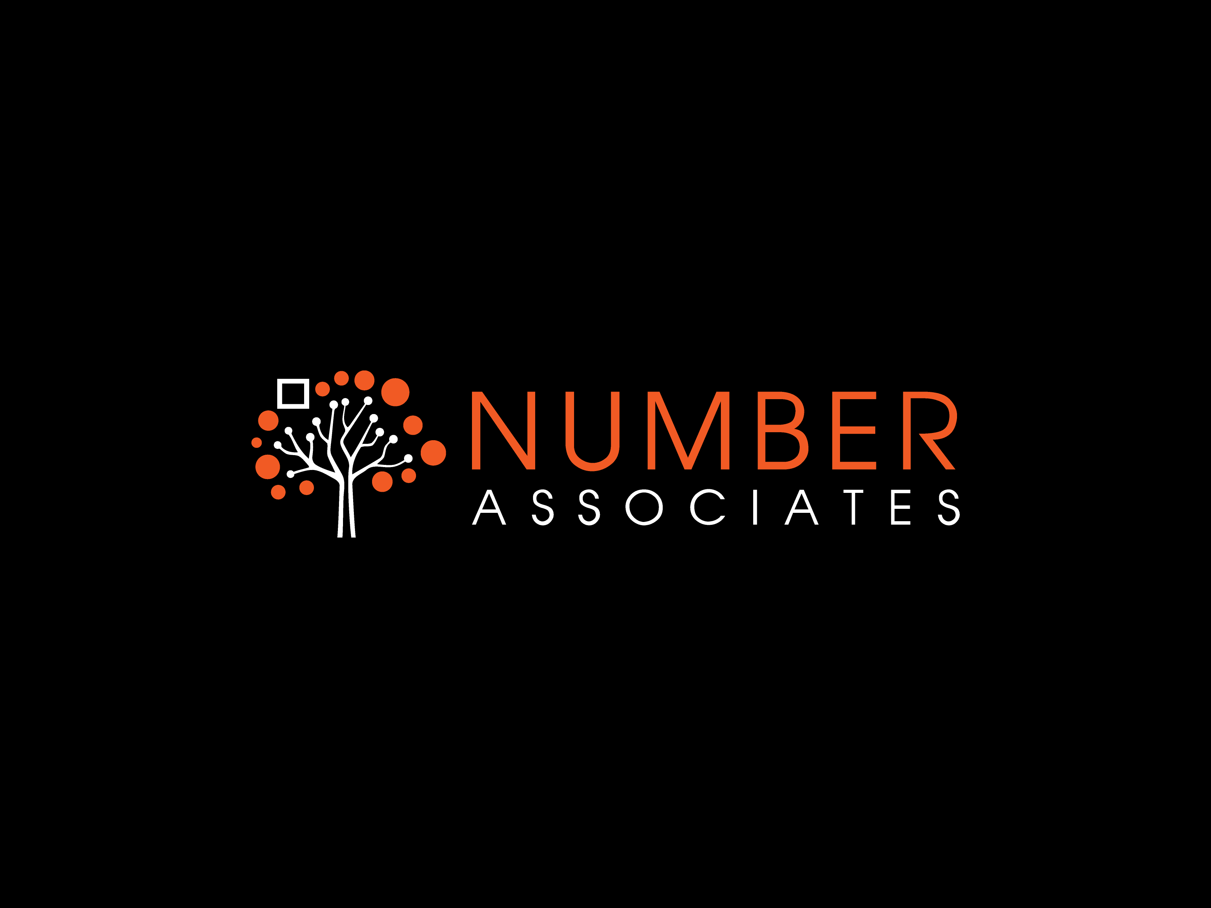
Existing design
Business card front:
Company logo:
Business card back:
The existing logo should fit the websites design. If you create a new color pallette, it should fit the existing colors of the logo

Slide 6
Website examples
Website examples and comments:
http://www.feedmusic.com/ - Allround impressive. A bit over the top for our goals.
http://www.luckcompanies.com/ - Great example of background video animations
https://themify.me/demo/themes/parallax/home/home-2/ - great existing theme that has all the content on a single page
http://gibeon.co.jp/ - Impressive homepage (not the website below) – fits a company that uses Data Science
http://www.iwc-skywriter.com/en - Skip the intro (see requirements) - quite original is the use of the same background video and the focus that adapts when a new selection is made
https://shift-paris.com/en/ - nice idea when you hover over the logo or icons
Added in version 2:
http://spatial.ai/ - clean and neat design
https://www.palantir.com/
https://www.echobox.com/ - moving particles in background
https://stepsize.com/ - no photos, just drawings – great example again (not sure of the effort this takes)

