Slide 1


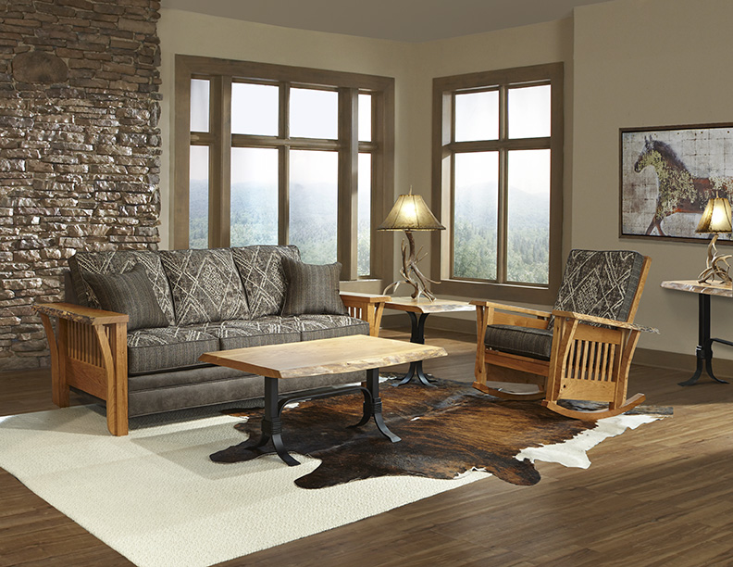
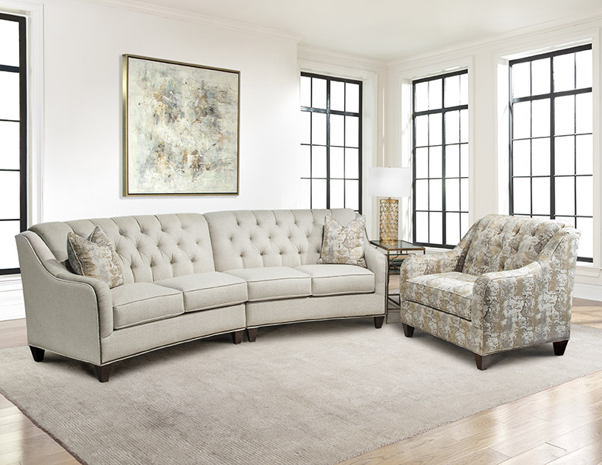
YOUR INVITED
Las Vegas Furniture Market
July 30-August 3, 2017
World Market Center

Slide 2


MARSHFIELD FURNITURE
137 W. 9th Street
Marshfield, WI 54449
P 715.387.1181 F 715.387.1182
Las Vegas Furniture Market
Show Dates: July 30-August 3, 2017
FIND US IN BUILDING A – 10TH FLOOR
Top of the Escalator - SPACE #1054
Come see our NEW Furniture Arrivals
*Fairfield *Raegan *James
PLUS
Pendleton by
for Marshfield
Indoor Fabric Performance Program
…and take advantage of our Market Specials
Instant CASH Rebates
Special Market Credit Terms
Special Market Pricing
www.marshfieldfurniture.com

