Slide 1
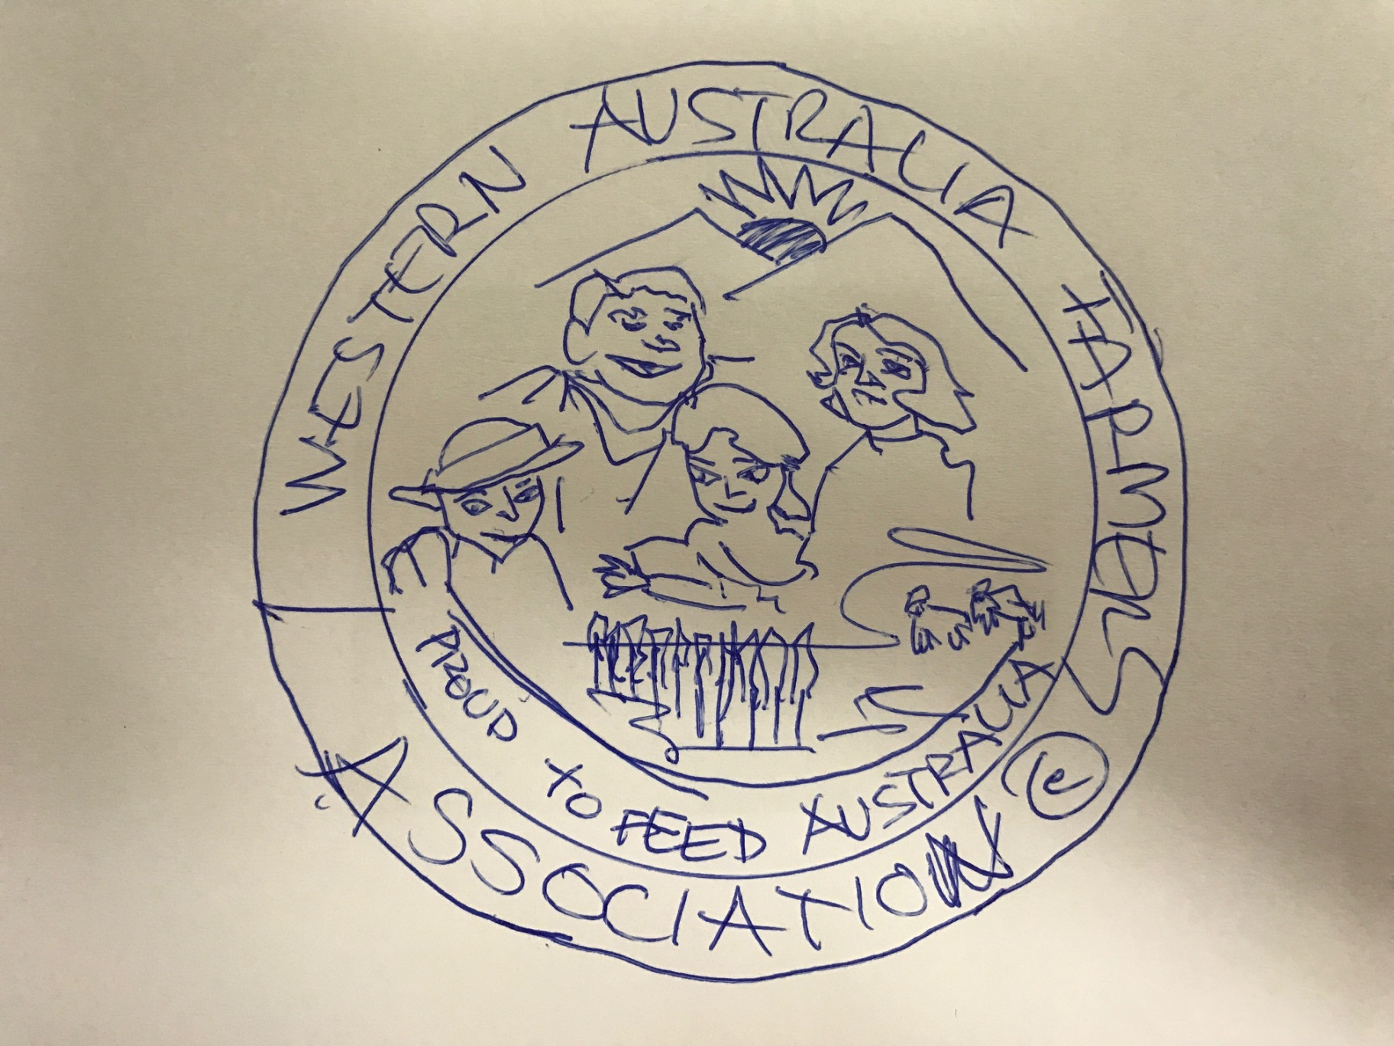

Slide 2
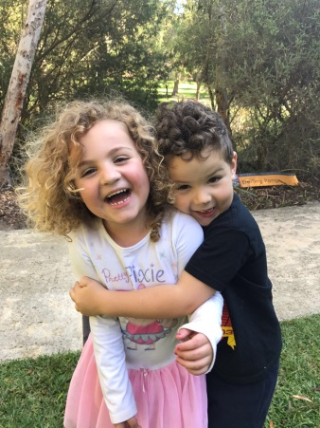
These are my grandkids – probably a good example of faces to use in the logo

Slide 3
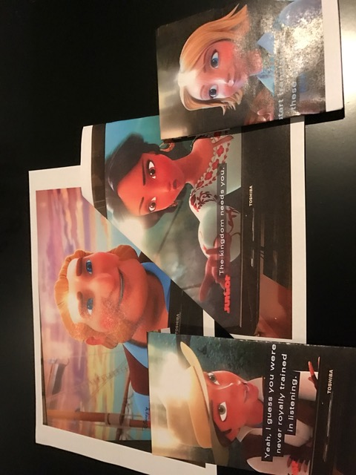
This is provided only as an example of good design – not to be copied as it belongs to someone else

