Slide 1
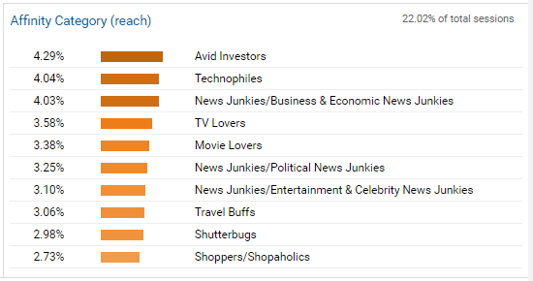
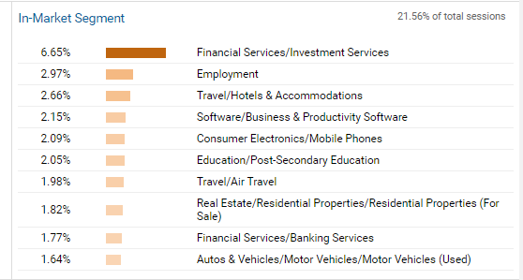
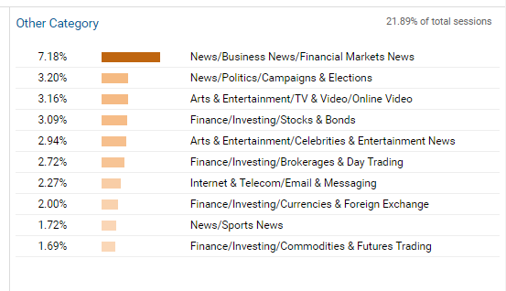
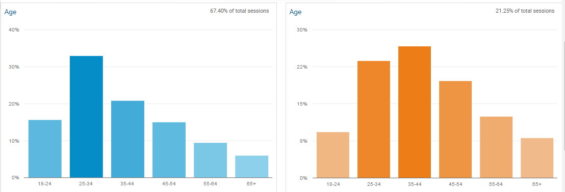
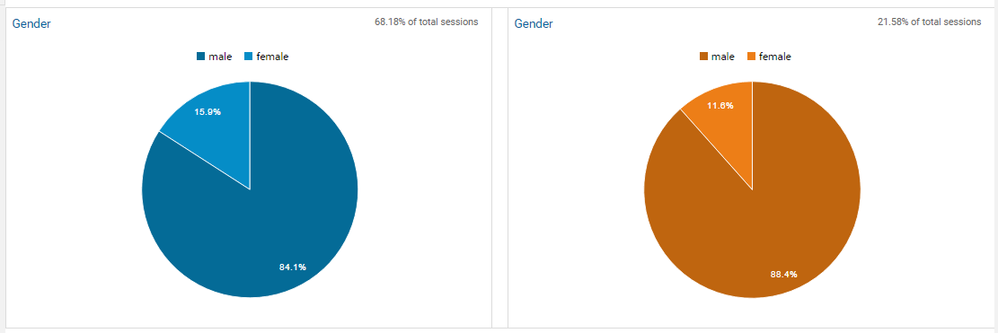
K2O Website Traffic Demographics
All Visitors – 68.88% 25-54
New Visitors – 70.07% 25-54
All Visitors – 84.1% Male
New Visitors – 88.4% Male

