Slide 1


Slide 2

Infrastructure is F*cked!

Slide 3
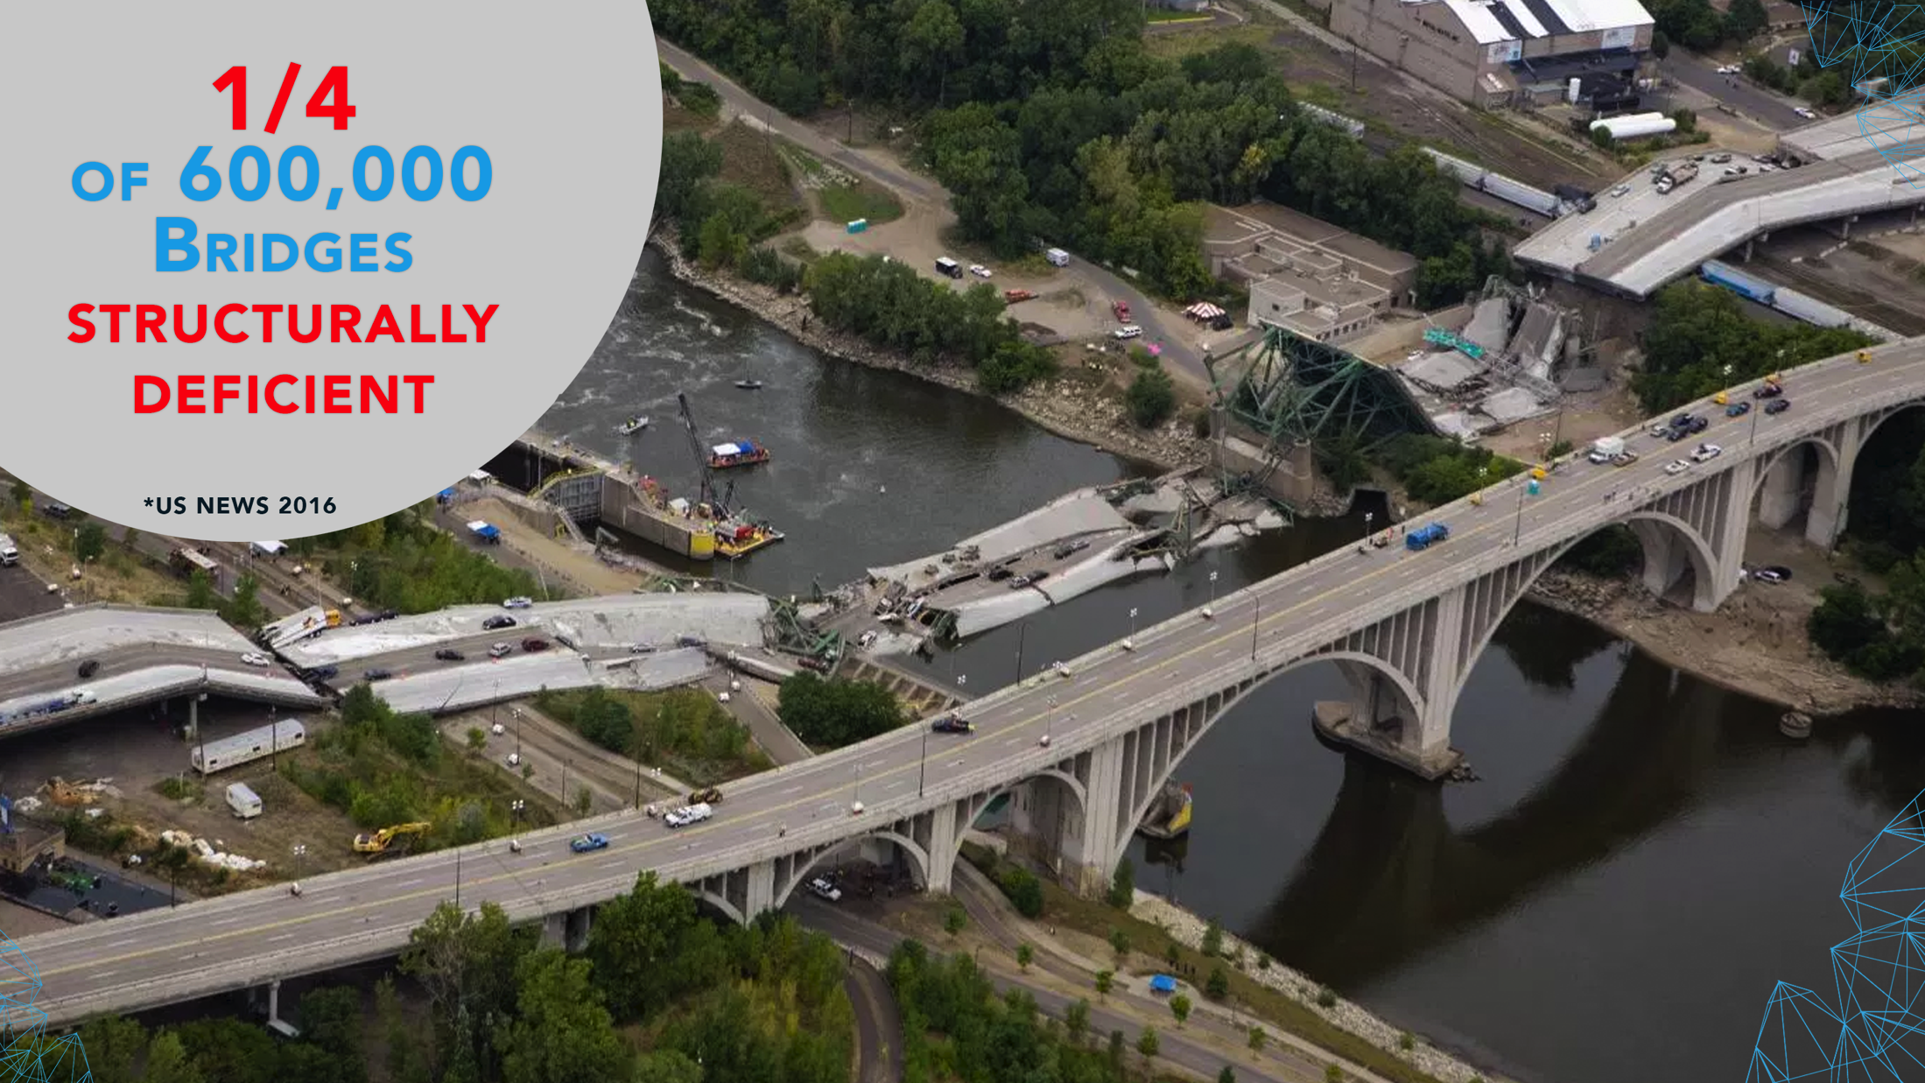

Slide 4

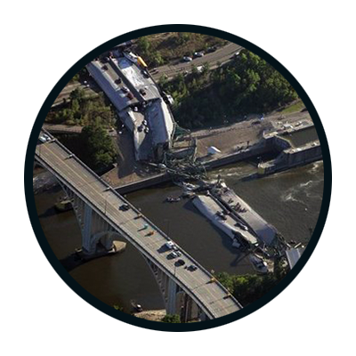
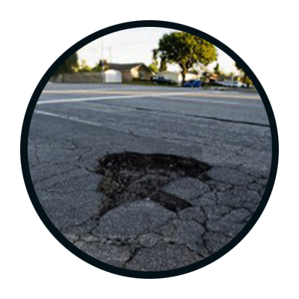
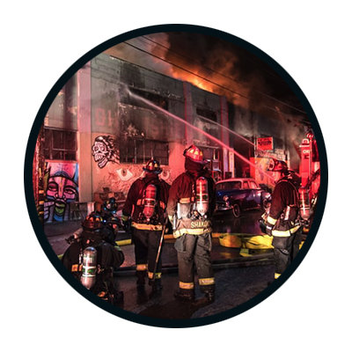
Problem-Grand
Infrastructure and infrastructure management in the United States is failing.
“The American Society of Civil Engineers most recently gave America a D+ rating in terms of infrastructure, citing dilapidated roadways, insufficient waterways and "a pressing need for modernization." The group estimates $3.6 trillion would need to be invested into U.S. infrastructure by 2020 just to raise the country's support systems to acceptable levels.” (US News)
“One in four of the nation’s bridges are rated as structurally deficient” (ASCE)
“Warehouse where 36 people perished during a fire…not even included in the Oakland Fire Department’s database” (NBC)
“Poorly maintained roads contribute to a third of all highway fatalities. That’s more than 13,000 deaths every year.” (Our Future)
This document is proprietary and confidential. No part of this document may be disclosed in any manner to a third party without the prior written consent of Raxar Technology Corporation
Notes:
Infrastructure and infrastructure services are shit” –whether its pothole, building, roadways, these things have problems
---make this relatable
--archaic technologies
---existing tools are etiher archaic or non-existent
-----still using paper to manage

Slide 5


Slide 6


Slide 7
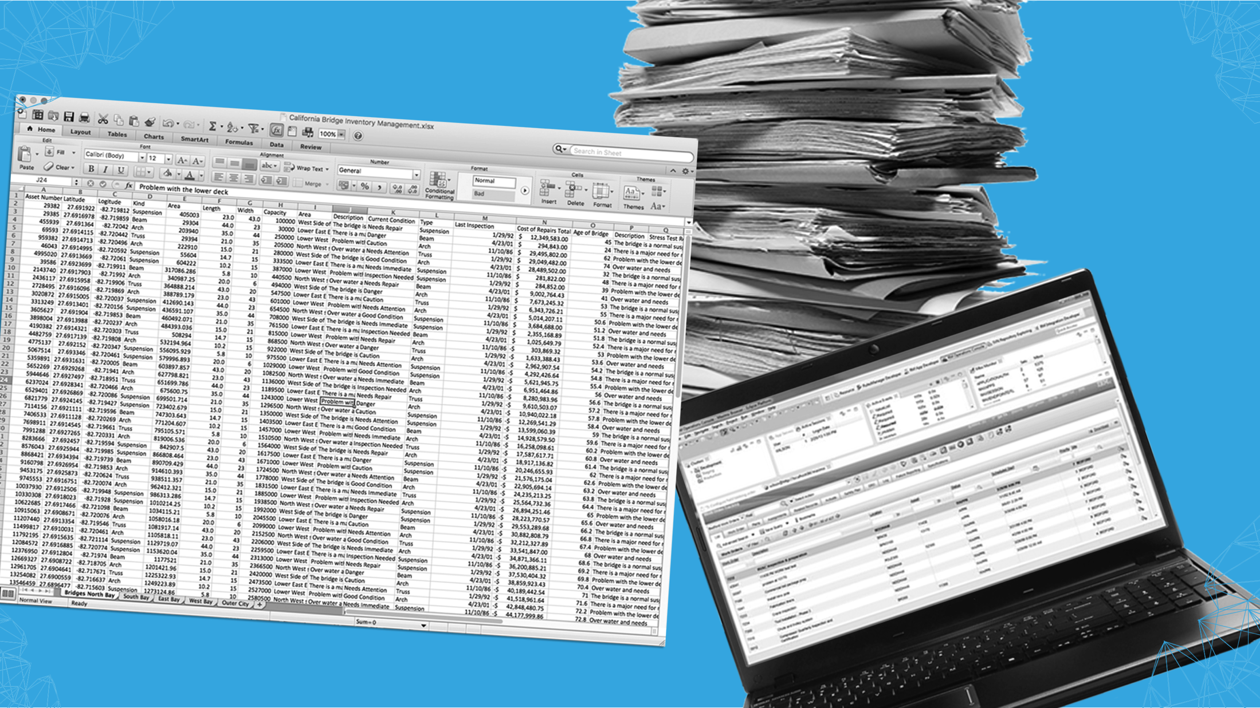

Slide 8
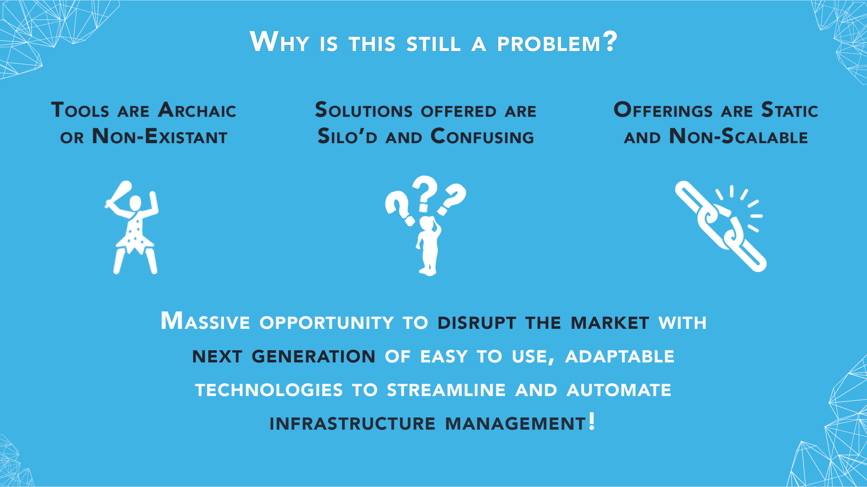
Why?
Tools are archaic or non existent
Silo’d solutions
Static, non scalable solutions
Constant updates to regulations and requirements
Opportunity to disrupt the market with next generation of easy to use, adaptable technologies to streamline and automate infrastructure management!

Slide 9
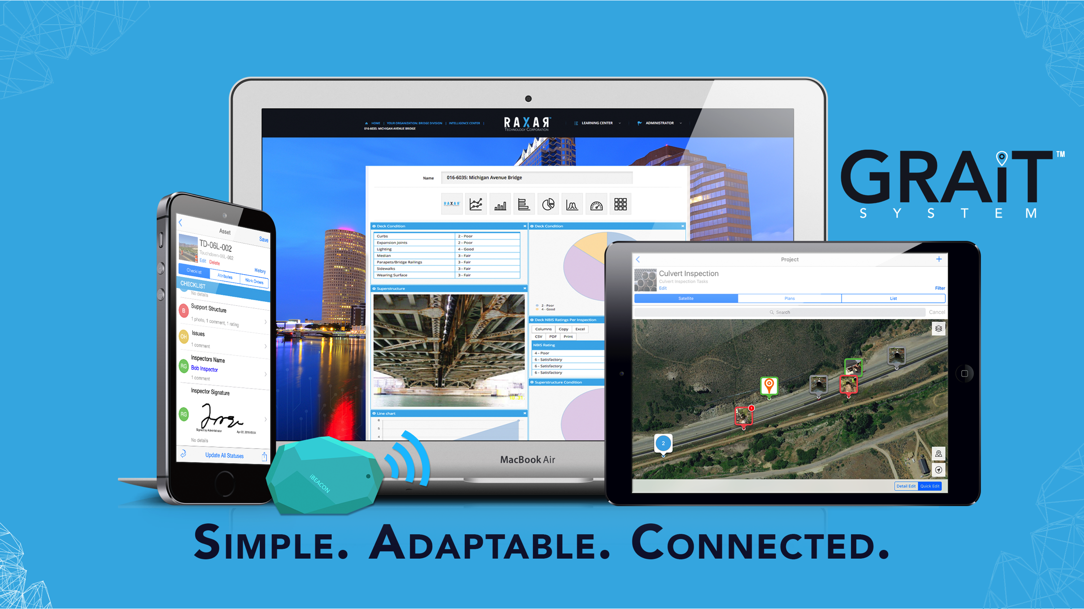

Slide 10
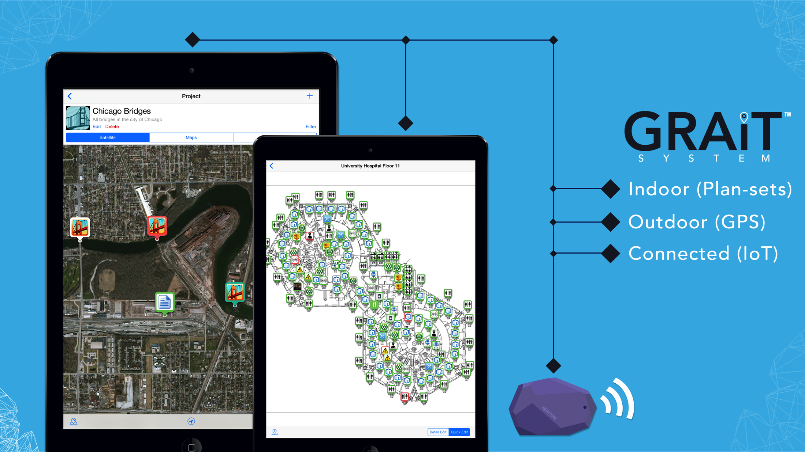

Slide 11


Slide 12
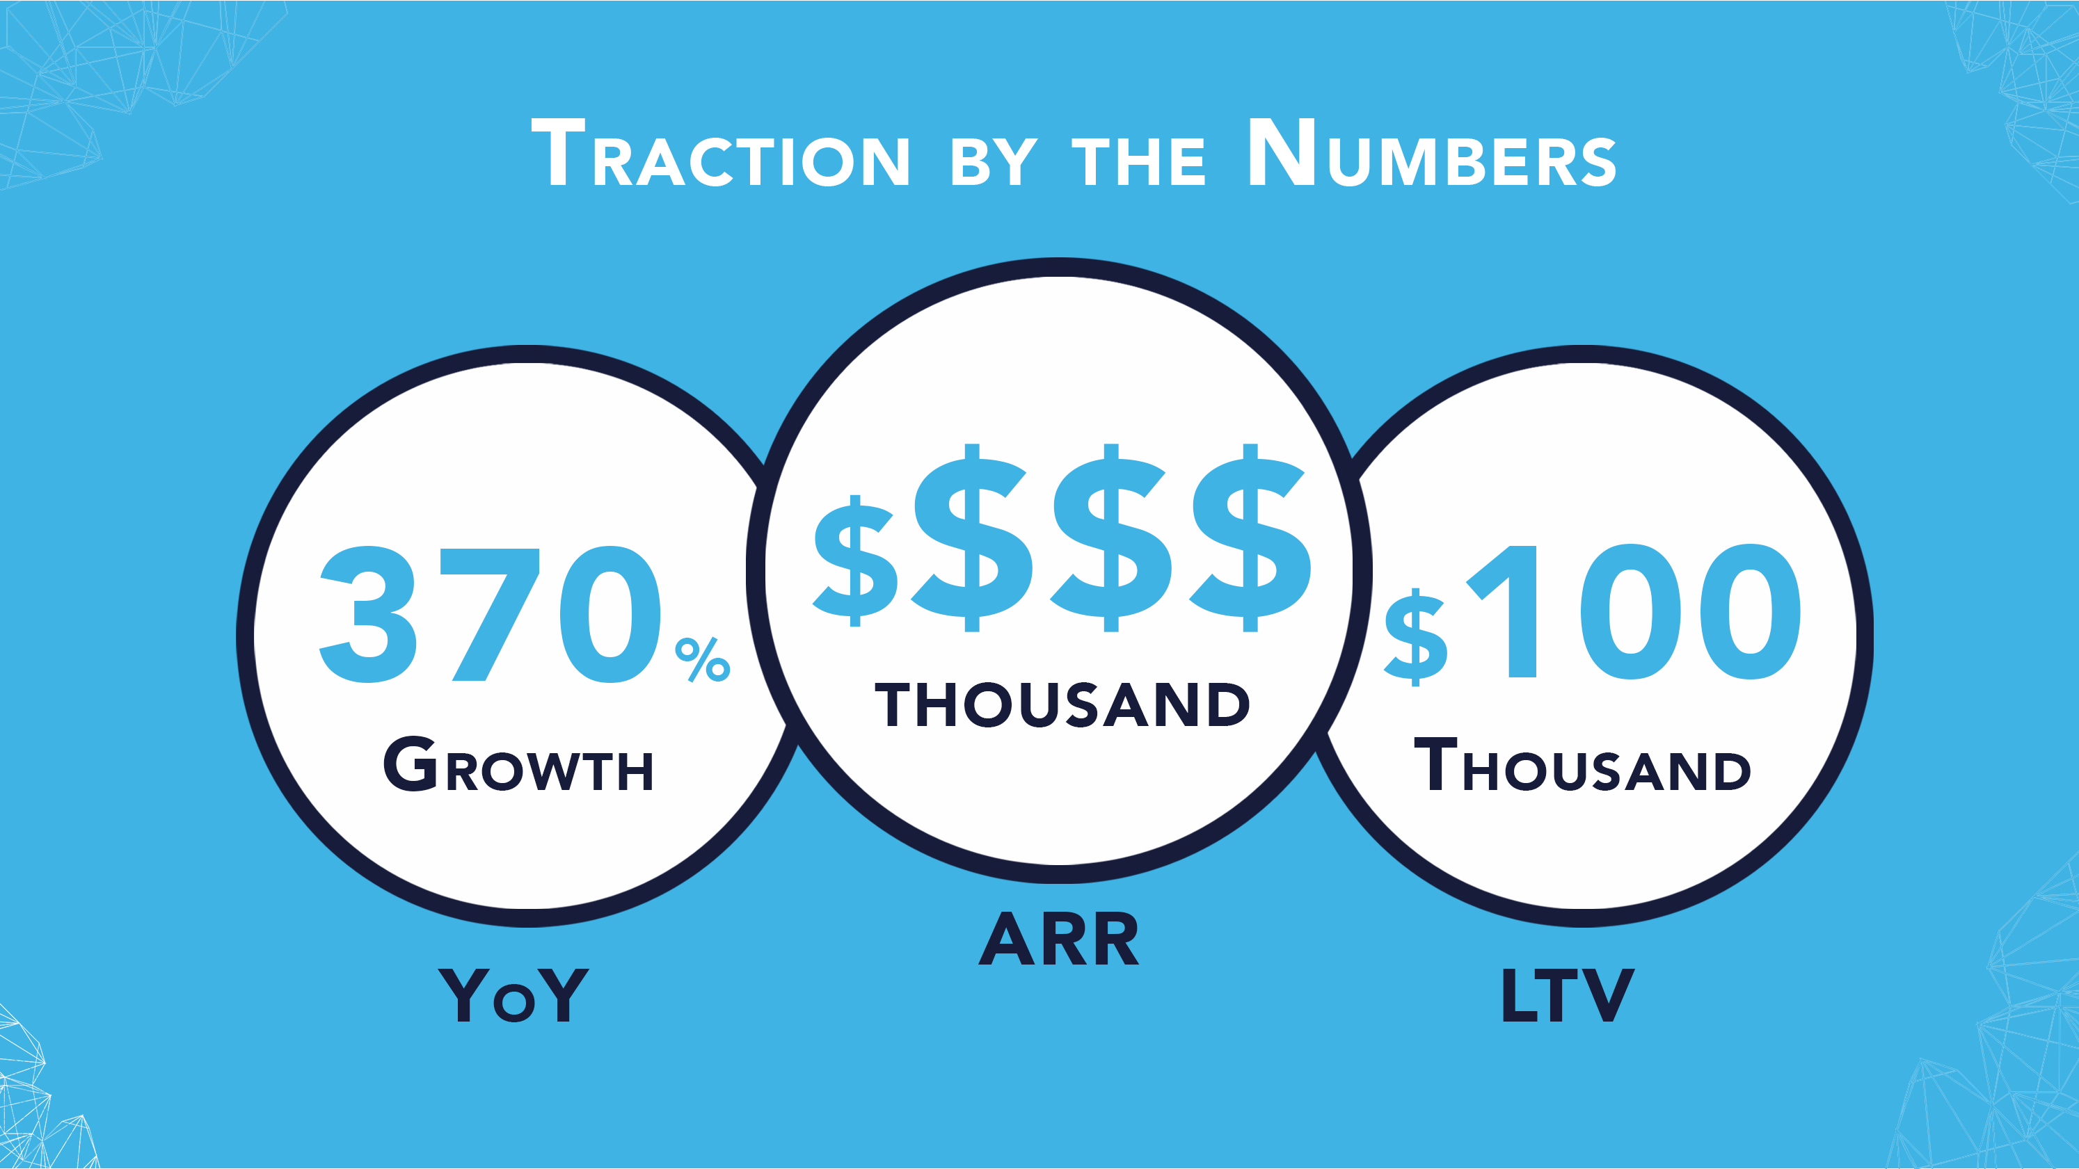

Slide 13
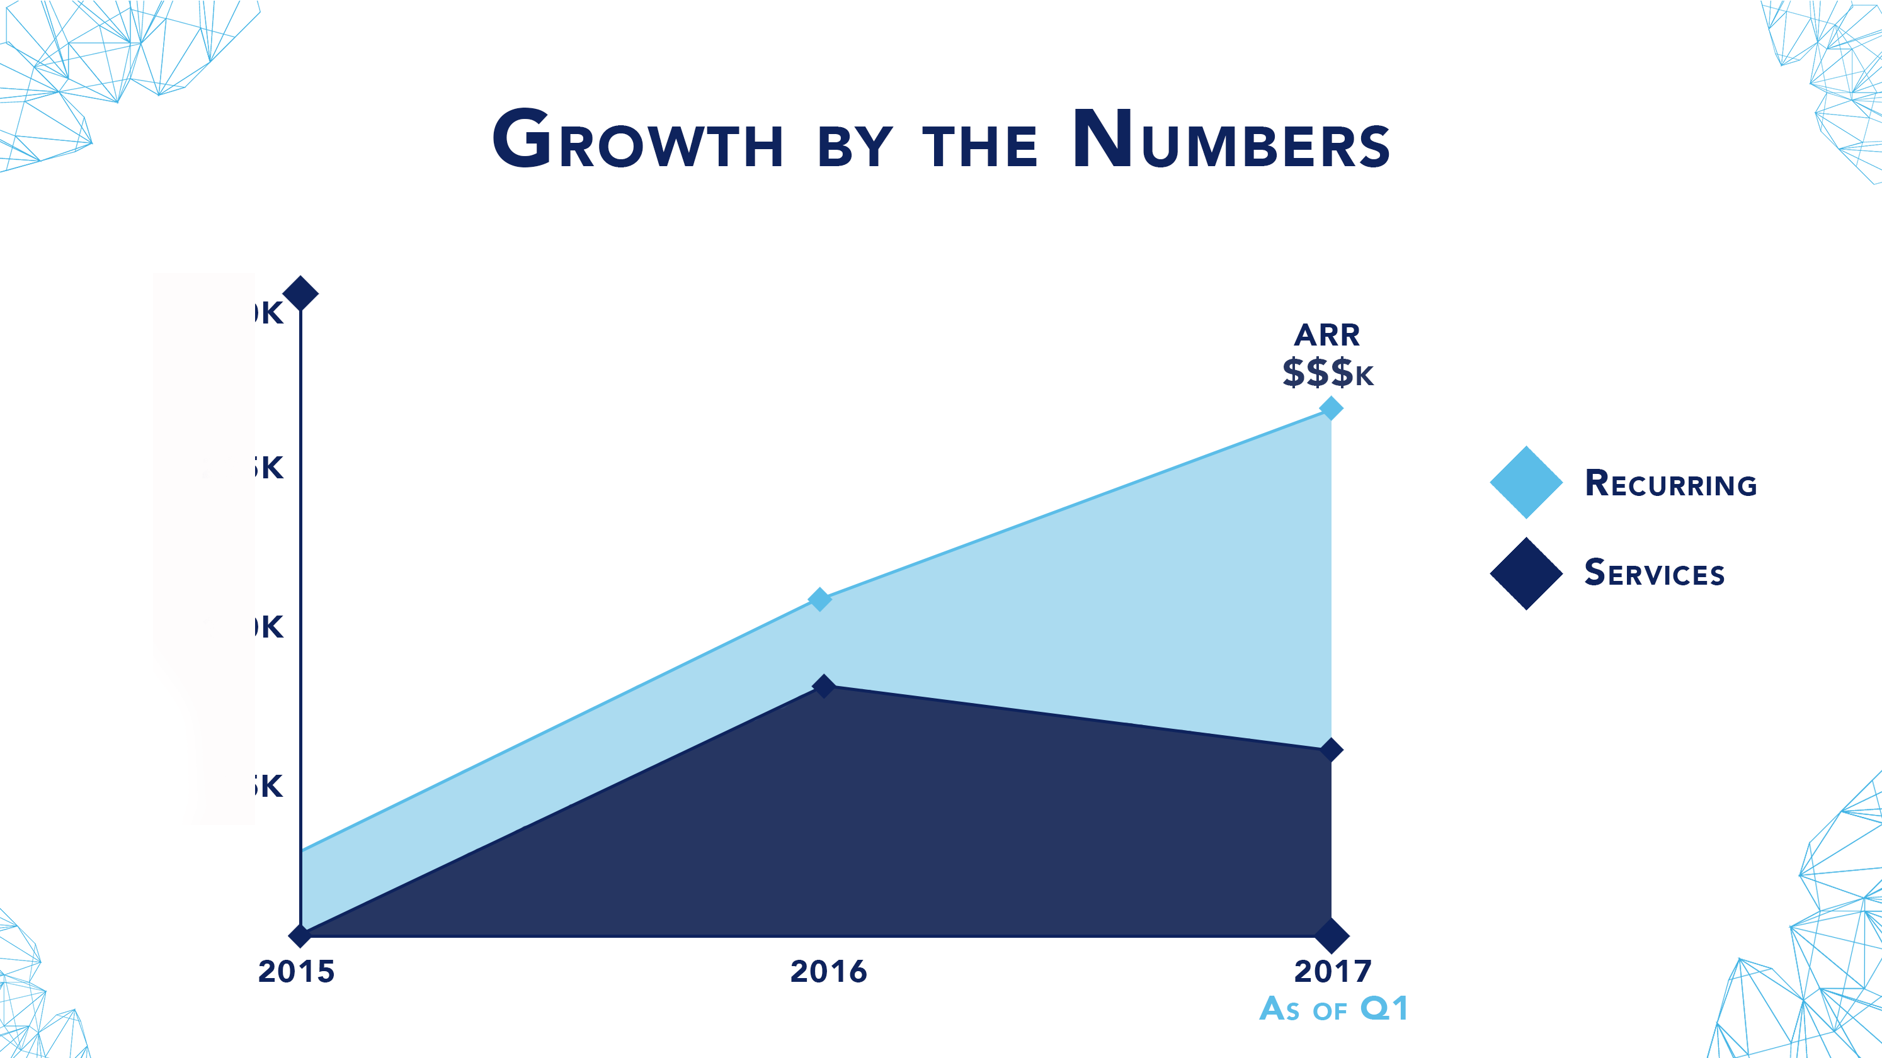

Slide 14

Business Model
Software as a Service
Pricing based on a tier model
Example
Tier 1: 1-15 Users
Tier 2: 15-30 Users
This document is proprietary and confidential. No part of this document may be disclosed in any manner to a third party without the prior written consent of Raxar Technology Corporation

Slide 15
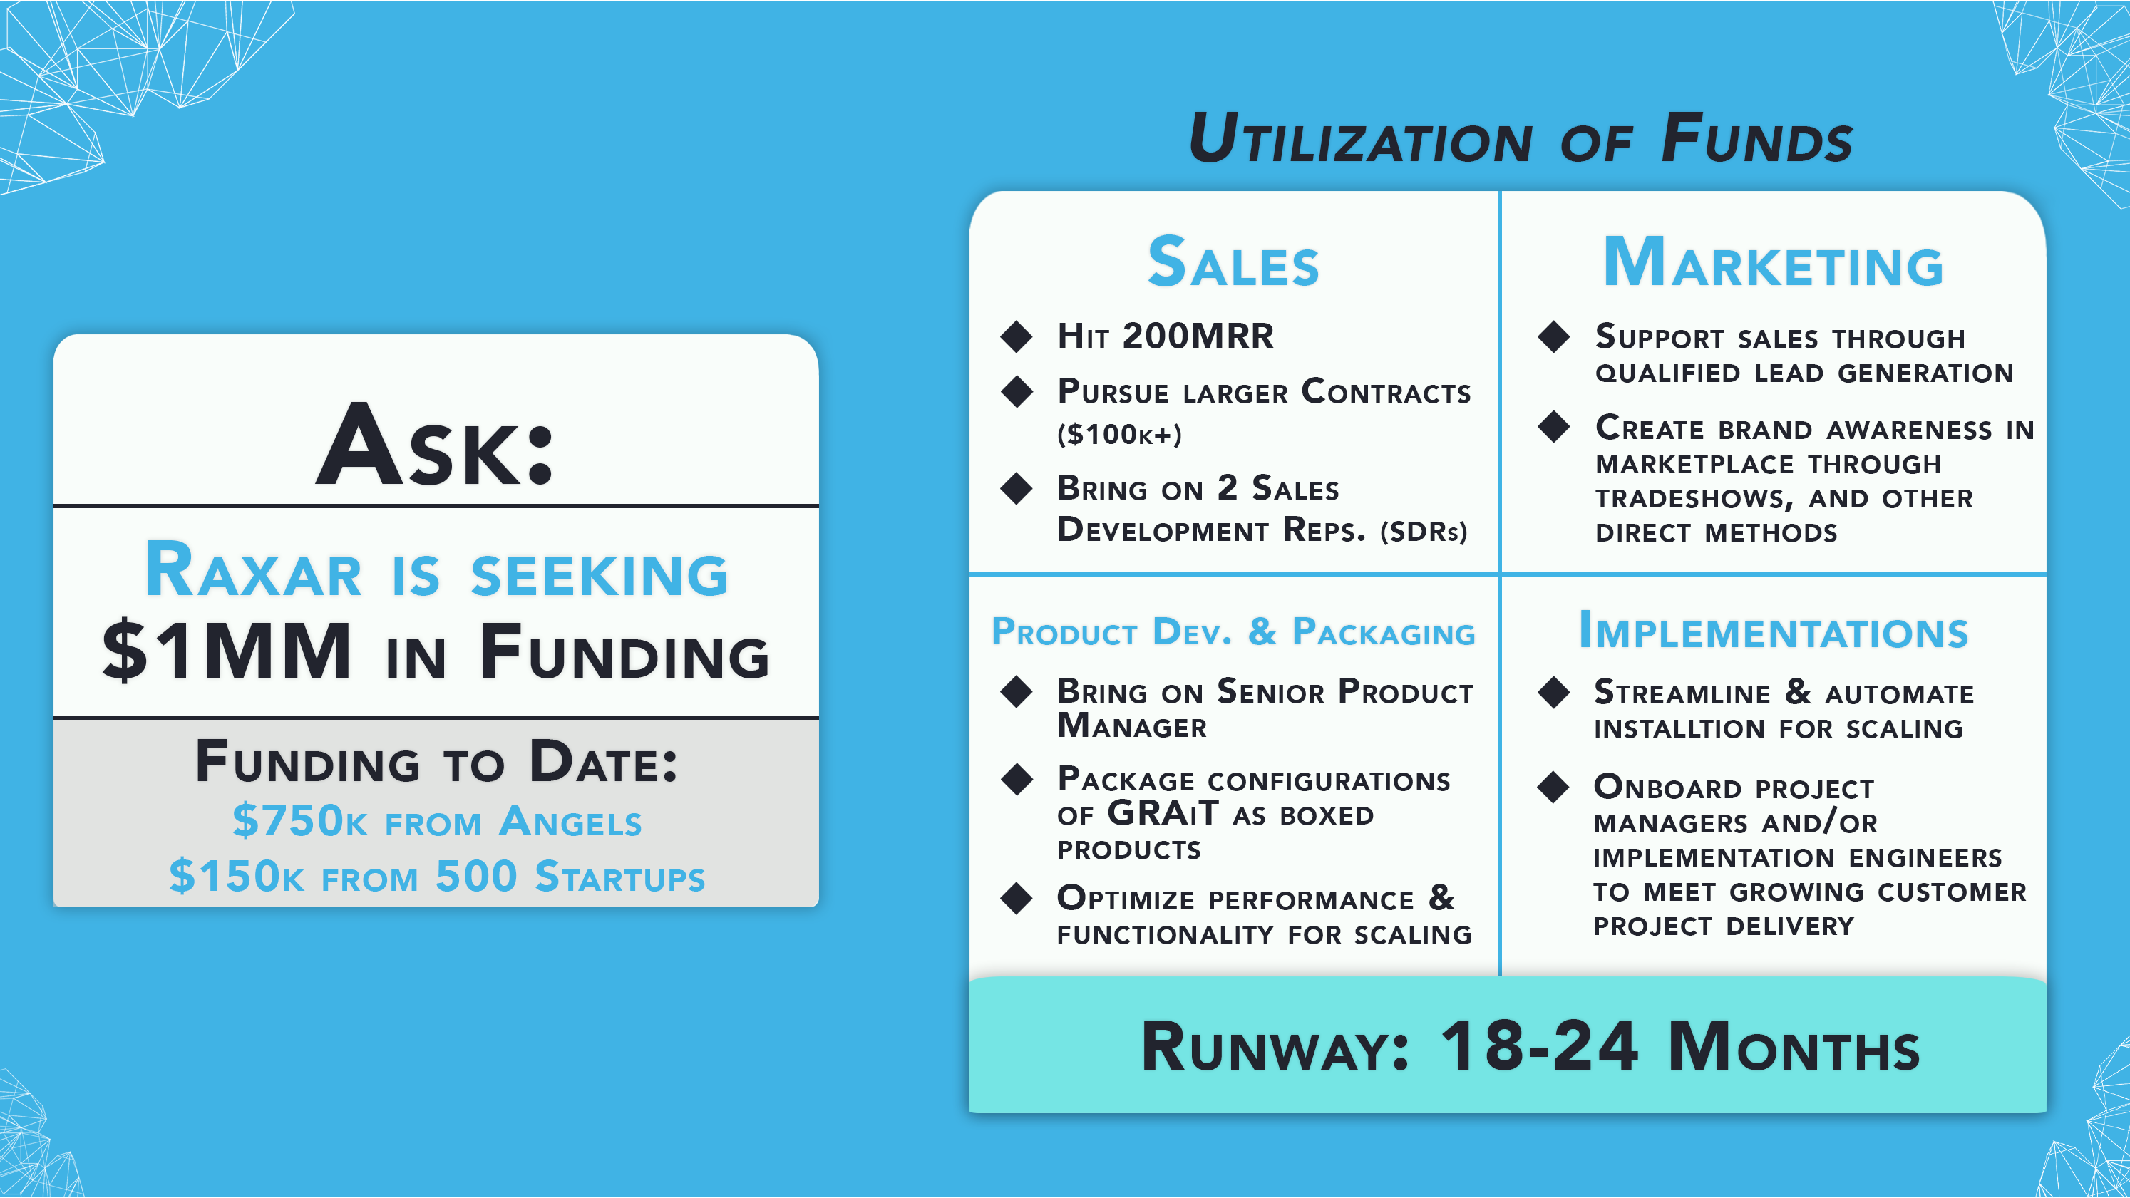
Ask/Use of Funds
Use of Funds:
Marketing
Content Marketing Campaign Deployment
PR Firm to Build Brand Awareness
Sales
Bring on 1 Senior Sales Executive
Bring on 2 Mid-Level Sales Associated
Product Development & Packaging
Bring on Senior Product Manager
Package configurations of GRAiT as boxed product
Implementations
Streamline and Automate installation for scaling
Request:
Raxar is seeking $3MM for 30% stake in the company.
Tranche Approach:
$1.5MM to reach:
$2MM in Annual Recurring Revenue
$1.5MM to Accelerate Growth to $5MM Recurring Annual Revenue
This document is proprietary and confidential. No part of this document may be disclosed in any manner to a third party without the prior written consent of Raxar Technology Corporation

Slide 17
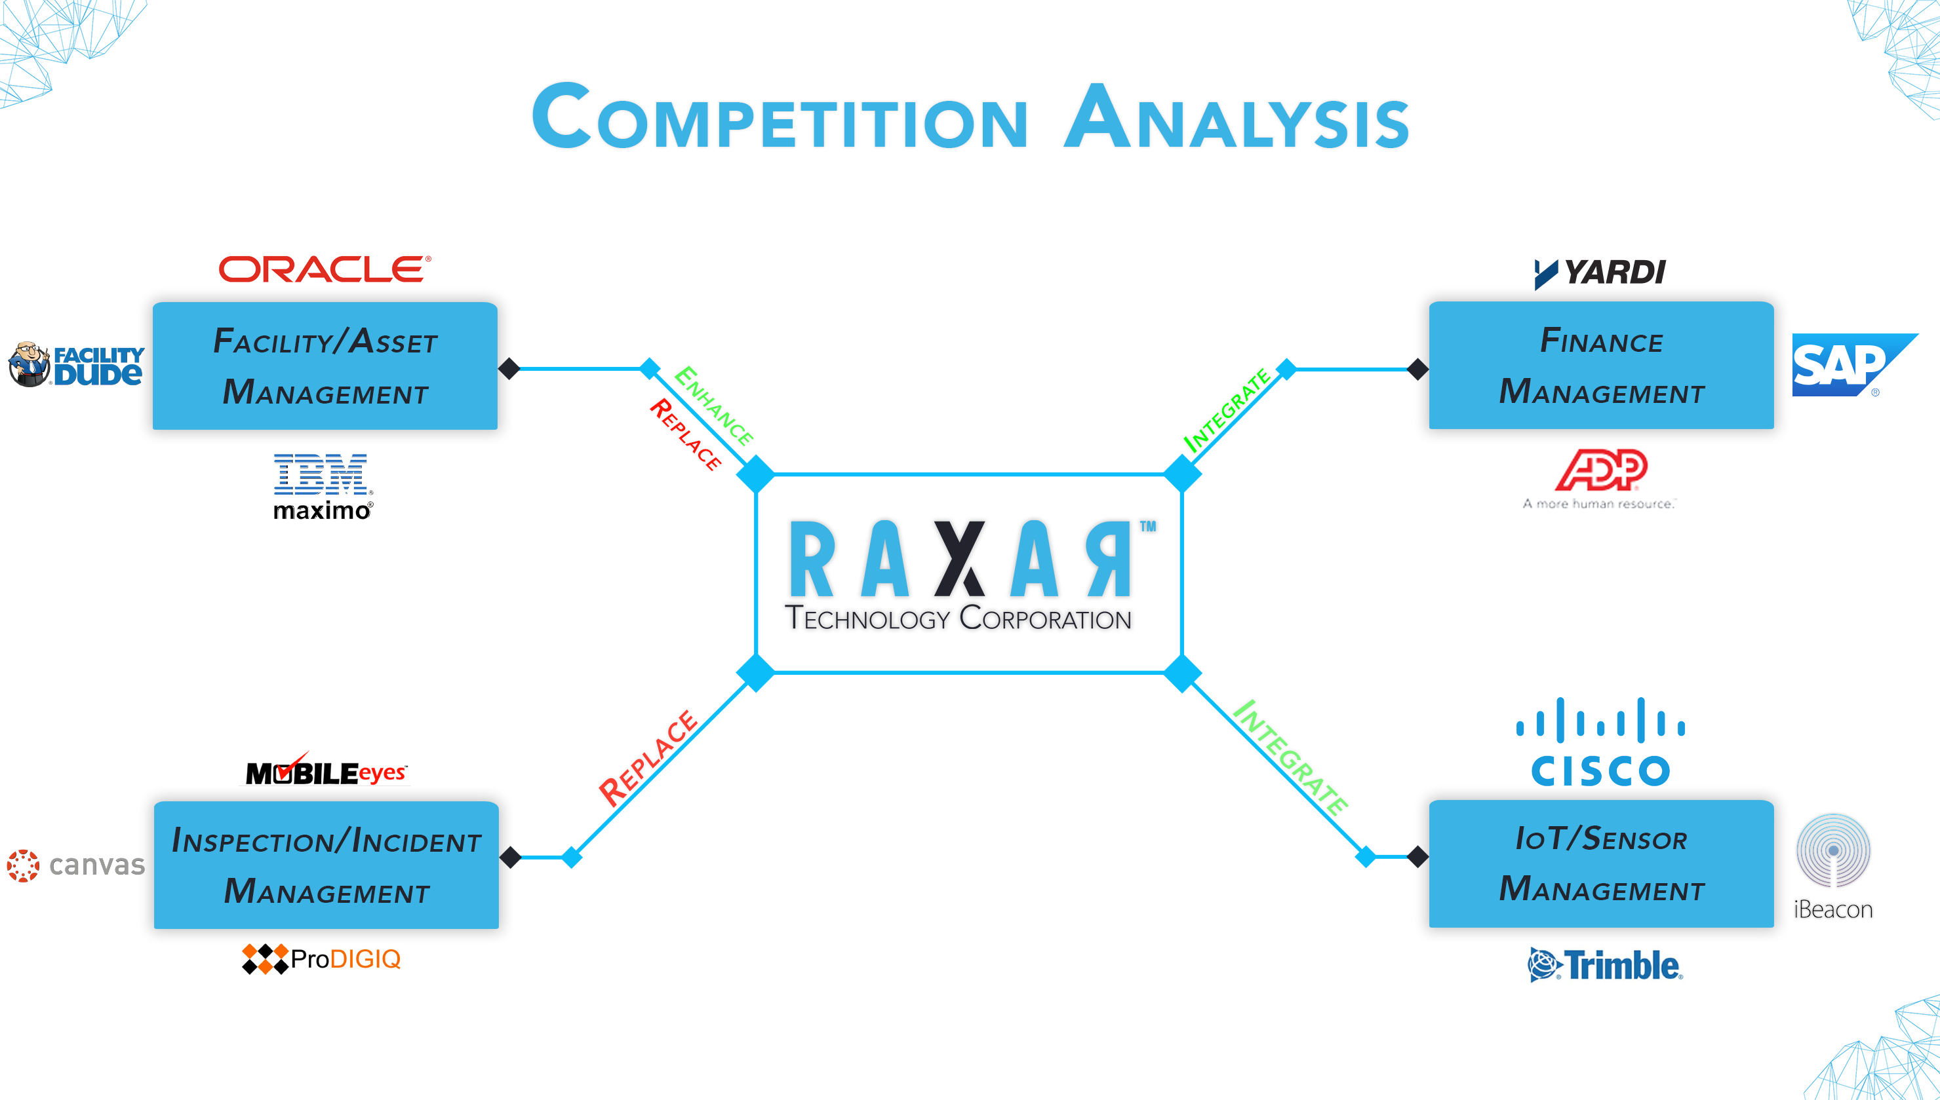










Competition-Two Key Perspectives (Perspective Two)
Customer Need
Facility Management
Finance
Replace
Integrate/Replace
Construction/Sensor
Management
Compliance/Incident
Management
This document is proprietary and confidential. No part of this document may be disclosed in any manner to a third party without the prior written consent of Raxar Technology Corporation

Slide 18
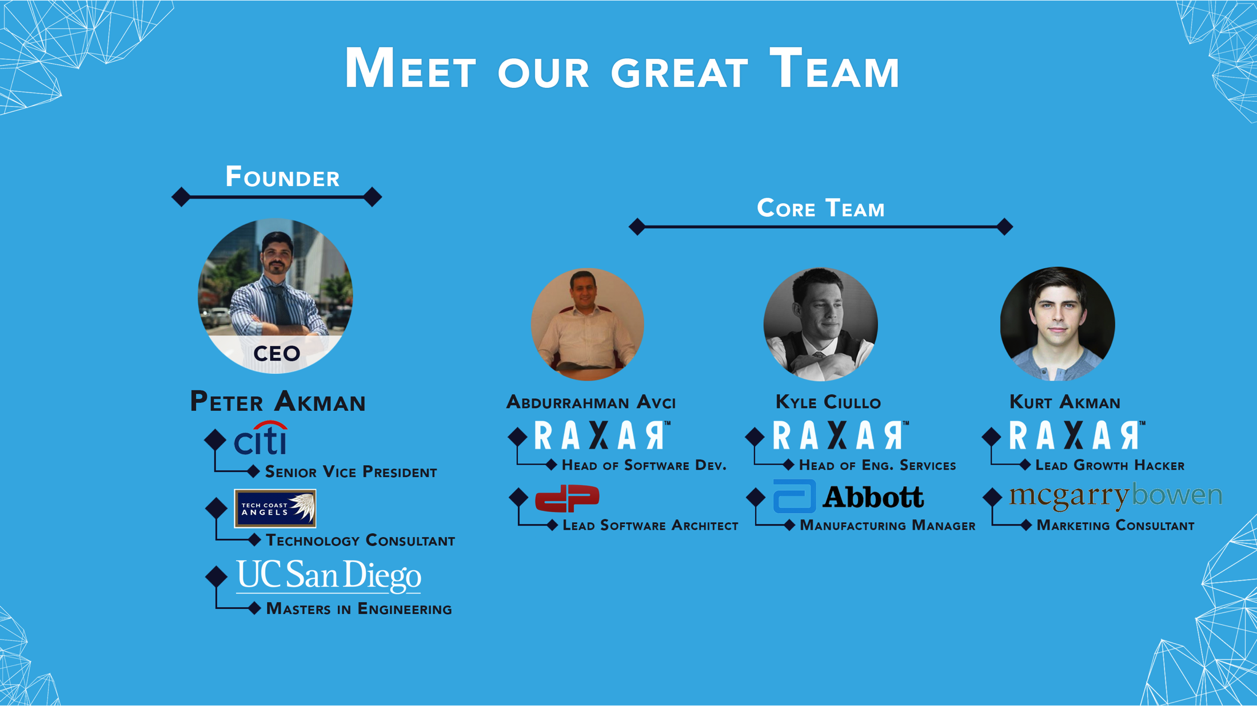
Team
This document is proprietary and confidential. No part of this document may be disclosed in any manner to a third party without the prior written consent of Raxar Technology Corporation

Slide 19
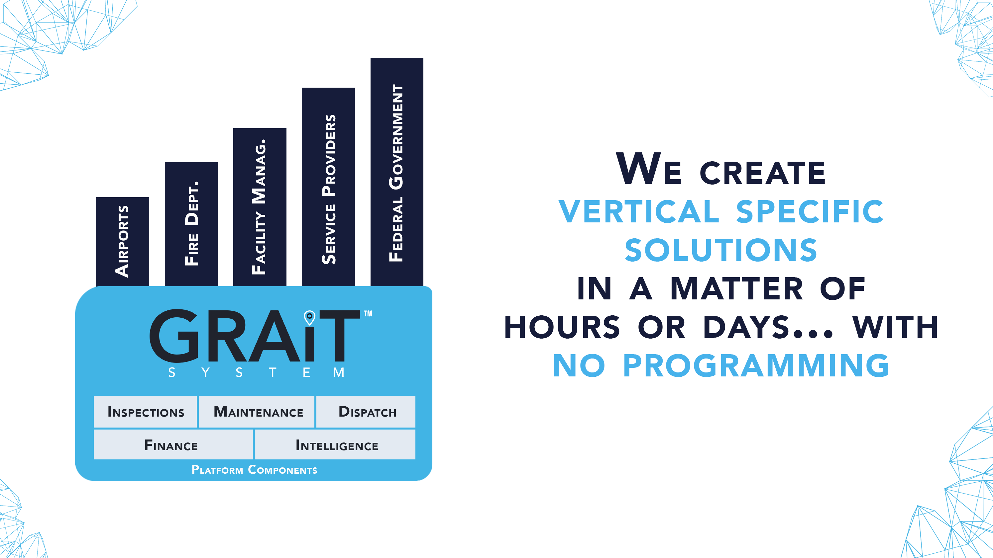

Slide 20
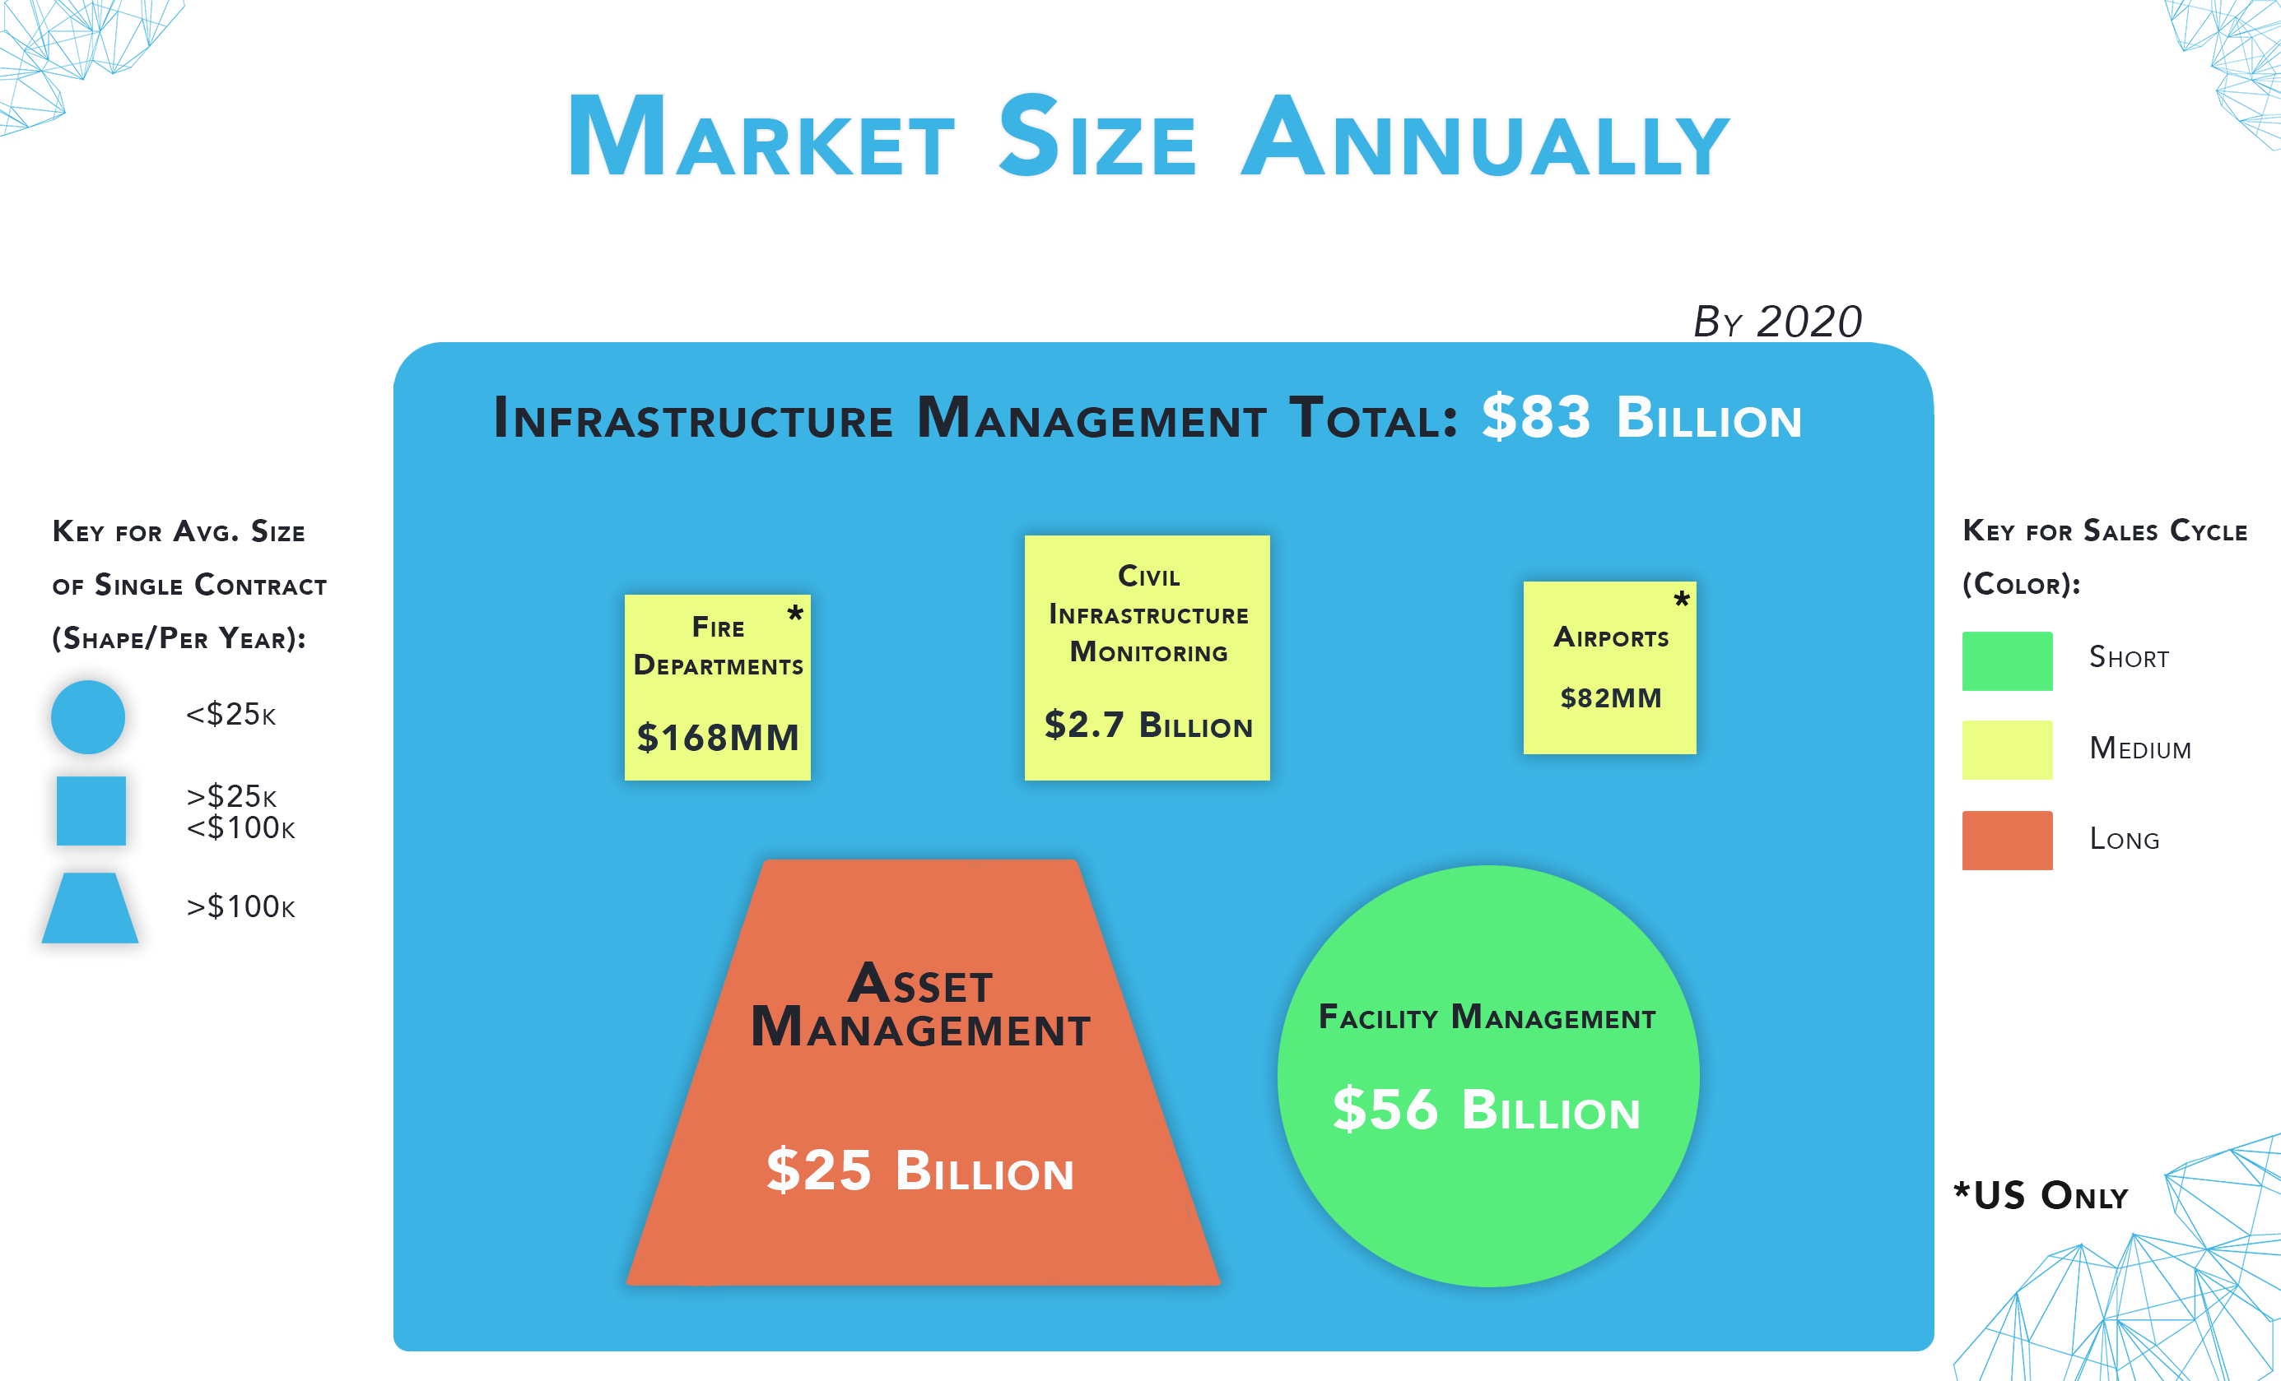
Market Size: Bottom Up
Civil
Infrastructure
Monitoring
By 2020
Infrastructure
Management Total: ~$212 Billion/Year
Key for Avg. Size of Single Contract (Shape/Per Year):
Airports
$2.7 Billion Annually
$19MM Annually
Key for Sales Cycle (Color):
<$25k
Short
Fire
Departments
Medium
>$25/<$100K
Other
(Hospitals,
DoTs, A&E Firms, DOD, Schools)
Facility Management
$543MM Annually
Long
$56.6 Billion
Annually
>$100K
$153 Billion Annually
This document is proprietary and confidential. No part of this document may be disclosed in any manner to a third party without the prior written consent of Raxar Technology Corporation

Slide 21

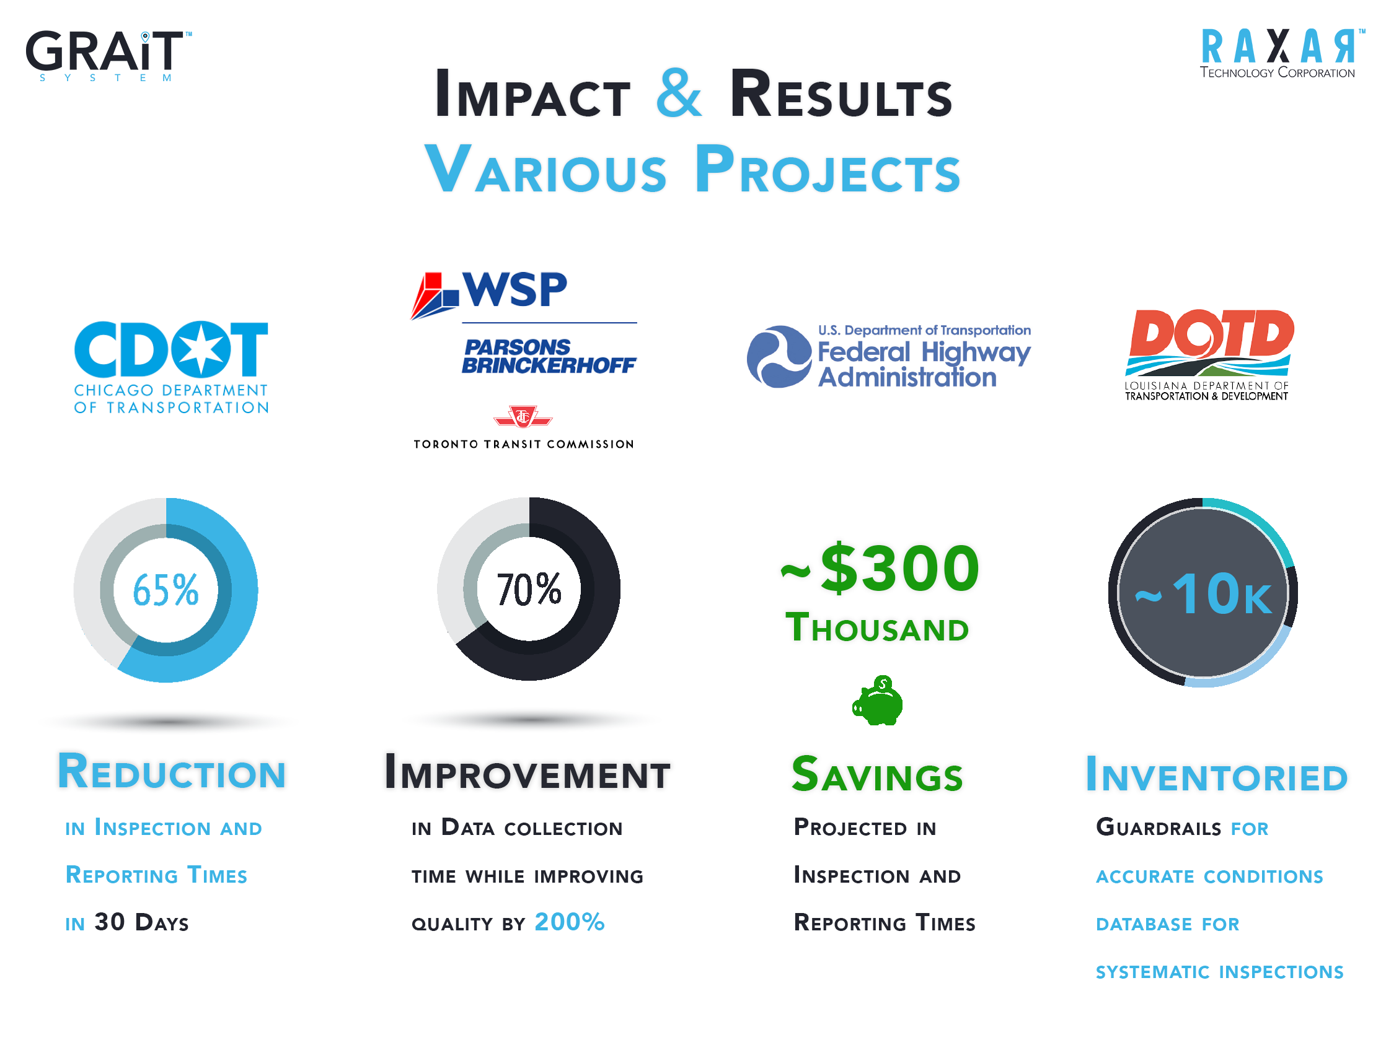
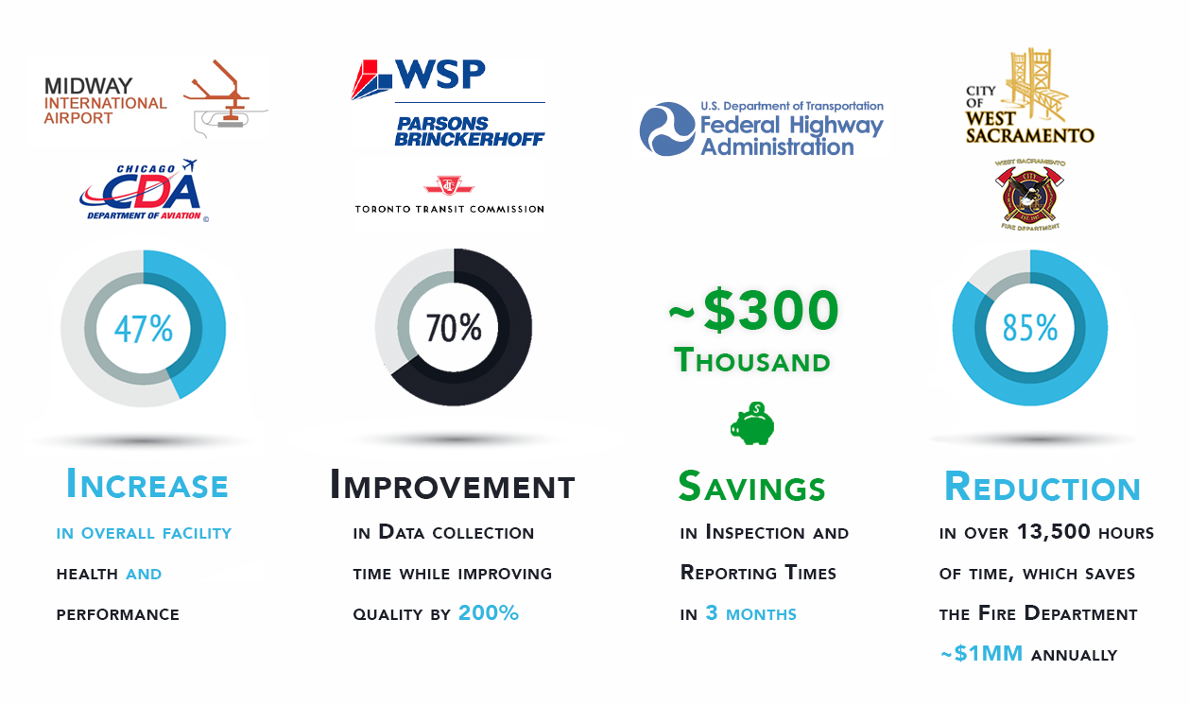

Impact & Results: City
Sample Project Results
85% reduction in average pre-plan completion time: 16 to 2.5 hours
16x1000= 16000
2.5 x 1000=2,500
13500 hours saved
Save 4.5 Firefighters a year of work with no days offf
Save over 10,000 hours of inspection time for remaining ISO facilities
5x opportunity improvement for ISO audit score
Fully Automate the ISO Audit Reports saving days of preparations and consolidation time
Proposed plan to complete pre-plans for ALL qualified facilities within 1 year
94% reduction in pre-plan completion frequency (1 preplan / inspector / month)
This document is proprietary and confidential. No part of this document may be disclosed in any manner to a third party without the prior written consent of Raxar Technology Corporation

Slide 22

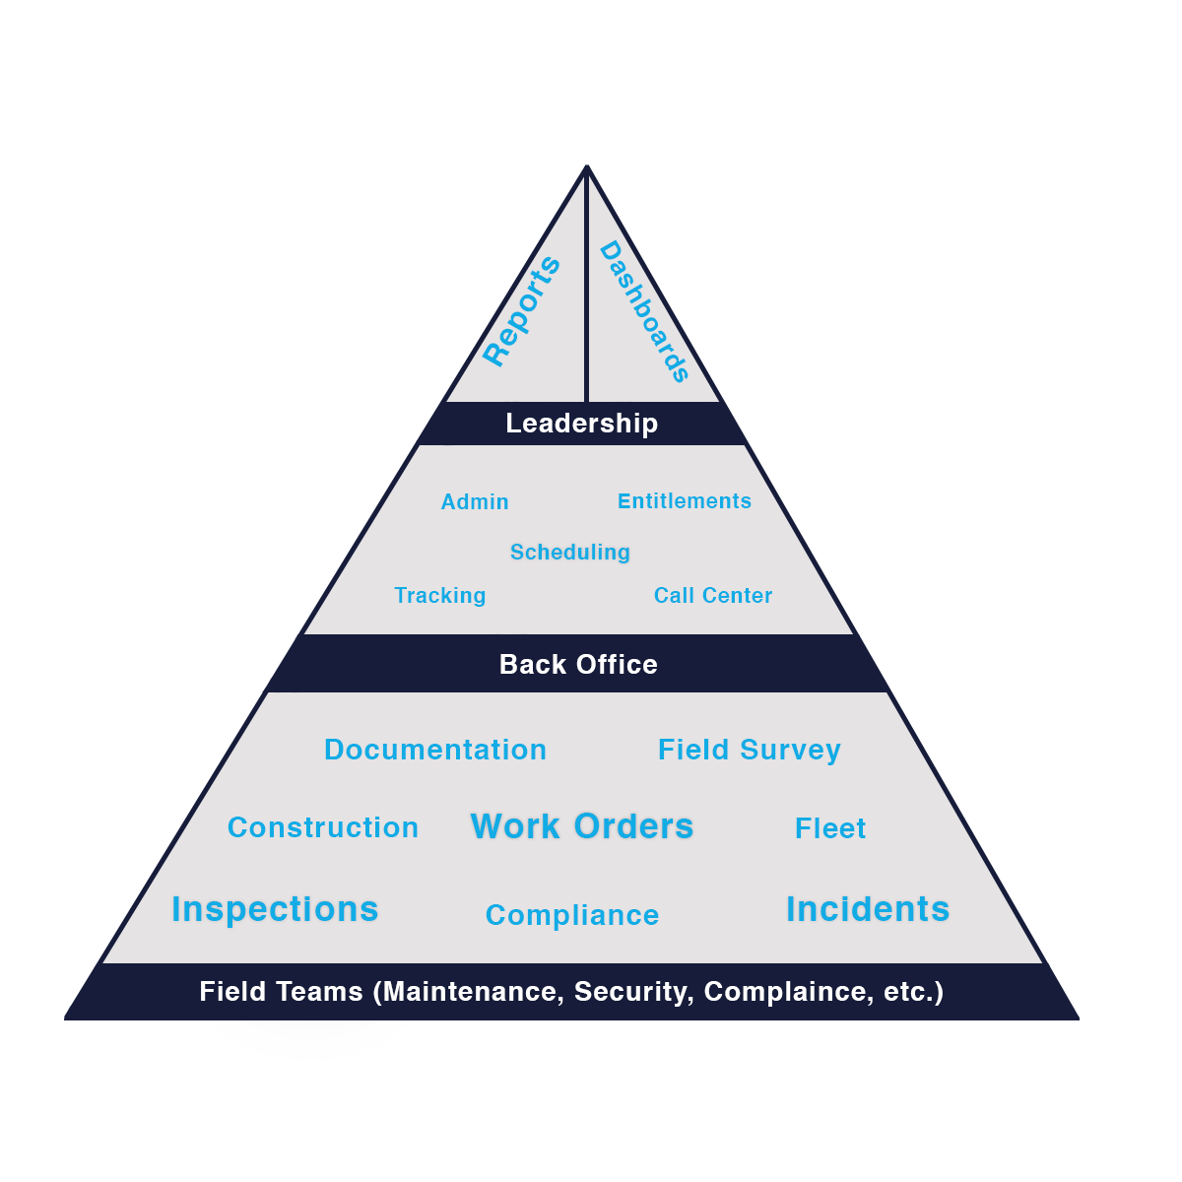



Organizational Structure Overview
One Platform for
All Your Teams
Business
Intelligence
Administrative
Console
Mobile Application

Slide 23
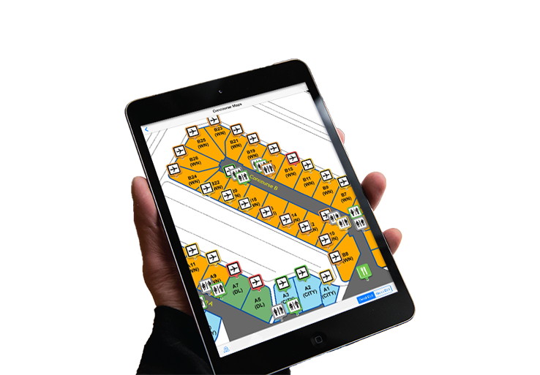
Technology Overview
Mobile Data Connectivity between Departments and Assets
All Areas Available for Utilization:
1. Inspections - Facility, Field, Equipment, Airfield, Security Perimeter, Fire Safety, Survey
2. Maintenance - Work Orders, PM's, Spot Maintenance,
Legacy System Interface
3. Asset Management – Indoor (Hangars, Terminals, Offices), Outdoor (Airfield, Parking) and Connected (IoT) Assets
4. Service Dispatch System
5. Compliance - Accessibility, Fire and Life Safety, more
6. Incident/Issue Management - Aircraft Rescue and Fire Fighting, Security, Injury, Incident, Hazmat, Construction
7. Business Intelligence – Reporting and Dashboarding
8. Document Management - Warranty, Training, Certificates, Manuals)
9. Equipment and Fleet Tracking
10. Image Management System
11. Asset Tracking – GPS, iBeacon, RFID, Ultra Wide Band
12. Field Survey Management – Field data collection & high precision Measurements

Slide 24
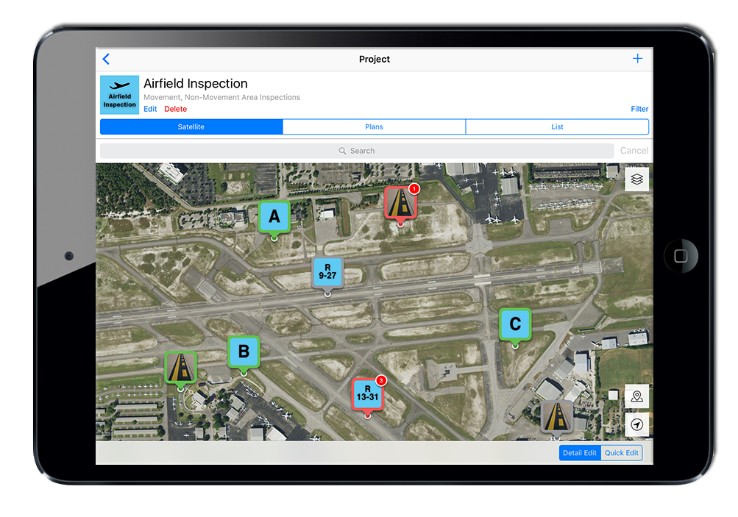
Technology Overview
GIS Management in GRAiT System
- Airport Example -
Purpose Driven Interface
Information delivered dependent upon:
Users role within the organization
Users specific location
Users current task
Specific Asset Information

Slide 25
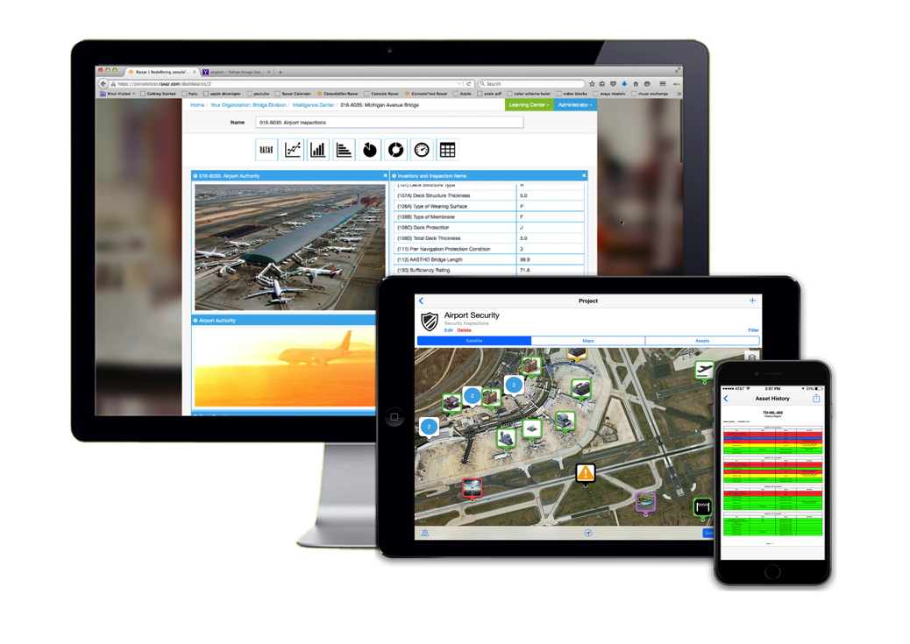
Technology Overview
Easily locate and identify assets
Assets are easily identified by:
GPS
Digital floor plans, blue prints, CAD files
GPS, Barcodes, QR Codes, RFID, iBeacons
Assign, track and visualize the exact location of assets, incidents, photos, etc.
Sensor Integration
Plan-Set and CAD Asset Overlay

Slide 26
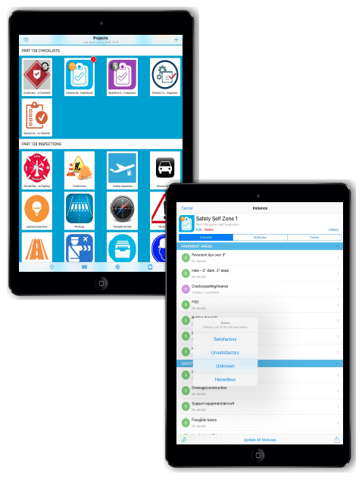
Technology Overview
Configurable Mobile Application, Work Orders, Checklists, Reports, Dashboards and more
NO PROGRAMMING Required
Department and Role Specific
Gather rich data out in the field
No more paper inspections
Include pictures, voice to text notes, risk ratings, work orders, etc.
Full Online/Offline Mobile Application
No more lost connections when in the Field!
Integrated communication tools
E-mail, mobile devices, interactive checklists, etc.
Mobile
Inspections
And Work Order
Management

Slide 27
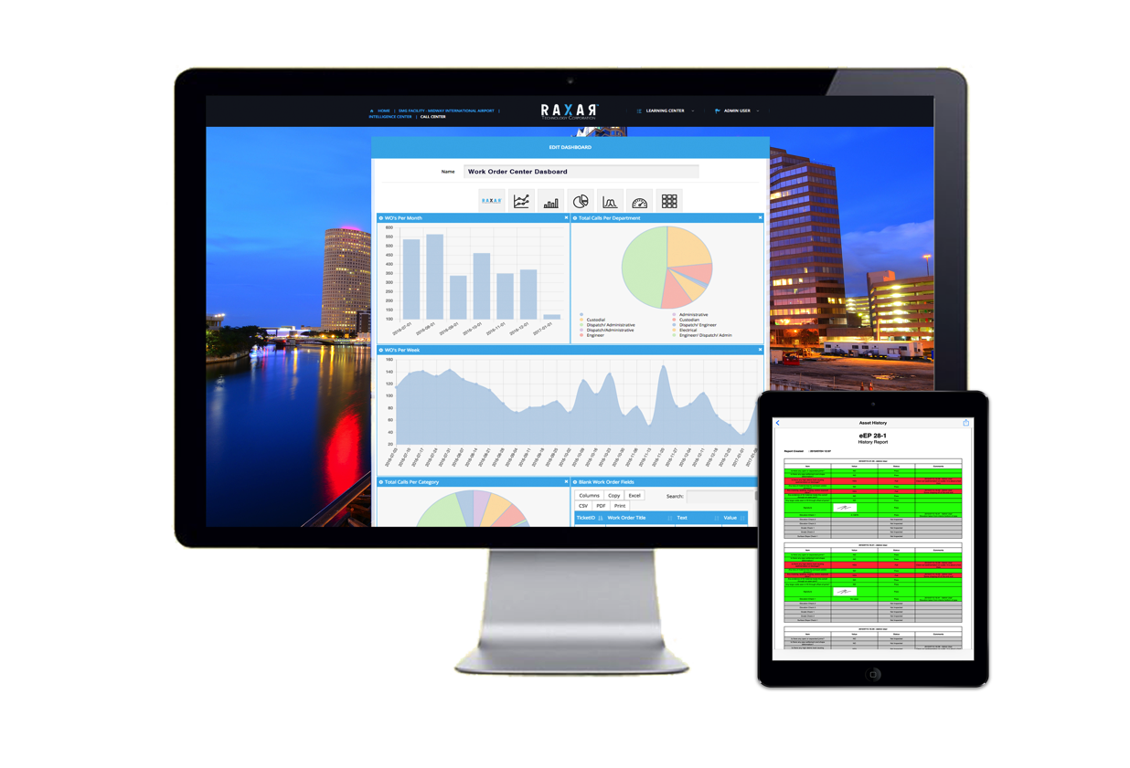
Technology Overview
Live Dashboards and Robust
Reporting Engine
Powerful, Real-Time Reporting and Dashboards
Field Information and Work Orders automatically pushed into highly organized reports
Customize reports for any part of your organization in many formats
E-mail history reports directly from the field

