Slide 1
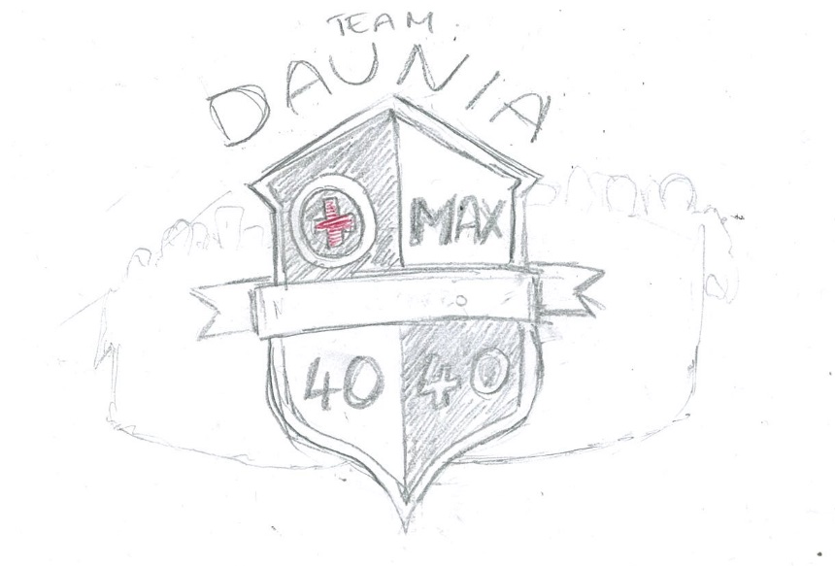
A zero with a red cross inside of it – this represents zero injuries
Silhouettes of people behind the shield
Max for maximum production
Banner – we want to be able to put a different mottos here each qtr or year
40 for 40% minimum female workforce
40 for $40 production cost
We decided on a crest as we’re really trying to have a logo that represents a close team – hence the ‘family crest’

Slide 2
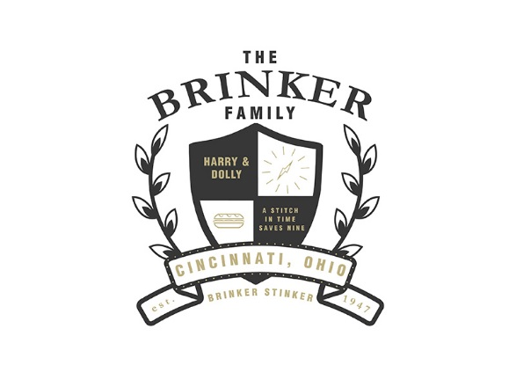

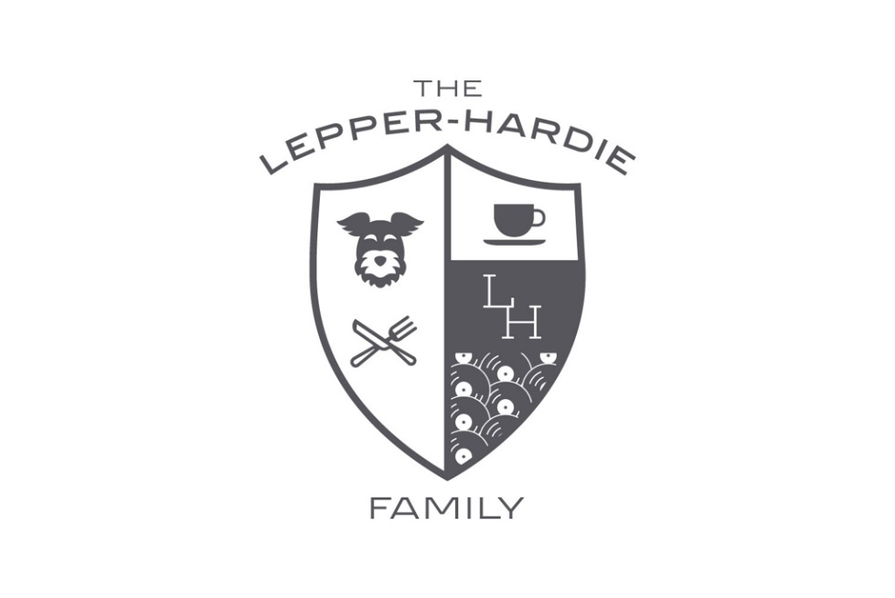
Examples
We’d like to keep it pretty clean as ultimately we’d really like to print this logo on to some shirts and baseball caps.
I’m also more fond of the charcoal colour in the Brinker example in the top left than straight black.

