Slide 1

About Agilis
Agilis Investment Management was founded in 2016 with a clear vision to create an independent and nimble firm focused on generating superior risk-adjusted returns.
Agilis has designed an innovative investment approach which aims to harness the best elements of alternative investment management whilst reducing its recognised shortcomings. We are a performance and client focused firm, committed to building lasting relationships, treating our clients like partners rather than revenue streams.
Our Approach
and Philosophy
Contact Us

Slide 2
About Agilis
Philosophy: Agilis’ philosophy is based on the understanding that financial markets tend to mean revert and that valuations and fundamentals matter. Agilis strives to construct a resilient portfolio diversified across asset classes, strategies and time horizons to achieve our target return objective. Freedom of idea expression enables us to react nimbly to market dislocations.
Approach: Agilis combines asset allocation, macro trading, hedging and fund selection capabilities in an actively risk-managed portfolio. This model provides increased control, flexibility and liquidity while lowering the overall fee burden. Our risk posture and asset allocation are synchronised with our cycle and valuation frameworks. Bottom-up ideas are consistent with these top-down views. We look to protect against steep drawdowns in times of market stress, so that we are in a position to invest when risk premia and margins of safety are high.
Our Approach
and Philosophy
Contact Us

Slide 3
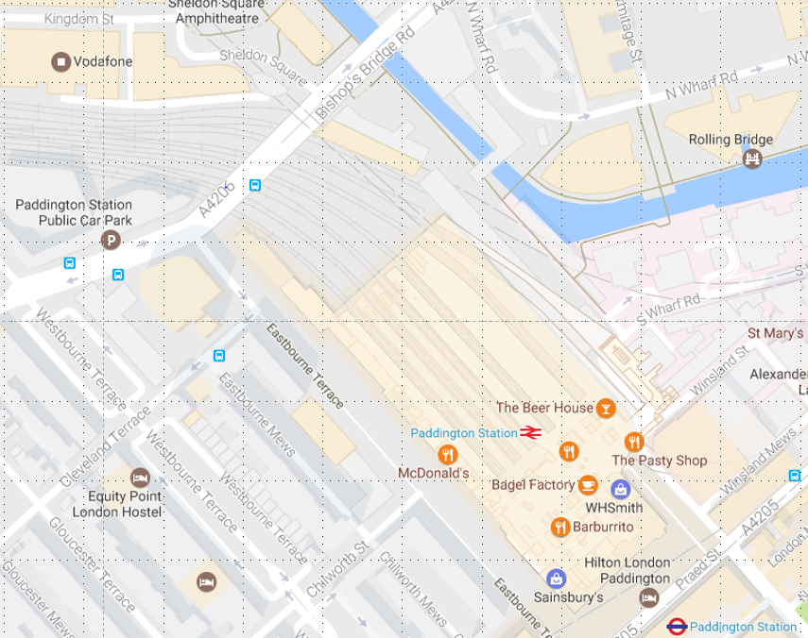
About Agilis
Agilis
20 Eastbourne Terrace
London W2 6LG
United Kingdom
T: +44 20 3859 0462
E: clientservices@agilisim.com
Our Approach
and Philosophy
Contact Us
Agilis
20 Eastbourne Terrace

Slide 4
Colour Guide
Main palette
Secondary palette
Fonts & Text
RGB: 0, 47, 99
CMYK: 100, 53, 0, 61
3155C
RGB: 0, 98, 114
CMYK: 100, 9, 29, 47
Logo Font: Lato
Text Font: Source Sans Pro
293C
RGB: 0, 61, 165
CMYK: 100, 69, 0, 4
Logo colour and font colour for some titles
RGB: 0, 47, 99
CMYK: 100, 53, 0, 61
209C
RGB: 111, 38, 61
CMYK: 20, 97, 40, 58
292C
RGB: 105, 179, 231
CMYK: 59, 11, 0, 0
536C
RGB: 162, 178, 200
CMYK: 34, 17, 2, 7
Font colour for main text
532C
RGB: 28, 31, 42
CMYK: 88, 76, 30, 82
532C
RGB: 28, 31, 42
CMYK: 88, 76, 30, 82
Font colour for footnotes
RGB: 90, 90, 90
CMYK: 0, 0, 0, 65

