Slide 1

Sale, Manchester , England , United kingdom
WWW.BOX-CLEVER-UK.COM
+44 (0)161 962 2510
Info@box-clever-uk.com

Slide 2
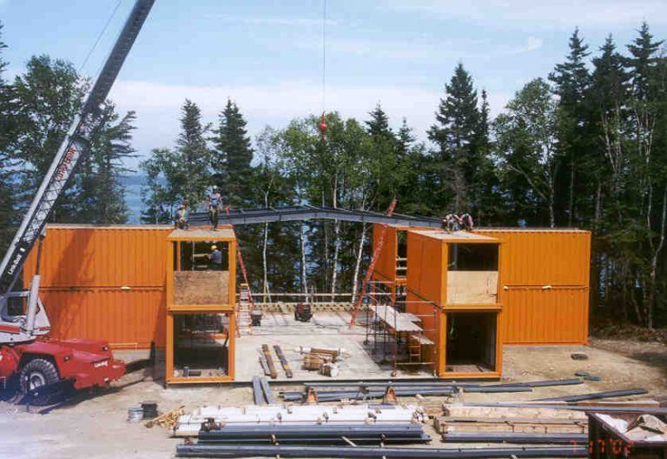
Website Pages
  Home
  About us
    Company Brief
    Our Team
    Why us?
      Sustainability
      Affordability
      Quality
      Structural Stability & Durability
      Design Flexibility
      Ease and Speed of Construction
      Safety
  Box Clever Building Solutions
      Houses
      Housing Extensions
      Vacation Lodges
      Granny Flats
      Portable Offices
      Home/Garden Offices / Studios
      School Classrooms
      Garage/Workshops
      Mobile Kitchens
      Retail units
      F&B Outlets
  Services
    Full Turnkey Solutions
    Design
    Engineering
    Project Management
    Cost and Budget Control
    Maintenance
    Off Grid Solutions
  Finishes
  Projects
    Dubai Box Park
    Design District Dubai
    Dubai Food Festival
  Partners
    Task Developments
    Aire Gulf Contracting
    Kitchens
    Bathrooms
    Tiles
    Flooring
    Lighting
  Contact us
    Map
    Contact page
    Online and address information

Slide 3
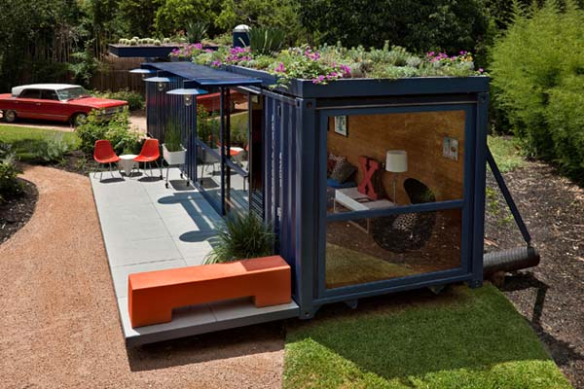
About us
Box-Clever-UK was set up by company owner Mark Lynch in 2015 to provide the UK housing and commercial property markets an alternative building solution to residential and commercial property construction methodology whilst providing better affordability and flexibility to the clients needs and requirements.
Box-Clever-UK takes the concept of using shipping containers as the fundamental modules in home and office space construction. Mark Lynch has had several years of experience working as a Senior Project Manager for large Engineering Consultants operating in Dubai whereby he has been heavily involved in the design and implementation of Dubai Box Park. It was whilst working on this iconic development that the Idea of Box-Clever was formed. Dubai Box Park is a revolutionary retail and Food & Beverage destination in Dubai utilising steel frame and shipping containers to provide a stunning tourist destination. Mark has utilized his experience on such projects along with the design philosophy & design principles to provide an alternative design and build solution to the UK housing and commercial property market.
Box-Clever is not revolutionary in the field of container homes and office spaces as such usages have been around for some time. Here at Box-Clever we look to open up the endless design opportunities available to us using Shipping Containers and really show how beautiful these modular building blocks can be when one uses their real imagination.
Throughout this website we will tell you a little more about ourselves, the services we offer, the endless opportunities and benefits in using Shipping Containers for everyday property construction and what our imagination and hard will give you if you take the exhilarating ride with Box-Clever-Uk in designing and building your container home or office space.
Our Team
Owner and Founder – Mark Lynch, born 1978.
Bsc Civil Eng, PMP, LEED Green Associate.
Mark Lynch is the Owner and Founder of Box-Clever-UK. He has 20 years Construction and design engineering & project management experience since obtaining his engineering degree at Manchester University.
Mark has since December 2006 worked in Dubai for over ten years and during this period was involved in the design and construction of some iconic buildings and developments including Dubai Box Park, Dubai Festival City and the Bvlgari Hotel and Marina Residences.
During this period in Marks career he has carved out a reputation as an Engineer with a wealth of experience in the design and construction of challenging buildings some of which have used shipping containers as a fundamental building component. It was in Dubai that Mark started to take a serious interest in sustainability within design after taking the LEED associate certification. Mark is a firm believer that all future design and construction should embrace green building techniques when constructing buildings for future generations.
Mark firmly believes that what looks simple and plain as a shipping container can be turned into something beautiful, iconic and aesthetically pleasing when you leave your imagination to it. There are no limitations as to how beautiful shipping container homes can be. The imaginative design options available are endless.
Mark loves his work and when asked about what he likes about his Job the most he replied, ”when designing buildings using containers its basically Lego for grown ups. Its such great fun and satisfying to see them evolve into something so beautiful from something s simple and plain.

Slide 4
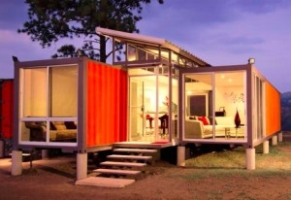
Why Us
Here at Box-Clever-UK we provide an experienced team that delivers a personalized service to your requirements with a real passion and enthusiasm for the work we do.
We believe that we can offer the most competitive prices in the market for all of our services whether this be for a conceptual design or a full turnkey design and build solution. We want to be your preferred partner throughout your container build project journey.
So what are you waiting for? Be Different, be Unique, be Green, be smart and Box Clever with us today.
Contact us on 00971507168579
Why use shipping Container Architecture for your home or office.
SUSTAINABILITY
Eight feet wide by 8.5 feet high, and either 20 or 40 feet long, the steel shipping container has been the globally standardized transportation module since 1956. Today, there are roughly 36 million shipping containers in the world of which only 26% are being used. The rest remain an idle abundance of construction building blocks
Containers are extremely eco-friendly, as they can be re-purposed into homes instead of being melted down. A large amount of cargo containers are discarded in ports across the globe because of one way shipments. Reusing a single 40' container upcycles about 3500kg of steel and saves about 8000 kWh that would otherwise be needed to melt it down. Repurposing it only uses about 400 kWh. Using containers also prevents the use of bricks and cement. The cement industry is one of the biggest producers of CO2 and bricks essentially make the natural materials they are made of, inert.
AFFORDABILITY
The biggest incentive and advantage for all those thinking about shipping container houses is that they are quite cheap. Getting a used shipping container and converting it into a home is far less expensive than getting a home in the cheapest place of the city. And you might not even find what you are looking for. But with shipping container houses, all you need to do is to look for one and you shall have one. They are in abundance and therefore as a result extremely well priced to buy all over the world.
Shipping containers typically cost only 1500-2000 pounds depending on their size. They're are already the perfect shape to be repurposed into homes, so a home built out of them is a minimum of 30% cheaper than a same sized home built in brick and mortar. The structural work is also minimal, reducing the cost further. This can be put to very good use.

Slide 5
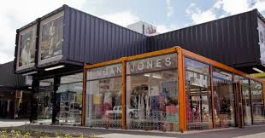
STRUCTURAL STABILITY
Containers are also “virtually indestructible”. Shipping containers are designed to bear heavy loads, withstand harsh climatic conditions, as well as rough seas and can also easily be stacked one on top of the other to create multi-story homes. Their structural stability makes such homes earthquake and hurricane proof, which makes them extremely safe for natural disaster-prone areas.
EASE & SPEED OF CONSTRUCTION
Building a housing structure out of a shipping container takes roughly 2-3 weeks in comparison to brick and mortar structure which takes around 4-6 months to make. Most structures can be assembled within a day or so, if all the pieces have been cut off site which is in equivalence to prefabricated structures.
OFF SITE QUALITY BUILD
Container homes can be built off site and then delivered to your land ready to move in to. Sometimes a plot of land isn’t suitable to build on. In this case, one can get the shipping container home made at a local workshop and then the finished product can be delivered to the plot of land. This save the Client time and money through loss of work on site due to adverse weather conditions or site conditions. The factory build environment reduces build time losses whilst maintaining better control over the quality of workmanship.
DESIGN FLEXABILITY
We at Box-Clever-Uk believe the biggest benefit of a shipping container home design is that you can absolutely make sure that it is the exact thing you need. In using our architectural and interior design team our homes and office spaces are designed so that if you choose, you can make it reflect exactly who you are and stand out from the crowd. But for those who want to get down to it right to the core, there is no stopping their imagination. With container ship homes, you can get exactly the kind of home you have in mind. All you need is a container ship design concept to discuss with us and we can help you end up with a home that’s exactly what you had in mind.
A container home design is sure to get you noticed. Whatever may seem like the best benefit for this architectural redemption, the fact remains that benefits of a shipping container home design are far too many to ignore.
Shipping containers are unique and are not very common in the UK, however elsewhere around the world they are becoming a very viable and trendy source of construction for small and large homes. Set Yourself apart from the norm and be adventurous, it cannot get better than this.
SAFETY
A major problem with remote and rural infrastructure is the risk of break-ins. Containers need a blowtorch or dynamite to break into, and are too heavy to lift up and make-off with without anyone noticing. This contributes to making it a safe structure for use in remote areas ie. Holiday parks and lodges.
CONCLUSION
Building a shipping container home can be one of the most rewarding experiences of your life. One of the biggest advantages of building your home using shipping containers is the cost saving aspects and their mobility. Also, they can be built with incredible speed. Not only are they cheap and quick to build, but they are also environmentally friendly; for every shipping container up cycled we are saving around 3500KG of steel. However, just like with traditional home building, one should make sure they have the right amount of information before building out of a shipping container. Here at Box-Clever-UK we are here to answer all your questions and take you on a journey you will never regret.

Slide 6
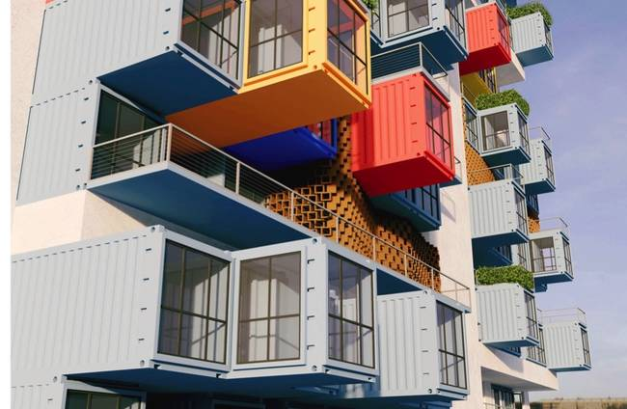
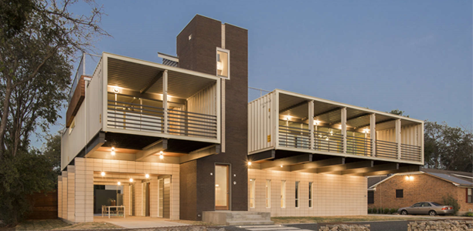

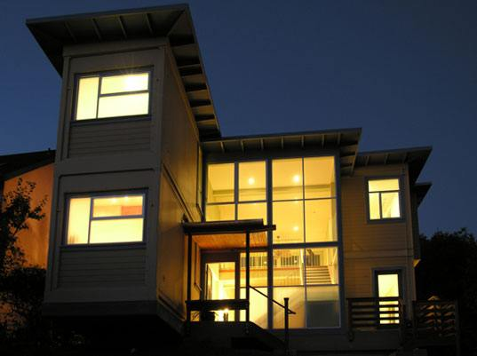
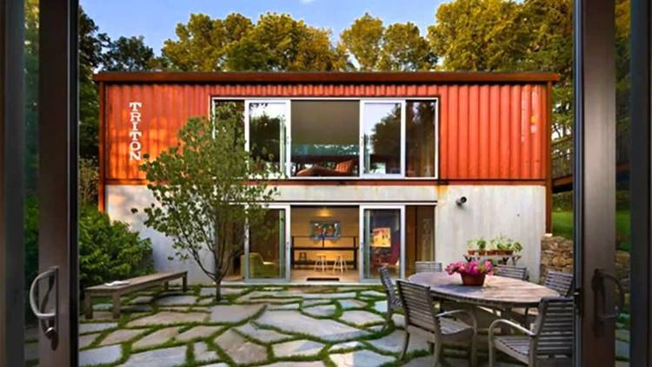
Residential Solutions

Slide 7
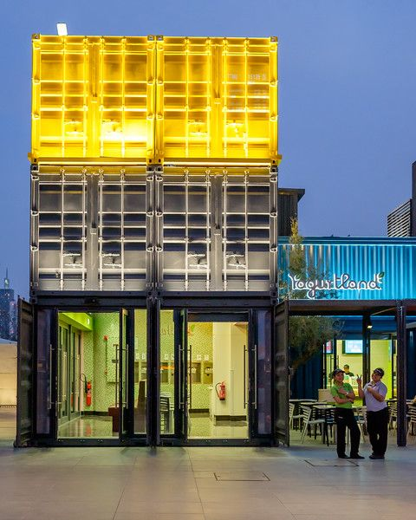
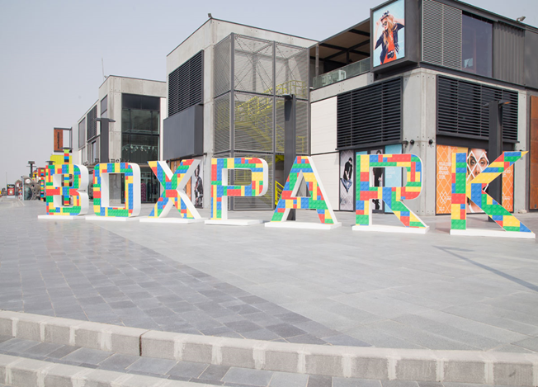

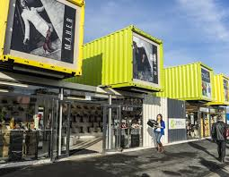
Retail and Commercial

Slide 8
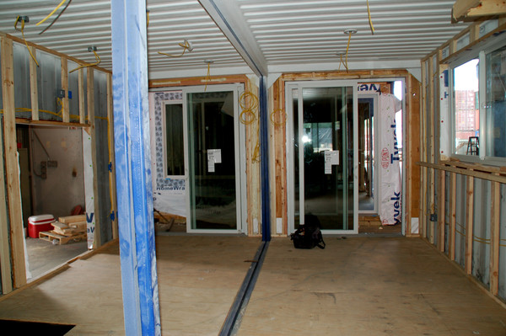
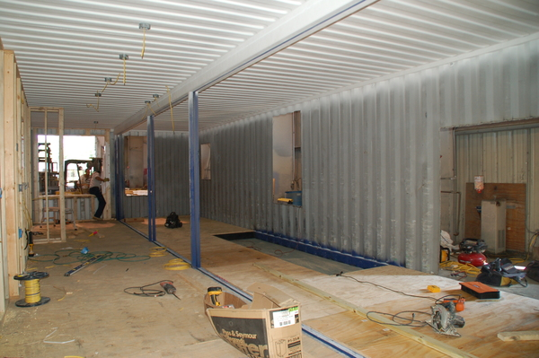
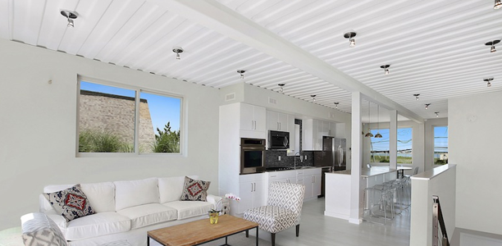
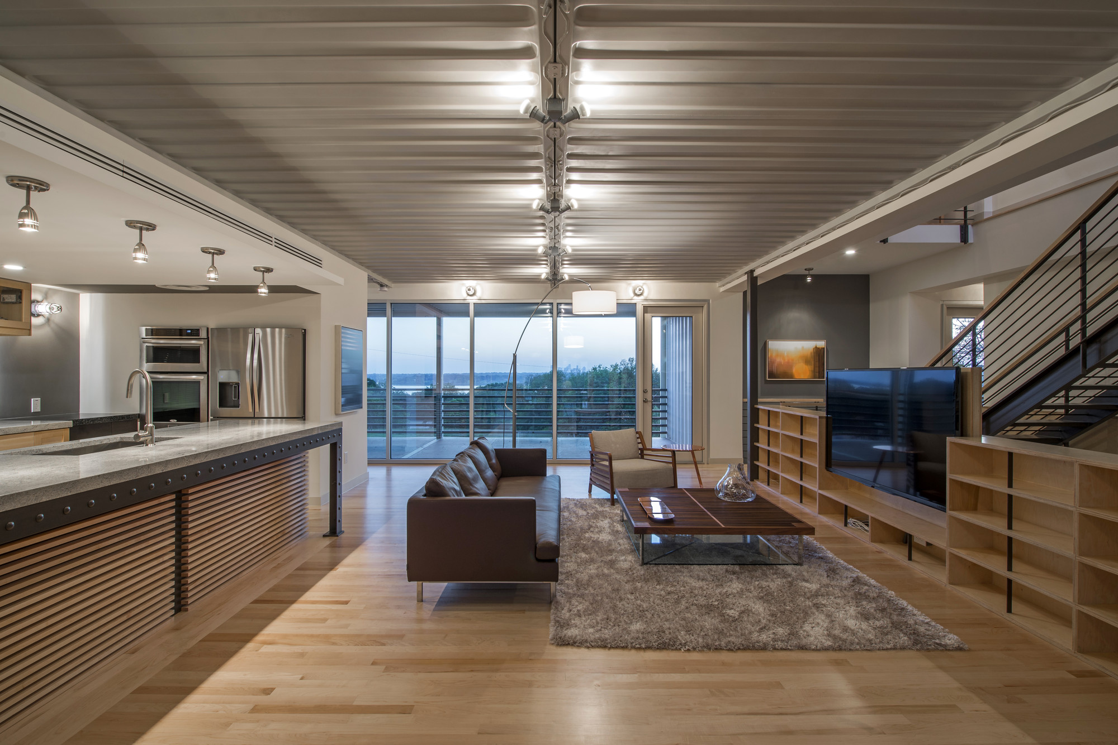
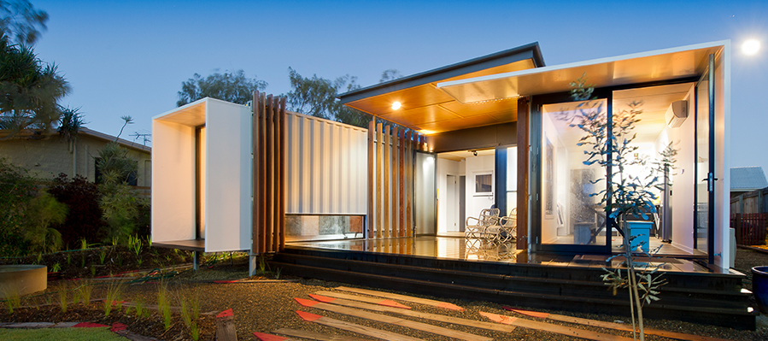
Interiors

Slide 9

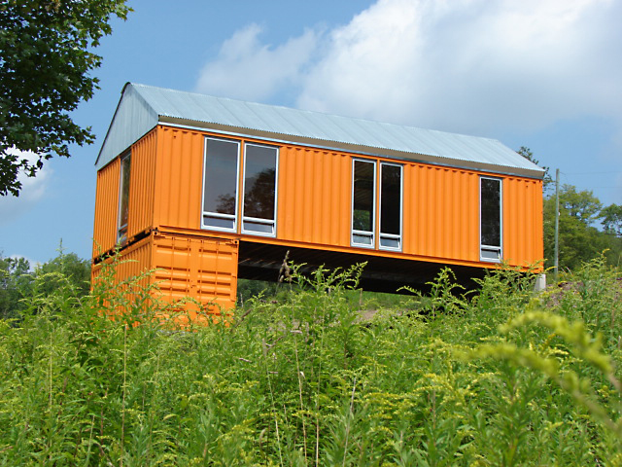

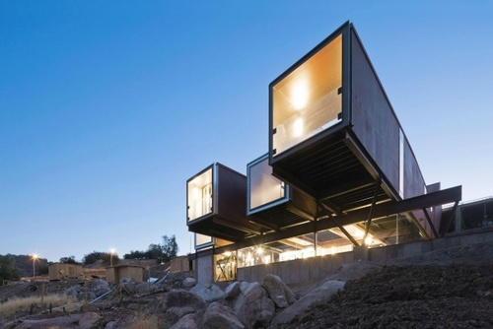
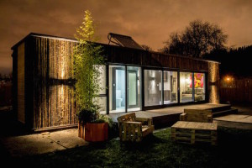
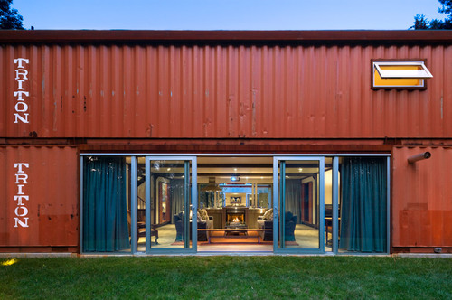

Slide 10
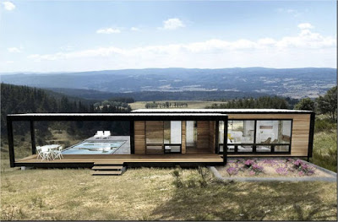
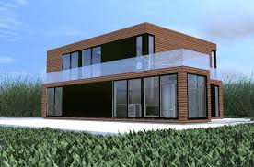
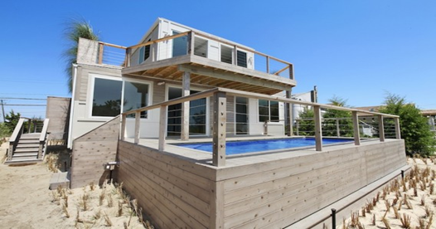
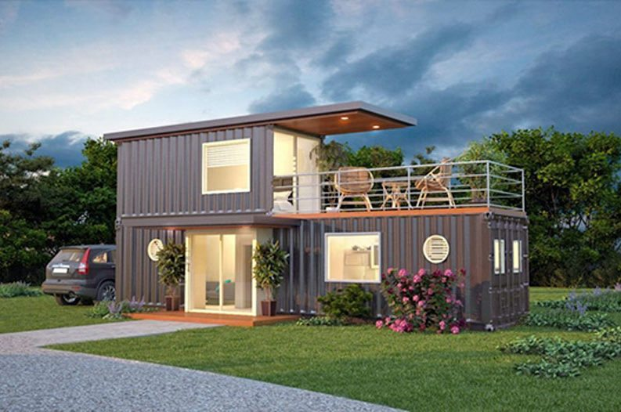
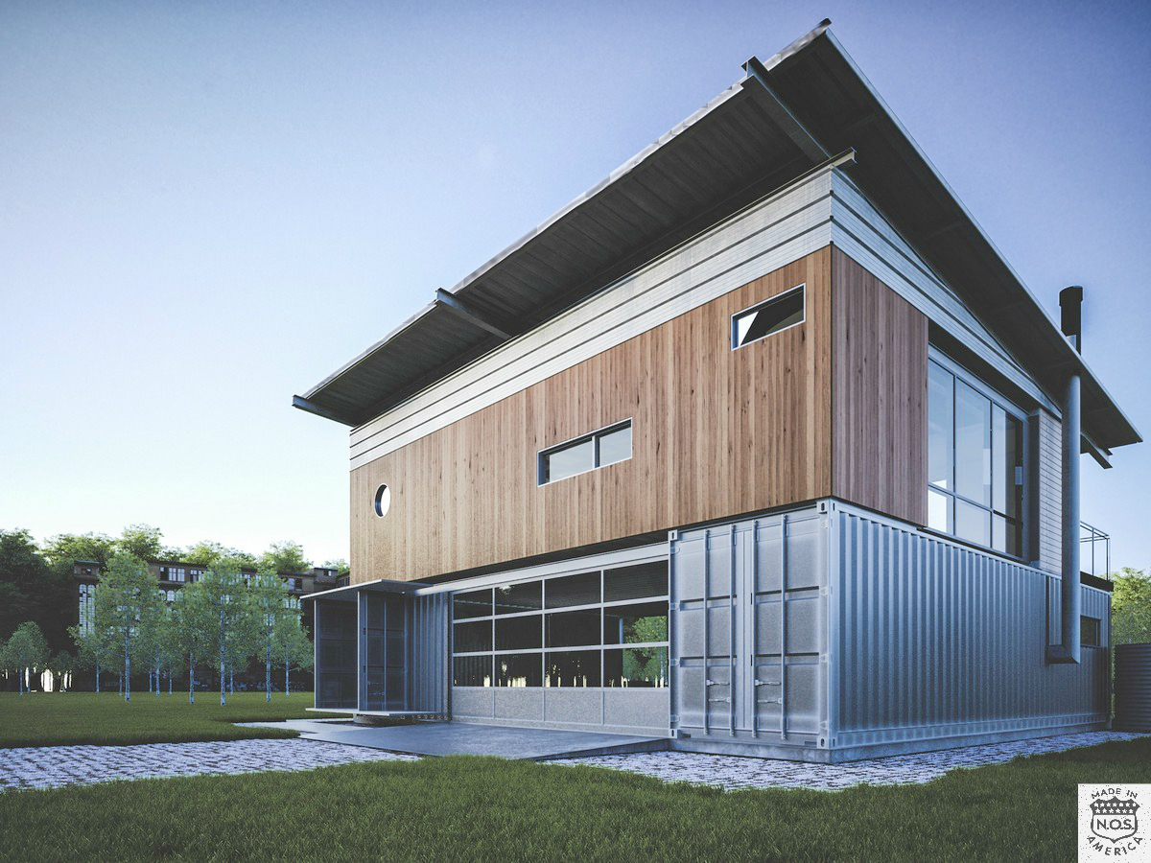
Housing Continued

Slide 11
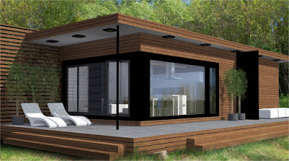
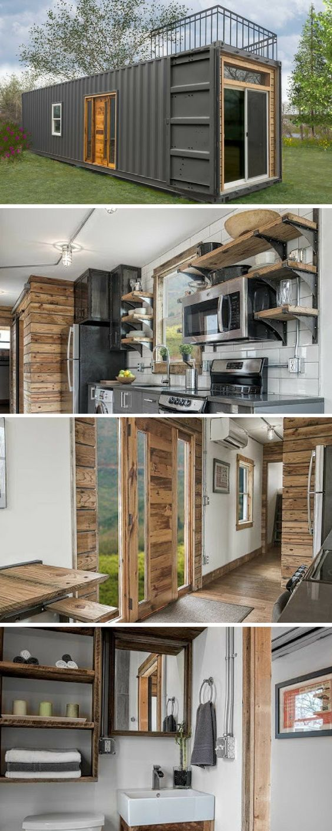
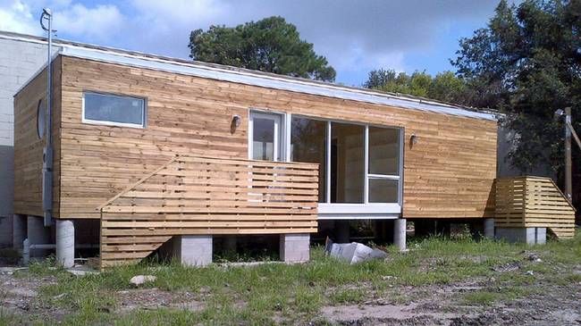
Lodges / Granny Flats

Slide 12
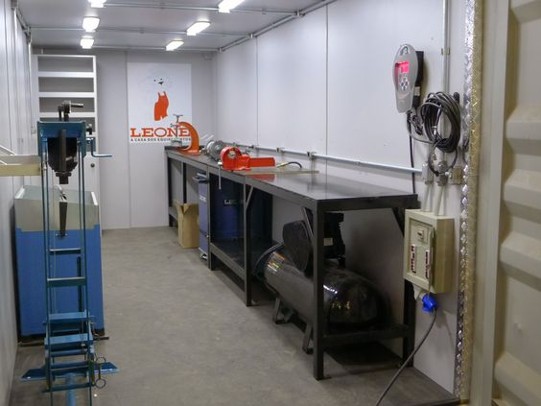
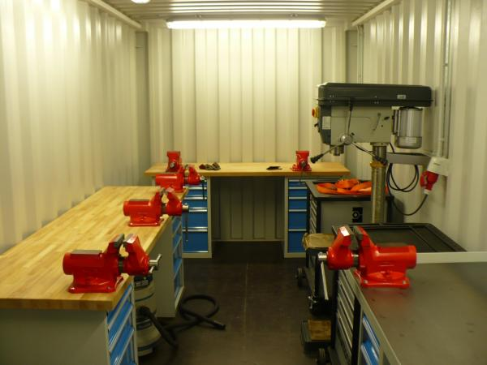
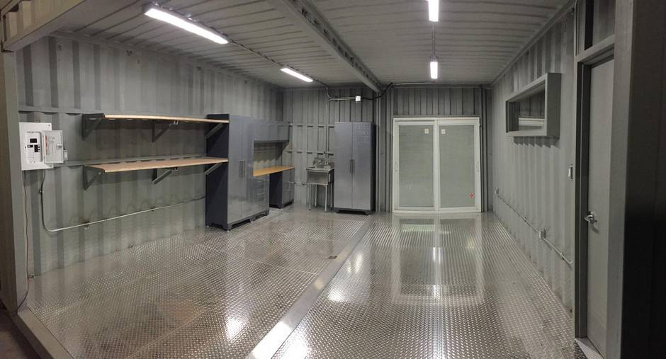
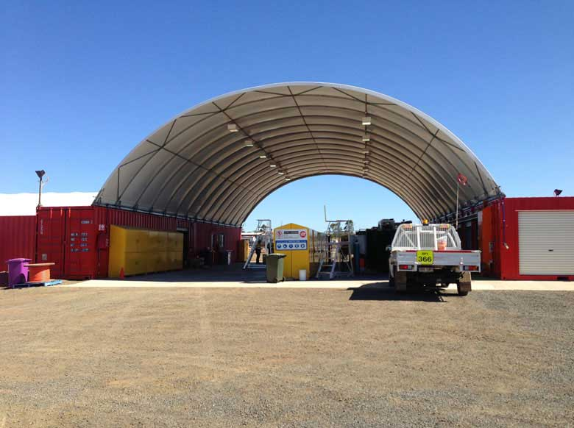
Garages and Workshops

Slide 13
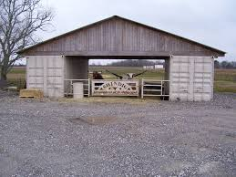
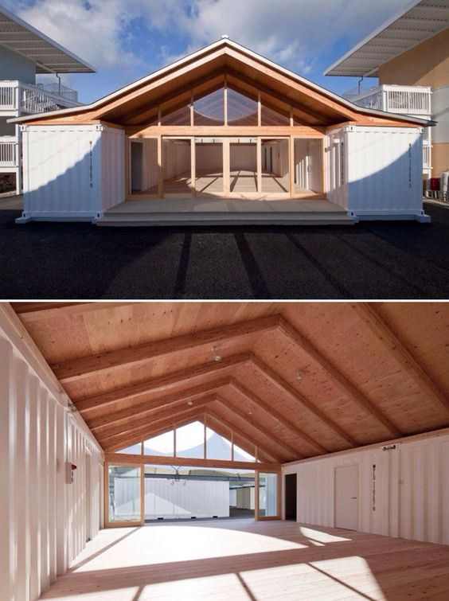
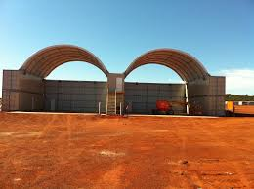
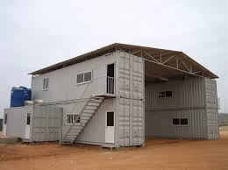
Barns / Depots

Slide 14
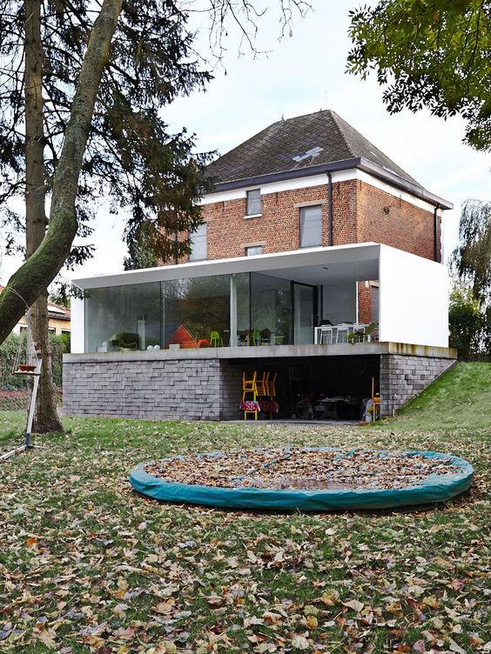
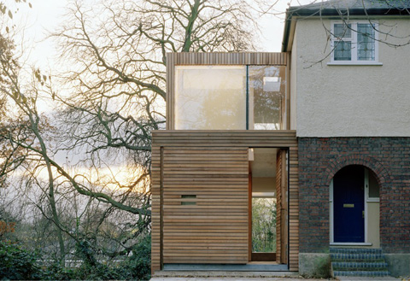

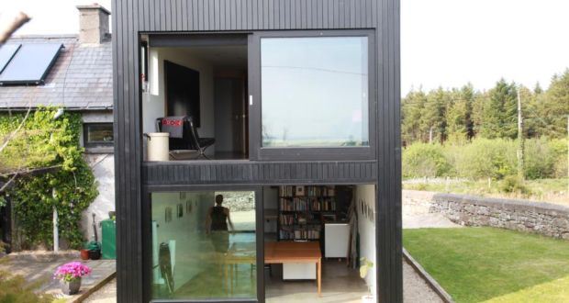
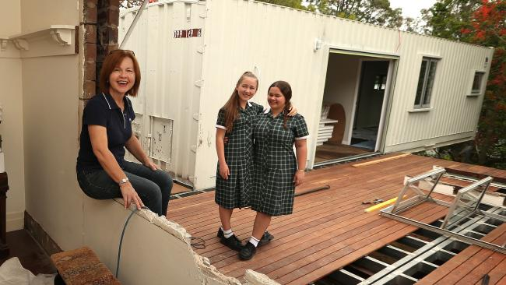
Modular Housing Extensions

Slide 15
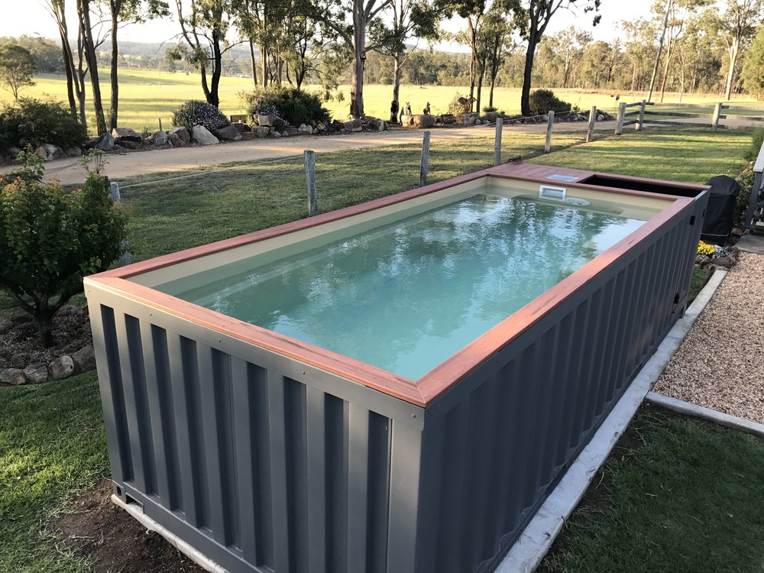
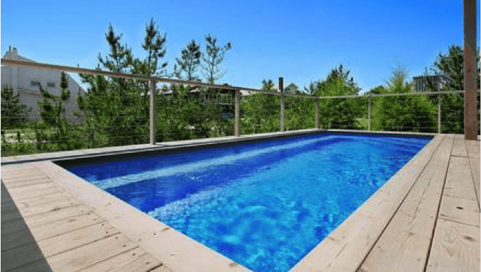

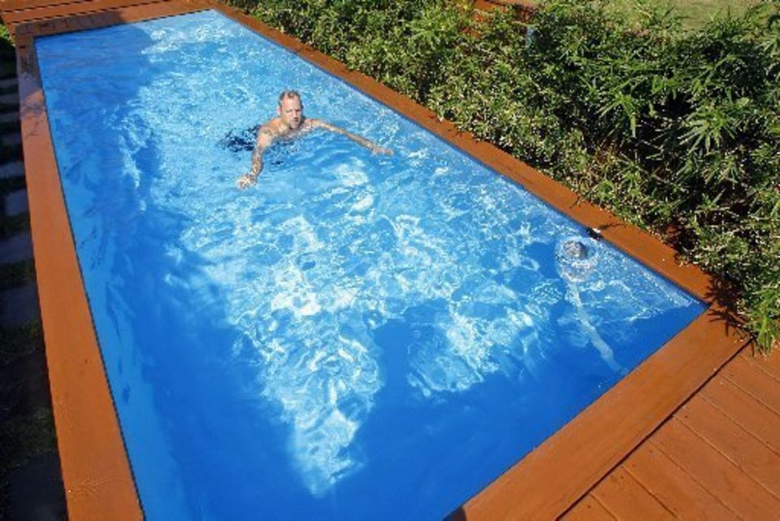
Pools and Water Storage Tanks
Handcrafted from brand new shipping containers, these ideal sized modules make excellent swimming pool sizes. Our container pools come in two distinct sizes to choose from, these are the 20FT and 40FT pools.
The Pro's are endless with container pools as NO planning permission needed, NO mess and NO major work to your property, they are easily maintained and simple to move if needed. They can even be taken with you in case you ever moved house!

Slide 16
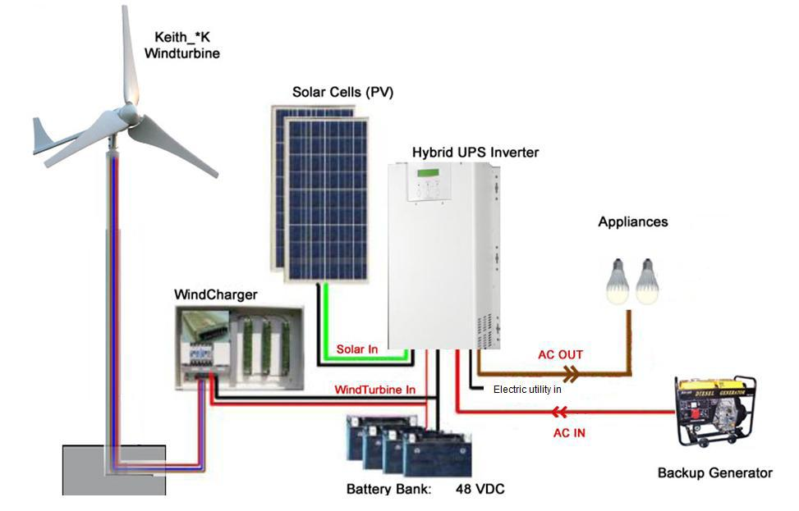


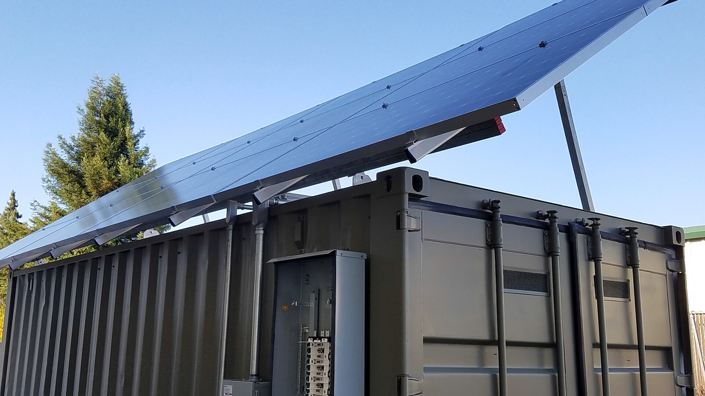
Off Grid Systems
Impact analyses - The practical effect of a solar cell system is obviously closely related to the local conditions where the system is deployed. With access to the NASA meteorological database we can derive the expected available solar insolation in any specific area. Combining this knowledge with a list of other critical information we can provide a fairly reliable prediction for the expected power output for a specific solar plant anywhere in the world. This information will provide the underlying basis for the economic analysis.
Cost benefit calculations - The economic analysis and break-even calculations are based on the investment sum, the expected power production, the cost of available alternative power sources, the possible income from power sales, the expected development in power prices, the expected maintenance costs, salvage value, interest rates etc. etc. We have the tools and the experience to assist in these crucial calculations.
Combining solar and other power sources - In critical applications or in areas with unstable solar insolation combining solar power with other power sources may be the only reasonable decision. We can help calculating the right combination and capacities of solar panels, batteries, generators, wind turbines, grid support etc. to secure the best performance and investment based on your requirements and preferences.
Project planning - Projects involving sustainable energy sources can be complicated. Let us help you to reach your target within time and achieve the desired results.

Slide 17
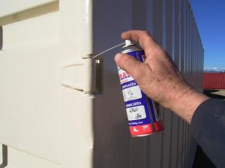
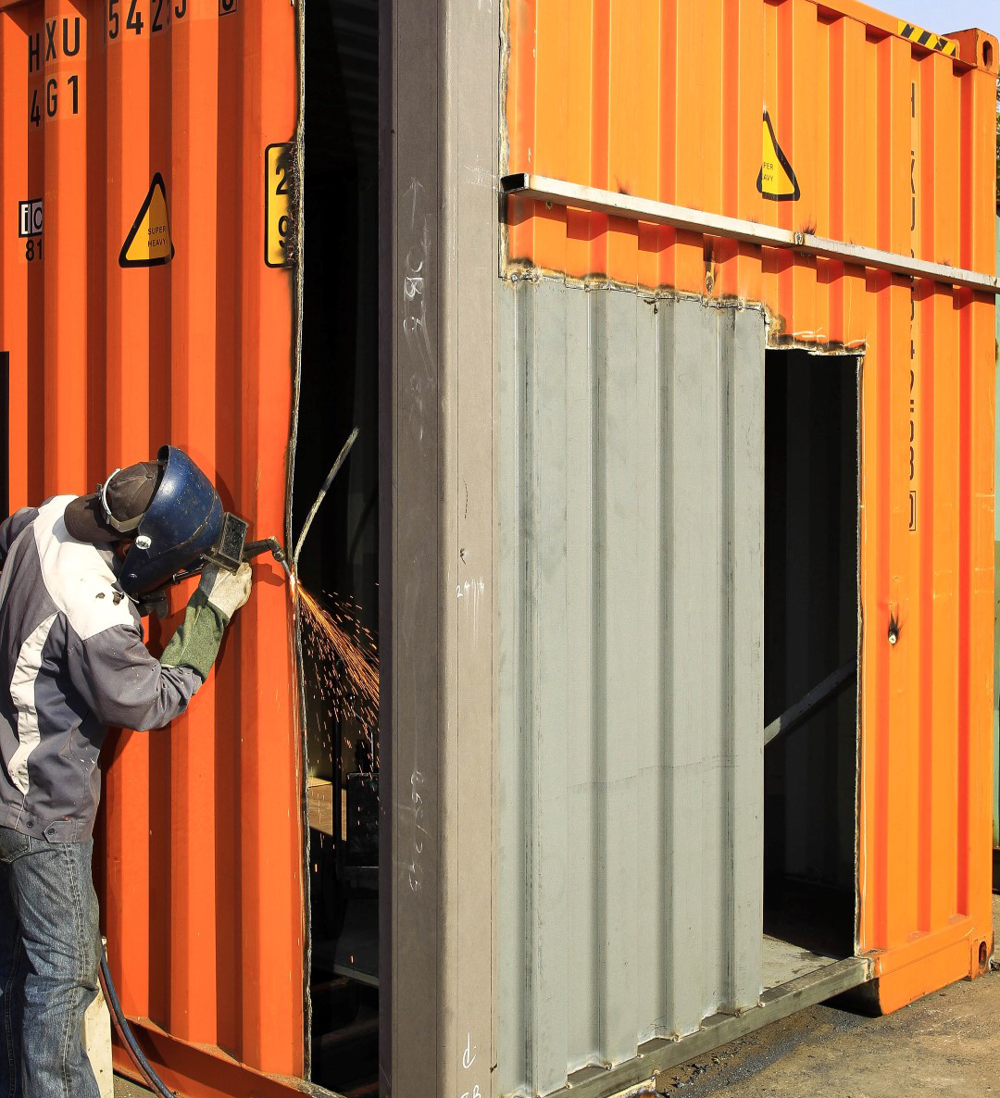
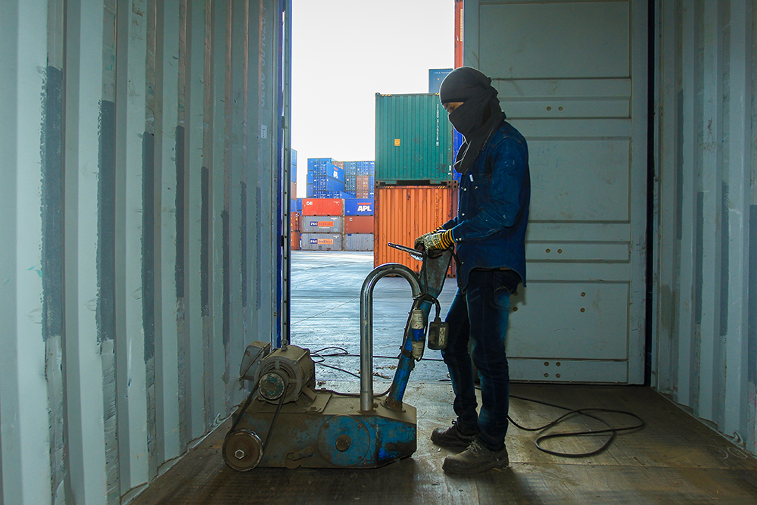

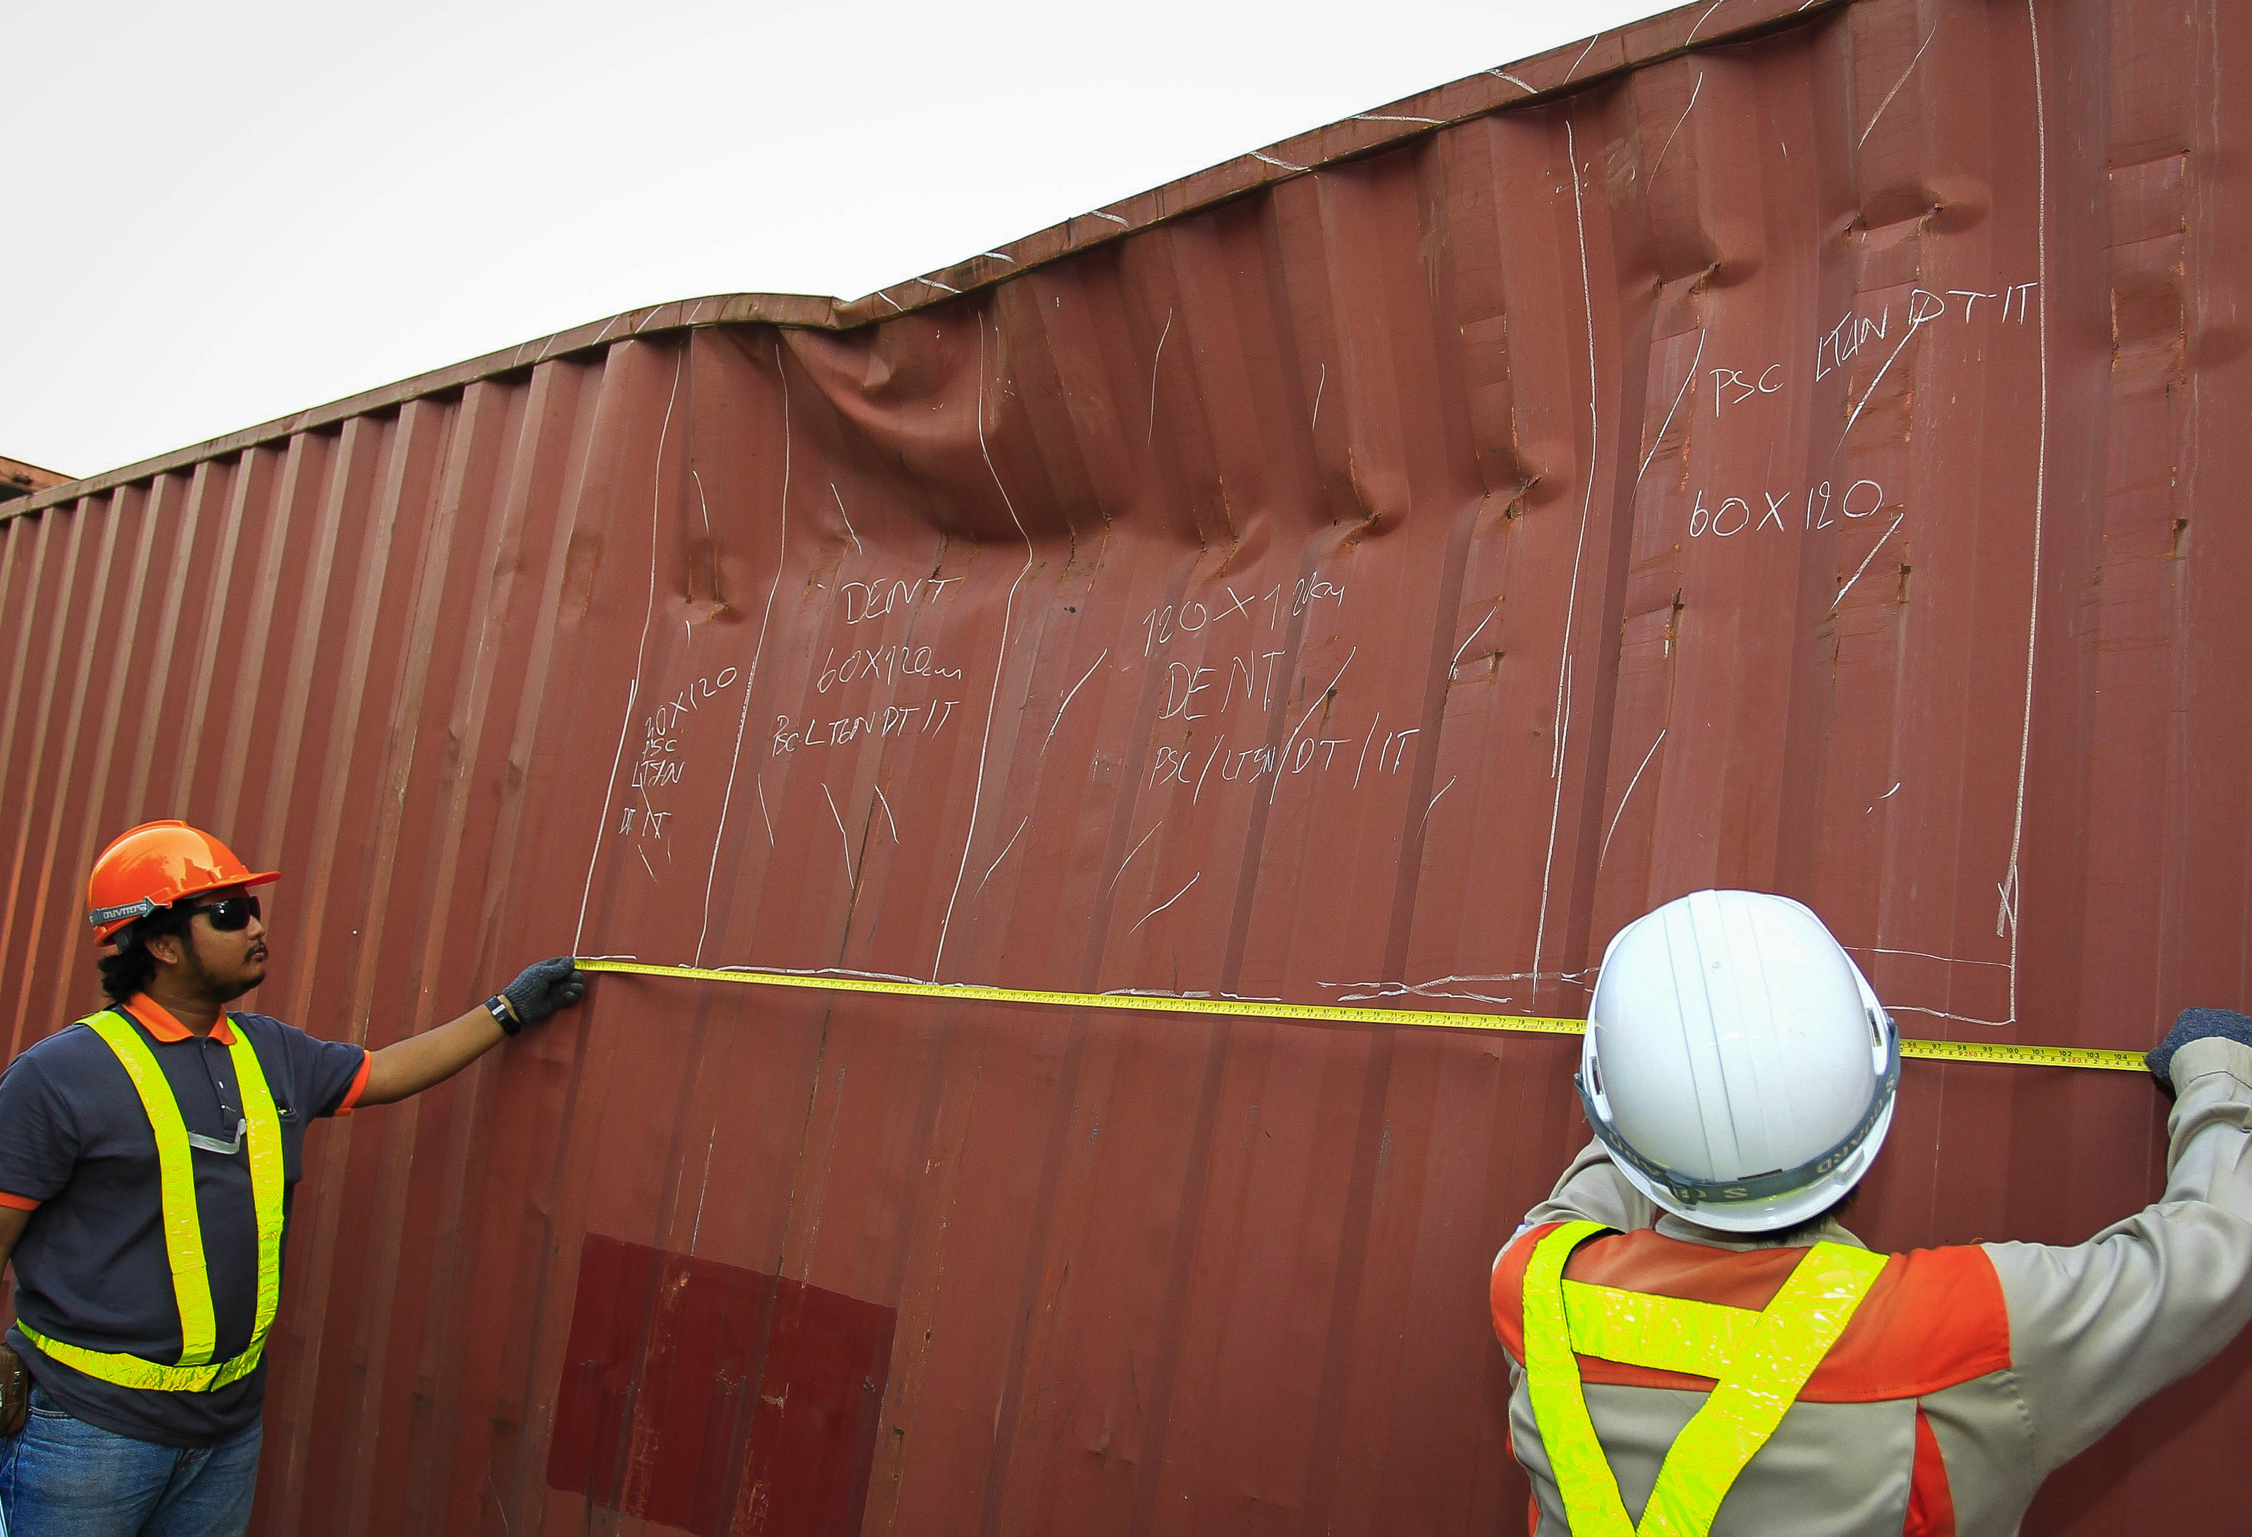
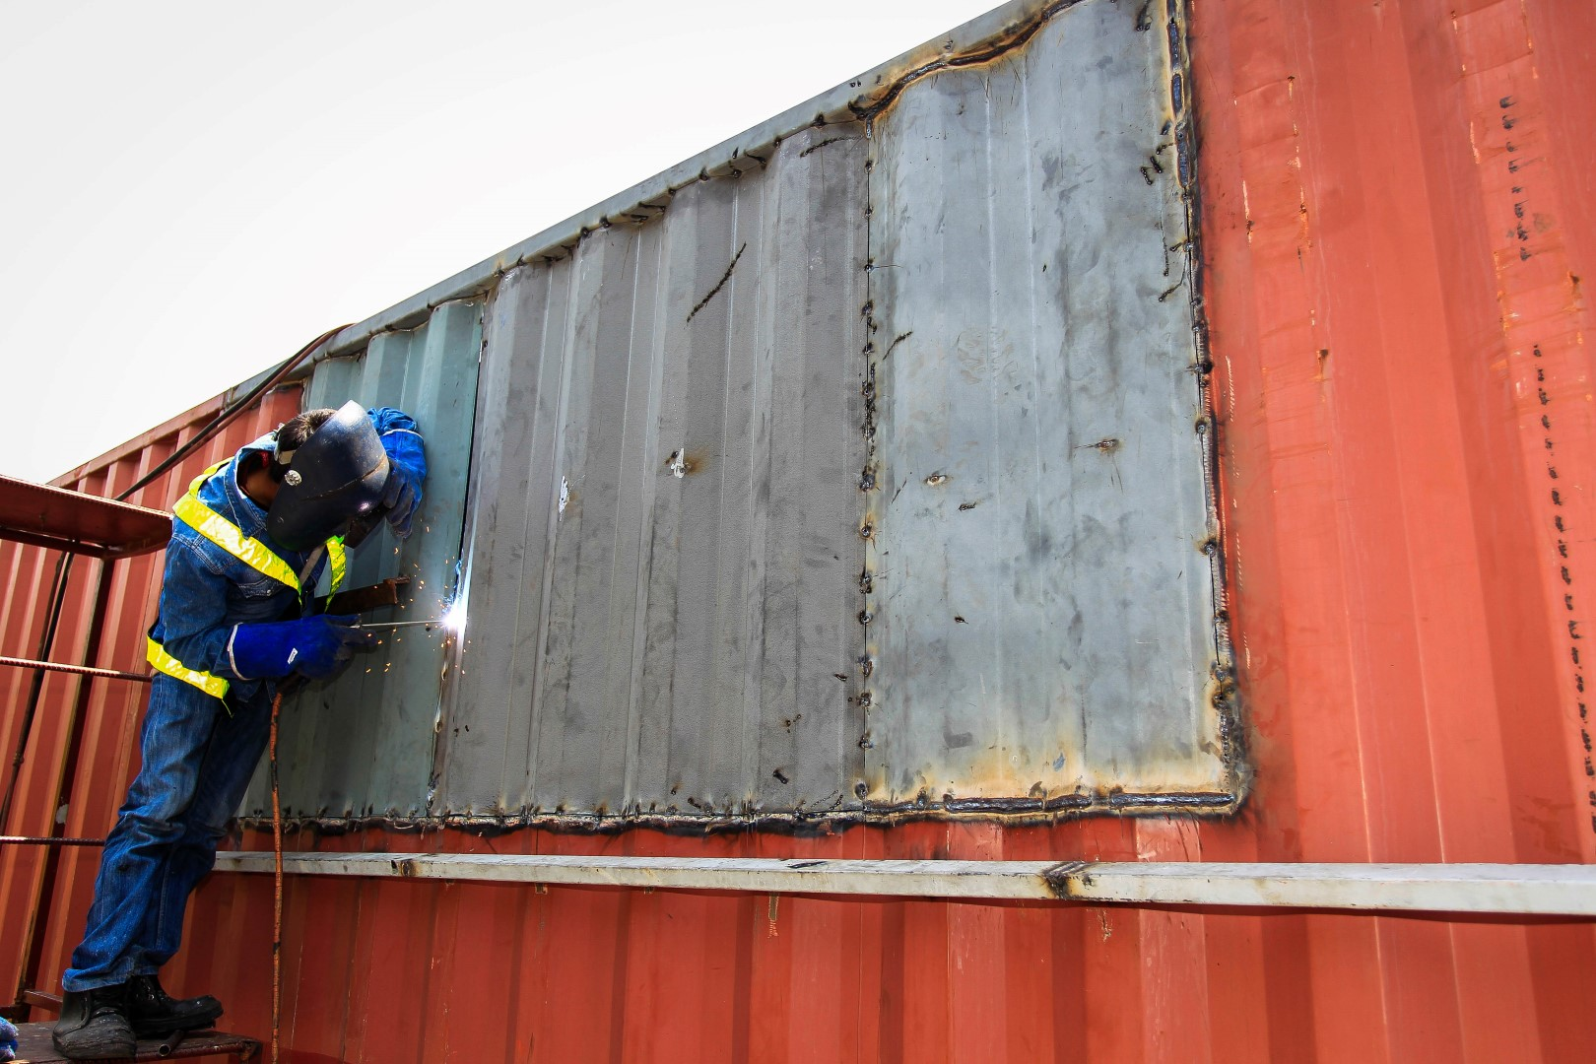

Maintenance
From repairing a little rust to making sure the shipping container is occasionally ventilated, these hardy vessels require little preventative maintenance. However, since we are increasingly converting containers into housing, mobile offices, modular buildings, and portable storage units, they do require some degree of cleaning. This is especially true for containers you have purchased that will be in your possession for an extended period of time.
As you are aware, containers are made of Corten weathering steel. Although Corten steel has increased resistance to corrosion, over time exposure to the weather can cause steel to rust, pit and boil. Occasionally boils become holes.
This is why it’s important to routinely check for leaks, and to perform minor repairs and preventative maintenance procedures to the container to avoid the potential for damage to your goods. Or, be sure to call us for repairs and replacement inquiries before any damage is done. Please continue reading to learn about shipping container maintenance tips, which we’ve learned from years of experience in the container industry.
Preventative maintenance guidelines
Removing Dust and Dirt: To make sure all dust and dirt is removed from your shipping container, use a bristled broom and then a pressure washer on the inside and outside of the empty container. It’s recommended to focus the pressure washer a little longer on the seam and corners, and to be cautious of any wear and tear on the floor.
Treating Serious Rust Spots: Surface rust typically amounts to nothing, but more serious rust spots should be treated to maintain the integrity of your unit. To treat any serious rust damages, you can easily use a natural rust remover, or even white vinegar or apple cider. After you apply your rust remover product, use a cloth, tough brush or even aluminium foil to rub the spot. Let the product dry completely.
Repairing Paint Damage: To fix any damages to the paint, rub the container with a medium grit sandpaper on the spots where paint may be broken or flaking. Then, apply a primer coat of paint, which helps to prevent future corrosion or moisture. Allow the primer to dry completely and then apply a thick exterior paint to both the inside and outside of the shipping container.
Preventing Condensation: Condensation may also occur within the container. The amount of condensation is typically minimal, but you should ventilate and inspect your container on occasion (once a month is ideal).

Slide 18


Turnkey Solutions
Turnkey is a product or service that is designed, supplied, built, or installed fully complete and ready to operate. The term implies that the end user just has to turn a key and start using the product or service.
For all of our projects Box-Clever-UK, in conjunction with its partners, undertakes the design and engineering, purchases all of the equipment, manages the construction using local labor, commissions the facility, and trains the operators / end users. The projects are typically executed on a firm lump-sum non-escalating price basis. Box-Clever-UK provides the customer with a single source of responsibility for the entire project including all performance and equipment warranties and guarantees.
At Box-Clever-UK if you require us to provide a full turnkey solution to your container project we will take you through the following phases. If you are interested in only using some of the below services this can also be arranged.
  Consultation
  Concept drafting
  Schematic design
  Detailed design
  Interior modelling and design
  Fabrication & Shop drawings
  Sourcing and procurement of materials
  Project and cost control
  Quality Control and Assurance
  Construction
  Testing and Commissioning
  Handover Completion

Slide 19





Project Management

Slide 20





Cost and Budget Control

Slide 21




Conceptual Design and Detail Design Drafting

Slide 22




Fabrication and Engineering

Slide 23
Local Authority Applications and Compliance
If a Client decides to go down the full turnkey route Box-Clever-UK will undertake the following steps on your behalf to make sure that your designer container build is a hassle free process.
STEP 1: Box-Cover-UK will ensure building permits and access for shipping containers are allowed on the designated site. A local crane company will procured by us if required to offload your container modules. Crane booking dates will be aligned to work with the overall full turnkey schedule.
STEP 2: After an initial consultation with Box-Clever-UK to ascertain your full requirements we will require an initial drafting fee to commence the concept drafting process and provide you a conceptual design report for your review and approval. Our drafting fee is subject to the size of the property development that you are planning to build.
STEP 3: You will need to contact and pick a builder or we can recommend one of our partner building companies to assist with the installation of your new home, we will liaise with the details of the build once drafting and engineering is done. Our drafting team will contact and liaise with you to work out all the internal and external features of your new home. We will also organise the soil investigation report if required from the local council building control department. Piling and structural designs can be provided as part of the detailed design process and will be submitted if required by us as part of the overall local authority approval process.
STEP 4: Once the final design has been confirmed, we shall proceed with a full energy requirement diagnostic for the size and required energy requirements of the development. The engineering and design calculations can be submitted to building control for approval prior to engagement of the building installations on site. The local authorities will likely require to be present on site for certain project milestone inspections. These will be subject to the size and design of the container build development. The engineers will receive a copy of the soil test and plans to design and engineer the footings or supports for your new home once approved by local authority building control / planning office.
STEP 5: Box-Clever-Uk will supply a fixed price contract on the final design and spec to build the containers and will liaise with the builder to get you a price for the install of your new home.
STEP 6: The Client will receive all the necessary documents to lodge to the utility authorities and council where your local council fees will need to be paid prior to any site installations.
STEP 7: Once the initial 50% of the contract is paid we fabricate the building according to plans and specifications and get your approval either with an on site visit or emailed photos.
STEP 8: Once approved and the other 50% of CBG’s contract is paid, the containers will be ready to leave via your approved transport company or transport company arrange by ourselves if required.
STEP 9: Your builder installs the building at your agreed price or we can install the building ourselves under part of the full turnkey contract commitments.
STEP 10: You move into your brand new container home upon completion of installation and interior fit-out. Crack open the champagne and let’s celebrate, you are now ready to move in your new Box-Clever-UK dwelling / workplace.

