Slide 1



DigiFSI
™
Your complete digital coupon solution

Slide 2

MANUFACTURER Coupons
To Customers
DigiFSI
™
More customer spending
At Caputo’s

Slide 3
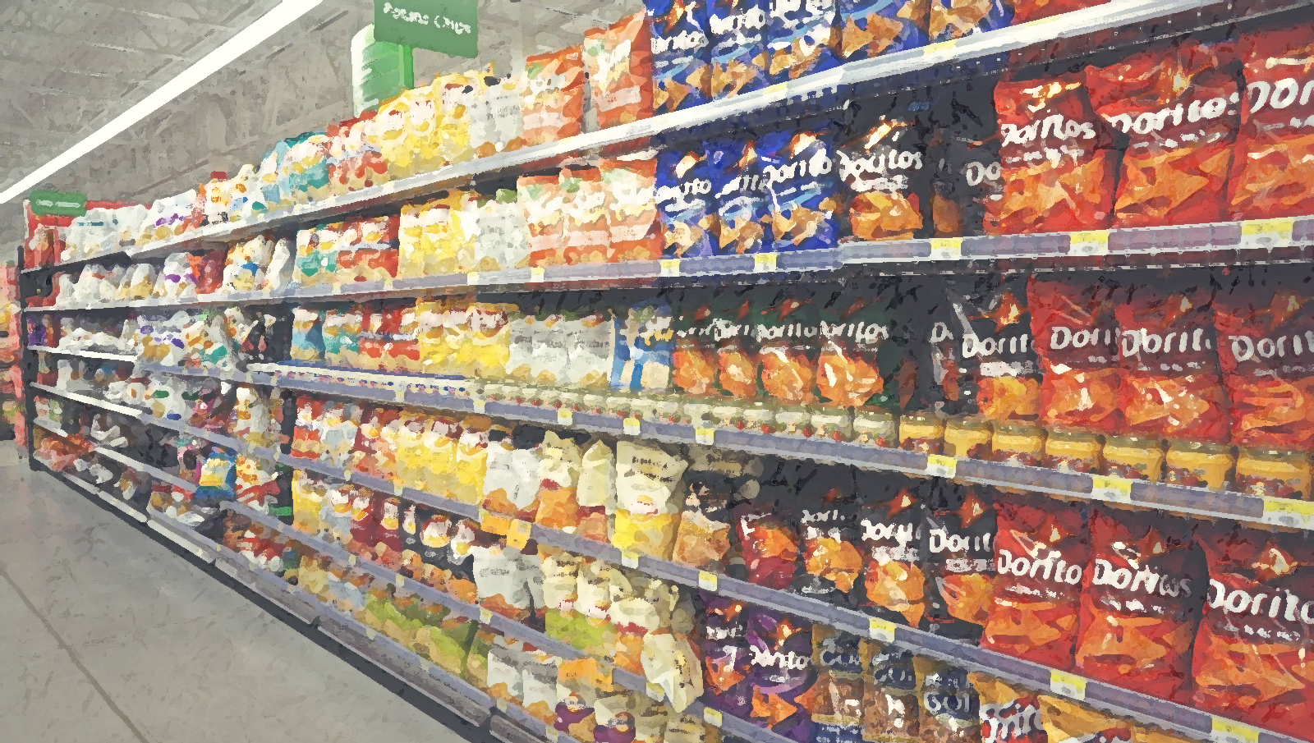


DigiFSI
™
Coupons available right on caputo’s shelves

Slide 4
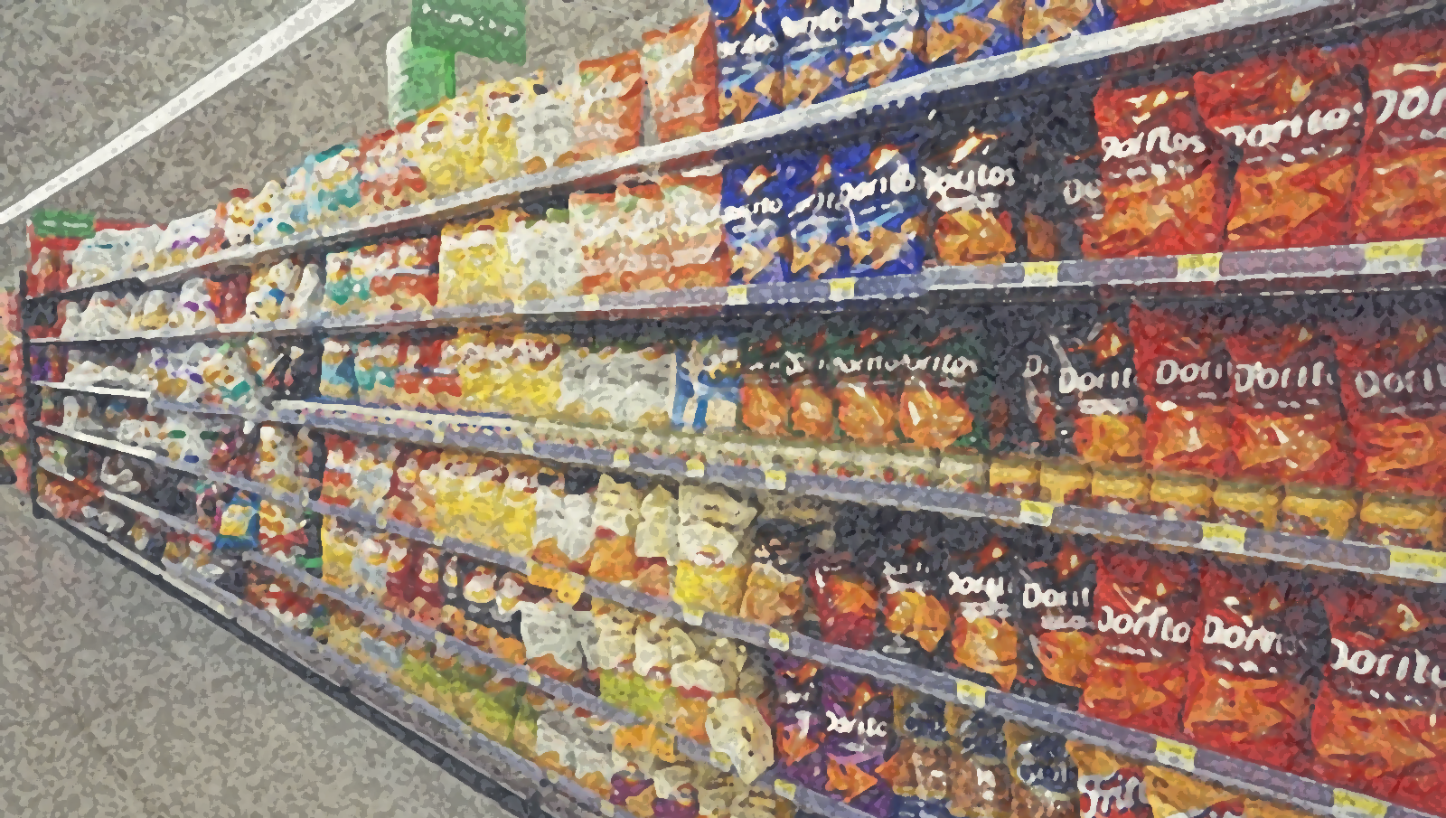



DigiFSI
™
Customers use their smartphones
No more cutting coupons

Slide 5

Step1
Scan coupon barcode

Slide 6
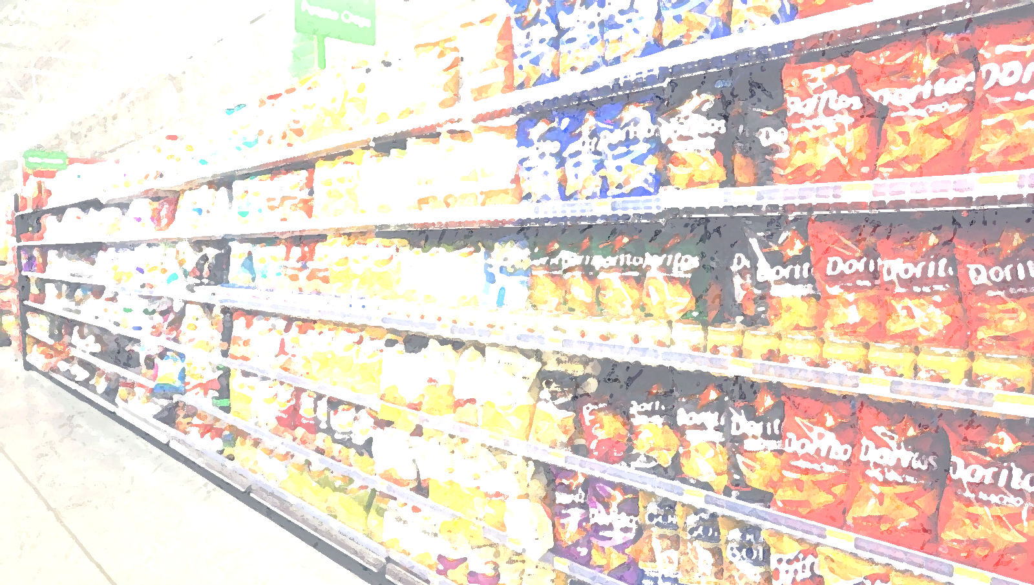




Step 2
Coupon automatically added to customer’s DigiFSI queue

Slide 7
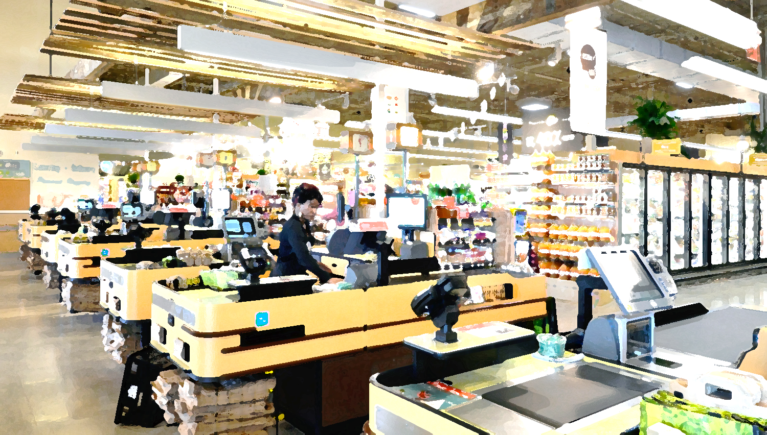

Step3
CHECK OUT

Slide 8
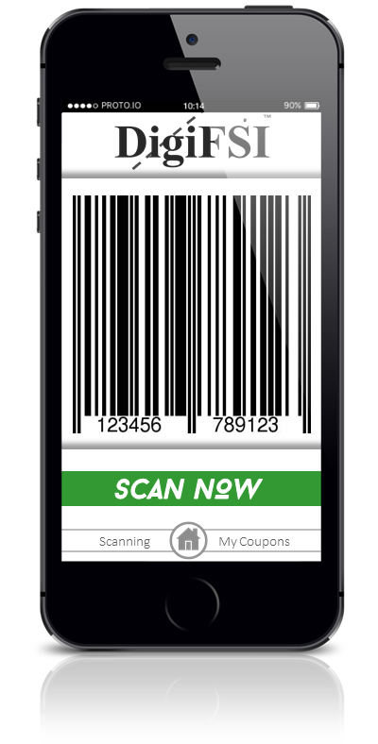
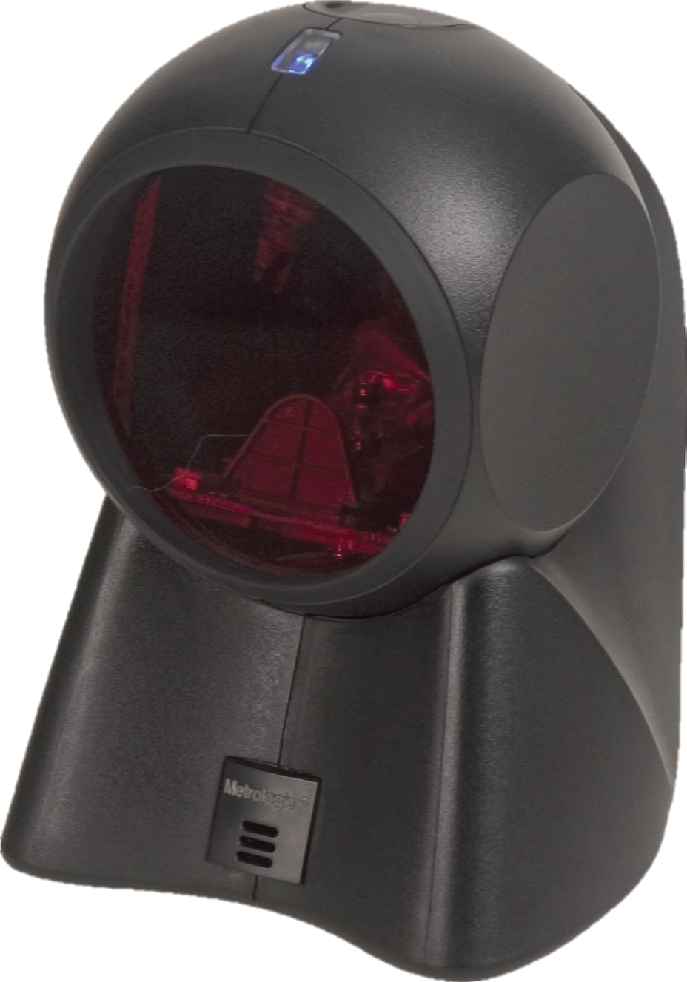
™
DigiFSI
Single scan loads coupons
directly to caputo’s POS

Slide 9
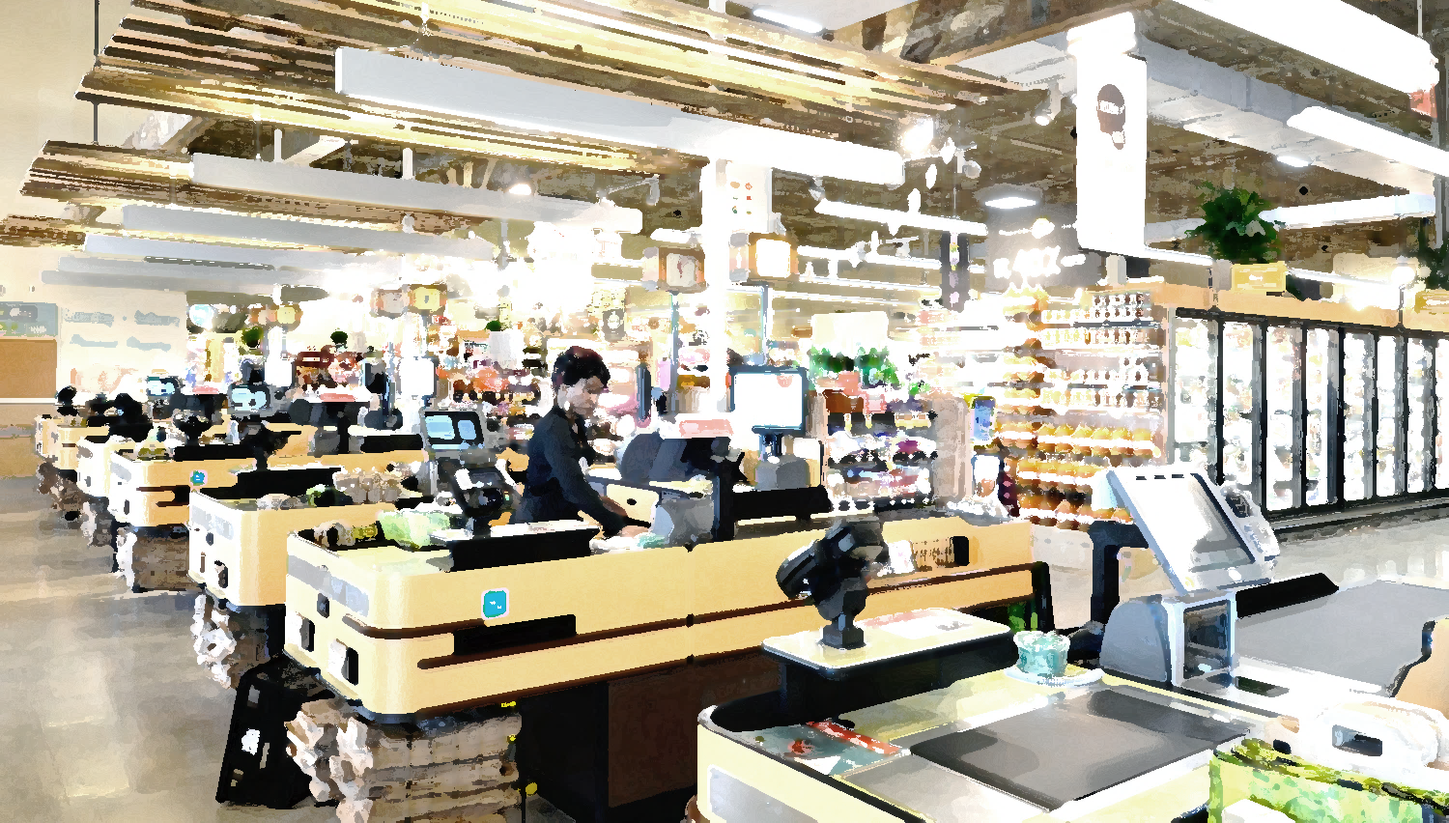
™
DigiFSI
Increased foot-traffic
Higher in-cart purchases
Real-Time Monitoring of Coupon Usage
Reports of Coupon Activity
Smooth Coupon Redemption Managed by DigiFSI
Faster Payment for Coupons after Redemption
manages coupon redemption process for caputo’s

Slide 10
T
Hank you
DigiFSI
™

