Slide 1


Spatula Waiting sucks. Spatula makes it better.
Andrew Walker | Founder @ Fleet Engineering | andrew@spatula.io
Notes:
My name is Andrew Walker, Founder and CEO of Fleet Engineering.
A week or two ago, I took the morning off work

Slide 2

The Big Idea in 125 words
Waiting sucks. Live tracking makes waiting for deliveries and services less painful. Spatula makes it easy.
You could track your pizza in realtime since 2015. Now business that still make people wait without a live tracking link are giving an unnecessarily poor customer experience and their brand suffers greatly.
Why doesn’t everyone send tracking links now? Why can’t we track important things like emergency services or mission-critical business deliveries? Legacy processes, complex last-mile arrangements through multiple providers, lack of a cheap and easy solution.
Spatula is the cleanest, simplest way to give customers a tracking link, while giving managers, drivers and developers the best possible tools to provide a great last-mile service cheaply and easily while promoting and reinforcing their brand and getting customer feedback.

Slide 3
Shifting Customer Expectation
Simple Global Deployment
Success of best-in-class integration
Why Now?
Notes:
3 forces
Modular Tech: because there are so many great software products for specific functions, those that have a clear place, that meet that requirement beautifully, and that integrate seamlessly so that other products become their features. They win. Think Xero, Slack, Stripe
Low Cost of Deployment: smartphones are ubiquitous. Phone coverage is broad and cheap. Global data centres make it lightning fast and cheap to deploy globally
Social: customer expectations have shifted, because in some areas of the economy companies are getting this right. You can track a $20 pizza with dominos, but you can’t track an incoming hotshot delivery. You can track a $5 felafel with Uber Eats, but not a $500,000 incoming $12,000 mission critical piece of machinery, but you can track a $12 pizza beautifully. You can continue to have your coffee meeting right up until your Uber pulls up, rather than waiting out front for your taxi.

Slide 4
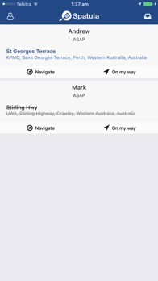
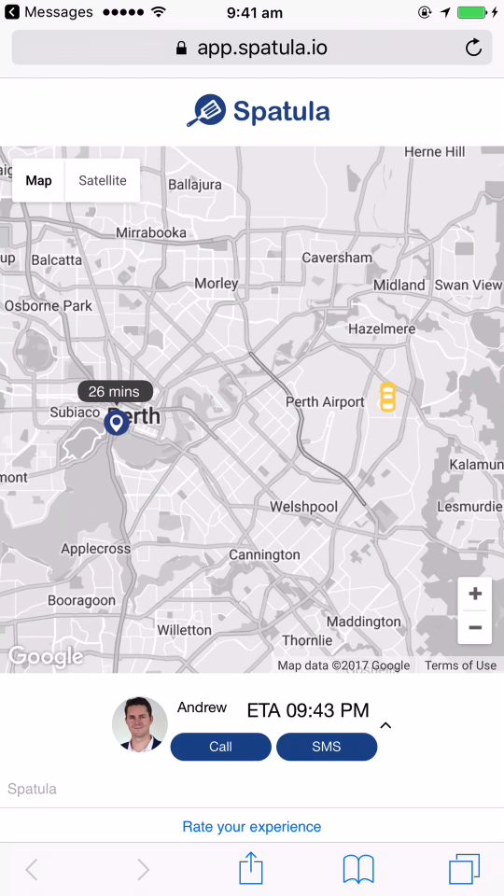
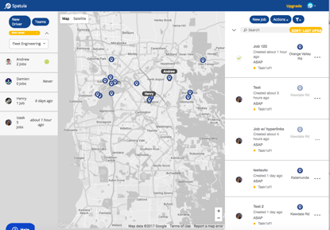
The Solution
Integrations with common sources of jobs and automation tools like Zapier
Simple web portal for keeping track of staff and jobs in realtime
A clean, intuitive driver app with 1 click to deliver the tracking link
A customer tracking link, sent via SMS and opened with 1 click
Notes:
For companies where last-mile logistics is critical to success, who are dissatisfied with their options - antiquated legacy systems, smartphone alternatives like GetSwift and Bringg, or adding a location service like Glympse, Spatula brings an integration-first technology suite that comes at the existing system like a Swiss Army Knife to get the best result, fastest, for the smallest implementation pains

Slide 5
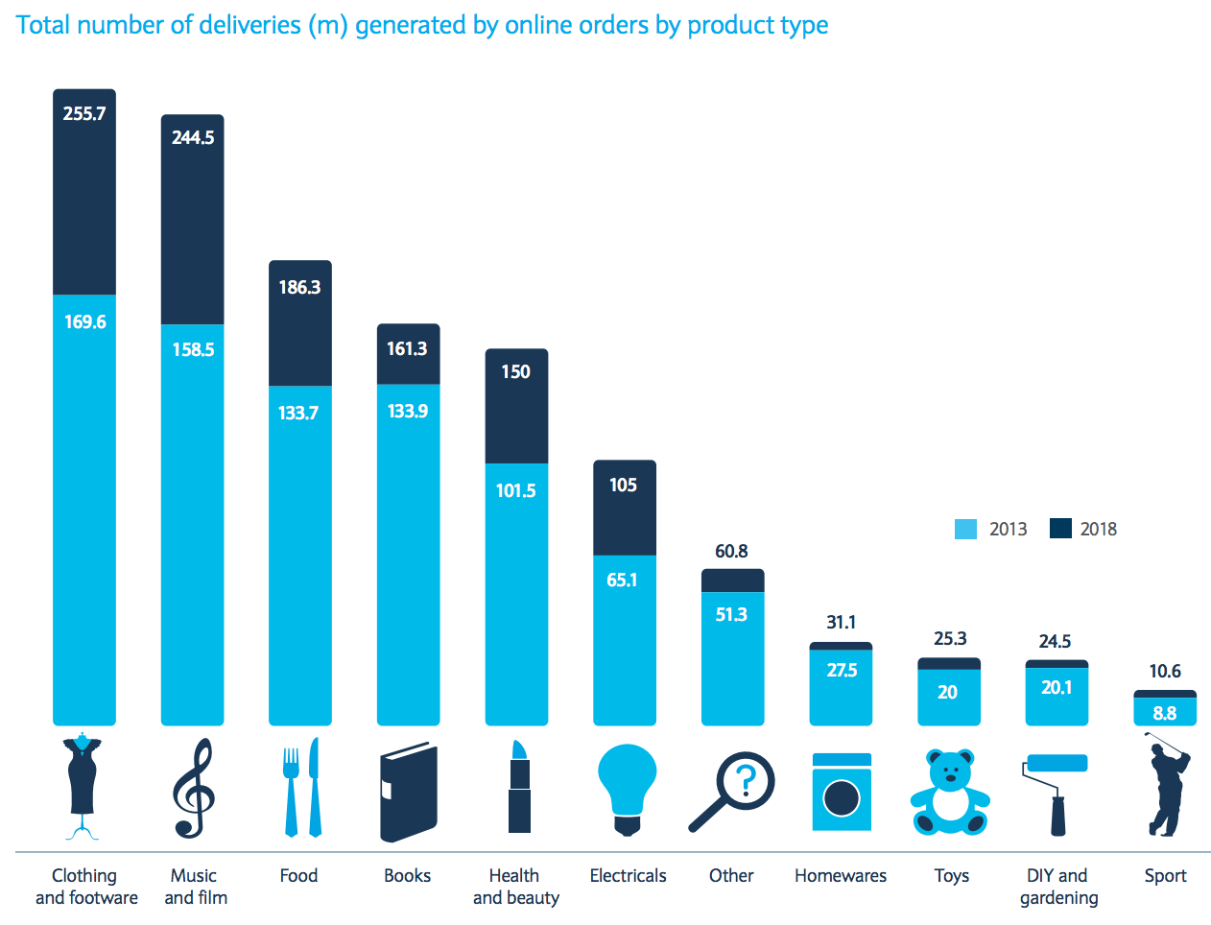
Market Size
1.35 billion annual deliveries from ecommerce by 2020 in UK
global e-commerce deliveries expected to exceed 24 billion*
Based on our bulk discount effective rate of USD12c per job total market will be USD2.8bn in 2018
*assuming UK 3.5% of world deliveries (in line with GDP %)
https://www.home.barclays/content/dam/barclayspublic/docs/BarclaysNews/2014/September/the-last-mile-report.pdf

Slide 6

Business Model
Transactional pricing
Spatula: 19c per task (USD)
Credit and top up like a pre-paid phone card
Bonus credit for higher top up amounts

Slide 7

Go to Market
Spatula has recently achieved market fit, with 8 paying SME customers in 4 countries. A pilot project is also in progress with a major WA Insurer. Spatula is a naturally viral product, with our customers sending an effective demonstration of Spatula to their customers. Multiple of our paying users are customers of other customers.
Our go-to-market plan now is to establish a repeatable sales process:
Target specific geographic regions to maximise network effect, starting with Australia, Singapore and London
Establish a revised automated online funnel targeting customers similar to those for whom we have demonstrated that Spatula solves a problem worth paying for
Target medium-large firms in market segments where there is an existing pilot or where interest has been expressed by stakeholders including retail, mining, insurance repairs and healthcare through a multi-channel sales mix

Slide 8

Our Team
Unique access to technical talent pipeline from our partnership with and colocation at UWA
Battle hardened from bootstrapping for 3 years
All key players have skin in the game
Founder & board’s commercial experience
Notes:
Background in management consulting - project lead in Singapore, Hong Kong, Jakarta. Using data to drive productivity improvements. Achieved over 30% for every project over 4 years
Mech Eng degree (smashed it, obviously). Looked at connected fleet tech for honours thesis.
Identified lots of uptake of the tech, but poorly run implementations that didn’t generate real improvements
Established an innovation partnership with UWA and colocated on campus
Member of the UWA ROSL group

Slide 9

Finance & Opportunity
2016 $250k ‘FFF’
Now Deal details
6-8 months Planned raise

Slide 10

How to Fuel Growth
Ramp up UX efforts
Customer journey management
Digital marketing expertise
Activation of digital campaign

Slide 11
Summary
A clear problem for a big market
The right people and a great pipeline of talent
Great technology foundation and technical skills
Paying customers in multiple countries
A clear opportunity for capital to create and drive the growth engine

