Slide 1
Energy Trilemma
Jurisdictions with large hydrocarbon resources playing key roles in economy, face the challenge of balancing environmental, economic and energy security goals – the so-called “energy trilemma.”
Limiting future global warming requires holding atmospheric CO₂ concentrations below a target value, leads inexorably to the conclusion that the carbon in most of the world’s fossil fuels, has to remain underground. Thus most fossil fuel resource would be stranded and so would the economic wealth associated with those resources, unless resource development can be accomplished by transitioning through a fossil fuel industry with a reduced and eventually eliminated environmental footprint.

Slide 2
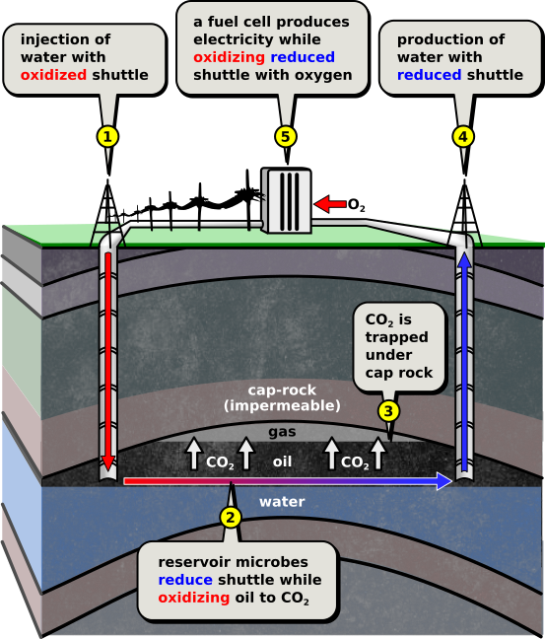
Energy available but:
low net energy generated due to product of low feasible shuttle concentrations- shuttle electron number and flow rate.
Max power bounded by max shuttle concentrations and fluid flow rate.
Linkage of electrochemical and reservoir systems key.
redox-flow-battery
Flow cleanup. Possible shuttle exchanger
Best fields to evaluate on would be light heavy oil fields already water flooded. Average oil recoveries are very low typically, so an enormous resource remains in produced fields.
SYZYGY 1-Shuttles

Slide 3
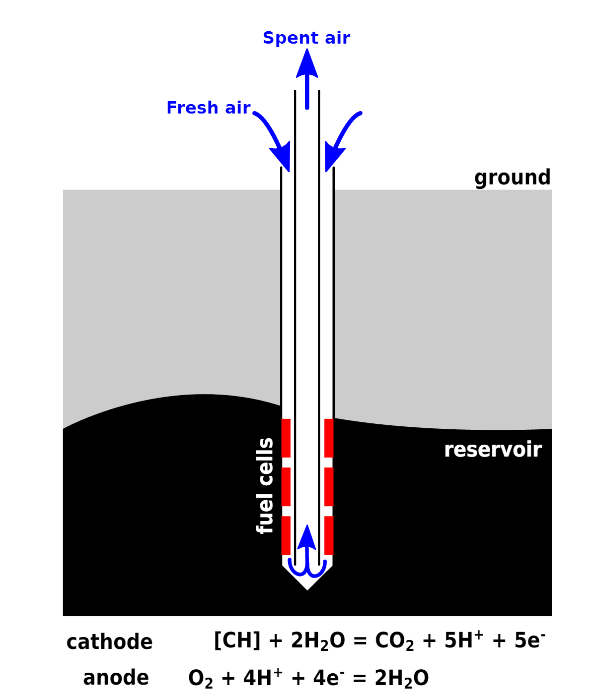
SYZYGY 2-
Active electrodes
Power to surface
ISSUES:
Diffusive transport of reactants.
Fuel cell design.
Electrical/ proton connections to reservoir.
Reservoir access (well configurations / lengths).
Biome function and management.
Water flow into and through device
Protecting fuel cell elements during emplacement.
Low electrode areal power density.
Scaling reservoir access geometry
Manufacturing costs
Anode
Cathode

Slide 4
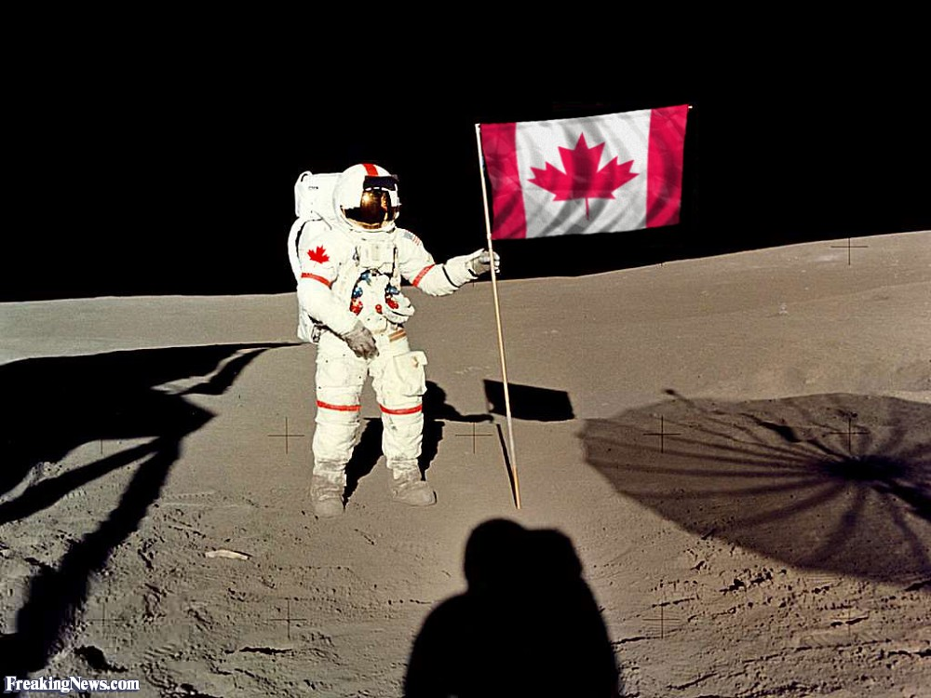

Slide 5
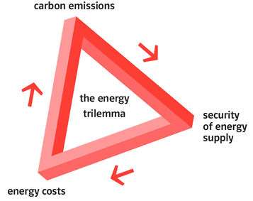

Slide 6
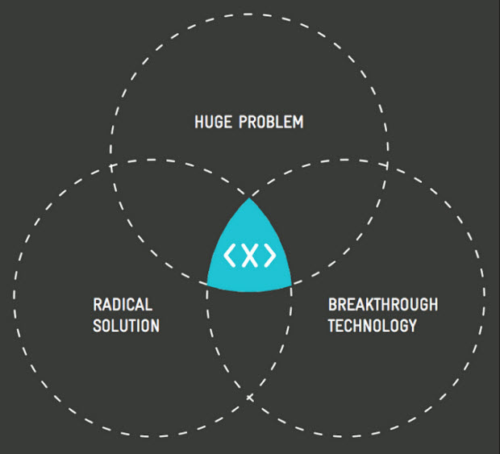

Slide 7


Slide 8
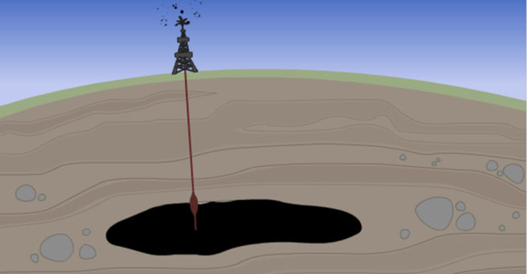

Slide 9
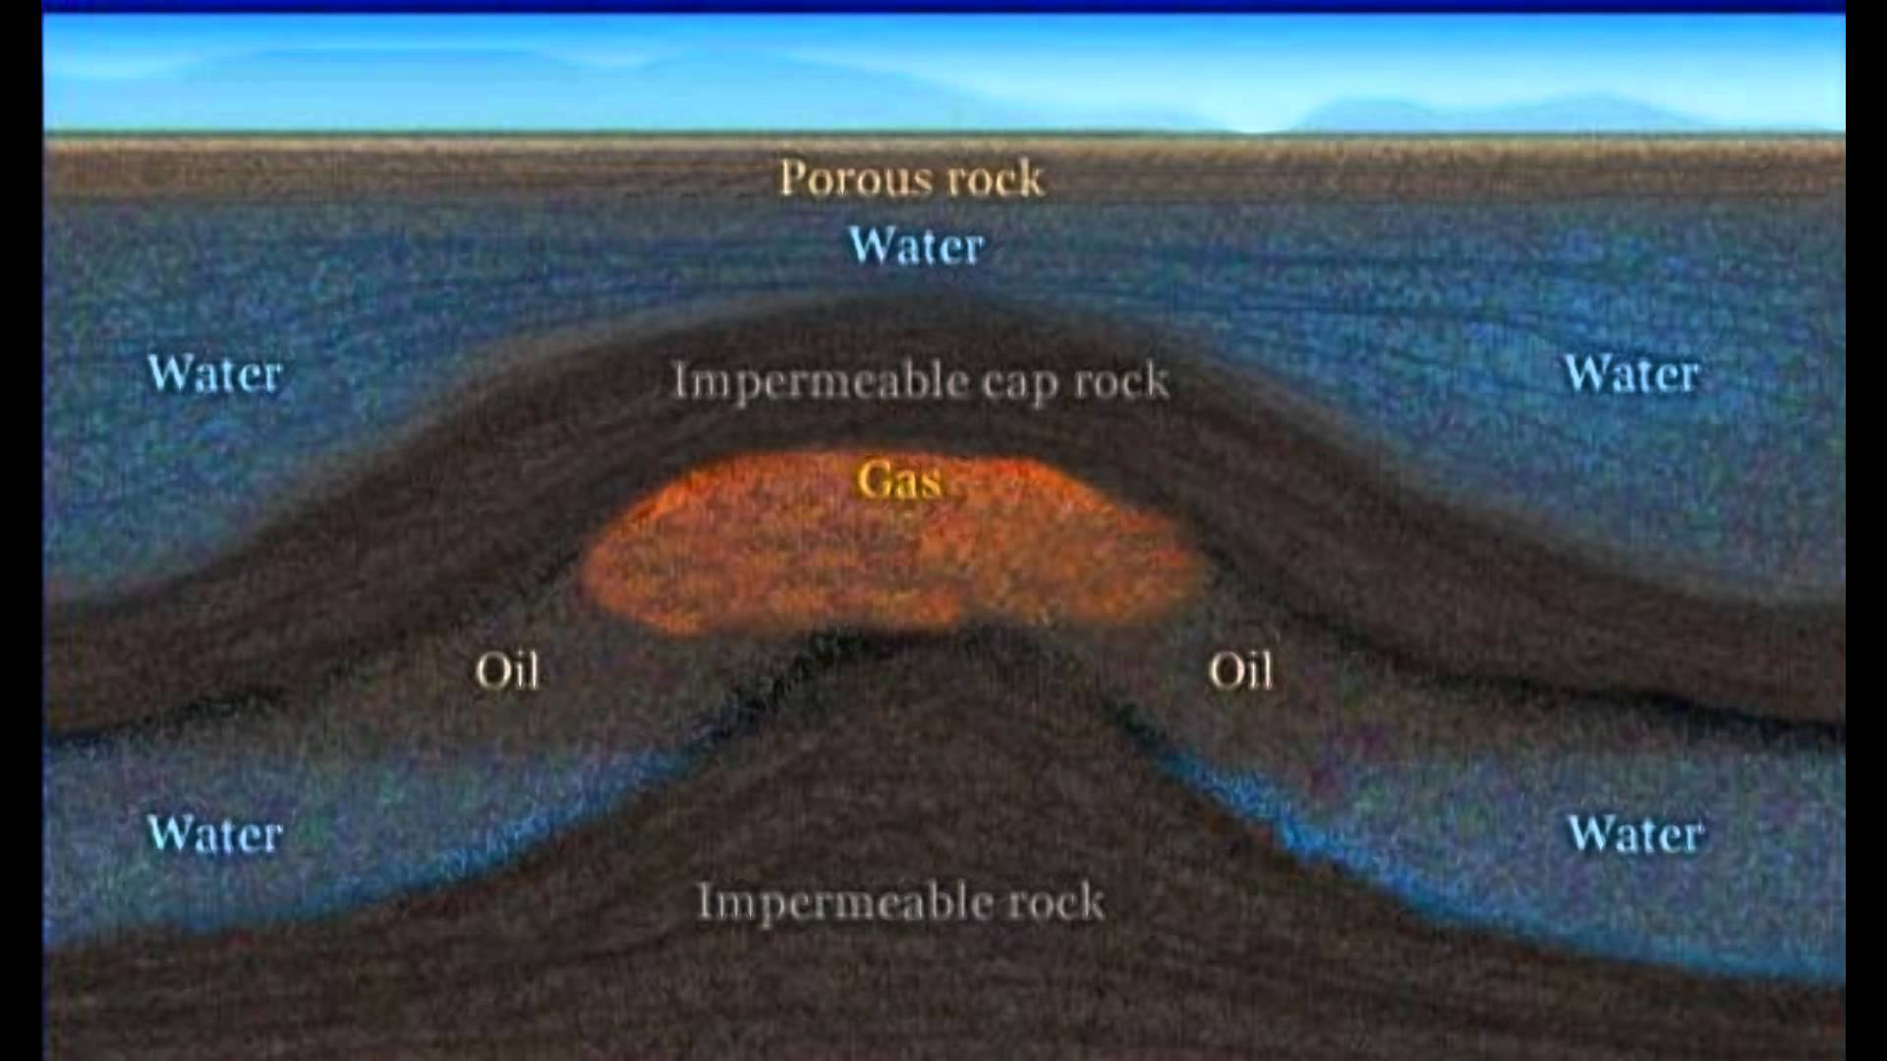

Slide 10
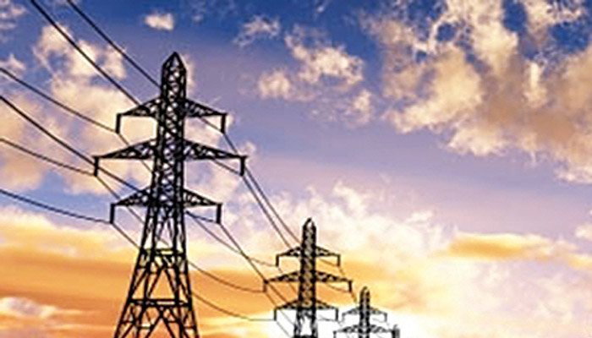

Slide 11
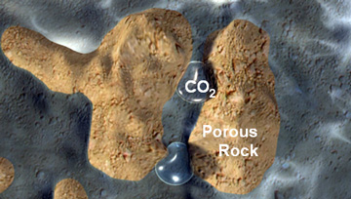

Slide 12
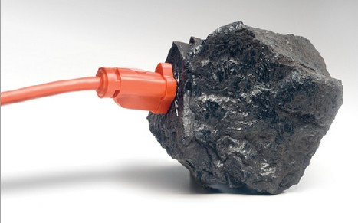

Slide 13


Slide 14
