Slide 1
DIRECTIONAL DESIGN
BODY MACHINE FITNESS
PLANO, TEXAS

Slide 2
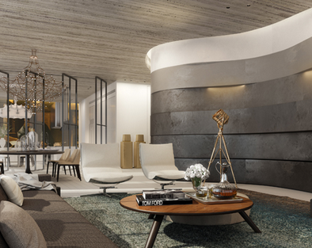
THE ‘LOOK & FEEL’ OF THE ENTIRE GYM (workout area would be different)
Chic, elegant, luxurious and edgy
Incorporation of unique elements
Semi-contemporary: clean/sleek materials and furniture that are functional, use of leather, wood, stones such as granite, marble etc. but not plastic if possible
Semi-industrial: use of concrete, iron/steel, range of gray/black colors
Warm (earthy) and inviting: use of rich color tree barks, washed wood, lighting (ex. spot lights, strip lights hidden under materials)
Natural & fresh: use of moss, greeneries in walls, white/cream colors
Design objective: to find a balance between cold (industrial/ contemporary) and warmth (earthy/greens) and pop of colors from items such as rich tree barks material/furniture, greenery accents (moss, plants, etc.), black iron/steel

Slide 3
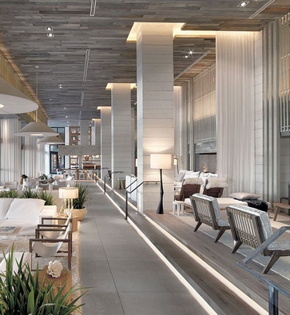
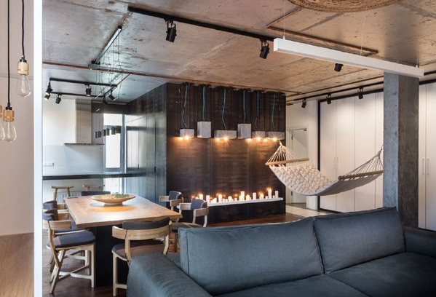
THE ‘LOOK & FEEL’ OF THE ENTIRE GYM (workout area would be different)
Beautiful balance and mix between concrete, wood and ambiance lighting

Slide 4
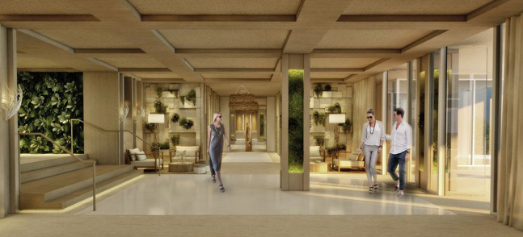
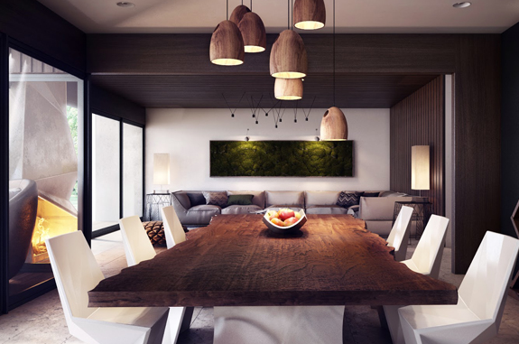
THE ‘LOOK & FEEL’ OF THE ENTIRE GYM (excluding the inside workout area)
This is a fabulous display of well-placed art-like greenery and unique wood elements to represent the “real/raw” part of the brand DNA; yet, still stay true to the chic elegant theme. This also is in line with the ‘earthy/warm’ feeling component to offset the concrete and metal that we’re going to use.

Slide 5
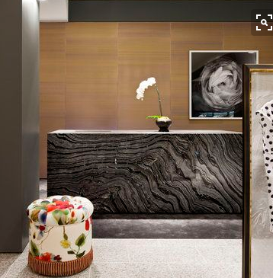
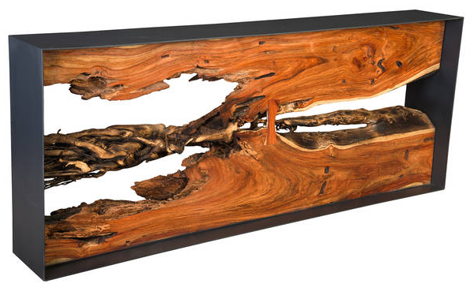
RECEPTION AND LOBBY INSPIRATION (check-in area)
Long slab wood table wood/metal

Slide 6
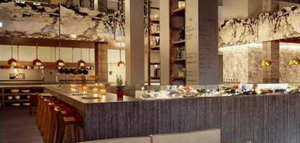
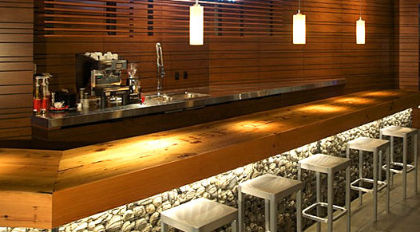
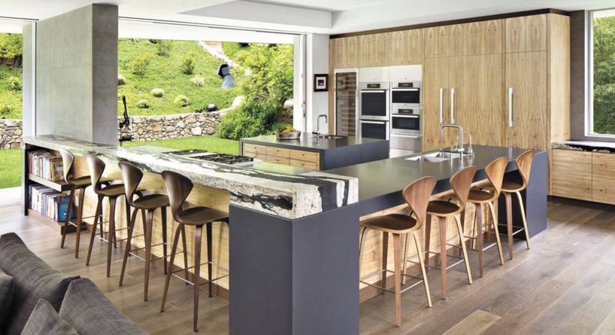
CAFÉ BAR INSPIRATION
Cool lighting above and beneath wood bar top to warm up the area
Inspiration visual of good mix between natural wood, concrete and stones highlighted by the greens in the back that can be replaced with plants, moss décor, etc.

Slide 7
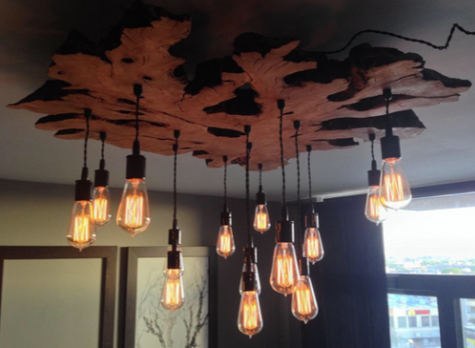
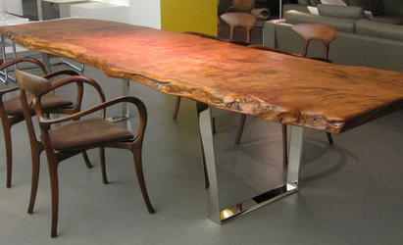
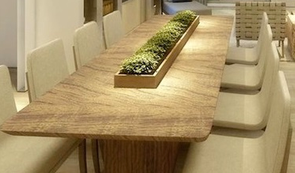
CAFÉ COMMUNAL TABLE & CHANDERLIER INSPIRATION

Slide 8
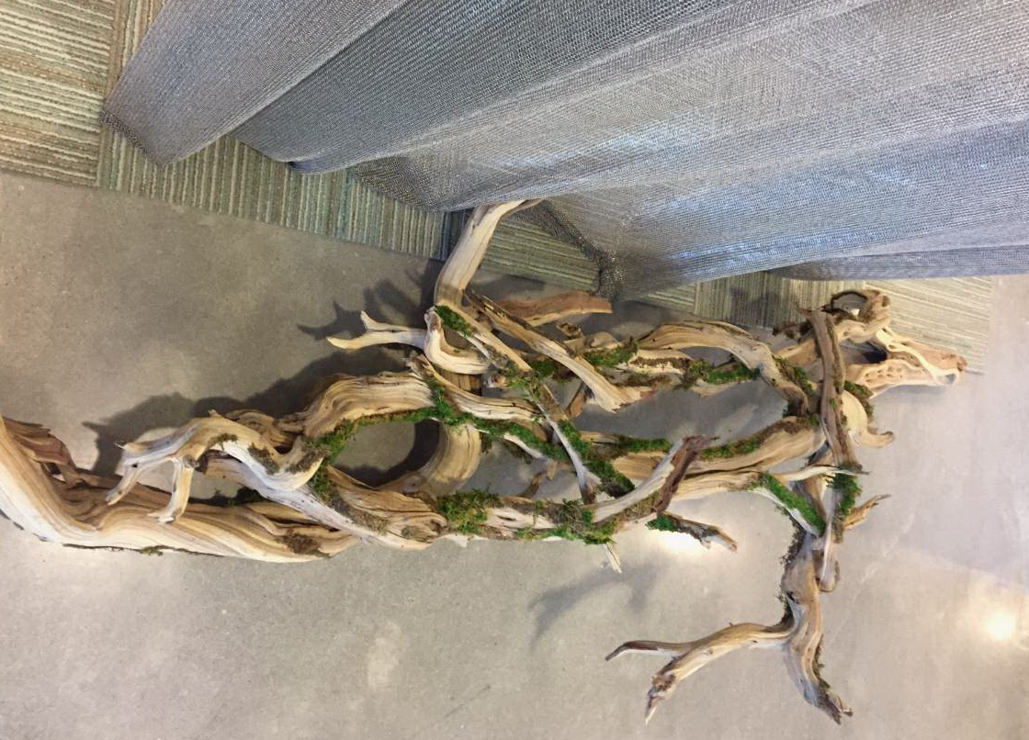
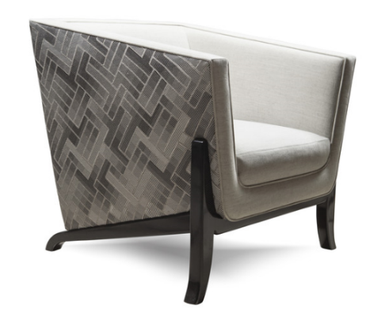
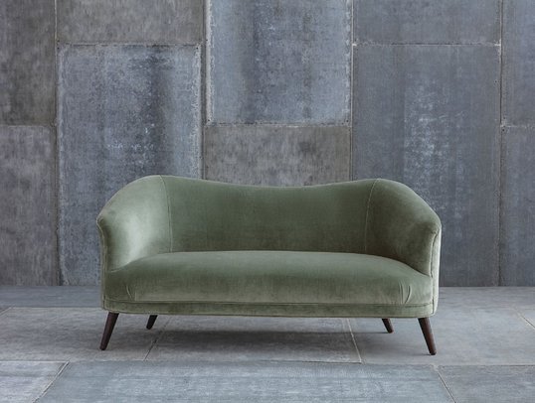
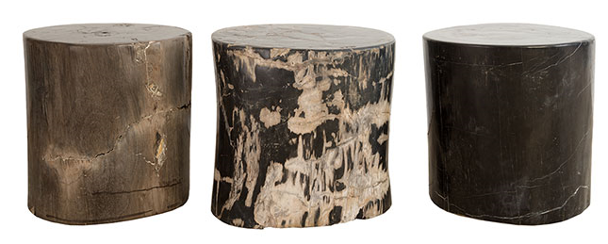
SOFT SEATING MATERIALS INSPIRATION
Example of sleek sofa (leather instead of fabric) with a bit of an edge and would be great in black
petrified wood side tables

Slide 9
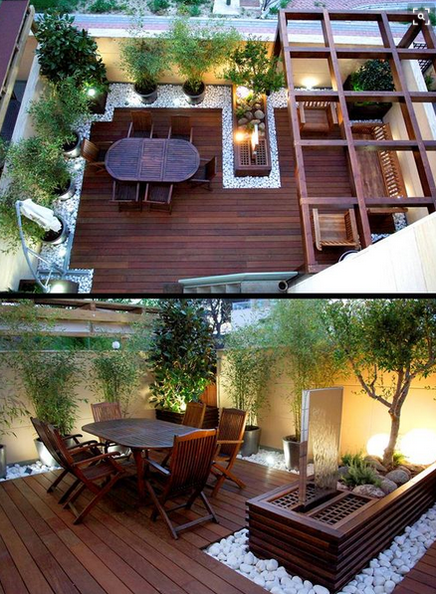
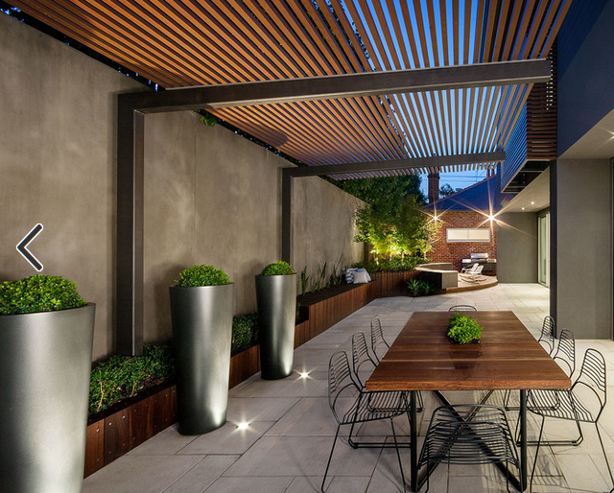
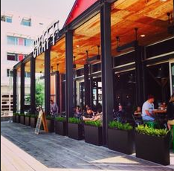
PATIO / EXTERIOR INSPIRATION
Nice display of potted plants as a border
Fantastic visual of the ‘vibe’ of the patio with mix of greens, wood, iron, and lighting

Slide 10
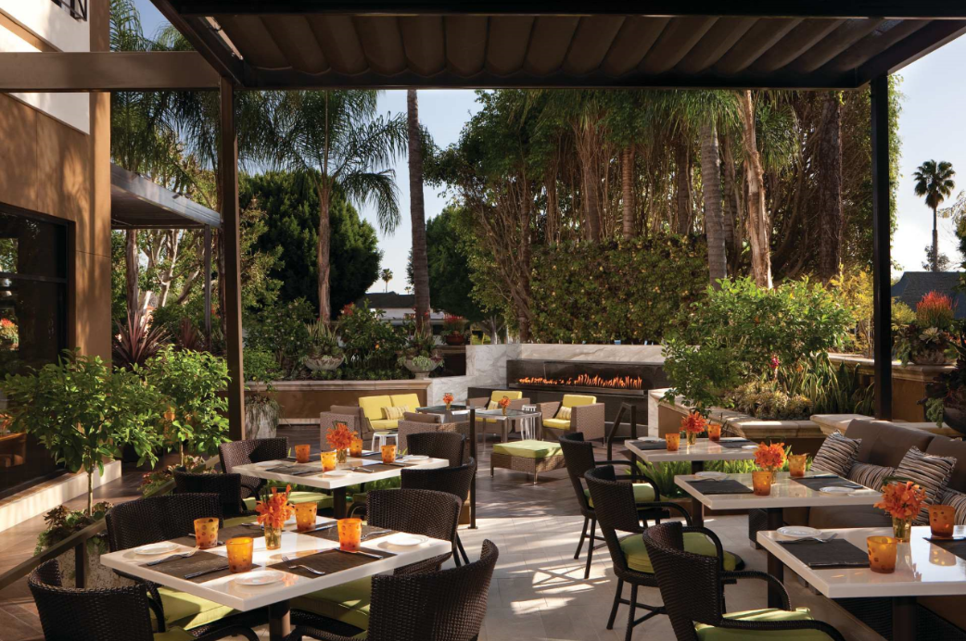
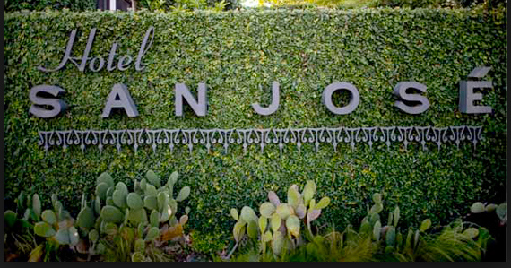
PATIO / EXTERIOR INSPIRATION Cont.
Live ‘green’ wall with company logo/name
Materials that are sturdy that may be made of wood, metal and/or plastic (pictures reflect group seating but will apply to smaller tables with four chairs)

Slide 11
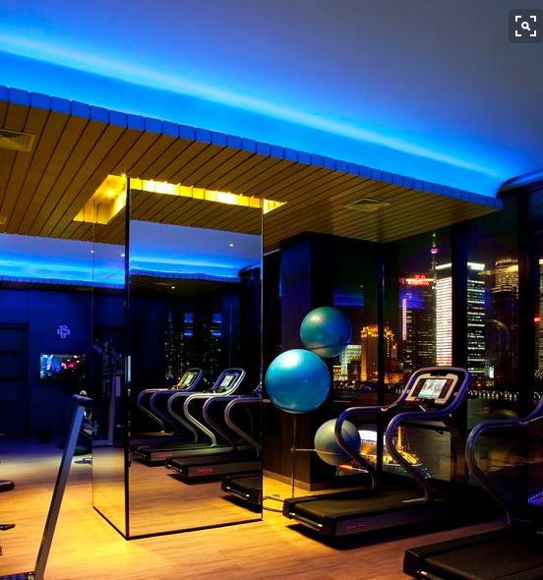
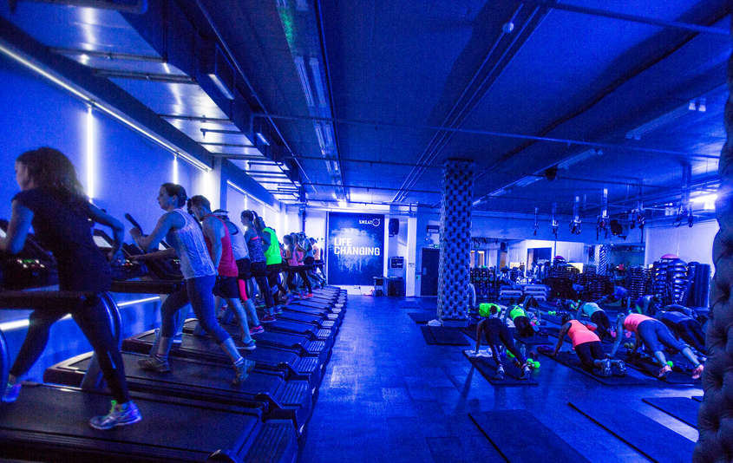
MAIN WORKOUT SPACE INSPIRATION
Accent color of cobalt blue in ceiling and/or walls

Slide 12
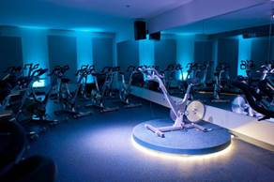
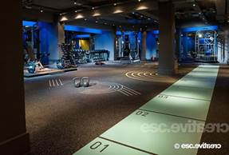
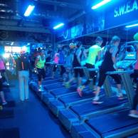
MAIN WORKOUT SPACE INSPIRATION

Slide 13
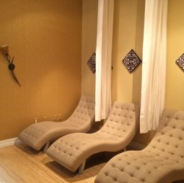
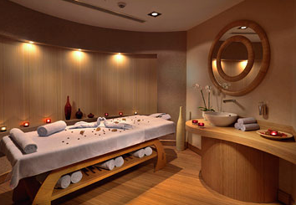
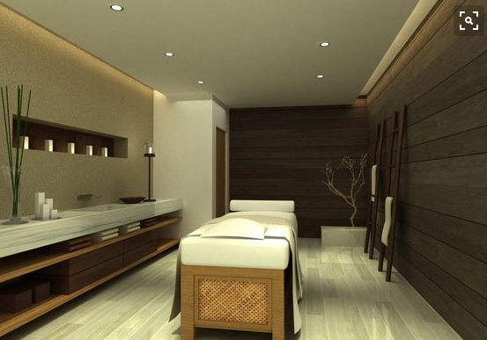
GUEST SERVICES INSPIRATION

Slide 14
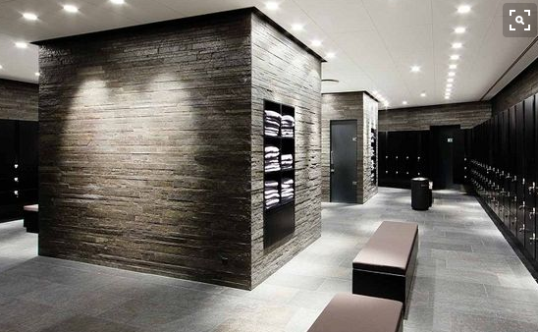
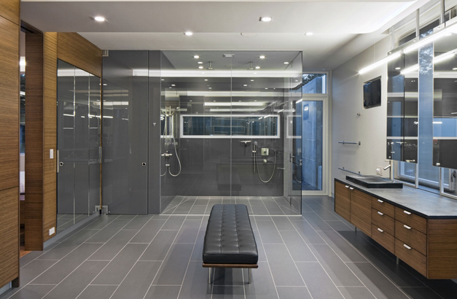
MEN LOCKER ROOM FURNITURE & MATERIALS INSPIRATION
Very nice mix of wood, class, stone, leather. Great lighting.
Incorporate one of the inspiration bench options on slide 15

Slide 15
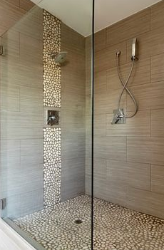
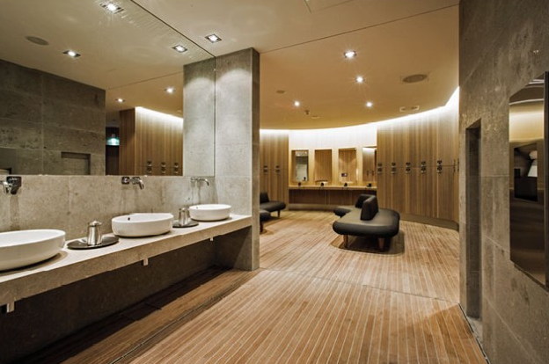
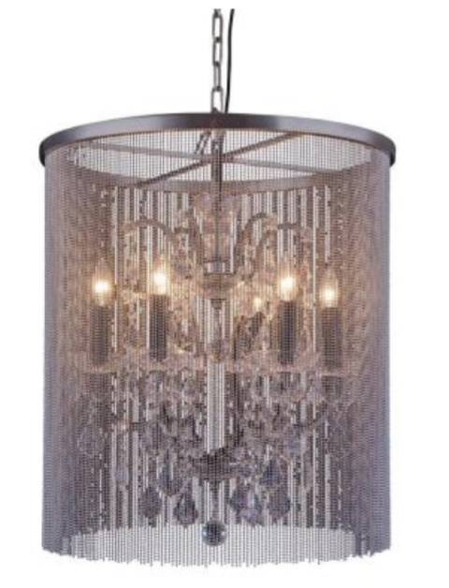
WOMEN LOCKER ROOM FURNITURE & MATERIALS INSPIRATION
Large textured tiles and Japanese rocks showers and frosted glass doors
Spa-like locker rooms and showers. Great use of lighting, wood mixed with concrete and metal

Slide 16
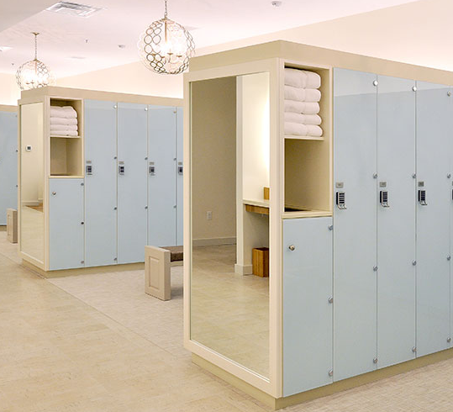
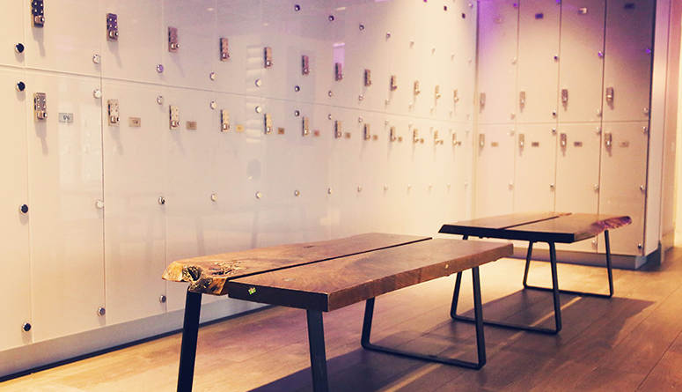
LOCKERS & CUBBIES INSPIRATION

Slide 17
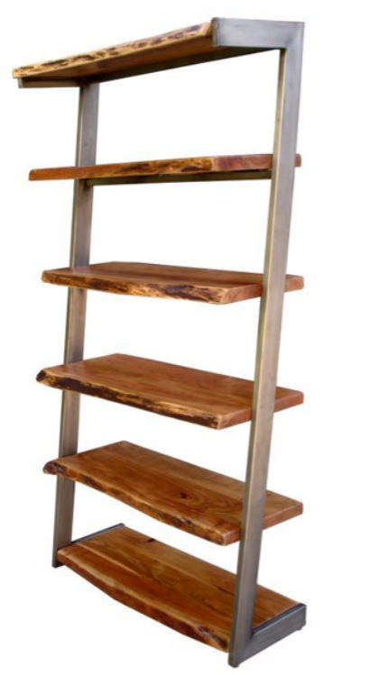
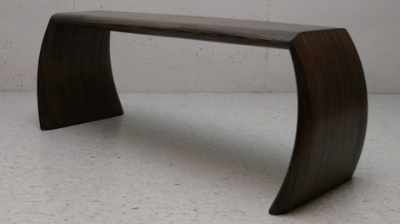
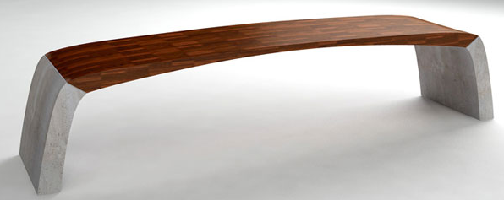
LOCKER BENCHES AND TOWELS SHELF INSPIRATION

Slide 18
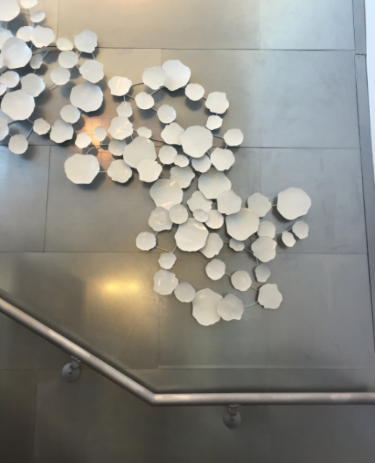
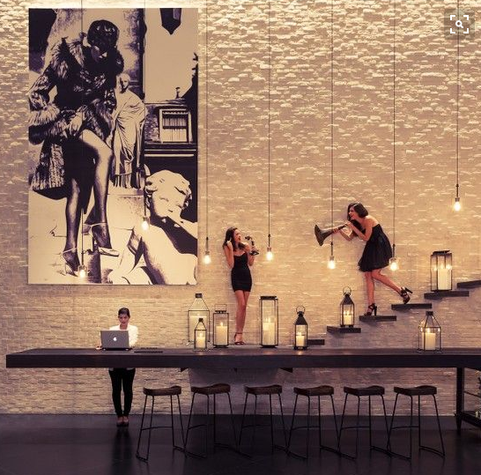
WALL ARTWORK/MESSAGE

Slide 19
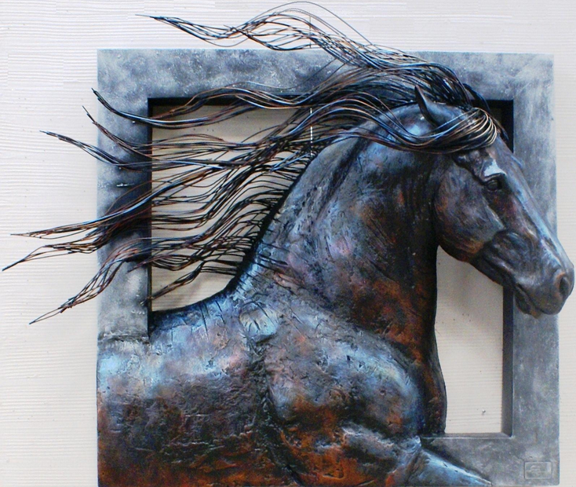
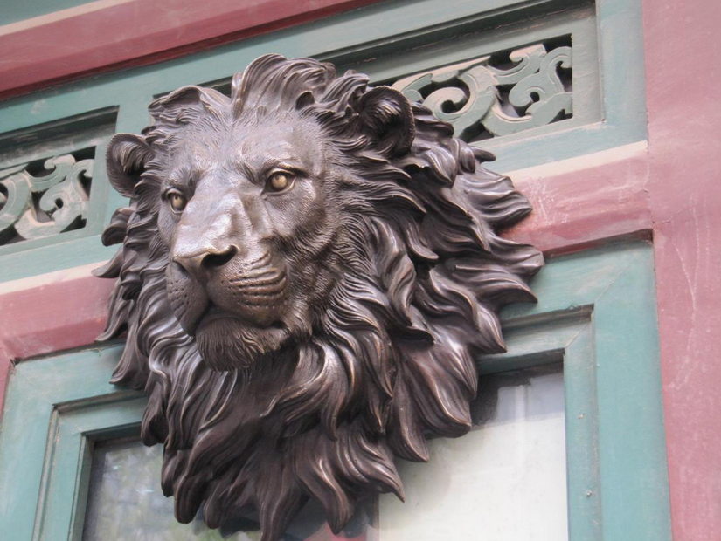
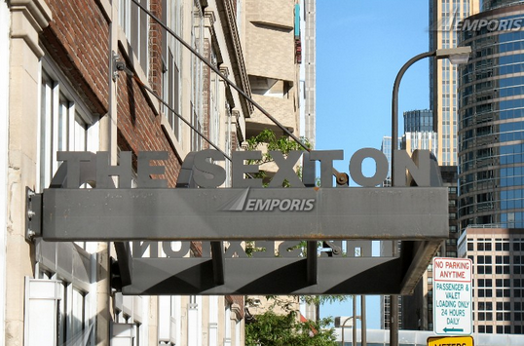
SIGNAGE INSPIRATION
3D Sculpture of BMF logo

Slide 20
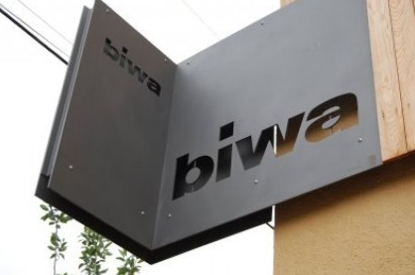
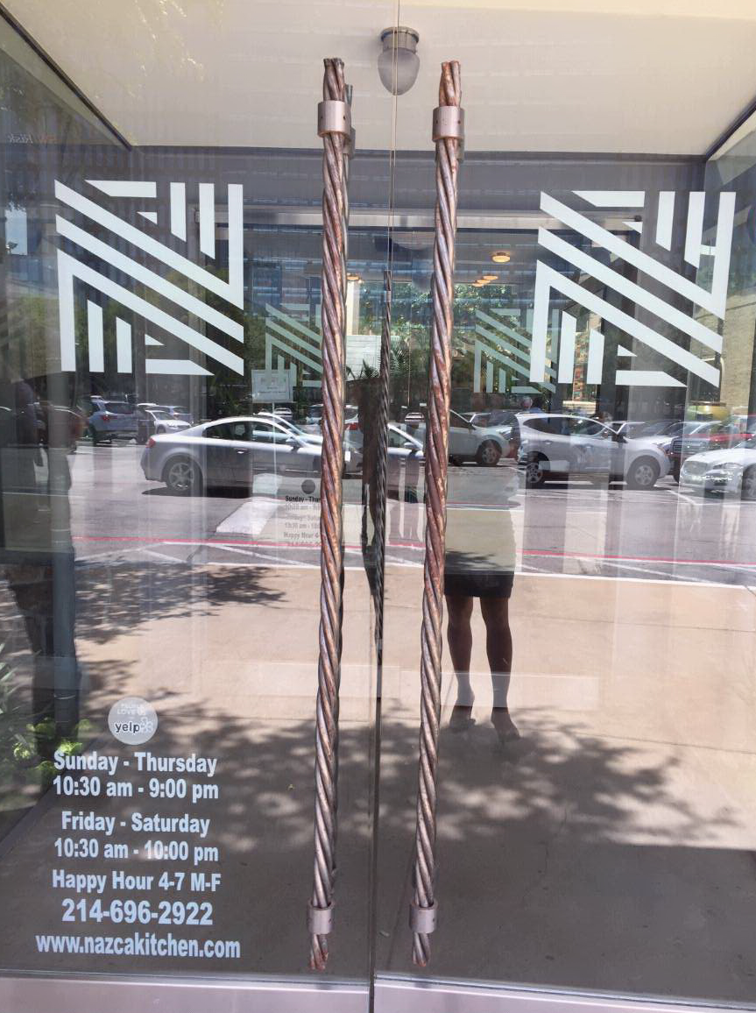
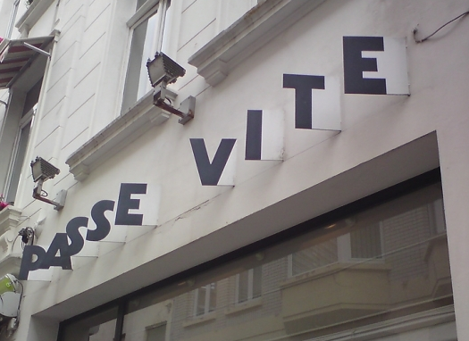
SIGNAGE INSPIRATION - EXTERIOR

Slide 21
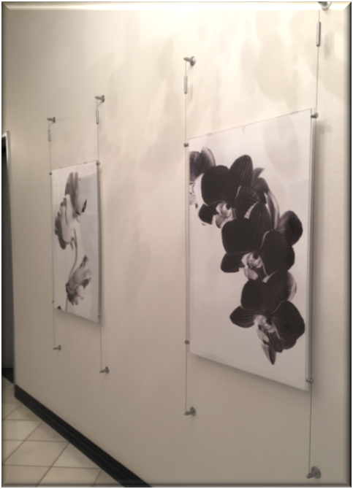
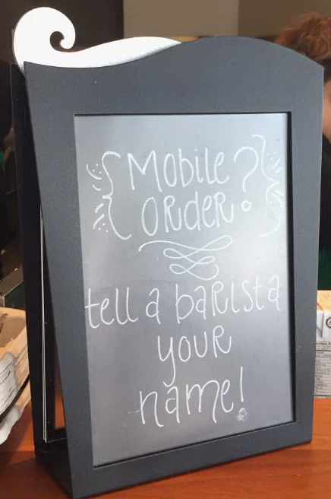


SIGNAGE INSPIRATION - INTERIOR

