Slide 1


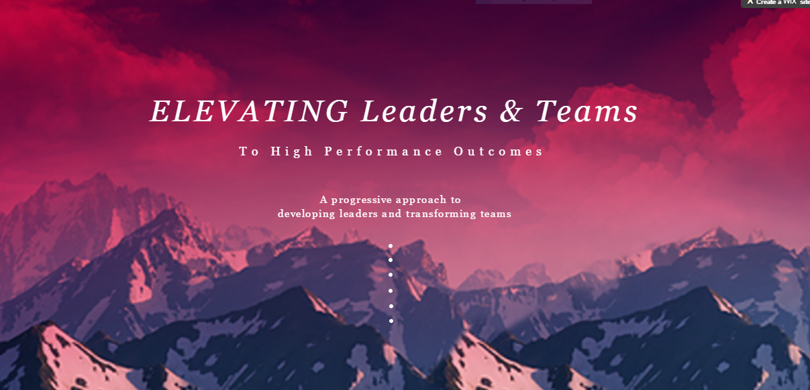
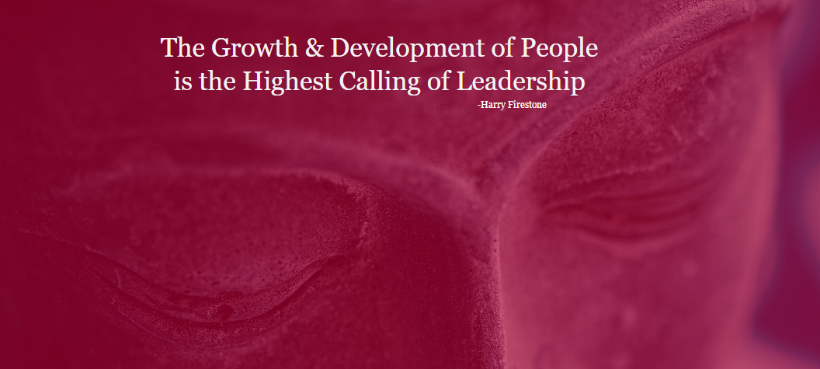
Graphic elements

Slide 2
Persona
Think Spiritual yet practical.
Knowing the heart, mind and motive strengthens belief.
Now more than ever before, leaders are faced with increased challenges. The workplace landscape has never been more competitive, complex and full of competing priorities. To make great strides in increasingly complex business environments leaders requires an awareness of self and to take 100% responsibility and ownership for their behaviors, actions and outcome I understands that organizational success depends on the growth of the leaders and people in it and to be their best self they need to be developed as people first.
That’s my responsibility. I engage your head, heart and hopefulness to awaken the powerful leader within.
My promise: To support the growth of leaders spiritually, emotionally, individually, and collectively. Sharing my wisdom and experience in a safe, trusted and meaningful way and give them everything they need to be the best leader they can be.
I do all this with the conviction to lead the way smarter, faster, more effectively, both for my clients and for myself. The competitive nature of leadership development demands nothing less and nor do the leaders that belong to the organization. The peril in leading is not aiming too high, but rather aiming too low.
I am Clif Cannon and I truly want to better those that I serve. It’s not a tagline or quid pro quo, I treat all people with compassion, empowerment and professionalism.
I utilize the latest in neuroscience, positive psychology, systems theory and performance coaching to help leaders reach their peak performance. In more authentic words I use a heart-centered and mind-based methodology to create transformation and create lasting change that causes organizations to experience leaps in performance they otherwise could not attain.
Beyond the data and insights, I empower leaders through deep exploration, openness and candor. I believe in teams, not isolated leaders. I believe true change happens through the power in people. I work with different disciplines in rich and deep learning environments that invite open dialogue, knowledge, exchange and discussion of real-world applications. It’s the art and science of collaborative learning that fosters opportunities.

