Slide 1
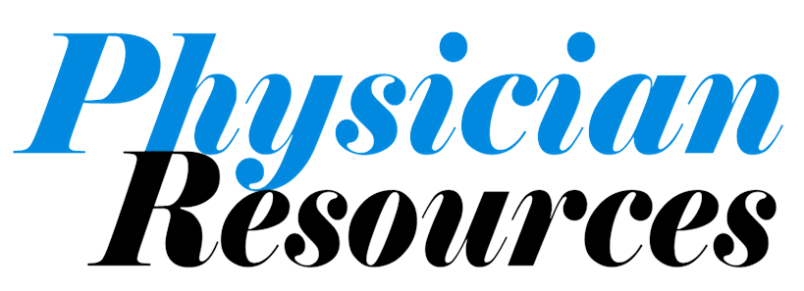
Cost Effective Resources For Your Practice
CASH BACK MEDICAL PLANS
15% WELLNESS MEDICAL DISCOUNT

Slide 2


Slide 3
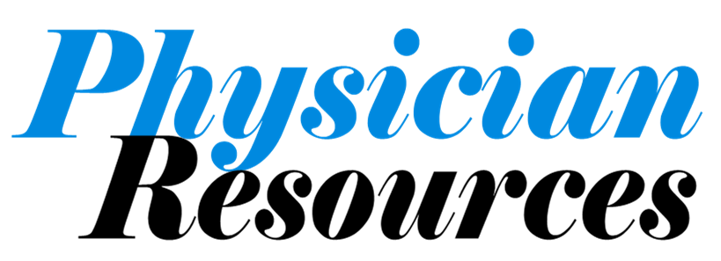
With Physician Resources, your practice comes first.
The Physician Resources practice management program is expressly designed to enhance your practice.
From cash back on select medical plans to low cost practice payroll fees.
With Physician Resources your practice will have access to products and services that help put thousands of dollars back into your practice each year.
Practice
Management

Slide 4


Slide 5
The time and effort you put in deserve no limitations.
Once you meet with our advisors, you’ll see what we mean by no limitations
Earn cash back on select medical plans, reduce your expenses
Reduce admin and practice payroll fees.
With our practice management solution, we partner with your existing staff leadership to help manage benefits, payroll and more.
Practice
Management

Slide 6


Slide 7
When was the last time you had a medical program that will help your practice?
With Physician Resources, we have access to exclusive programs that provide a premium return and help your practice benefits soar.
Earn cash back on select medical plans, money back each year
Earn 7% to 15% with wellness discounts
$0 Risk with all the rewards with our medical rebate programs
Practice
Management

Slide 8
Always on the job for you and your staff
Physician Resources offers “Practice Management Concierge”. Your staff can reach our advisors after hours including weekends.
Need an ID card for medical, dental or assistance
Can’t access the payroll system to get a paystub or w-2
Have a question regarding a claim, need assistance with a carrier
Serving your staff and your practice is our mission, let’s talk more
Practice
Management

Slide 9
Concentrate on your practice and patients, we’ll take care of you.
Physician Resources offers more than just words, we get results. Here are some cases:
55 physician practice - paying $150,000 annually in workers comp, Physician Resources reduced their cost to $70,000
Practice using national payroll service provider had fragmented results, lack of coordination – we now run their payroll, benefits, 401(k) and more
Your practice has a story, Physician Resources Practice Management has the narrative, please schedule your review.
Practice
Management

Slide 10
Physician Resources Practice Management is a relationship that gives your practice time, cost and rewards
Proven guidance in group benefits, payroll, human resources, workers compensation, 401(k) and more
VISIT: www.phyrc.com
or
CALL 407-509-2354

