Slide 1
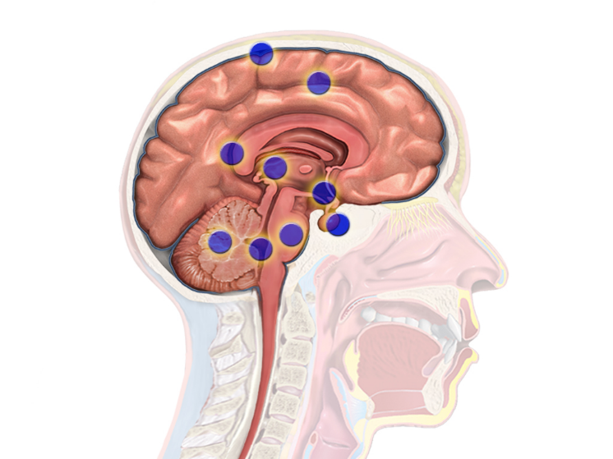
MARIE SKLODOWSKA-CURIE INNOVATIVE TRAINING NETWORK
B B D i a g

