Slide 1

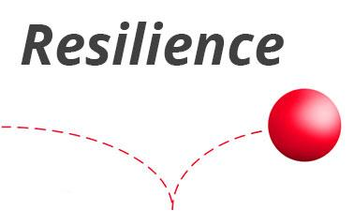
Resilience Training teaches participants how to:
See what is really going on, not what they want to see
Seek the power to be gained, not fear loss
Clarify priorities and values
Improvise to create solutions
Foster teamwork and better decision making
Build acceptance rather than resistance
The problem is that we are all stressed and not as satisfied as we would like to be in all of our work and home situations due a seemingly relentless and uncontrollable tidal wave of change.
The solution is to learn how to build your reliance in a way to thrive on change. Resilience is learned and practiced by owning the power of choice, focusing on the ways to gain power and building meaningful relationships.
Stepping Up to Change
Who Needs Resilience Training?
Is your organization going through a major change (reorganization, new strategy, merger/acquisition, downsizing, turbulent market)? Does your organization need to be creative and nimble to deliver to demanding clients? Do you need your people to grow and take on new responsibilities? Then you, your team, or your organization needs Resilience Training.

