Slide 1
GConnex
brand strategy presentation

Slide 2
the organisation’s image

Slide 3
the organisation’s image
1
Is based on people’s perceptions of what the organisation is like

Slide 4
the organisation’s image
Is based on people’s perceptions of what the organisation is like Is influenced by what people have:
1
2

Slide 5
the organisation’s image
Is based on people’s perceptions of what the organisation is like Is influenced by what people have:
seen (symbol, name / colour, typography)
read or heard (advertisements, editorials, word-of-mouth, media)
experienced or observed in dealing with (client’s) or working with the company (peers)
1
2

Slide 6
brand structure building a strong foundation
the
brand

Slide 7
brand structure building a strong foundation
L1 visual identity
the
brand

Slide 8
brand structure building a strong foundation
L1 visual identity
the
L2 corporate identity
brand

Slide 9
brand structure building a strong foundation
L1 visual identity
the
L2 corporate identity
brand
L3 technical identity

Slide 10
brand structure building a strong foundation
L1 visual identity
the
L2 corporate identity
brand
L3 technical identity
L4 profile identity

Slide 11
brand structure building a strong foundation
outside in
perception
L1 visual identity
the
L2 corporate identity
brand
L3 technical identity
L4 profile identity

Slide 12
brand structure building a strong foundation
outside in
perception
L1 visual identity
the
L2 corporate identity
brand
L3 technical identity
L4 profile identity
inside out
reputation

Slide 13
brand structure building a strong foundation
outside in
perception
L1 visual identity
the
L2 corporate identity
brand
L3 technical identity
L4 profile identity
inside out
reputation

Slide 14
brand structure building a strong foundation
outside in
perception
L1 visual identity
corporate image
the
L2 corporate identity
brand
L3 technical identity
brand retention
L4 profile identity
inside out
reputation

Slide 15
brand success

Slide 16
brand success
different
1
Creating a brand is about being
and delivering the unanticipated.

Slide 17
brand success
different
1
Creating a brand is about being and delivering the unanticipated.
capture your attention.
2
To last the distance brands must challenge you and

Slide 18
brand success
different
1
Creating a brand is about being and delivering the unanticipated.
capture your attention.
To last the distance brands must challenge you and
impact!
2
3
The more original they are the greater their

Slide 19
brand success
different
1
Creating a brand is about being and delivering the unanticipated.
capture your attention.
To last the distance brands must challenge you and
impact!
2
3
The more original they are the greater their
4
The greater their impact the greater their ^{success.}

Slide 20
brand culture the big picture

Slide 21
brand culture the big picture
corporate identity

Slide 22
brand culture the big picture
corporate identity
internal
the real organisation
the way key stakeholders and staff see the entity = ownership

Slide 23
brand culture the big picture
corporate identity
internal
the real organisation
the way key stakeholders and staff see the entity = ownership
logo/mark + name the brand/trademark

Slide 24
brand culture the big picture
corporate identity
internal
the real organisation
the way key stakeholders and staff see the entity = ownership
logo/mark + name the brand/trademark
agenda for change

Slide 25
brand culture the big picture
corporate identity
internal
the real organisation
the way key stakeholders and staff see the entity = ownership
logo/mark + name the brand/trademark
agenda for change
brand leadership

Slide 26
brand culture the big picture
corporate identity
internal
the real organisation
the way key stakeholders and staff see the entity = ownership
logo/mark + name the brand/trademark
agenda for change
comfort
brand leadership

Slide 27
brand culture the big picture
corporate identity
internal
the real organisation
the way key stakeholders and staff see the entity = ownership
logo/mark + name the brand/trademark
agenda for change
comfort
brand leadership

Slide 28
brand culture the big picture
corporate identity
internal
the real organisation
the way key stakeholders and staff see the entity = ownership
logo/mark + name the brand/trademark
agenda for change
comfort
brand leadership

Slide 29
brand culture the big picture
corporate identity
internal
the real organisation
the way key stakeholders and staff see the entity = ownership
logo/mark + name the brand/trademark
agenda for change
comfort
brand leadership

Slide 30
brand culture the big picture
corporate identity
internal
the real organisation
the way key stakeholders and staff see the entity = ownership
logo/mark + name the brand/trademark
agenda for change
comfort
brand leadership

Slide 31
brand culture the big picture
corporate identity
internal
the real organisation
the way key stakeholders and staff see the entity = ownership
logo/mark + name the brand/trademark
agenda for change
comfort
brand leadership

Slide 32
brand culture the big picture
corporate identity
internal
the real organisation
the way key stakeholders and staff see the entity = ownership
logo/mark + name the brand/trademark
agenda for change
comfort
brand leadership
position 1
position 2
position 3
existing mark
evolved mark
new mark

Slide 33
brand culture the big picture
corporate identity
internal
the real organisation
the way key stakeholders and staff see the entity = ownership
logo/mark + name the brand/trademark
agenda for change
comfort
brand leadership
position 1
position 2
position 3
existing mark
evolved mark
new mark
position 4
position 5
position 6
existing name
evolved name
new brand

Slide 34
brand culture the big picture
corporate identity
internal
the real organisation
the way key stakeholders and staff see the entity = ownership
logo/mark + name the brand/trademark
agenda for change
comfort
brand leadership
position 1
position 2
position 3
existing mark
evolved mark
new mark
position 4
position 5
position 6
existing name
evolved name
new brand

Slide 35
brand science

Slide 36
brand governance technical descriptor brand promise solution streams
brand theme campaign voice brand ethics
_{m}a
brand map
_{b}g
_{d}e _{p}r
_{s}l _{t}h _{c}v _{e}t
_{b}v
_{a}u _{i}n _{c}p
_{t}y _{b}i _{s}u
brand inventory
identity audit
_{c}r
_{v}i _{s}t _{c}o _{o}n _{l}v _{e}n
brand credential
visual identity
_{w}o
wordscout™
_{o}b _{a}g
_{s}t
_{d}i _{i}d
brand objectives
brand agenda brand strategy whiteboard diagram corporate identity
inspiration
stationery
colour palette
brand collateral
typography
online
brand icon
sub brand
livery
environment

Slide 37
table of brand elements

Slide 38
brand map

Slide 39
3 Energy
“Financial & human capital to grow business, people & values”
brand map

Slide 40
3 Energy
“Financial & human capital to grow business, people & values”
Geiger Group
brand map

Slide 41
3 Energy
“Financial & human capital to grow business, people & values”
Geiger Group
Geiger Group Qld
Electrical
Civil
Maintenance
Construction
Fibre / coms
Water
Property M’ment
Consultation
brand map

Slide 42
3 Energy
“Financial & human capital to grow business, people & values”
Geiger Group
Geiger Group Qld
Electrical
Civil
Maintenance
Construction
Fibre / coms
Water
Property M’ment
Consultation
Geiger Group Vic
Electrical
brand map

Slide 43
3 Energy
“Financial & human capital to grow business, people & values”
Geiger Group
Geiger Fuel Solutions
Geiger Group Qld
Electrical
Construction
Service
Maintenance
Civil
Maintenance
Construction
Fibre / coms
Water
Property M’ment
Consultation
Geiger Group Vic
Electrical
brand map

Slide 44
3 Energy
“Financial & human capital to grow business, people & values”
Geiger Group
Geiger Fuel Solutions
Tuff Group
Geiger Group Qld
Electrical
Construction
Service
Maintenance
Civil
Maintenance
Construction
Fibre / coms
Water
Property M’ment
Consultation
Geiger Group Vic
Electrical
brand map

Slide 45
3 Energy
“Financial & human capital to grow business, people & values”
Geiger Group
Geiger Fuel Solutions
Tuff Group
Geiger Group Qld
Electrical
Construction
Service
Maintenance
Tuff Bullbars
Bullbars
brand map
Civil
Brushrails
Maintenance
Construction
Fibre / coms
Accessories
Water
Property M’ment
Consultation
Geiger Group Vic
Electrical

Slide 46
3 Energy
“Financial & human capital to grow business, people & values”
Geiger Group
Geiger Fuel Solutions
Tuff Group
Geiger Group Qld
Electrical
Construction
Service
Maintenance
Tuff Bullbars
Bullbars
brand map
Civil
Brushrails
Maintenance
Construction
Accessories
Fibre / coms
Water
Tuff Coatings
Powdercoating
Rhino lining
Sandblasting
Property M’ment
Consultation
Geiger Group Vic
Electrical

Slide 47
3 Energy
“Financial & human capital to grow business, people & values”
Geiger Group
Geiger Fuel Solutions
Tuff Group
Sanki (Aus)
Fuel delivery devices for retail
Geiger Group Qld
Electrical
Construction
Service
Maintenance
Tuff Bullbars
fuel industry
Bullbars
brand map
Civil
Brushrails
Maintenance
Construction
Accessories
Fibre / coms
Water
Tuff Coatings
Powdercoating
Rhino lining
Sandblasting
Property M’ment
Consultation
Geiger Group Vic
Electrical

Slide 48
3 Energy
“Financial & human capital to grow business, people & values”
Geiger Group
Geiger Fuel Solutions
Tuff Group
Sanki (Aus)
Fuel delivery devices for retail
RDS
Rotating Disc Systems
Geiger Group Qld
Electrical
Construction
Service
Maintenance
Tuff Bullbars
fuel industry
Water treatment solutions
Bullbars
brand map
Civil
Brushrails
Maintenance
Construction
Accessories
Fibre / coms
Water
Tuff Coatings
Powdercoating
Rhino lining
Sandblasting
Property M’ment
Consultation
Geiger Group Vic
Electrical

Slide 49
3 Energy
“Financial & human capital to grow business, people & values”
Geiger Group
Geiger Fuel Solutions
Tuff Group
Sanki (Aus)
Fuel delivery devices for retail
RDS
Future Acquisitions...
Rotating Disc Systems
Geiger Group Qld
Electrical
Construction
Service
Maintenance
Tuff Bullbars
fuel industry
Water treatment solutions
Bullbars
brand map
Civil
Brushrails
Maintenance
Construction
Accessories
Fibre / coms
Water
Tuff Coatings
Powdercoating
Rhino lining
Sandblasting
Property M’ment
Consultation
Geiger Group Vic
Electrical

Slide 50
3 Energy
“Financial & human capital to grow business, people & values”
Aviation
Geiger Group
Geiger Fuel Solutions
Tuff Group
Sanki (Aus)
RDS
Future Acquisitions...
Fuel delivery devices for retail fuel industry
Rotating Disc Systems
Water treatment solutions
Geiger Group Qld
Electrical
Construction
Service
Maintenance
Tuff Bullbars
Bullbars
brand map
Civil
Brushrails
Maintenance
Construction
Accessories
Fibre / coms
Water
Tuff Coatings
Powdercoating
Rhino lining
Sandblasting
Property M’ment
Consultation
Geiger Group Vic
Electrical

Slide 51
Geiger Group
Geiger Group Qld
Electrical
Civil
Maintenance
Construction
Fibre / coms
Water
Property M’ment
Consultation
Geiger Group Vic
Electrical
brand map

Slide 52
Geiger Group
Geiger Group Qld
Electrical
Civil
Maintenance
Construction
Fibre / coms
Water
Property M’ment
Consultation
Geiger Group Vic
Electrical
brand map

Slide 53
Trust Time
Honesty and integrity
Lifestyle, fun, well being, family, enjoyment, friendship
Collaboration, contribution, support, good working group, serving
Learning, growth, continuos improvement, self improvement and advancement, personal growth
Leadership
Loyalty, engagement, open honest communication, connection, relationships
Doing a quality job
Geiger Group
Geiger Group Qld
Electrical
Civil
Maintenance
Construction
Fibre / coms
Water
Property M’ment
Consultation
Geiger Group Vic
Electrical
Helping others
Challenge
brand map
Structure Culture
Excellence Safety Money

Slide 54
Internal elements
Trust Time
Helping others Challenge Structure Culture Excellence Safety
Money
Geiger Group
Geiger Group Qld
Electrical
Civil
Maintenance
Construction
Fibre / coms
Water
Property M’ment
Consultation
Geiger Group Vic
Electrical
brand map

Slide 55
Internal elements
External elements
Trust Time
Helping others Challenge Structure Culture Excellence Safety
Money
Geiger Group
Geiger Group Qld
Electrical
Civil
Maintenance
Construction
Fibre / coms
Water
Property M’ment
Consultation
Geiger Group Vic
Electrical
Corporate ID Technical ID Visual ID Profile ID Brand ethics
Service and industry
streams
Campaign voice
brand map

Slide 56
wordscoutTM

Slide 57
innovative, fresh, high standard of excellence, solid, stable, recognised, edgy, safe, high quality, nimble, decisive, driven, international, strong long-term relationships, service oriented, down to earth, problem solvers, real world experience, safety driven, reliable, exciting, trustworthy, connected, loyal, proud, fun, secure, enjoyable, honest, accountable, supportive, passionate, inspired, genuine, generous, chameleon, awesome, unstoppable, annoying, connectivity, different, low risk, one stop shop, experts, complete integrated solution, clever, experienced, compliant, fun, energetic, tenacious, caring, committed, electric eel, honey badger, ferocious, simple, transparent, everyday, diverse, ethical, competitive, honest, family values, trusted, authentic, exciting, push the boundaries, well known, red bull, celebrated under dog, solutions, infrastructure, sub-divisions, energised, unstoppable.
wordscout™

Slide 58
innovative, fresh, high standard of excellence, solid, stable, recognised, edgy, safe, high quality, nimble, decisive, driven, international, strong long-term relationships, service oriented, down to earth, problem solvers, real world experience, safety driven, reliable, exciting, trustworthy, connected, loyal, proud, fun, secure, enjoyable, honest, accountable, supportive, passionate, inspired, genuine, generous, chameleon, awesome, unstoppable, annoying, connectivity, different, low risk, one stop shop, experts, complete integrated solution, clever, experienced, compliant, fun, energetic, tenacious, caring, committed, electric eel, honey badger, ferocious, simple, transparent, everyday, diverse, ethical, competitive, honest, family values, trusted, authentic, exciting, push the boundaries, well known, red bull, celebrated under dog, solutions, infrastructure, sub-divisions, energised, unstoppable.
wordscout™

Slide 59
innovative, fresh, high standard of excellence, solid, stable, recognised, edgy, safe, high quality, nimble, decisive, driven, international, strong long-term relationships, service oriented, down to earth, problem solvers, real world experience, safety driven, reliable, exciting, trustworthy, connected, loyal, proud, fun, secure, enjoyable, honest, accountable, supportive, passionate, inspired, genuine, generous, chameleon, awesome, unstoppable, annoying, connectivity, different, low risk, one stop shop, experts, complete integrated solution, clever, experienced, compliant, fun, energetic, tenacious, caring, committed, electric eel, honey badger, ferocious, simple, transparent, everyday, diverse, ethical, competitive, honest, family values, trusted, authentic, exciting, push the boundaries, well known, red bull, celebrated under dog, solutions, infrastructure, sub-divisions, energised, unstoppable.
wordscout™

Slide 60

wordscout™

Slide 61
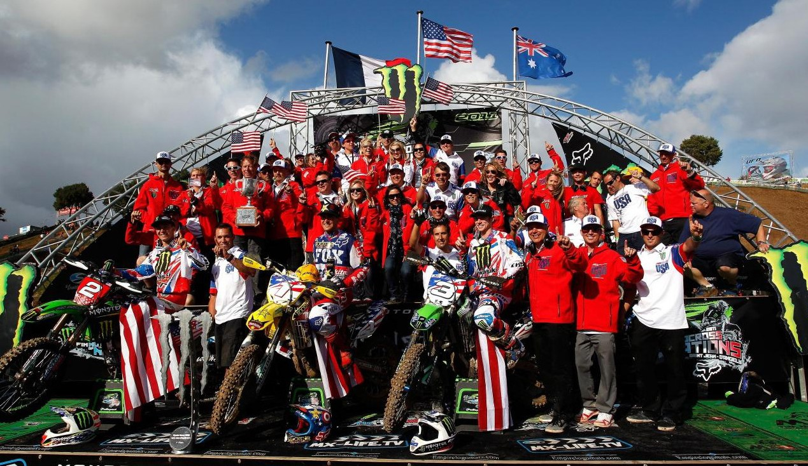
wordscout™

Slide 62
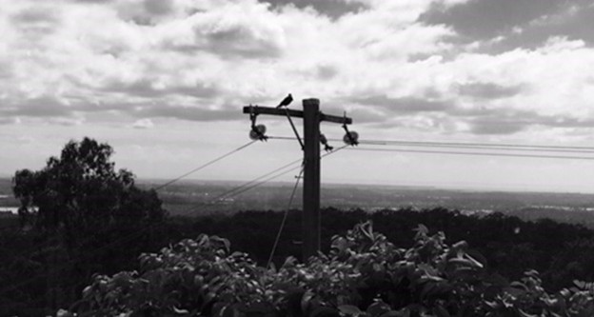
wordscout™

Slide 63

wordscout™

Slide 64
wordscout™
connection – collaboration – capability

Slide 65




wordscout™
energised

Slide 66
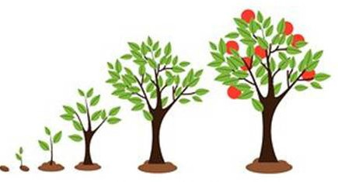

wordscout™
strategic growth

Slide 67
brand objectives

Slide 68
Be clear
brand objectives

Slide 69
Be clear
Clearly communicate our capability and capacity in the markets and industries we cover.
brand objectives

Slide 70
Be clear
Clearly communicate our capability and capacity in the markets and industries we cover.
Be respectful
brand objectives

Slide 71
Be clear
Clearly communicate our capability and capacity in the markets and industries we cover.
Be respectful
Celebrate the heritage and equity within our brand and leverage it to continue to build that equity.
brand objectives

Slide 72
Be clear
Clearly communicate our capability and capacity in the markets and industries we cover.
Be respectful
Celebrate the heritage and equity within our brand and leverage it to continue to build that equity.
Be respected
brand objectives

Slide 73
Be clear
Clearly communicate our capability and capacity in the markets and industries we cover.
Be respectful
Celebrate the heritage and equity within our brand and leverage it to continue to build that equity.
Be respected
Position ourselves as more than just the ‘doers’ in our markets. Bring to light that we are also the experts, practical problem solvers and project managers.
brand objectives

Slide 74
Be clear
Clearly communicate our capability and capacity in the markets and industries we cover.
Be respectful
Celebrate the heritage and equity within our brand and leverage it to continue to build that equity.
Be respected
Position ourselves as more than just the ‘doers’ in our markets. Bring to light that we are also the experts, practical problem solvers and project managers.
Be bold
brand objectives

Slide 75
Be clear
Clearly communicate our capability and capacity in the markets and industries we cover.
Be respectful
Celebrate the heritage and equity within our brand and leverage it to continue to build that equity.
Be respected
Position ourselves as more than just the ‘doers’ in our markets. Bring to light that we are also the experts, practical problem solvers and project managers.
Be bold
Create a solid, memorable and unique brand that communicates our strength, ingenuity and expertise.
brand objectives

Slide 76
brand agenda

Slide 77
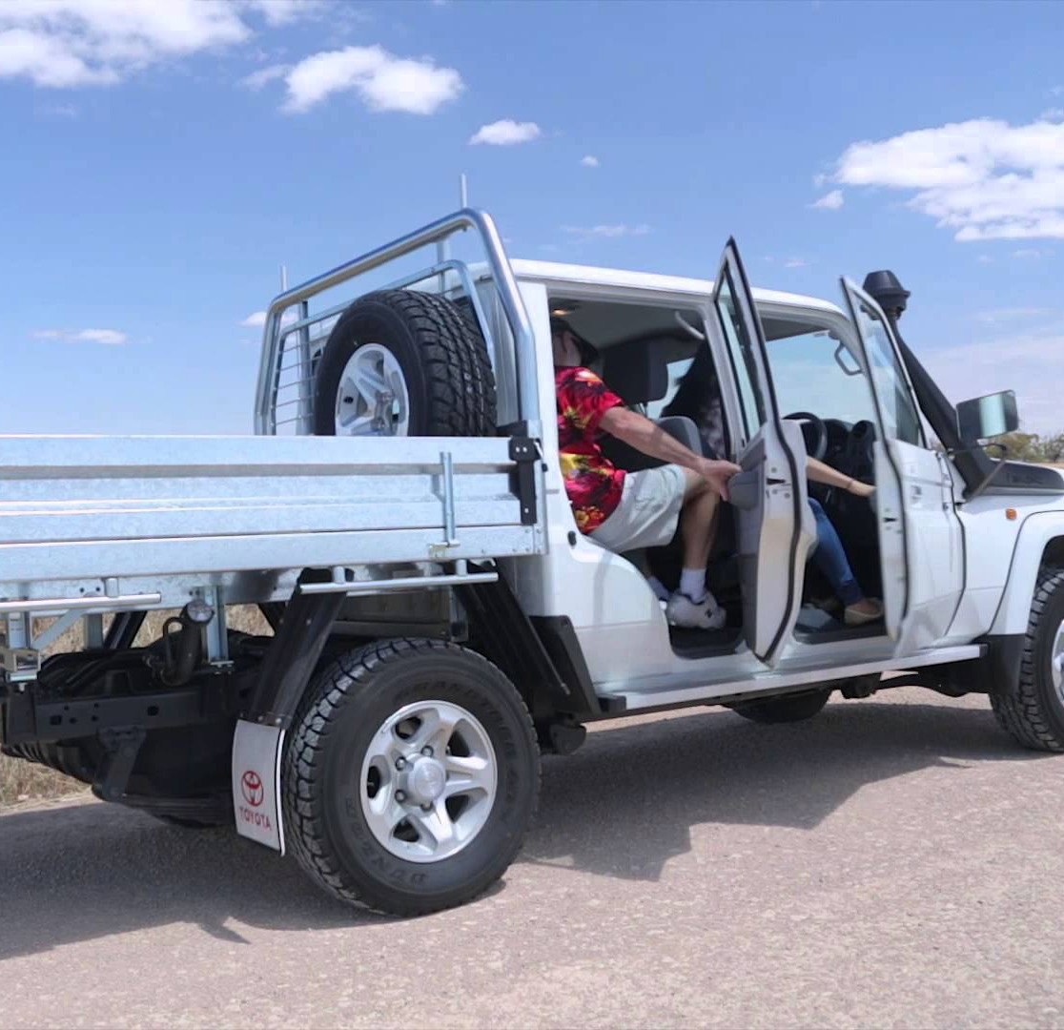
practical performance
brand agenda

Slide 78
practical performance
brand agenda
Unbreakable reliability and performance, delivered with seamless workmanship and focus.

Slide 79

practical performance
team players
brand agenda
Unbreakable reliability and performance, delivered with seamless workmanship and focus.

Slide 80
practical performance
team players
brand agenda
Unbreakable reliability and performance, delivered with seamless workmanship and focus.
At our core is an authentic commitment to our colleagues, our communities, our families and our craft.

Slide 81
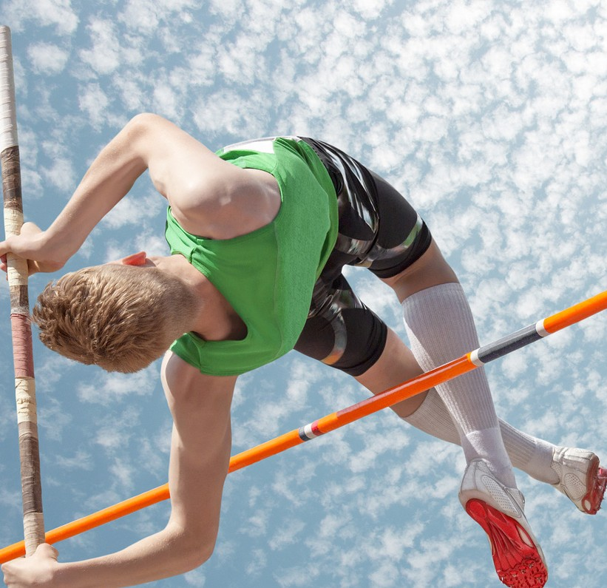
practical performance
team players
driven excellence
brand agenda
Unbreakable reliability and performance, delivered with seamless workmanship and focus.
At our core is an authentic commitment to our colleagues, our communities, our families and our craft.

Slide 82
practical performance
team players
driven excellence
brand agenda
Unbreakable reliability and performance, delivered with seamless workmanship and focus.
At our core is an authentic commitment to our colleagues, our communities, our families and our craft.
Our competitive spirit drives us to find a better way, a smarter solution, a faster route and always, an outstanding result.

Slide 83
practical performance
team players
driven excellence
brand agenda
Unbreakable reliability and performance, delivered with seamless workmanship and focus.
At our core is an authentic commitment to our colleagues, our communities, our families and our craft.
Our competitive spirit drives us to find a better way, a smarter solution, a faster route and always, an outstanding result.
capable

Slide 84
practical performance
team players
driven excellence
brand agenda
Unbreakable reliability and performance, delivered with seamless workmanship and focus.
At our core is an authentic commitment to our colleagues, our communities, our families and our craft.
Our competitive spirit drives us to find a better way, a smarter solution, a faster route and always, an outstanding result.
capable
committed

Slide 85
practical performance
team players
driven excellence
brand agenda
Unbreakable reliability and performance, delivered with seamless workmanship and focus.
At our core is an authentic commitment to our colleagues, our communities, our families and our craft.
Our competitive spirit drives us to find a better way, a smarter solution, a faster route and always, an outstanding result.
capable
committed
competitive

Slide 86
what makes us different?
brand agenda

Slide 87
what makes us different?
we see through complexity to simple solutions
brand agenda

Slide 88
what makes us different?
we see through complexity to simple solutions
our down to earth approach drives authentic outcomes
brand agenda

Slide 89
what makes us different?
we see through complexity to simple solutions
our down to earth approach drives authentic outcomes
we are invested in our projects, our community and families
brand agenda

Slide 90
what makes us different?
we see through complexity to simple solutions
our down to earth approach drives authentic outcomes
we are invested in our projects, our community and families
we are focused and present in each situation
brand agenda

Slide 91
what makes us different?
we see through complexity to simple solutions
our down to earth approach drives authentic outcomes
we are invested in our projects, our community and families
we are focused and present in each situation
we are agile, flexible and mobile
brand agenda

Slide 92
what makes us different?
we see through complexity to simple solutions
our down to earth approach drives authentic outcomes
we are invested in our projects, our community and families
we are focused and present in each situation
we are agile, flexible and mobile
we can be whatever we need to be to get the job done
brand agenda

Slide 93
what makes us different?
we see through complexity to simple solutions
our down to earth approach drives authentic outcomes
we are invested in our projects, our community and families
we are focused and present in each situation
we are agile, flexible and mobile
we can be whatever we need to be to get the job done
we commit our passion to every project
brand agenda

Slide 94
what makes us different?
we see through complexity to simple solutions
our down to earth approach drives authentic outcomes
we are invested in our projects, our community and families
we are focused and present in each situation
we are agile, flexible and mobile
we can be whatever we need to be to get the job done
we commit our passion to every project
we want every project to end in a PB
brand agenda

Slide 95
what makes us different?
we are invested in our projects, our community and families
we are focused and present in each situation
we are agile, flexible and mobile
we can be whatever we need to be to get the job done
we commit our passion to every project
we want every project to end in a PB
Practical
we see through complexity to simple solutions
our down to earth approach drives authentic outcomes
brand agenda

Slide 96
what makes us different?
Practical
we see through complexity to simple solutions
our down to earth approach drives authentic outcomes
Connected
we are invested in our projects, our community and families
we are focused and present in each situation
brand agenda
we are agile, flexible and mobile
we can be whatever we need to be to get the job done
we commit our passion to every project
we want every project to end in a PB

Slide 97
what makes us different?
Practical
we see through complexity to simple solutions
our down to earth approach drives authentic outcomes
Connected
we are invested in our projects, our community and families
we are focused and present in each situation
brand agenda
Adaptable
we are agile, flexible and mobile
we can be whatever we need to be to get the job done
we commit our passion to every project
we want every project to end in a PB

Slide 98
what makes us different?
Practical
we see through complexity to simple solutions
our down to earth approach drives authentic outcomes
Connected
we are invested in our projects, our community and families
we are focused and present in each situation
brand agenda
Adaptable
we are agile, flexible and mobile
we can be whatever we need to be to get the job done
Driven
we commit our passion to every project
we want every project to end in a PB

Slide 99
what makes us different?
Our practical approach comes from real world expertise and experienced solution building. We connect with our clients and remain invested in their projects beyond just those parts we are providing.
brand agenda

Slide 100
what makes us different?
Our practical approach comes from real world expertise and experienced solution building. We connect with our clients and remain invested in their projects beyond just those parts we are providing.
We are highly adaptable and can bring together additional capability from our network of partners to address any infrastructure brief. We have an unflagging passion
for outstanding outcomes and are committed to our craftsmanship.
brand agenda

Slide 101
corporate identity

Slide 102
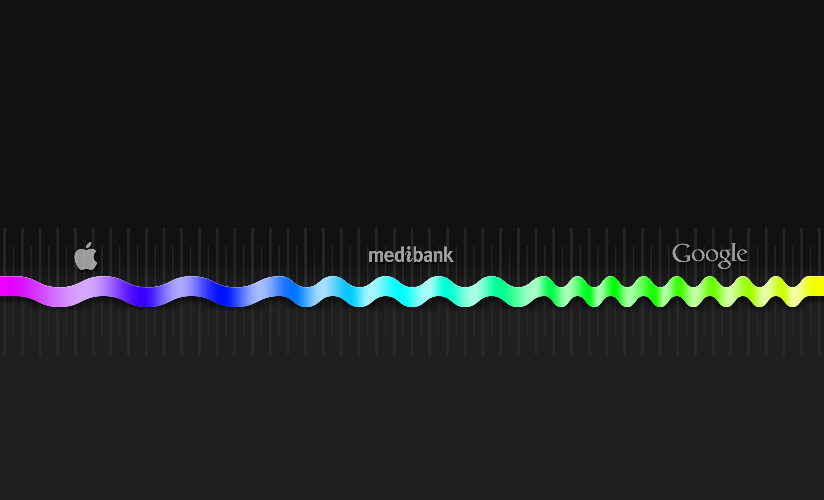
common word/concept
© All materials provided are commercial and in confidence. All rights reserved DAIS Studio Pty Ltd.
real word construct
unique word/concept
memorable easy to spell simple story
PROS
low IP risk simpler .com search no common usage clear ™ space
corporate identity
COMFORT
POSITIVE DISRUPTION
difficult .com search more common usage cluttered ™ space high IP risk
harder to remember challenging spelling complex story
CONS

Slide 103
We have built strong connections in our marketplace.
corporate identity

Slide 104
We have built strong connections in our marketplace.
The Geiger name has considerable brand equity developed over years of proven performance.
corporate identity

Slide 105
We have built strong connections in our marketplace.
The Geiger name has considerable brand equity developed over years of proven performance.
We have taken steps to secure the intellectual property around our brand, and see it as a valuable asset.
corporate identity

Slide 106
We have built strong connections in our marketplace.
The Geiger name has considerable brand equity developed over years of proven performance.
We have taken steps to secure the intellectual property around our brand, and see it as a valuable asset.
We are:
corporate identity

Slide 107
We have built strong connections in our marketplace.
The Geiger name has considerable brand equity developed over years of proven performance.
We have taken steps to secure the intellectual property around our brand, and see it as a valuable asset.
We are: Gconnex
corporate identity

Slide 108
technical descriptor

Slide 109
We have a diverse range of infrastructure building capabilities.
technical descriptor

Slide 110
We have a diverse range of infrastructure building capabilities. We collaborate to create energised performance.
technical descriptor

Slide 111
We have a diverse range of infrastructure building capabilities. We collaborate to create energised performance.
We are an interconnected group of infrastructure experts.
technical descriptor

Slide 112
We have a diverse range of infrastructure building capabilities. We collaborate to create energised performance.
We are an interconnected group of infrastructure experts.
We are a:
technical descriptor

Slide 113
We have a diverse range of infrastructure building capabilities. We collaborate to create energised performance.
We are an interconnected group of infrastructure experts.
We are a: Group
technical descriptor

Slide 114
We have a diverse range of infrastructure building capabilities. We collaborate to create energised performance.
We are an interconnected group of infrastructure experts.
We are a: Group
technical descriptor
A collective set of capabilities beyond individuals or corporate structures.

Slide 115
brand promise

Slide 116
We bring a unique energy to every project, focusing on delivering highly energised performance.
brand promise

Slide 117
We bring a unique energy to every project, focusing on delivering highly energised performance.
Our team brings a uniquely agile infrastructure to infrastructure projects that deliver...
brand promise

Slide 118
We bring a unique energy to every project, focusing on delivering highly energised performance.
Our team brings a uniquely agile infrastructure to infrastructure projects that deliver...
...on time or faster,
brand promise

Slide 119
We bring a unique energy to every project, focusing on delivering highly energised performance.
Our team brings a uniquely agile infrastructure to infrastructure projects that deliver...
...on time or faster,
...on spec or better.
brand promise

Slide 120
We bring a unique energy to every project, focusing on delivering highly energised performance.
Our team brings a uniquely agile infrastructure to infrastructure projects that deliver...
...on time or faster,
...on spec or better.
We are:
brand promise

Slide 121
We bring a unique energy to every project, focusing on delivering highly energised performance.
Our team brings a uniquely agile infrastructure to infrastructure projects that deliver...
...on time or faster,
...on spec or better.
We are: Energising
brand promise

Slide 122
We bring a unique energy to every project, focusing on delivering highly energised performance.
Our team brings a uniquely agile infrastructure to infrastructure projects that deliver...
...on time or faster,
...on spec or better.
We are: Energising Infrastructure
brand promise

Slide 123
We bring a unique energy to every project, focusing on delivering highly energised performance.
Our team brings a uniquely agile infrastructure to infrastructure projects that deliver...
...on time or faster,
...on spec or better.
We are: Energising Infrastructure
brand promise
Internal Value
Our capability and capacity energises infrastructure projects.

Slide 124
We bring a unique energy to every project, focusing on delivering highly energised performance.
Our team brings a uniquely agile infrastructure to infrastructure projects that deliver...
...on time or faster,
...on spec or better.
We are: Energising Infrastructure
brand promise
Internal Value
Our capability and capacity energises infrastructure projects.
External Value
The pace and quality with which the infrastructure is delivered will energise the larger project.

Slide 125
solution streams

Slide 126
Our experience and expertise allow us to consult on the best way to deliver practical results on infrastructure projects.
solution streams

Slide 127
Our experience and expertise allow us to consult on the best way to deliver practical results on infrastructure projects.
Our proven ability to effectively manage projects provides tier one results, while our tier two focus provides the drive to deliver better outcomes.
solution streams

Slide 128
Our experience and expertise allow us to consult on the best way to deliver practical results on infrastructure projects.
Our proven ability to effectively manage projects provides tier one results, while our tier two focus provides the drive to deliver better outcomes.
We consult, project manage, and deliver on our promise of energising infrastructure projects.
solution streams

Slide 129
Our experience and expertise allow us to consult on the best way to deliver practical results on infrastructure projects.
Our proven ability to effectively manage projects provides tier one results, while our tier two focus provides the drive to deliver better outcomes.
We consult, project manage, and deliver on our promise of energising infrastructure projects.
We:
solution streams

Slide 130
Our experience and expertise allow us to consult on the best way to deliver practical results on infrastructure projects.
Our proven ability to effectively manage projects provides tier one results, while our tier two focus provides the drive to deliver better outcomes.
We consult, project manage, and deliver on our promise of energising infrastructure projects.
We: Consult
solution streams

Slide 131
Our experience and expertise allow us to consult on the best way to deliver practical results on infrastructure projects.
Our proven ability to effectively manage projects provides tier one results, while our tier two focus provides the drive to deliver better outcomes.
We consult, project manage, and deliver on our promise of energising infrastructure projects.
We: Consult | Manage
solution streams

Slide 132
Our experience and expertise allow us to consult on the best way to deliver practical results on infrastructure projects.
Our proven ability to effectively manage projects provides tier one results, while our tier two focus provides the drive to deliver better outcomes.
We consult, project manage, and deliver on our promise of energising infrastructure projects.
We: Consult | Manage | Deliver
solution streams

Slide 133
We have a solid heritage of successful infrastructure projects.
We: Consult | Manage | Deliver
solution streams

Slide 134
We have a solid heritage of successful infrastructure projects.
Whether it is above the ground, on the ground or under it, we can make it happen.
We: Consult | Manage | Deliver
solution streams

Slide 135
We have a solid heritage of successful infrastructure projects.
Whether it is above the ground, on the ground or under it, we can make it happen.
Our capability spans electrical, civil and industrial projects.
We: Consult | Manage | Deliver
solution streams

Slide 136
We have a solid heritage of successful infrastructure projects.
Whether it is above the ground, on the ground or under it, we can make it happen.
Our capability spans electrical, civil and industrial projects.
We: Consult | Manage | Deliver
For:
solution streams

Slide 137
We have a solid heritage of successful infrastructure projects.
Whether it is above the ground, on the ground or under it, we can make it happen.
Our capability spans electrical, civil and industrial projects.
We: Consult | Manage | Deliver
For: Electrical
solution streams

Slide 138
We have a solid heritage of successful infrastructure projects.
Whether it is above the ground, on the ground or under it, we can make it happen.
Our capability spans electrical, civil and industrial projects.
We: Consult | Manage | Deliver
For: Electrical | Civil
solution streams

Slide 139
We have a solid heritage of successful infrastructure projects.
Whether it is above the ground, on the ground or under it, we can make it happen.
Our capability spans electrical, civil and industrial projects.
We: Consult | Manage | Deliver
For: Electrical | Civil | Industrial
solution streams

Slide 140
brand theme

Slide 141
Our benchmark standard:
brand theme

Slide 142
As individuals, teams, and a company we are always connected to the projects we take on, and to the end result we aim to achieve.
Our benchmark standard:
brand theme

Slide 143
As individuals, teams, and a company we are always connected to the projects we take on, and to the end result we aim to achieve.
Safety is at the core of our business. In order to bring ‘work safe, home safe’ to life, we are always connected to the present moment, our environment and our team members.
Our benchmark standard:
brand theme

Slide 144
As individuals, teams, and a company we are always connected to the projects we take on, and to the end result we aim to achieve.
Safety is at the core of our business. In order to bring ‘work safe, home safe’ to life, we are always connected to the present moment, our environment and our team members.
Always Connected
brand theme

Slide 145
campaign voice

Slide 146
We do more than just connecting wires, pipes and roads. We connect with our
partners, our colleagues and our communities to deliver the outcomes that really matter.
campaign voice

Slide 147
Connection Matters
We do more than just connecting wires, pipes and roads. We connect with our
partners, our colleagues and our communities to deliver the outcomes that really matter.
campaign voice

Slide 148
brand ethics

Slide 149
We deliver practical solutions with focused capability
brand ethics

Slide 150
We deliver practical solutions with focused capability
The best way to a positive outcome isn’t always the most obvious, but it is usually the most practical. Our down to earth approach and capability delivers no-nonsense results.
brand ethics

Slide 151
Capable
We deliver practical solutions with focused capability
The best way to a positive outcome isn’t always the most obvious, but it is usually the most practical. Our down to earth approach and capability delivers no-nonsense results.
brand ethics

Slide 152
Capable
We deliver practical solutions with focused capability
The best way to a positive outcome isn’t always the most obvious, but it is usually the most practical. Our down to earth approach and capability delivers no-nonsense results.
We are passionate about and committed to our work
brand ethics

Slide 153
Capable
We deliver practical solutions with focused capability
The best way to a positive outcome isn’t always the most obvious, but it is usually the most practical. Our down to earth approach and capability delivers no-nonsense results.
We are passionate about and committed to our work
We believe that successful projects begin with committed partnerships, and approach each with integrity and authenticity.
brand ethics

Slide 154
Capable
We deliver practical solutions with focused capability
The best way to a positive outcome isn’t always the most obvious, but it is usually the most practical. Our down to earth approach and capability delivers no-nonsense results.
Committed
We are passionate about and committed to our work
We believe that successful projects begin with committed partnerships, and approach each with integrity and authenticity.
brand ethics

Slide 155
Capable
We deliver practical solutions with focused capability
The best way to a positive outcome isn’t always the most obvious, but it is usually the most practical. Our down to earth approach and capability delivers no-nonsense results.
Committed
We are passionate about and committed to our work
We believe that successful projects begin with committed partnerships, and approach each with integrity and authenticity.
We will deliver industry leading performance
brand ethics

Slide 156
Capable
We deliver practical solutions with focused capability
The best way to a positive outcome isn’t always the most obvious, but it is usually the most practical. Our down to earth approach and capability delivers no-nonsense results.
Committed
We are passionate about and committed to our work
We believe that successful projects begin with committed partnerships, and approach each with integrity and authenticity.
We will deliver industry leading performance
Our innately competitive nature pushes us to seek out the best possible result on every project and for every client. This results in tier one performance with tier two agility.
brand ethics

Slide 157
Capable
We deliver practical solutions with focused capability
The best way to a positive outcome isn’t always the most obvious, but it is usually the most practical. Our down to earth approach and capability delivers no-nonsense results.
Committed
We are passionate about and committed to our work
We believe that successful projects begin with committed partnerships, and approach each with integrity and authenticity.
Competitive
We will deliver industry leading performance
Our innately competitive nature pushes us to seek out the best possible result on every project and for every client. This results in tier one performance with tier two agility.
brand ethics

Slide 158
Capable
We deliver practical solutions with focused capability
The best way to a positive outcome isn’t always the most obvious, but it is usually the most practical. Our down to earth approach and capability delivers no-nonsense results.
Committed
We are passionate about and committed to our work
We believe that successful projects begin with committed partnerships, and approach each with integrity and authenticity.
Competitive
We will deliver industry leading performance
Our innately competitive nature pushes us to seek out the best possible result on every project and for every client. This results in tier one performance with tier two agility.
brand ethics
Capable | Committed | Competitive

Slide 159
brand strategy

Slide 160
Gconnex
brand strategy
©© AAllll mmaatteerriiaallss pprroovviiddeedd aarree ccoommmmeerrcciiaall aanndd iinn ccoonnfifiddeennccee.. AAllll rriigghhttss rreesseerrvveedd DDAAIISS SSttuuddiioo PPttyy LLttdd..

Slide 161
Gconnex
Capable
brand strategy
©© AAllll mmaatteerriiaallss pprroovviiddeedd aarree ccoommmmeerrcciiaall aanndd iinn ccoonnfifiddeennccee.. AAllll rriigghhttss rreesseerrvveedd DDAAIISS SSttuuddiioo PPttyy LLttdd..

Slide 162
CONSULT
ELECTRICAL
ENERGISING INFRASTRUCTURE
MANAGE
Gconnex
Capable Committed Competitive
CIVIL
brand strategy
DELIVER
INDUSTRIAL
©© AAllll mmaatteerriiaallss pprroovviiddeedd aarree ccoommmmeerrcciiaall aanndd iinn ccoonnfifiddeennccee.. AAllll rriigghhttss rreesseerrvveedd DDAAIISS SSttuuddiioo PPttyy LLttdd..

Slide 163





energising
consult
electrical
infrastructure
manage
G c o n n e x
capable committed competitive
civil
whiteboard diagram
deliver
industrial

Slide 164
Gconnex
_{i}d
corporate identity
_{d}e
technical descriptor
Gconnex
_{p}r
brand promise
Energising Infrastructure
Consult | Manage | Deliver Electrical | Civil | Industrial
Always Connected
_{s}l
solution streams
brand inventory
_{t}h
brand theme
_{c}v
campaign voice
Connection Matters
_{e}t
brand ethics
Capable | Committed | Competitive

Slide 165
wordscoutTM

Slide 166
innovative, fresh, high standard of excellence, solid, stable, recognised, edgy, safe, high quality, nimble, decisive, driven, international, strong long-term relationships, service oriented, down to earth, problem solvers, real world experience, safety driven, reliable, exciting, trustworthy, connected, loyal, proud, fun, secure, enjoyable, honest, accountable, supportive, passionate, inspired, genuine, generous, chameleon, awesome, unstoppable, annoying, connectivity, different, low risk, one stop shop, experts, complete integrated solution, clever, experienced, compliant, fun, energetic, tenacious, caring, committed, electric eel, honey badger, ferocious, simple, transparent, everyday, diverse, ethical, competitive, honest, family values, trusted, authentic, exciting, push the boundaries, well known, red bull, celebrated under dog, solutions, infrastructure, sub-divisions, energised, unstoppable.
wordscout™

Slide 167
innovative, fresh, high standard of excellence, solid, stable, recognised, edgy, safe, high quality, nimble, decisive, driven, international, strong long-term relationships, service oriented, down to earth, problem solvers, real world experience, safety driven, reliable, exciting, trustworthy, connected, loyal, proud, fun, secure, enjoyable, honest, accountable, supportive, passionate, inspired, genuine, generous, chameleon, awesome, unstoppable, annoying, connectivity, different, low risk, one stop shop, experts, complete integrated solution, clever, experienced, compliant, fun, energetic, tenacious, caring, committed, electric eel, honey badger, ferocious, simple, transparent, everyday, diverse, ethical, competitive, honest, family values, trusted, authentic, exciting, push the boundaries, well known, red bull, celebrated under dog, solutions, infrastructure, sub-divisions, energised, unstoppable.
wordscout™

Slide 168
inspiration

Slide 169
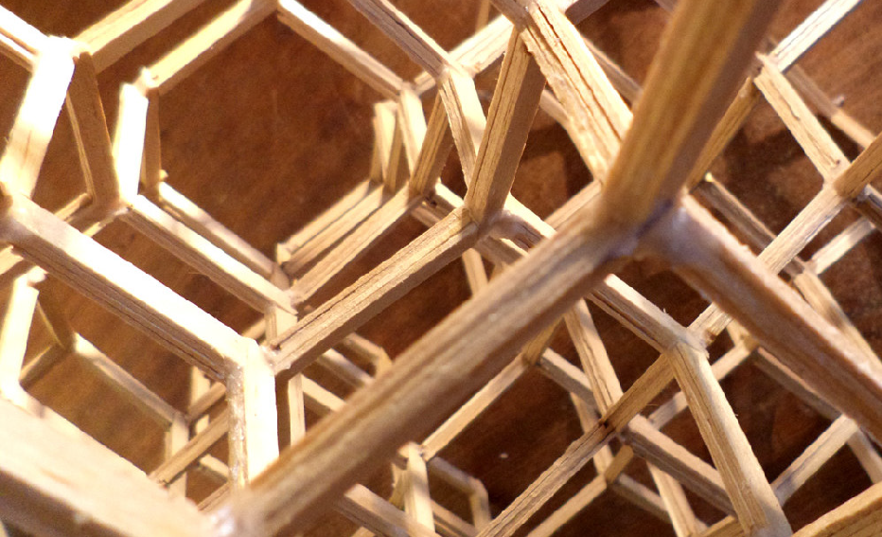
integrity
inspiration

Slide 170


integrity
integration
© All materials provided are commercial and in confidence. All rights reserved DAIS Studio Pty Ltd.
inspiration

Slide 171
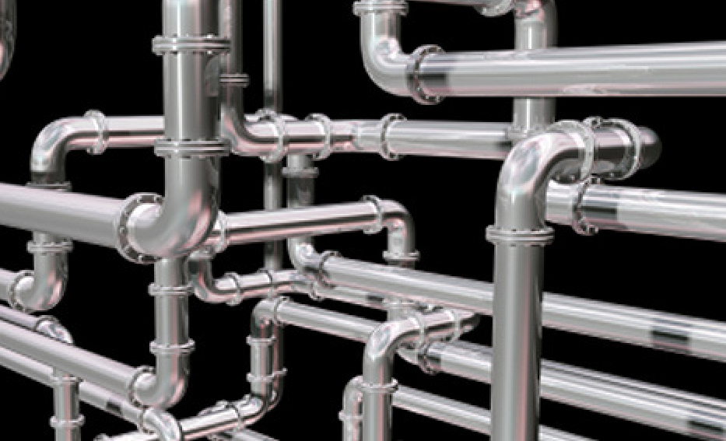
integrity
© All materials provided are commercial and in confidence. All rights reserved DAIS Studio Pty Ltd.
connection
integration
inspiration

Slide 172
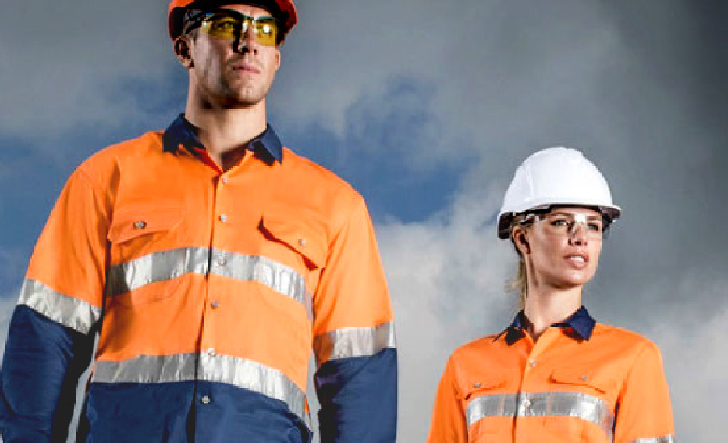
visibility connection
integrity integration
© All materials provided are commercial and in confidence. All rights reserved DAIS Studio Pty Ltd.
inspiration

Slide 173
colour palette

Slide 174
primary colour palette
Pantone 654C
colour palette

Slide 175
primary colour palette
Pantone 654C
Pantone 137C
colour palette

Slide 176

primary colour palette
Pantone 654C
Pantone 137C
Pantone 422C
colour palette

Slide 177
typography

Slide 178
STRUCTURED SAFE
DIRECT
typographic palette
AkcelerAlat Book
ABCDEFGHIJKLMNOPQRSTUVWXYZ
abcdefghijklmnopqrstuvwxyz 1234567890 @
typography

Slide 179
STRUCTURED SAFE
DIRECT
typographic palette
AkcelerAlat Book
ABCDEFGHIJKLMNOPQRSTUVWXYZ
abcdefghijklmnopqrstuvwxyz 1234567890 @
STRONG COMMITTED BOLD WELCOMING
AkcelerAlat Medium
ABCDEFGHIJKLMNOPQRSTUVWXYZ
abcdefghijklmnopqrstuvwxyz 1234567890 @
typography

Slide 180
brand icon

Slide 181
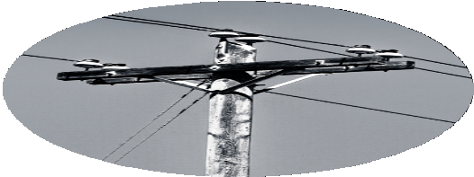
brand icon
Electrical

Slide 182
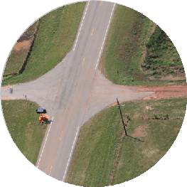
brand icon
Electrical
Civil

Slide 183
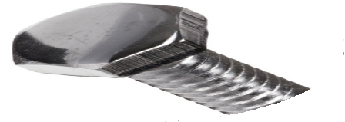
brand icon
Electrical
Civil
Industrial

Slide 184
brand icon
Electrical

Slide 185
brand icon
Electrical

Slide 186
brand icon
Electrical

Slide 187

brand icon
Civil

Slide 188
brand icon
Civil

Slide 189
brand icon
Civil

Slide 190
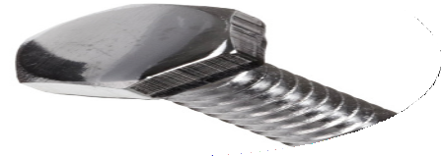
brand icon
Industrial

Slide 191
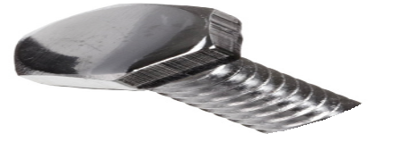
brand icon
Industrial

Slide 192
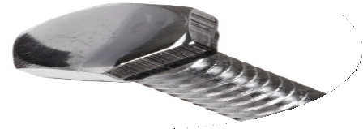
brand icon
Industrial

Slide 193
brand icon
Electrical
Civil
Industrial

Slide 194
brand icon

Slide 195
brand icon

Slide 196
brand icon

Slide 197
brand icon

Slide 198
brand icon

Slide 199
brand icon

Slide 200
brand icon

Slide 201
brand icon

Slide 202
brand icon

Slide 203

© All materials provided are commercial and in confidence. All rights reserved DAIS Studio Pty Ltd.
CONNEX
corporate identity

Slide 204

© All materials provided are commercial and in confidence. All rights reserved DAIS Studio Pty Ltd.
CONNEX
corporate identity

Slide 205

© All materials provided are commercial and in confidence. All rights reserved DAIS Studio Pty Ltd.
CONNEX
corporate identity

Slide 206
CONSULT MANAGE DELIVER
ELECTRICAL CIVIL INDUSTRIAL
© All materials provided are commercial and in confidence. All rights reserved DAIS Studio Pty Ltd.
solution streams

Slide 207
CONSULT MANAGE DELIVER
ELECTRICAL CIVIL INDUSTRIAL
© All materials provided are commercial and in confidence. All rights reserved DAIS Studio Pty Ltd.
solution streams

Slide 208
CONSULT MANAGE DELIVER
ELECTRICAL CIVIL INDUSTRIAL
© All materials provided are commercial and in confidence. All rights reserved DAIS Studio Pty Ltd.

Slide 209
visual identity

Slide 210
© All materials provided are commercial and in confidence. All rights reserved DAIS Studio Pty Ltd.
visual identity

Slide 211
© All materials provided are commercial and in confidence. All rights reserved DAIS Studio Pty Ltd.
visual identity

Slide 212
© All materials provided are commercial and in confidence. All rights reserved DAIS Studio Pty Ltd.
visual identity

Slide 213
© All materials provided are commercial and in confidence. All rights reserved DAIS Studio Pty Ltd.
visual identity

Slide 214
© All materials provided are commercial and in confidence. All rights reserved DAIS Studio Pty Ltd.
visual identity

Slide 215
© All materials provided are commercial and in confidence. All rights reserved DAIS Studio Pty Ltd.
visual identity

Slide 216
© All materials provided are commercial and in confidence. All rights reserved DAIS Studio Pty Ltd.
visual identity

Slide 217
© All materials provided are commercial and in confidence. All rights reserved DAIS Studio Pty Ltd.
visual identity

Slide 218

© All materials provided are commercial and in confidence. All rights reserved DAIS Studio Pty Ltd.
visual identity

Slide 219
_{i}d
corporate identity
CONNEX
_{b}i
brand icon
_{d}e
?
technical descriptor
_{p}r
brand promise
_{s}l
solution streams
CONSULT MANAGE DELIVER
ELECTRICAL CIVIL INDUSTRIAL
_{v}i
visual identity
brand inventory
_{c}r
?
brand credential
_{c}p
colour palette
PANTONE 655C
PANTONE 137C
PANTONE 422C

Slide 220

CONNEX
corporate identity

