Slide 1
3 Energy
brand strategy presentation

Slide 2
brand culture the big picture
corporate identity
internal
the real organisation
the way key stakeholders and staff see the entity = ownership
logo/mark + name the brand/trademark
agenda for change
comfort
brand leadership
position 1
position 2
position 3
existing mark
evolved mark
new mark
position 4
position 5
position 6
existing name
evolved name
new brand

Slide 3
brand map

Slide 4
3 Energy
“Financial & human capital to grow business, people & values”
Aviation
Geiger Group
Geiger Fuel Solutions
Tuff Group
Sanki (Aus)
RDS
Future Acquisitions...
Fuel delivery devices for retail fuel industry
Rotating Disc Systems
Water treatment solutions
Geiger Group Qld
Electrical
Construction
Service
Maintenance
Tuff Bullbars
Bullbars
brand map
Civil
Brushrails
Maintenance
Construction
Accessories
Fibre / coms
Water
Tuff Coatings
Powdercoating
Rhino lining
Sandblasting
Property M’ment
Consultation
Geiger Group Vic
Electrical

Slide 5
wordscoutTM

Slide 6
international, big, solid, impressive, low key, tier 2, mystique, consolidated, capable, network, smart, agile, young, energetic, give it a go, diversified, acumen, efficient, quality, safe, compliant, integrity, reliable, connected, wow, intriguing, family focused, protective, authentic, supportive, nurturing, dynamic wellbeing, fun, give to get, adaptive balance, teamwork, energetic, catalyst, ballsy, lion, tough, majestic, cuddly, got fight in us, leaders, king of the jungle, value for money, service, on time, agile, flexible, mobile, controlled variants, good at what they do, nonconforming, knowledgeable, real world expertise, practical, adaptive solvers, competitive, tenacious, genuine, trusted, brave, foresight, fluidity, exceed expectations, committed, power in numbers, solution alchemists, big fish in small fish camouflage, financial stability & security, responsible, satisfying, determined, toyota – safety, long term, good value, honda – consistent, reliable, virgin, exciting, inspirational leadership, steve jobs apple: innovation, elegant, meryl lynch – powerful, determined, murray goldbern, shine lawyers, dominating, structured, clever, ownership,
wordscout™
controllable, changing the market, rebels, “we do it right”, “never say die” constitution, sugar ray leonard: punch above your weight – willingness to have a go, solution + adaption oriented, giving customers something they didn’t know they wanted, momentum to drive forward, adaptive, focus, tenacious, lion, bold, trusted, reliable, fun, 22 year old corporate
© All materials provided are commercial and in confidence. All rights reserved DAIS Studio Pty Ltd.

Slide 7
international, big, solid, impressive, low key, tier 2, mystique, consolidated, capable, network, smart, agile, young, energetic, give it a go, diversified, acumen, efficient, quality, safe, compliant, integrity, reliable, connected, wow, intriguing, family focused, protective, authentic, supportive, nurturing, dynamic wellbeing, fun, give to get, adaptive balance, teamwork, energetic, catalyst, ballsy, lion, tough, majestic, cuddly, got fight in us, leaders, king of the jungle, value for money, service, on time, agile, flexible, mobile, controlled variants, good at what they do, nonconforming, knowledgeable, real world expertise, practical, adaptive solvers, competitive, tenacious, genuine, trusted, brave, foresight, fluidity, exceed expectations, committed, power in numbers, solution alchemists, big fish in small fish camouflage, financial stability & security, responsible, satisfying, determined, toyota – safety, long term, good value, honda – consistent, reliable, virgin, exciting, inspirational leadership, steve jobs apple: innovation, elegant, meryl lynch – powerful, determined, murray goldbern, shine lawyers, dominating, structured, clever, ownership,
wordscout™
controllable, changing the market, rebels, “we do it right”, “never say die” constitution, sugar ray leonard: punch above your weight – willingness to have a go, solution + adaption oriented, giving customers something they didn’t know they wanted, momentum to drive forward, adaptive, focus, tenacious, lion, bold, trusted, reliable, fun, 22 year old corporate
© All materials provided are commercial and in confidence. All rights reserved DAIS Studio Pty Ltd.

Slide 8
brand objectives

Slide 9


Slide 10


Slide 11


Slide 12
Be tactical
brand objectives

Slide 13
Be tactical
Leverage our strategic acumen and build upon our foundations. Create success through focussed, connected diversification.
brand objectives

Slide 14
Be tactical
Leverage our strategic acumen and build upon our foundations. Create success through focussed, connected diversification.
Be trusted
brand objectives

Slide 15
Be tactical
Leverage our strategic acumen and build upon our foundations. Create success through focussed, connected diversification.
Be trusted
We maintain our reputation for reliably supporting our partnerships, through individual development and market-savvy shared services.
brand objectives

Slide 16
Be tactical
Leverage our strategic acumen and build upon our foundations. Create success through focussed, connected diversification.
Be trusted
We maintain our reputation for reliably supporting our partnerships, through individual development and market-savvy shared services.
Be agile
brand objectives

Slide 17
Be tactical
Leverage our strategic acumen and build upon our foundations. Create success through focussed, connected diversification.
Be trusted
We maintain our reputation for reliably supporting our partnerships, through individual development and market-savvy shared services.
Be agile
We continue on a path of growth with a fluid, efficient business model and a considered, nimble acquisition process.
brand objectives

Slide 18
Be tactical
Leverage our strategic acumen and build upon our foundations. Create success through focussed, connected diversification.
Be trusted
We maintain our reputation for reliably supporting our partnerships, through individual development and market-savvy shared services.
Be agile
We continue on a path of growth with a fluid, efficient business model and a considered, nimble acquisition process.
Be attractive
brand objectives

Slide 19
Be tactical
Leverage our strategic acumen and build upon our foundations. Create success through focussed, connected diversification.
Be trusted
We maintain our reputation for reliably supporting our partnerships, through individual development and market-savvy shared services.
Be agile
We continue on a path of growth with a fluid, efficient business model and a considered, nimble acquisition process.
Be attractive
Our collective of exciting business ventures are respected within the industry and are the key to our continued development and strength.
brand objectives

Slide 20
brand agenda

Slide 21
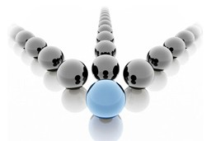
leading directors
brand agenda

Slide 22
leading directors
We identify and connect oppropriate resources to the relevant opportunity points to create business momentum.
brand agenda

Slide 23

leading directors
leading motivators
We identify and connect oppropriate resources to the relevant opportunity points to create business momentum.
brand agenda

Slide 24
leading directors
leading motivators
We identify and connect oppropriate resources to the relevant opportunity points to create business momentum.
We generate inspiration, motivation and activation through our shared passion for success and converting opportunity to results.
brand agenda

Slide 25

leading directors
leading motivators
leading energisers
We identify and connect oppropriate resources to the relevant opportunity points to create business momentum.
We generate inspiration, motivation and activation through our shared passion for success and converting opportunity to results.
brand agenda

Slide 26
leading directors
leading motivators
leading energisers
We identify and connect oppropriate resources to the relevant opportunity points to create business momentum.
We generate inspiration, motivation and activation through our shared passion for success and converting opportunity to results.
Together, our collective combination of business capabilities forge a powerful, visible impact – delivered with efficiency and effectiveness.
brand agenda

Slide 27
leading directors
leading motivators
leading energisers
We identify and connect oppropriate resources to the relevant opportunity points to create business momentum.
We generate inspiration, motivation and activation through our shared passion for success and converting opportunity to results.
Together, our collective combination of business capabilities forge a powerful, visible impact – delivered with efficiency and effectiveness.
brand agenda
direct

Slide 28
leading directors
leading motivators
leading energisers
We identify and connect oppropriate resources to the relevant opportunity points to create business momentum.
We generate inspiration, motivation and activation through our shared passion for success and converting opportunity to results.
Together, our collective combination of business capabilities forge a powerful, visible impact – delivered with efficiency and effectiveness.
brand agenda
direct
human

Slide 29
leading directors
leading motivators
leading energisers
We identify and connect oppropriate resources to the relevant opportunity points to create business momentum.
We generate inspiration, motivation and activation through our shared passion for success and converting opportunity to results.
Together, our collective combination of business capabilities forge a powerful, visible impact – delivered with efficiency and effectiveness.
brand agenda
direct
human
energy

Slide 30
what makes us different?
mobile agility
brand agenda

Slide 31
what makes us different?
mobile agility
we act and respond swiftly – but responsibly
brand agenda

Slide 32
what makes us different?
mobile agility
we act and respond swiftly – but responsibly
welcoming family
brand agenda

Slide 33
what makes us different?
mobile agility
we act and respond swiftly – but responsibly
welcoming family
considerate and respectful of the importance of lifestyle balance
brand agenda

Slide 34
what makes us different?
mobile agility
we act and respond swiftly – but responsibly
welcoming family
considerate and respectful of the importance of lifestyle balance
we champion our values
brand agenda

Slide 35
what makes us different?
mobile agility
we act and respond swiftly – but responsibly
welcoming family
considerate and respectful of the importance of lifestyle balance
we champion our values
connections – leadership – success
brand agenda

Slide 36
what makes us different?
mobile agility
we act and respond swiftly – but responsibly
welcoming family
considerate and respectful of the importance of lifestyle balance
we champion our values
connections – leadership – success
network integrity
brand agenda

Slide 37
what makes us different?
mobile agility
we act and respond swiftly – but responsibly
welcoming family
considerate and respectful of the importance of lifestyle balance
we champion our values
connections – leadership – success
network integrity
quality, responsibility and consideration
brand agenda

Slide 38
what makes us different?
welcoming family
considerate and respectful of the importance of lifestyle balance
we champion our values
connections – leadership – success
network integrity
quality, responsibility and consideration
responsive
mobile agility
we act and respond swiftly – but responsibly
brand agenda

Slide 39
what makes us different?
responsive
mobile agility
we act and respond swiftly – but responsibly
supportive
welcoming family
considerate and respectful of the importance of lifestyle balance
brand agenda
we champion our values
connections – leadership – success
network integrity
quality, responsibility and consideration

Slide 40
what makes us different?
responsive
mobile agility
we act and respond swiftly – but responsibly
supportive
welcoming family
considerate and respectful of the importance of lifestyle balance
brand agenda
transparent
we champion our values
connections – leadership – success
network integrity
quality, responsibility and consideration

Slide 41
what makes us different?
responsive
mobile agility
we act and respond swiftly – but responsibly
supportive
welcoming family
considerate and respectful of the importance of lifestyle balance
brand agenda
transparent
we champion our values
connections – leadership – success
performance
network integrity
quality, responsibility and consideration

Slide 42
what makes us different?
brand agenda

Slide 43
what makes us different?
Our organisation responds with agility. We provide a supportive environment and respect the wellbeing of our network.
brand agenda

Slide 44
what makes us different?
Our organisation responds with agility. We provide a supportive environment and respect the wellbeing of our network.
We champion our values because they contribute to our integrity and collective performance.
brand agenda

Slide 45
technical descriptor

Slide 46
We invest people and financial capital in ventures that have potential.
technical descriptor

Slide 47
We invest people and financial capital in ventures that have potential.
We create joint ventures with partners that will bring synergies to our house of brands.
technical descriptor

Slide 48
We invest people and financial capital in ventures that have potential.
We create joint ventures with partners that will bring synergies to our house of brands.
We confidently venture into new markets, industries and initiatives with entrepreneurial energy.
technical descriptor

Slide 49
We invest people and financial capital in ventures that have potential.
We create joint ventures with partners that will bring synergies to our house of brands.
We confidently venture into new markets, industries and initiatives with entrepreneurial energy.
We build:
technical descriptor

Slide 50
We invest people and financial capital in ventures that have potential.
We create joint ventures with partners that will bring synergies to our house of brands.
We confidently venture into new markets, industries and initiatives with entrepreneurial energy.
We build: Ventures
technical descriptor

Slide 51
We invest people and financial capital in ventures that have potential.
We create joint ventures with partners that will bring synergies to our house of brands.
We confidently venture into new markets, industries and initiatives with entrepreneurial energy.
We build: Ventures
technical descriptor
We invest in, support and grow successful business ventures.

Slide 52
brand promise

Slide 53
Our passion for business, performance and success energises our ventures, our people, and the opportunities we invest in.
brand promise

Slide 54
Our passion for business, performance and success energises our ventures, our people, and the opportunities we invest in.
Our vision and focus energises people to see beyond what is, to what could be, oppening up new opportunities.
brand promise

Slide 55
Our passion for business, performance and success energises our ventures, our people, and the opportunities we invest in.
Our vision and focus energises people to see beyond what is, to what could be, oppening up new opportunities.
The opportunities we create energise existing ventures with positive momentum.
brand promise

Slide 56
Our passion for business, performance and success energises our ventures, our people, and the opportunities we invest in.
Our vision and focus energises people to see beyond what is, to what could be, oppening up new opportunities.
The opportunities we create energise existing ventures with positive momentum.
We are:
brand promise

Slide 57
Our passion for business, performance and success energises our ventures, our people, and the opportunities we invest in.
Our vision and focus energises people to see beyond what is, to what could be, oppening up new opportunities.
The opportunities we create energise existing ventures with positive momentum.
We are: Energising Opportunities
brand promise

Slide 58
Our passion for business, performance and success energises our ventures, our people, and the opportunities we invest in.
Our vision and focus energises people to see beyond what is, to what could be, oppening up new opportunities.
The opportunities we create energise existing ventures with positive momentum.
We are: Energising Opportunities
brand promise
Internal Value
We see big picture opportunities and energise them with positive people and financial capital.

Slide 59
Our passion for business, performance and success energises our ventures, our people, and the opportunities we invest in.
Our vision and focus energises people to see beyond what is, to what could be, oppening up new opportunities.
The opportunities we create energise existing ventures with positive momentum.
We are: Energising Opportunities
brand promise
Internal Value
We see big picture opportunities and energise them with positive people and financial capital.
External Value
Our partner ventures gain energised momentum and new opportunities.

Slide 60
solution streams

Slide 61
We invest in our people supporting their personal and professional growth.
solution streams

Slide 62
We invest in our people supporting their personal and professional growth.
We invest our people and financial capital into partnerships driving success.
solution streams

Slide 63
We invest in our people supporting their personal and professional growth.
We invest our people and financial capital into partnerships driving success.
We provide the strategic leadership, direction and vision with a strategy of empowering our ventures.
solution streams

Slide 64
We invest in our people supporting their personal and professional growth.
We invest our people and financial capital into partnerships driving success.
We provide the strategic leadership, direction and vision with a strategy of empowering our ventures.
We deliver:
solution streams

Slide 65
We invest in our people supporting their personal and professional growth.
We invest our people and financial capital into partnerships driving success.
We provide the strategic leadership, direction and vision with a strategy of empowering our ventures.
We deliver: People
solution streams

Slide 66
We invest in our people supporting their personal and professional growth.
We invest our people and financial capital into partnerships driving success.
We provide the strategic leadership, direction and vision with a strategy of empowering our ventures.
We deliver: People
solution streams
Our acumen, leadership and culture that puts people first.

Slide 67
We invest in our people supporting their personal and professional growth.
We invest our people and financial capital into partnerships driving success.
We provide the strategic leadership, direction and vision with a strategy of empowering our ventures.
We deliver: People | Capital
solution streams
Our acumen, leadership and culture that puts people first.

Slide 68
We invest in our people supporting their personal and professional growth.
We invest our people and financial capital into partnerships driving success.
We provide the strategic leadership, direction and vision with a strategy of empowering our ventures.
We deliver: People | Capital
solution streams
Our acumen, leadership and culture that puts people first.
The financial and personal investment required to succeed.

Slide 69
We invest in our people supporting their personal and professional growth.
We invest our people and financial capital into partnerships driving success.
We provide the strategic leadership, direction and vision with a strategy of empowering our ventures.
We deliver: People | Capital | Strategy
solution streams
Our acumen, leadership and culture that puts people first.
The financial and personal investment required to succeed.

Slide 70
We invest in our people supporting their personal and professional growth.
We invest our people and financial capital into partnerships driving success.
We provide the strategic leadership, direction and vision with a strategy of empowering our ventures.
We deliver: People | Capital | Strategy
solution streams
Our acumen, leadership and culture that puts people first.
The financial and personal investment required to succeed.
Sound strategy driven by asture vision and expertise.

Slide 71
brand theme

Slide 72
Our benchmark standard
brand theme

Slide 73
We bring positive energy into everything we do.
Our benchmark standard
brand theme

Slide 74
We bring positive energy into everything we do.
As a leadership group, we share this energy and passion for activation – but it’s when we pass that energy on to our venture groups that leadership truly flourishes.
Our benchmark standard
brand theme

Slide 75
We bring positive energy into everything we do.
As a leadership group, we share this energy and passion for activation – but it’s when we pass that energy on to our venture groups that leadership truly flourishes.
Our benchmark standard
brand theme

Slide 76
We bring positive energy into everything we do.
As a leadership group, we share this energy and passion for activation – but it’s when we pass that energy on to our venture groups that leadership truly flourishes.
Energising leadership
brand theme

Slide 77
brand ethics

Slide 78
We invest in the potential of people
brand ethics

Slide 79
We invest in the potential of people
Our venture partner organisations are built a collaborative approach to shared acumen, capital, effort and belief.
brand ethics

Slide 80
invest
We invest in the potential of people
Our venture partner organisations are built a collaborative approach to shared acumen, capital, effort and belief.
brand ethics

Slide 81
invest
We invest in the potential of people
Our venture partner organisations are built a collaborative approach to shared acumen, capital, effort and belief.
We are optimisation specialists
brand ethics

Slide 82
invest
We invest in the potential of people
Our venture partner organisations are built a collaborative approach to shared acumen, capital, effort and belief.
We are optimisation specialists
By reducing administration, automating compliance and simplifying workflows we create clear headspace that drives better performance.
brand ethics

Slide 83
invest
We invest in the potential of people
Our venture partner organisations are built a collaborative approach to shared acumen, capital, effort and belief.
optimise
We are optimisation specialists
By reducing administration, automating compliance and simplifying workflows we create clear headspace that drives better performance.
brand ethics

Slide 84
invest
We invest in the potential of people
Our venture partner organisations are built a collaborative approach to shared acumen, capital, effort and belief.
optimise
We are optimisation specialists
By reducing administration, automating compliance and simplifying workflows we create clear headspace that drives better performance.
We will navigate with productivity in mind
brand ethics

Slide 85
invest
We invest in the potential of people
Our venture partner organisations are built a collaborative approach to shared acumen, capital, effort and belief.
optimise
We are optimisation specialists
By reducing administration, automating compliance and simplifying workflows we create clear headspace that drives better performance.
We will navigate with productivity in mind
Our management strategies enable you to direct your focus on the work that delivers income, multiplying your productivity and profitability.
brand ethics

Slide 86
invest
We invest in the potential of people
Our venture partner organisations are built a collaborative approach to shared acumen, capital, effort and belief.
optimise
We are optimisation specialists
By reducing administration, automating compliance and simplifying workflows we create clear headspace that drives better performance.
navigate
We will navigate with productivity in mind
Our management strategies enable you to direct your focus on the work that delivers income, multiplying your productivity and profitability.
brand ethics

Slide 87
invest
We invest in the potential of people
Our venture partner organisations are built a collaborative approach to shared acumen, capital, effort and belief.
optimise
We are optimisation specialists
By reducing administration, automating compliance and simplifying workflows we create clear headspace that drives better performance.
navigate
We will navigate with productivity in mind
Our management strategies enable you to direct your focus on the work that delivers income, multiplying your productivity and profitability.
brand ethics
invest | optimise | navigate

Slide 88
corporate identity

Slide 89
More than 284,000,000 domain names have now been registered.
By 2013, every possible four letter .com had been registered.
Rumours are that every possible five letter .com has also been registered.
corporate identity

Slide 90

© All materials provided are commercial and in confidence. All rights reserved DAIS Studio Pty Ltd.
The Naming Spectrum
corporate identity
COMFORT
POSITIVE DISRUPTION

Slide 91
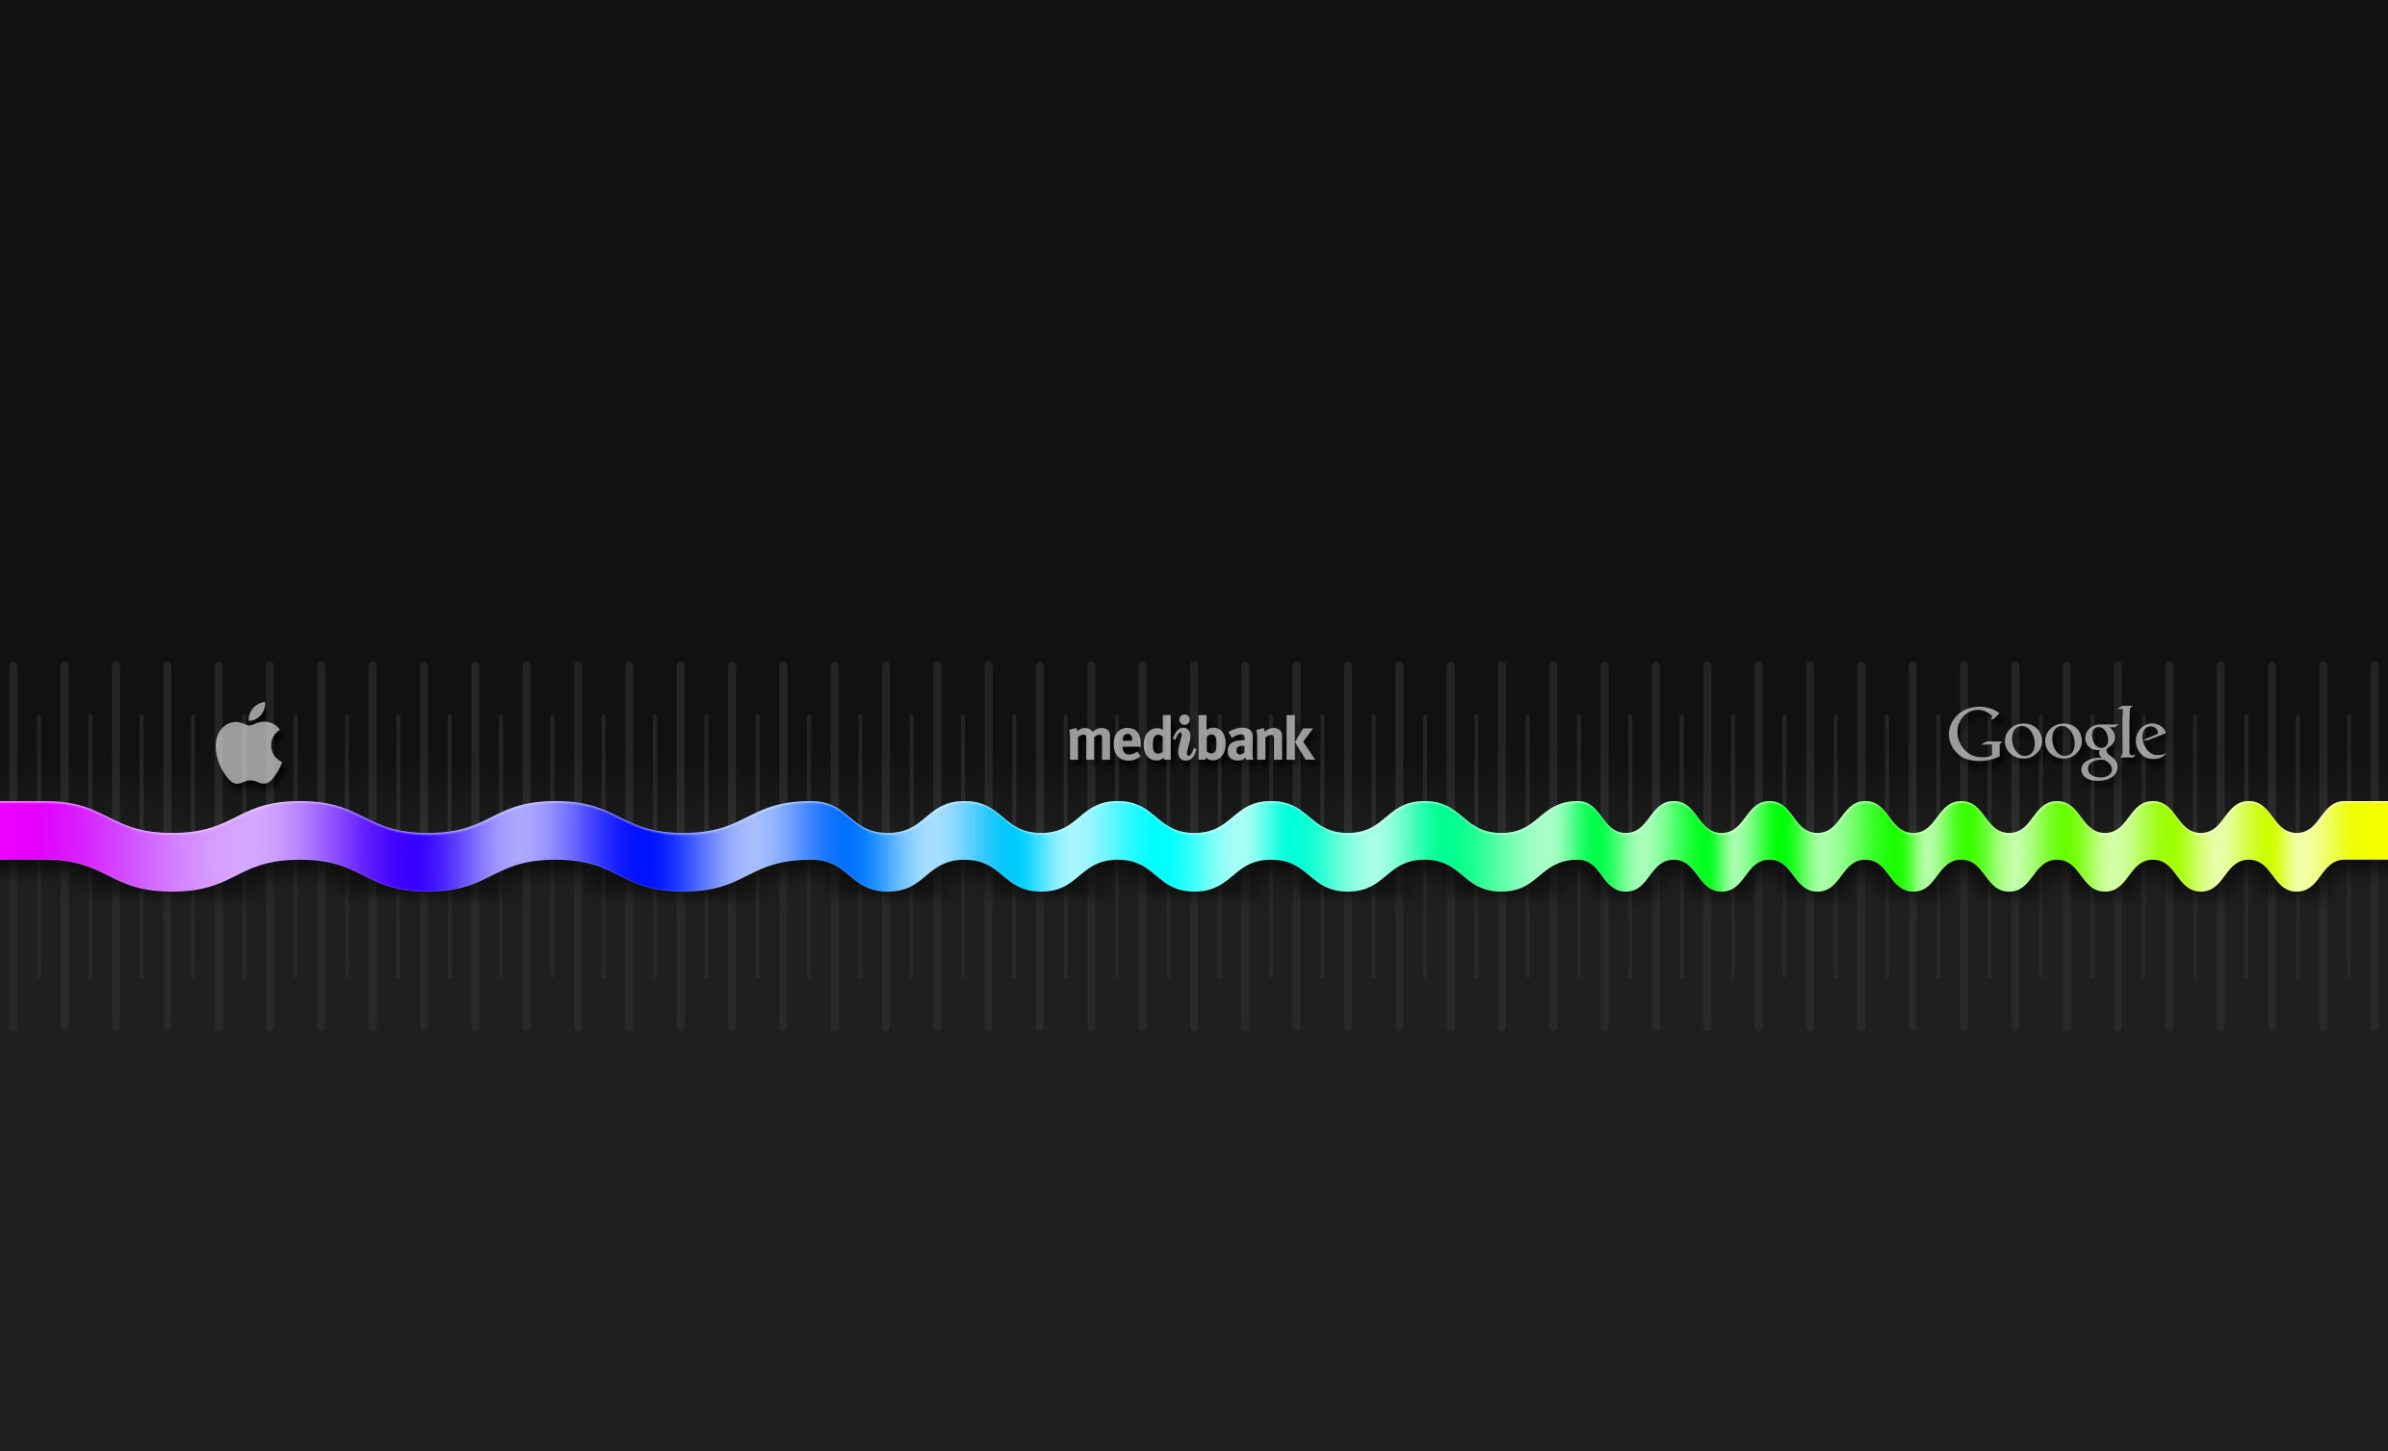
common word/concept
© All materials provided are commercial and in confidence. All rights reserved DAIS Studio Pty Ltd.
real word construct
unique word/concept
PROS
corporate identity
COMFORT
POSITIVE DISRUPTION
CONS

Slide 92
common word/concept
© All materials provided are commercial and in confidence. All rights reserved DAIS Studio Pty Ltd.
real word construct
unique word/concept
memorable easy to spell simple story
PROS
corporate identity
COMFORT
POSITIVE DISRUPTION
difficult .com search more common usage
cluttered ™ space high IP risk
CONS

Slide 93
common word/concept
© All materials provided are commercial and in confidence. All rights reserved DAIS Studio Pty Ltd.
real word construct
unique word/concept
memorable easy to spell simple story
PROS
low IP risk simpler .com search no common usage clear ™ space
corporate identity
COMFORT
POSITIVE DISRUPTION
difficult .com search more common usage cluttered ™ space
harder to remember challenging spelling complex story
high IP risk
CONS

Slide 94
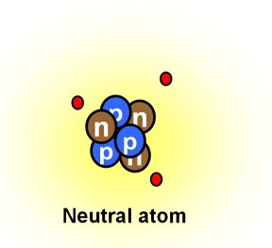
The ion – remove a negative or add a positive and it becomes energised.
corporate identity

Slide 95
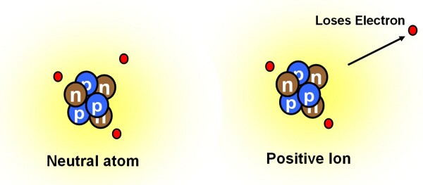
The ion – remove a negative or add a positive and it becomes energised.
corporate identity

Slide 96

The ion – remove a negative or add a positive and it becomes energised.
The ionosphere – big picture vision and energy.
We are: Ionos
corporate identity

Slide 97
The ion – remove a negative or add a positive and it becomes energised.
The ionosphere – big picture vision and energy.
We harness the power of that energy conversion and create something spectacular.
corporate identity

Slide 98
The ion – remove a negative or add a positive and it becomes energised.
The ionosphere – big picture vision and energy.
We harness the power of that energy conversion and create something spectacular.
We are: Energised
corporate identity

Slide 99
The ion – remove a negative or add a positive and it becomes energised.
The ionosphere – big picture vision and energy.
We harness the power of that energy conversion and create something spectacular.
We are: Ion
corporate identity

Slide 100
The ion – remove a negative or add a positive and it becomes energised.
The ionosphere – big picture vision and energy.
We harness the power of that energy conversion and create something spectacular.
We are: Ion opportunity
corporate identity

Slide 101
The ion – remove a negative or add a positive and it becomes energised.
The ionosphere – big picture vision and energy.
We harness the power of that energy conversion and create something spectacular.
We are: Ion opportunity
system
corporate identity

Slide 102
The ion – remove a negative or add a positive and it becomes energised.
The ionosphere – big picture vision and energy.
We harness the power of that energy conversion and create something spectacular.
We are: Ion opportunity
system
corporate identity

Slide 103
The ion – remove a negative or add a positive and it becomes energised.
The ionosphere – big picture vision and energy.
We harness the power of that energy conversion and create something spectacular.
We are: Ion o s
corporate identity

Slide 104
The ion – remove a negative or add a positive and it becomes energised.
The ionosphere – big picture vision and energy.
We harness the power of that energy conversion and create something spectacular.
We are: Ion o s
corporate identity

Slide 105
The ion – remove a negative or add a positive and it becomes energised.
The ionosphere – big picture vision and energy.
We harness the power of that energy conversion and create something spectacular.
We are: Ion o s
corporate identity

Slide 106
The ion – remove a negative or add a positive and it becomes energised.
The ionosphere – big picture vision and energy.
We harness the power of that energy conversion and create something spectacular.
We are: Ionos
corporate identity

Slide 107
The ion – remove a negative or add a positive and it becomes energised.
The ionosphere – big picture vision and energy.
We harness the power of that energy conversion and create something spectacular.
We are: Ionos
corporate identity
Delivering the vision and energy of the ionosphere.

Slide 108
brand governance

Slide 109
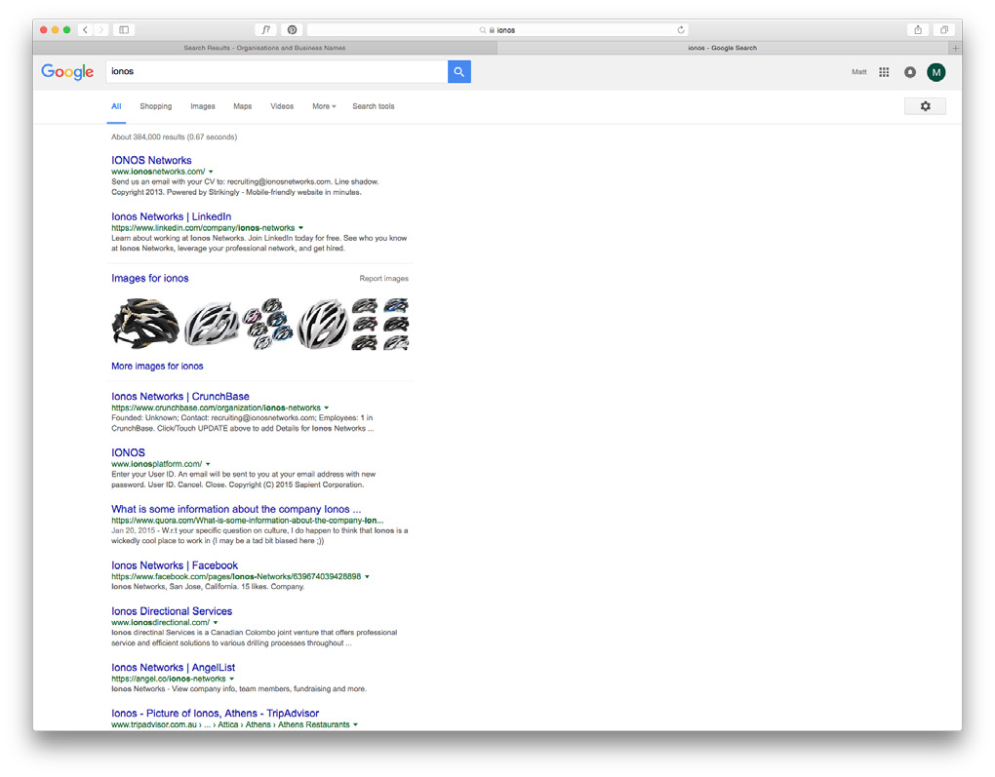
ionos
google.com.au: 384,000 results
brand governance

Slide 110






ionos
google.com.au: 384,000 results ionos.com.au: secured ionosventures.com.au: secured ionos.com: available
Certificate of Registration
.au Domain Name
This is to certify that
Certificate of Registration
.com / .net domain names
Date of issue: ^{24 Feb, 2016}
ionos.com.au
This is to certify that
was on registered to
ionosventures.com
03 Feb, 2016
DAIS STUDIO PTY LTD
is registered to
for a ² year period, subject to the terms and conditions of the domain name licence and according to .au Domain Administration Limited’s policies published from time to time.
DAIS
Issued by: TPP Wholesale Pty Ltd - ABN 54 109 565 095
The domain name will be due for renewal on 10/02/2017 subject to the terms and conditions of the domain name license.
Issued by: TPP Wholesale Pty Ltd - ABN 54 109 565 095
on: ^{24 Feb, 2016}
Authorised Signatory
an auDA Accredited Registrar
on: ^{24 Feb, 2016}
Authorised Signatory
Larry Bloch CEO
Larry Bloch CEO
IMPORTANT NOTICE
It is auDA policy that domain name registrants must notify their registrar of any changes to their contact details or others registration information. Failure to do so many result in revocation of the domain name licence.
brand governance

Slide 111
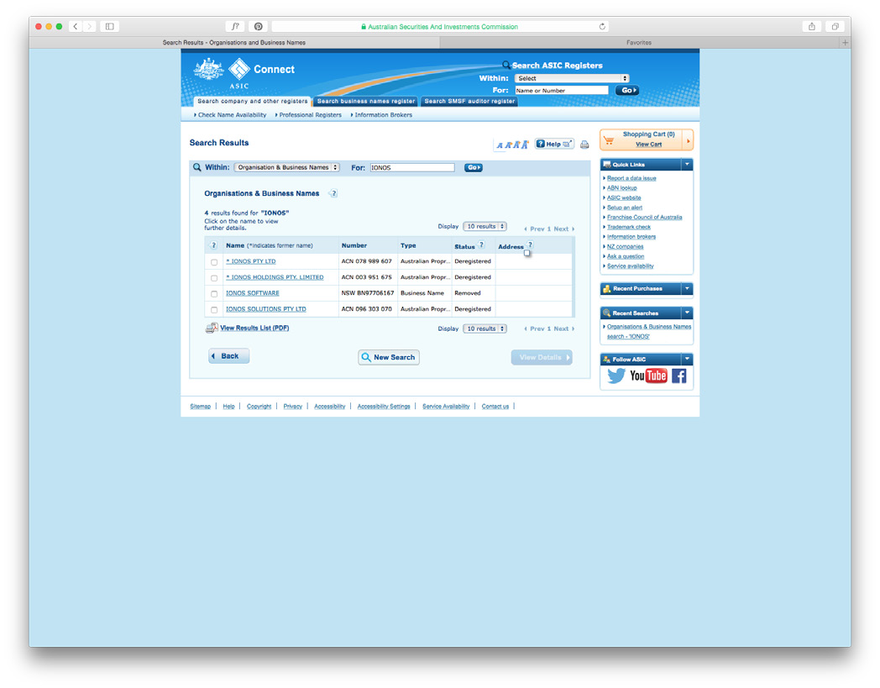
ionos
google.com.au: 384,000 results ionos.com.au: secured ionosventures.com.au: secured ionos.com: available
asic search: clear
Certificate of Registration
.au Domain Name
This is to certify that
Certificate of Registration
.com / .net domain names
Date of issue: ^{24 Feb, 2016}
This is to certify that
ionosventures.com
is registered to
DAIS
The domain name will be due for renewal on 10/02/2017 subject to the terms and conditions of the domain name license.
Issued by: TPP Wholesale Pty Ltd - ABN 54 109 565 095
on: ^{24 Feb, 2016}
ionos.com.au
was on registered to
03 Feb, 2016 DAIS STUDIO PTY LTD
for a ² year period, subject to the terms and conditions of the domain name licence and according to .au Domain Administration Limited’s policies published from time to time.
Issued by: TPP Wholesale Pty Ltd - ABN 54 109 565 095
an auDA Accredited Registrar
on: ^{24 Feb, 2016}
Authorised Signatory
Authorised Signatory
Larry Bloch CEO
Larry Bloch CEO
IMPORTANT NOTICE
It is auDA policy that domain name registrants must notify their registrar of any changes to their contact details or others registration information. Failure to do so many result in revocation of the domain name licence.
brand governance

Slide 112
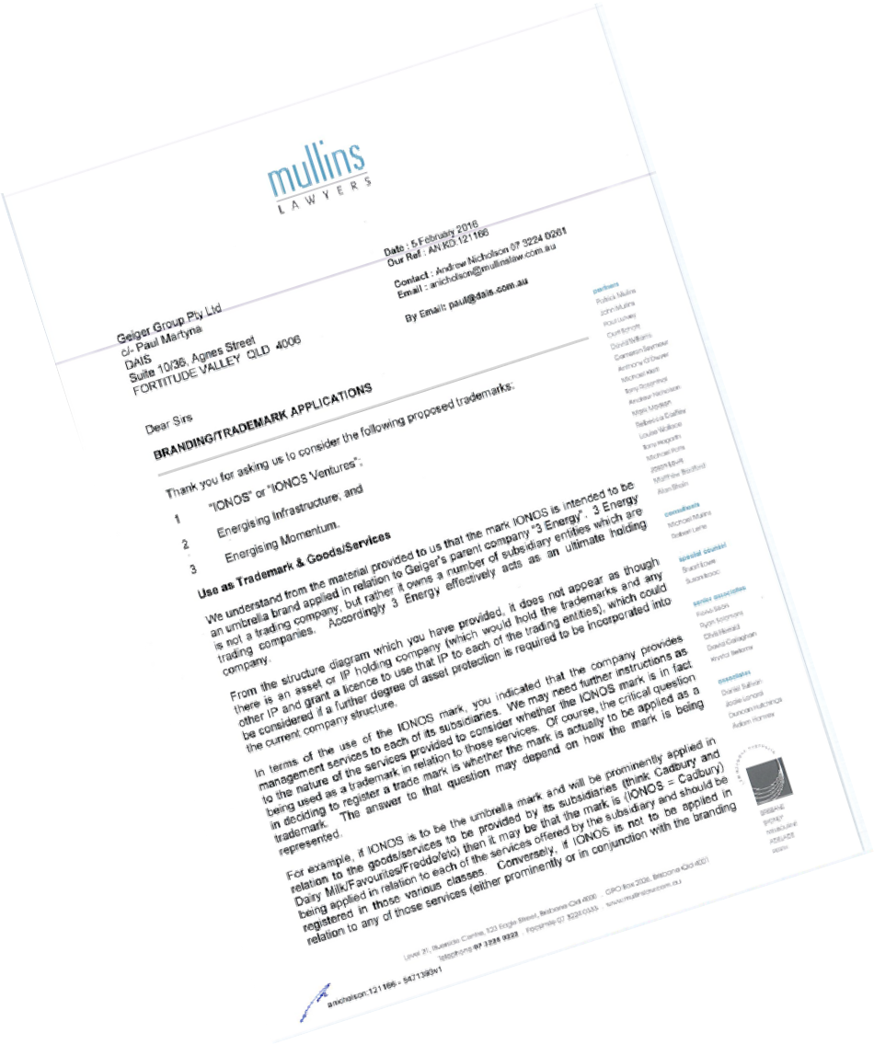
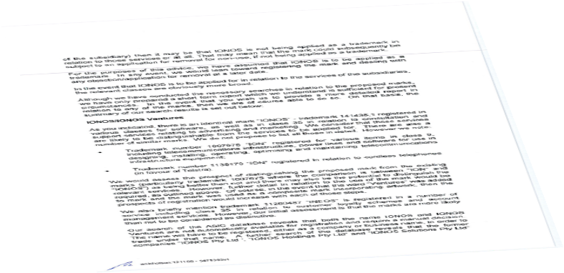

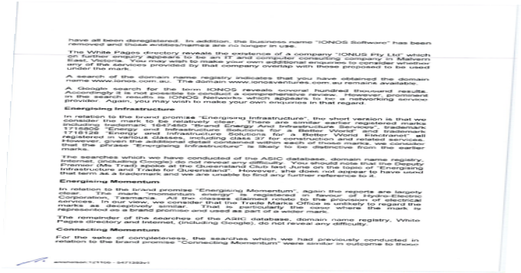
ionos
google.com.au: 384,000 results ionos.com.au: secured ionosventures.com.au: secured ionos.com: available
asic search: clear
trademark: clear
Certificate of Registration
.au Domain Name
This is to certify that
Certificate of Registration
.com / .net domain names
Date of issue: ^{24 Feb, 2016}
ionos.com.au
This is to certify that
was on registered to
ionosventures.com
03 Feb, 2016
DAIS STUDIO PTY LTD
is registered to
for a ² year period, subject to the terms and conditions of the domain name licence and according to .au Domain Administration Limited’s policies published from time to time.
DAIS
Issued by: TPP Wholesale Pty Ltd - ABN 54 109 565 095
The domain name will be due for renewal on 10/02/2017 subject to the terms and conditions of the domain name license.
an auDA Accredited Registrar
Issued by: TPP Wholesale Pty Ltd - ABN 54 109 565 095
on: ^{24 Feb, 2016}
Authorised Signatory
on: ^{24 Feb, 2016}
to their contact details or others licence.
Authorised Signatory
Larry Bloch CEO
Larry Bloch CEO
IMPORTANT NOTICE
It is auDA policy that domain name registrants must notify their registrar of any changes registration information. Failure to do so many result in revocation of the domain name
brand governance

Slide 113
brand strategy

Slide 114
brand strategy

Slide 115
brand strategy

Slide 116
Invest
I
brand strategy

Slide 117
Invest
I
People
brand strategy

Slide 118
Invest
IO
People
brand strategy
Optimise

Slide 119
IO
Capital
Invest
People
brand strategy
Optimise

Slide 120
ION
Capital
Invest
Navigate
People
brand strategy
Optimise

Slide 121
ION
Strategy
Capital
Invest
Navigate
People
brand strategy
Optimise

Slide 122

ION
Strategy
Capital
Invest
Navigate
People
brand strategy
Optimise

Slide 123
ION Opportunity System
Strategy
Capital
Invest
Navigate
People
brand strategy
Optimise

Slide 124
whiteboard diagram

Slide 125


IIOONN
OS
Strategy People Capital
I
N
whiteboard diagram
O

Slide 126
brand inventory

Slide 127
Ionos
_{i}d
corporate identity
brand inventory

Slide 128
Ionos
_{i}d
corporate identity
_{d}e
technical descriptor
Ventures
brand inventory

Slide 129
Ionos
_{i}d
corporate identity
_{d}e
technical descriptor
Ventures
_{p}r
brand promise
Energising Opportunities
brand inventory

Slide 130
Ionos
_{i}d
corporate identity
_{d}e
technical descriptor
Ventures
_{p}r
brand promise
Energising Opportunities
_{s}l
solution streams
People | Capital | Strategy
brand inventory

Slide 131
Ionos
_{i}d
corporate identity
_{d}e
technical descriptor
Ventures
_{p}r
brand promise
Energising Opportunities
_{s}l
solution streams
People | Capital | Strategy
brand inventory
_{t}h
brand theme
Energising Leadership

Slide 132
Ionos
_{i}d
corporate identity
_{d}e
technical descriptor
Ventures
_{p}r
brand promise
Energising Opportunities
_{s}l
solution streams
People | Capital | Strategy
brand inventory
_{t}h
brand theme
Energising Leadership
_{e}t
brand ethics
Invest | Optimise | Navigate

Slide 133
3 Energy
brand creative presentation

Slide 134
inspiration

Slide 135

awareness
inspiration

Slide 136

awareness energy
inspiration

Slide 137


awareness
energy
© All materials provided are commercial and in confidence. All rights reserved DAIS Studio Pty Ltd.
monitor
inspiration

Slide 138

awareness monitor
energy simplicity
© All materials provided are commercial and in confidence. All rights reserved DAIS Studio Pty Ltd.
inspiration

Slide 139
colour palette

Slide 140
primary colour palette
PANTONE 419 C
colour palette

Slide 141
primary colour palette
PANTONE 419 C
PANTONE 3395 C
colour palette

Slide 142
primary colour palette
PANTONE 419 C
PANTONE 3395 C
PANTONE 443 C
colour palette

Slide 143
typography

Slide 144
primary typographic palette
corporate
bold big solid power ballsy
GALANO GROTESQUE
ABCDEFGHIJKLMNOPQRSTUVWXYZ
abcdefghijklmnopqrstuvwxyz 1234567890 @
typography

Slide 145
primary typographic palette
corporate
bold big solid power ballsy clever efficient agile elegant
intriguing
GALANO GROTESQUE
ABCDEFGHIJKLMNOPQRSTUVWXYZ
abcdefghijklmnopqrstuvwxyz 1234567890 @
APEX NEW BOOK
ABCDEFGHIJKLMNOPQRSTUVWXYZ
abcdefghijklmnopqrstuvwxyz 1234567890 @
typography
APEX NEW MEDIUM
ABCDEFGHIJKLMNOPQRSTUVWXYZ
abcdefghijklmnopqrstuvwxyz 1234567890 @

Slide 146
corporate identity

Slide 147

ION Opportunity System
Strategy
Capital
Invest
Navigate
People
corporate identity
Optimise

Slide 148
corporate identity

Slide 149
corporate identity

Slide 150
corporate identity

Slide 151
corporate identity

Slide 152
ventures
corporate identity

Slide 153
ventures
corporate identity

Slide 154
ventures
corporate identity

Slide 155
brand promise

Slide 156
energising opportunities
brand promise
©© AAllll mmaatteerriiaallss pprroovviiddeedd aarree ccoommmmeerrcciiaall aanndd iinn ccoonnfifiddeennccee.. AAllll rriigghhttss rreesseerrvveedd DDAAIISS SSttuuddiioo PPttyy LLttdd..

Slide 157
energising opportunities
brand promise
©© AAllll mmaatteerriiaallss pprroovviiddeedd aarree ccoommmmeerrcciiaall aanndd iinn ccoonnfifiddeennccee.. AAllll rriigghhttss rreesseerrvveedd DDAAIISS SSttuuddiioo PPttyy LLttdd..

Slide 158
energising opportunities
brand promise
©© AAllll mmaatteerriiaallss pprroovviiddeedd aarree ccoommmmeerrcciiaall aanndd iinn ccoonnfifiddeennccee.. AAllll rriigghhttss rreesseerrvveedd DDAAIISS SSttuuddiioo PPttyy LLttdd..

Slide 159
pportunities
energising
brand promise
©© AAllll mmaatteerriiaallss pprroovviiddeedd aarree ccoommmmeerrcciiaall aanndd iinn ccoonnfifiddeennccee.. AAllll rriigghhttss rreesseerrvveedd DDAAIISS SSttuuddiioo PPttyy LLttdd..

Slide 160
pportunities
energising
brand promise
©© AAllll mmaatteerriiaallss pprroovviiddeedd aarree ccoommmmeerrcciiaall aanndd iinn ccoonnfifiddeennccee.. AAllll rriigghhttss rreesseerrvveedd DDAAIISS SSttuuddiioo PPttyy LLttdd..

Slide 161
pportunities
© All materials provided are commercial and in confidence. All rights reserved DAIS Studio Pty Ltd.
energising
brand promise

Slide 162
pportunities
© All materials provided are commercial and in confidence. All rights reserved DAIS Studio Pty Ltd.
energising
brand promise

Slide 163
solution streams

Slide 164
strategy
people
capital
solution streams
©© AAllll mmaatteerriiaallss pprroovviiddeedd aarree ccoommmmeerrcciiaall aanndd iinn ccoonnfifiddeennccee.. AAllll rriigghhttss rreesseerrvveedd DDAAIISS SSttuuddiioo PPttyy LLttdd..

Slide 165
strategy
people
capital
solution streams
©© AAllll mmaatteerriiaallss pprroovviiddeedd aarree ccoommmmeerrcciiaall aanndd iinn ccoonnfifiddeennccee.. AAllll rriigghhttss rreesseerrvveedd DDAAIISS SSttuuddiioo PPttyy LLttdd..

Slide 166
strategy
people
capital
solution streams
©© AAllll mmaatteerriiaallss pprroovviiddeedd aarree ccoommmmeerrcciiaall aanndd iinn ccoonnfifiddeennccee.. AAllll rriigghhttss rreesseerrvveedd DDAAIISS SSttuuddiioo PPttyy LLttdd..

Slide 167
strategy
people
capital
solution streams
©© AAllll mmaatteerriiaallss pprroovviiddeedd aarree ccoommmmeerrcciiaall aanndd iinn ccoonnfifiddeennccee.. AAllll rriigghhttss rreesseerrvveedd DDAAIISS SSttuuddiioo PPttyy LLttdd..

Slide 168
strategy
© All materials provided are commercial and in confidence. All rights reserved DAIS Studio Pty Ltd.
people
capital
solution streams

Slide 169
visual identity

Slide 170

© All materials provided are commercial and in confidence. All rights reserved DAIS Studio Pty Ltd.
visual identity

Slide 171
visual identity
©© AAllll mmaatteerriiaallss pprroovviiddeedd aarree ccoommmmeerrcciiaall aanndd iinn ccoonnfifiddeennccee.. AAllll rriigghhttss rreesseerrvveedd DDAAIISS SSttuuddiioo PPttyy LLttdd..

Slide 172
visual identity
©© AAllll mmaatteerriiaallss pprroovviiddeedd aarree ccoommmmeerrcciiaall aanndd iinn ccoonnfifiddeennccee.. AAllll rriigghhttss rreesseerrvveedd DDAAIISS SSttuuddiioo PPttyy LLttdd..

Slide 173

© All materials provided are commercial and in confidence. All rights reserved DAIS Studio Pty Ltd.
visual identity

Slide 174

© All materials provided are commercial and in confidence. All rights reserved DAIS Studio Pty Ltd.
visual identity

Slide 175

© All materials provided are commercial and in confidence. All rights reserved DAIS Studio Pty Ltd.
visual identity

Slide 176

© All materials provided are commercial and in confidence. All rights reserved DAIS Studio Pty Ltd.
visual identity

Slide 177

© All materials provided are commercial and in confidence. All rights reserved DAIS Studio Pty Ltd.
visual identity

Slide 178
brand credential

Slide 179
ventures
brand credential
©© AAllll mmaatteerriiaallss pprroovviiddeedd aarree ccoommmmeerrcciiaall aanndd iinn ccoonnfifiddeennccee.. AAllll rriigghhttss rreesseerrvveedd DDAAIISS SSttuuddiioo PPttyy LLttdd..

Slide 180
venture
an
brand credential
©© AAllll mmaatteerriiaallss pprroovviiddeedd aarree ccoommmmeerrcciiaall aanndd iinn ccoonnfifiddeennccee.. AAllll rriigghhttss rreesseerrvveedd DDAAIISS SSttuuddiioo PPttyy LLttdd..

Slide 181
an
venture
brand credential
©© AAllll mmaatteerriiaallss pprroovviiddeedd aarree ccoommmmeerrcciiaall aanndd iinn ccoonnfifiddeennccee.. AAllll rriigghhttss rreesseerrvveedd DDAAIISS SSttuuddiioo PPttyy LLttdd..

Slide 182
© All materials provided are commercial and in confidence. All rights reserved DAIS Studio Pty Ltd.
an
venture
brand credential

Slide 183
brand inventory

Slide 184
_{i}d
corporate identity
brand inventory

Slide 185
_{i}d
corporate identity
_{d}e
technical descriptor
ventures
brand inventory

Slide 186
_{i}d
corporate identity
_{d}e
technical descriptor
ventures
_{p}r
brand promise
energising
pportunities
brand inventory

Slide 187
_{i}d
corporate identity
_{d}e
technical descriptor
ventures
_{p}r
brand promise
energising
pportunities
_{s}l
solution streams
people
capital
strategy
brand inventory

Slide 188

_{i}d | corporate identity |  | _{v}i | visual identity
_{d}e | technical descriptor | ventures
_{p}r | brand promise | energising pportunities
_{s}l | solution streams | people capital strategy
brand inventory

Slide 189
_{i}d | corporate identity |  | _{v}i | visual identity
_{d}e | technical descriptor | ventures
_{p}r | brand promise | energising pportunities
_{s}l | solution streams | people capital strategy
_{c}r | brand credential | an venture
brand inventory

Slide 190
_{i}d | corporate identity |  | _{v}i | visual identity
_{d}e | technical descriptor | ventures
_{p}r | brand promise | energising pportunities
_{s}l | solution streams | people capital strategy
_{c}r | brand credential | an venture
_{c}p | colour palette | PANTONE 419 C PANTONE 3395 C PANTONE 443 C
brand inventory

Slide 191
brand map

Slide 192
3 Energy
“Financial & human capital to grow business, people & values”
Aviation
Geiger Group
Geiger Fuel Solutions
Tuff Group
Sanki (Aus)
RDS
Future Acquisitions...
Fuel delivery devices for retail fuel industry
Rotating Disc Systems
Water treatment solutions
Geiger Group Qld
Electrical
Construction
Service
Maintenance
Tuff Bullbars
Bullbars
brand map
Civil
Brushrails
Maintenance
Construction
Accessories
Fibre / coms
Water
Tuff Coatings
Powdercoating
Rhino lining
Sandblasting
Property M’ment
Consultation
Geiger Group Vic
Electrical

Slide 193
Aviation
Geiger Group
Geiger Fuel Solutions
Tuff Group
Sanki (Aus)
RDS
Future Acquisitions...
Fuel delivery devices for retail fuel industry
Rotating Disc Systems
Water treatment solutions
Geiger Group Qld
Electrical
Construction
Service
Maintenance
Tuff Bullbars
Bullbars
brand map
Civil
Brushrails
Maintenance
Construction
Accessories
Fibre / coms
Water
Tuff Coatings
Powdercoating
Rhino lining
Sandblasting
Property M’ment
Consultation
Geiger Group Vic
Electrical

Slide 194
thank you

Slide 195
ventures
corporate identity

Slide 196
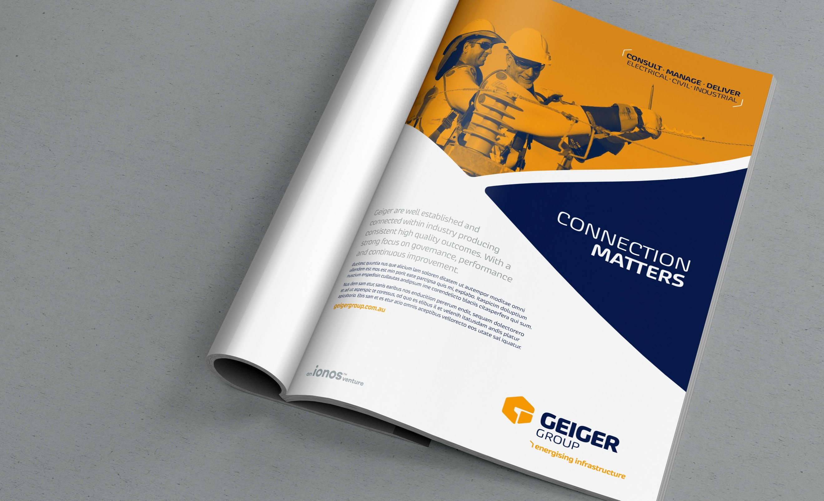
brand credential

Slide 197
brand credential

