Slide 1
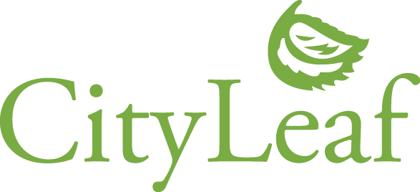
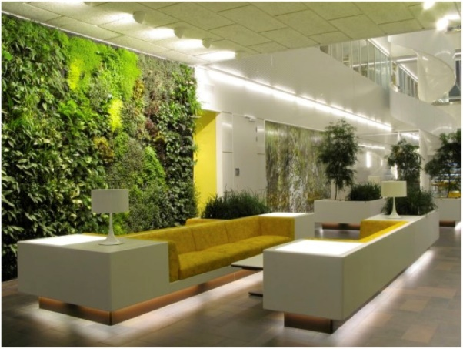
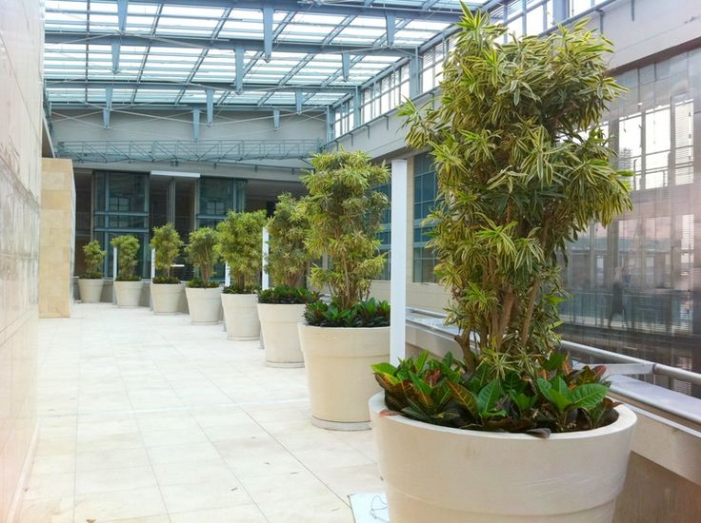

Indoor Plant Design and Maintenance Services for Healthcare Facilities
We can help you make your healthcare facility more welcoming!
We know healthcare facilities
We currently serve over 20 of the largest hospitals and healthcare facilities across the Bay Area
We understand what works in a hospital from using the right moss to minimize dusty to the right plant
Benefits of plants…
High impact amenity at a low cost
Create a calming environment for patients
Patients’ stress levels increase in the hospital, however exposure to natural settings has the ability to reduce stress and enhance the process of healing
Are proven to provide health benefits such as cleaning indoor air
For a design consultation, please contact 510-655-2062 or
Jeff Fitterman at fitterman@cityleaf.com
 | CityLeaf, Inc. PO Box 20538 Oakland, CA 94620 info@cityleaf.com

