Slide 1
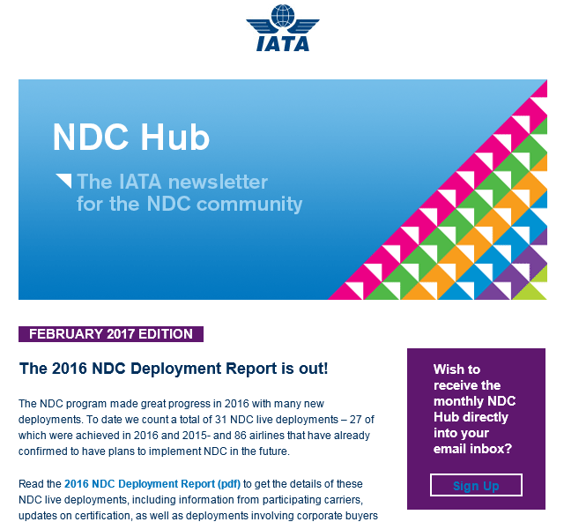


I like the modern look of these
And the brightness of them

Slide 2

This is the one I had but I don’t really like it. Bit basic

Slide 3


Over the next few pages, some other examples we have done
You will see that many of them have icons from the location of the event as part of the logo, that I don’t really like.

Slide 4



Slide 5



Slide 6



Slide 7


