Slide 1

“Matching events with venues”

Slide 2
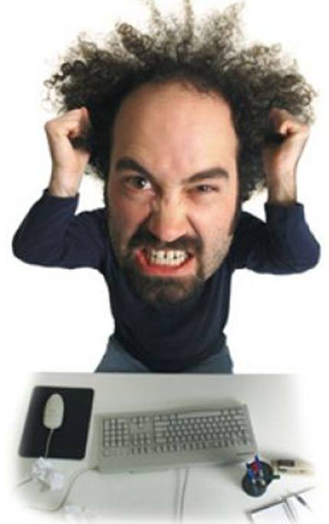

Slide 3

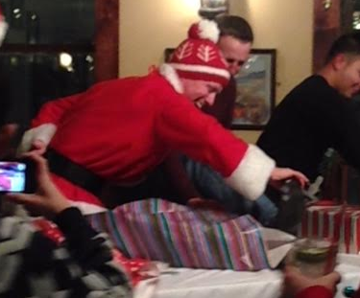
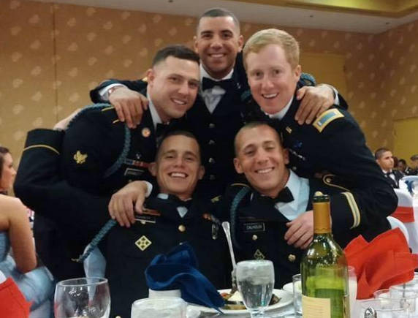




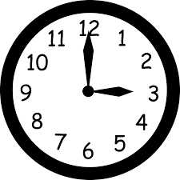
Problem for Event Planners
Small Event ($500)
Meet Up
Mid Size Event ($4000)
Company Holiday Party
Large Event ($50,000)
Unit Formal Event

Slide 4

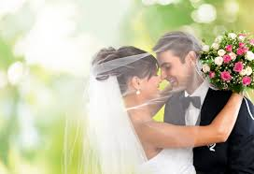
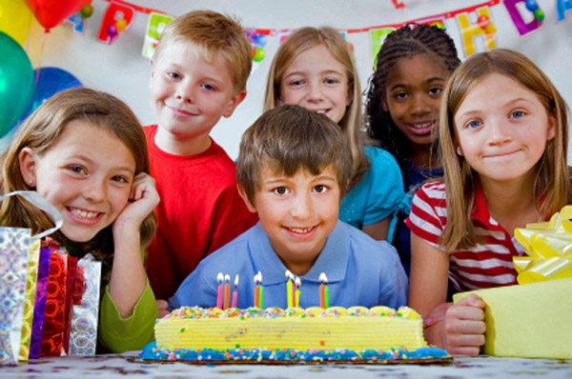
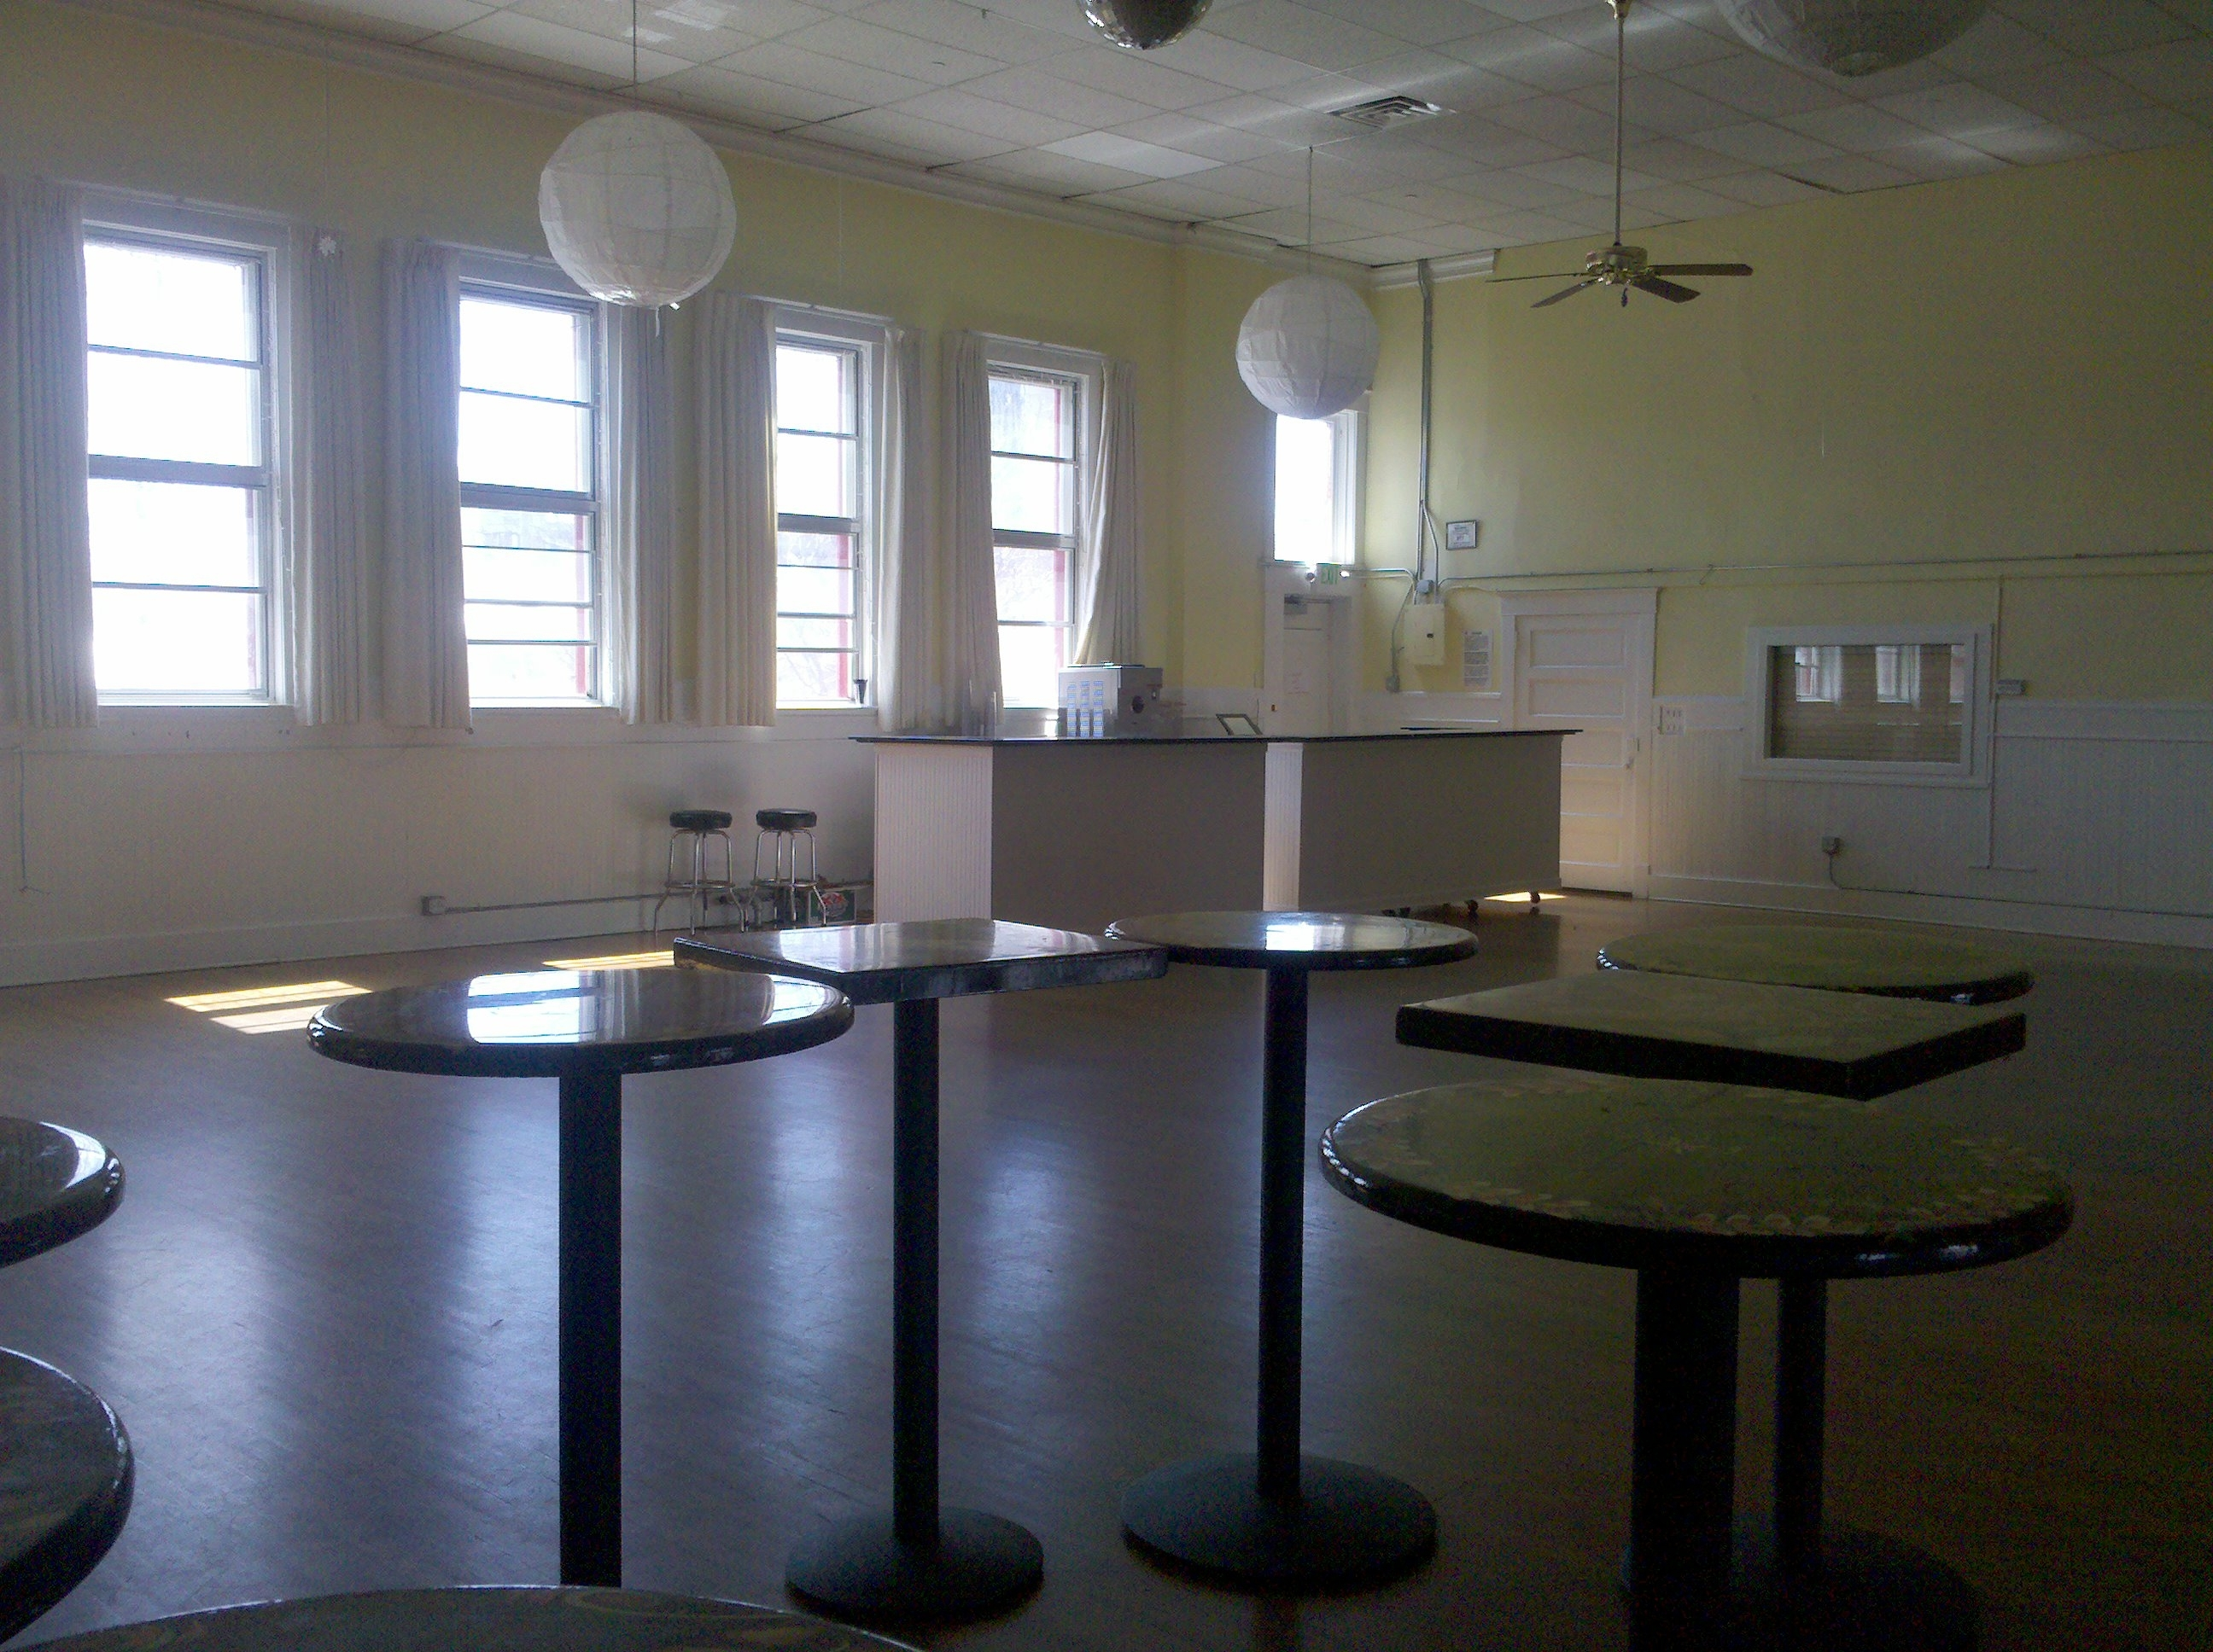
Problem
No easy way to instantly find and book venues
Many types of events
Venues need events

Slide 5
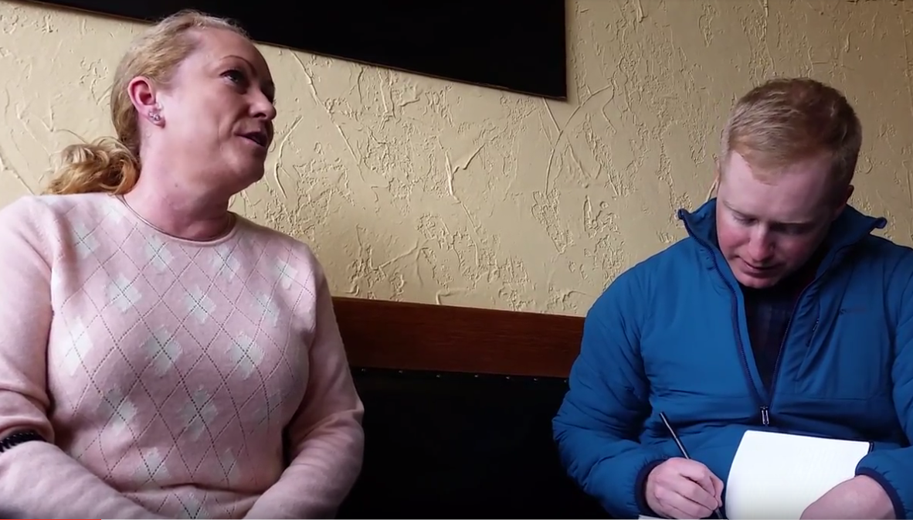
Problem for Venue Managers
“Events are critical to our profitability”
– Susan, Restaurant Owner (270+ people space)
“Empty 3 nights a week”
– Shaundy, Restaurant Owner (130+ people space)
“It’s time consuming responding to event inquiries”
– Calder, Distillery Owner (30+ people space)

Slide 6

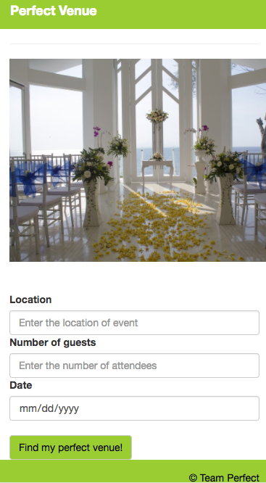
Solution and Validation
Solution
Easily book events
Increase bookings
Venue owners agree
“We’ve talked about the need for something like this”
– Shaundy, Restaurant Owner (130+ people)
“I make an average of $35 per customer, I’d be more than willing to pay $1 for each customer you bring me”
– Calder, Distillery Owner (~40 person venue)

