Slide 1



Slide 2

Kaishi Partners
WHAT
WHO
WHEN
LONGER-TERM GOAL
CORE VALUES
We are the ‘recruitment partner for the startup ecosystem in South-East Asia’; partnering with Venture Capital and startup tech firms, HQ’d out of Singapore.
Established by Ben Poh & Michael Milne
Opened our doors in September 2016
Asia and Global expansion
Positivity - Proactivity - Teamwork - Delivery

Slide 3

Our Core Values
POSITIVITY
PROACTIVITY
TEAMWORK
DELIVERY
We look on the bright side… and don’t let limiting beliefs hold us back
We don't wait… we make things happen
We work together… to solve problems, find solutions, and celebrate the good times
We do what we say we're going to do… for our candidates, clients, and colleagues alike

Slide 4
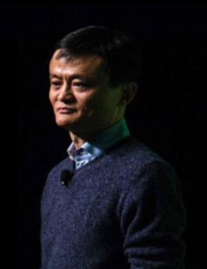







Positivity… the character of being positive
We look on the bright side… and don’t let limiting beliefs hold us back
“Today is hard, tomorrow will
be worse, but the day after tomorrow will be sunshine”
Jack Ma, Alibaba

Slide 5




Proactivity… to initiate change rather than reacting to events
We don't wait… we make things happen
“There are people who make things happen, there are people who watch things happen and there are people who wonder what happened.
To be successful, you need to be a person who makes things happen”
Jim Lovell, Astronaut

Slide 6





Teamwork… working together
We work together… to solve problems, find solutions, and celebrate the good times
“Great things in business are never done by one person, they’re done by a team of people”
Steve Jobs, Apple

Slide 7
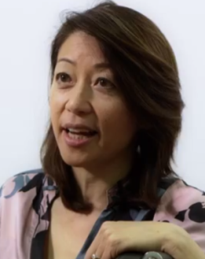


Delivery… to achieve what is desired, expected or promised
We do what we say we're going to do… for our candidates, clients, and colleagues alike
“Instead of just offering advice, we actually deliver solutions”
Rosaline Koo, Founder Of CXA

Slide 8
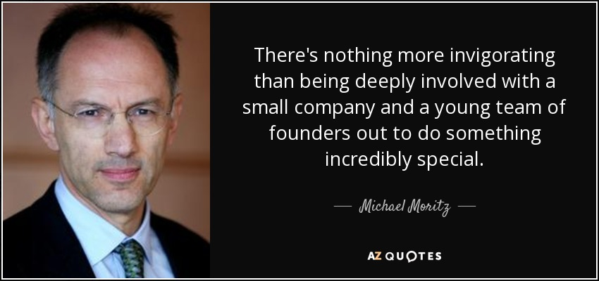
Michael Moritz, Venture Capitalist

