Slide 1
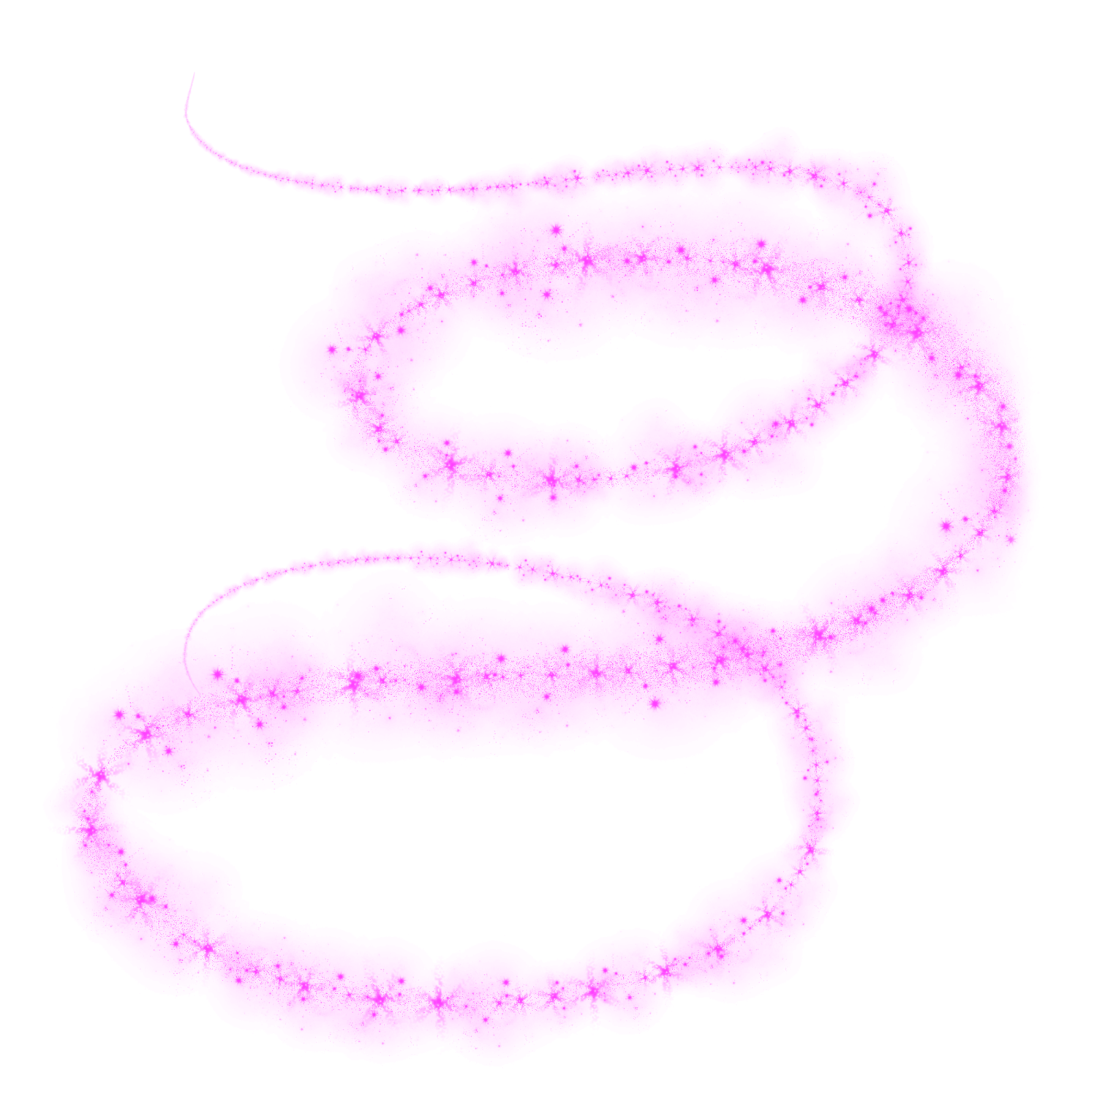
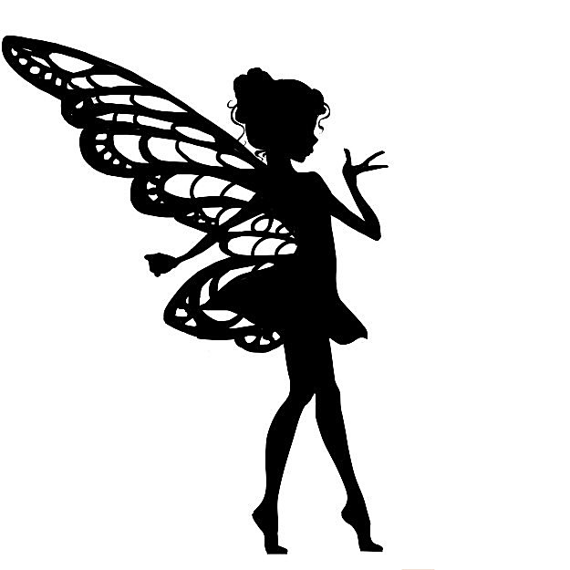
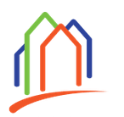
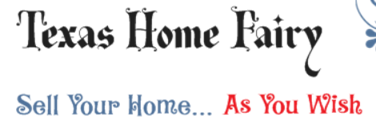
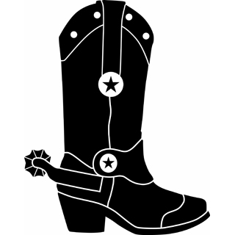
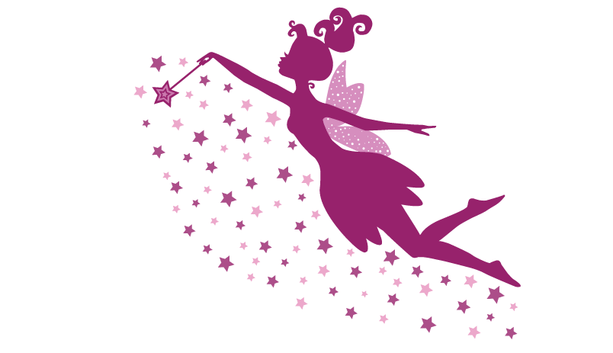
Notes:
Name: Texas Home Fairy
Business/target customer: people who need to sell their home quickly.
Want a friendly, cute FAIRY (1st priority) but with TEXAS traits (2nd priority)
Brand: helpful, friendly, reliable… and local (Texas). Marketing messaging will be focused on magical fairy that solves home problems.
EXAMPLE Concepts:
I pulled these together with clip art from web, just to provide concept. I like these fairy graphics, but need to create something original. Would love a personified/cartoon mascot, but have been disappointed with attempts at creating mascot, so have settled on silhouette. Silhouette can be black, or perhaps multi-color?
Fairy needs cowboy boots!!! (integral to brand!). I added clip art boots as example. May also want a cowboy hat, but only if it “works” with the design.
I am not sure whether to have Fairy on one end and house on the other with name in between (concept 1) OR to have fairy next to house on one end and name next to it. (concept 2)
In any case, I’d like the fairy to “enchant” the house… via either (1) blowing pixie dust or (2) using magic wand.
I like the gothic font as it aligns with fairy tales, but open to other fonts.
Current home graphic is just a placeholder. Would like something different, but prefer the home to be colorful (rainbow, happy).
Open to other concepts/ideas! I am no designer!!!
Concept 1
Boots!
Fairy dust!
Concept 2

