Slide 1


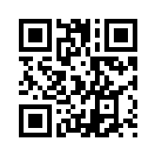
Over 1 Million US Homes Have Solar
5 Mins On Solar Dashboard
Saves You Thousands of Dollars
Learn More at pmaxsolar.com
Instant Solar Report Up to 3 quotes from Installers near you Compare quotations

