Slide 1




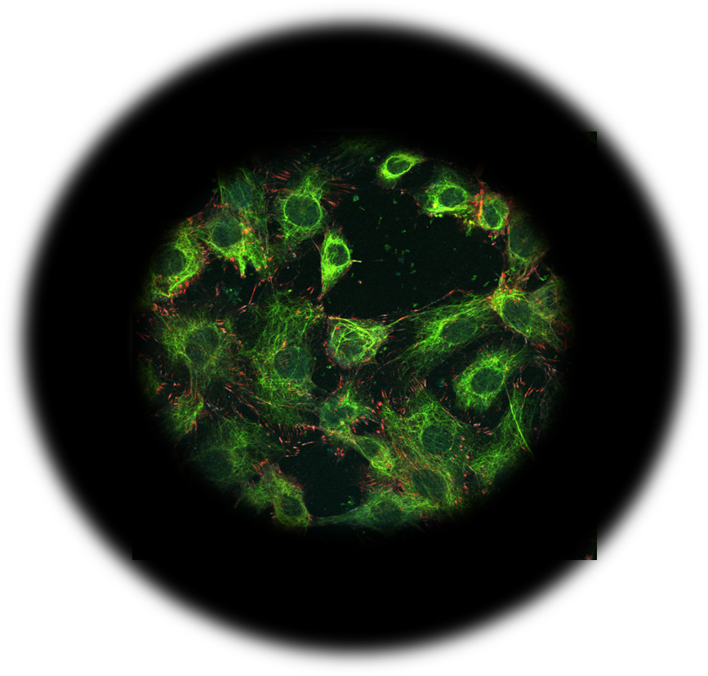

Pressure
Shear
Tension
Strain
Tension stress
Forces on cells
Cell fitness
Cell frailty
Functional
cellular machineries
Mechanostasis
Dysfunctional
cellular machineries
Therapies
Health
Prevention
Disease
Critical targets
Cellular machineries
Disease models
Cell, tissue & organ responses
Mechanical force models

