Slide 1


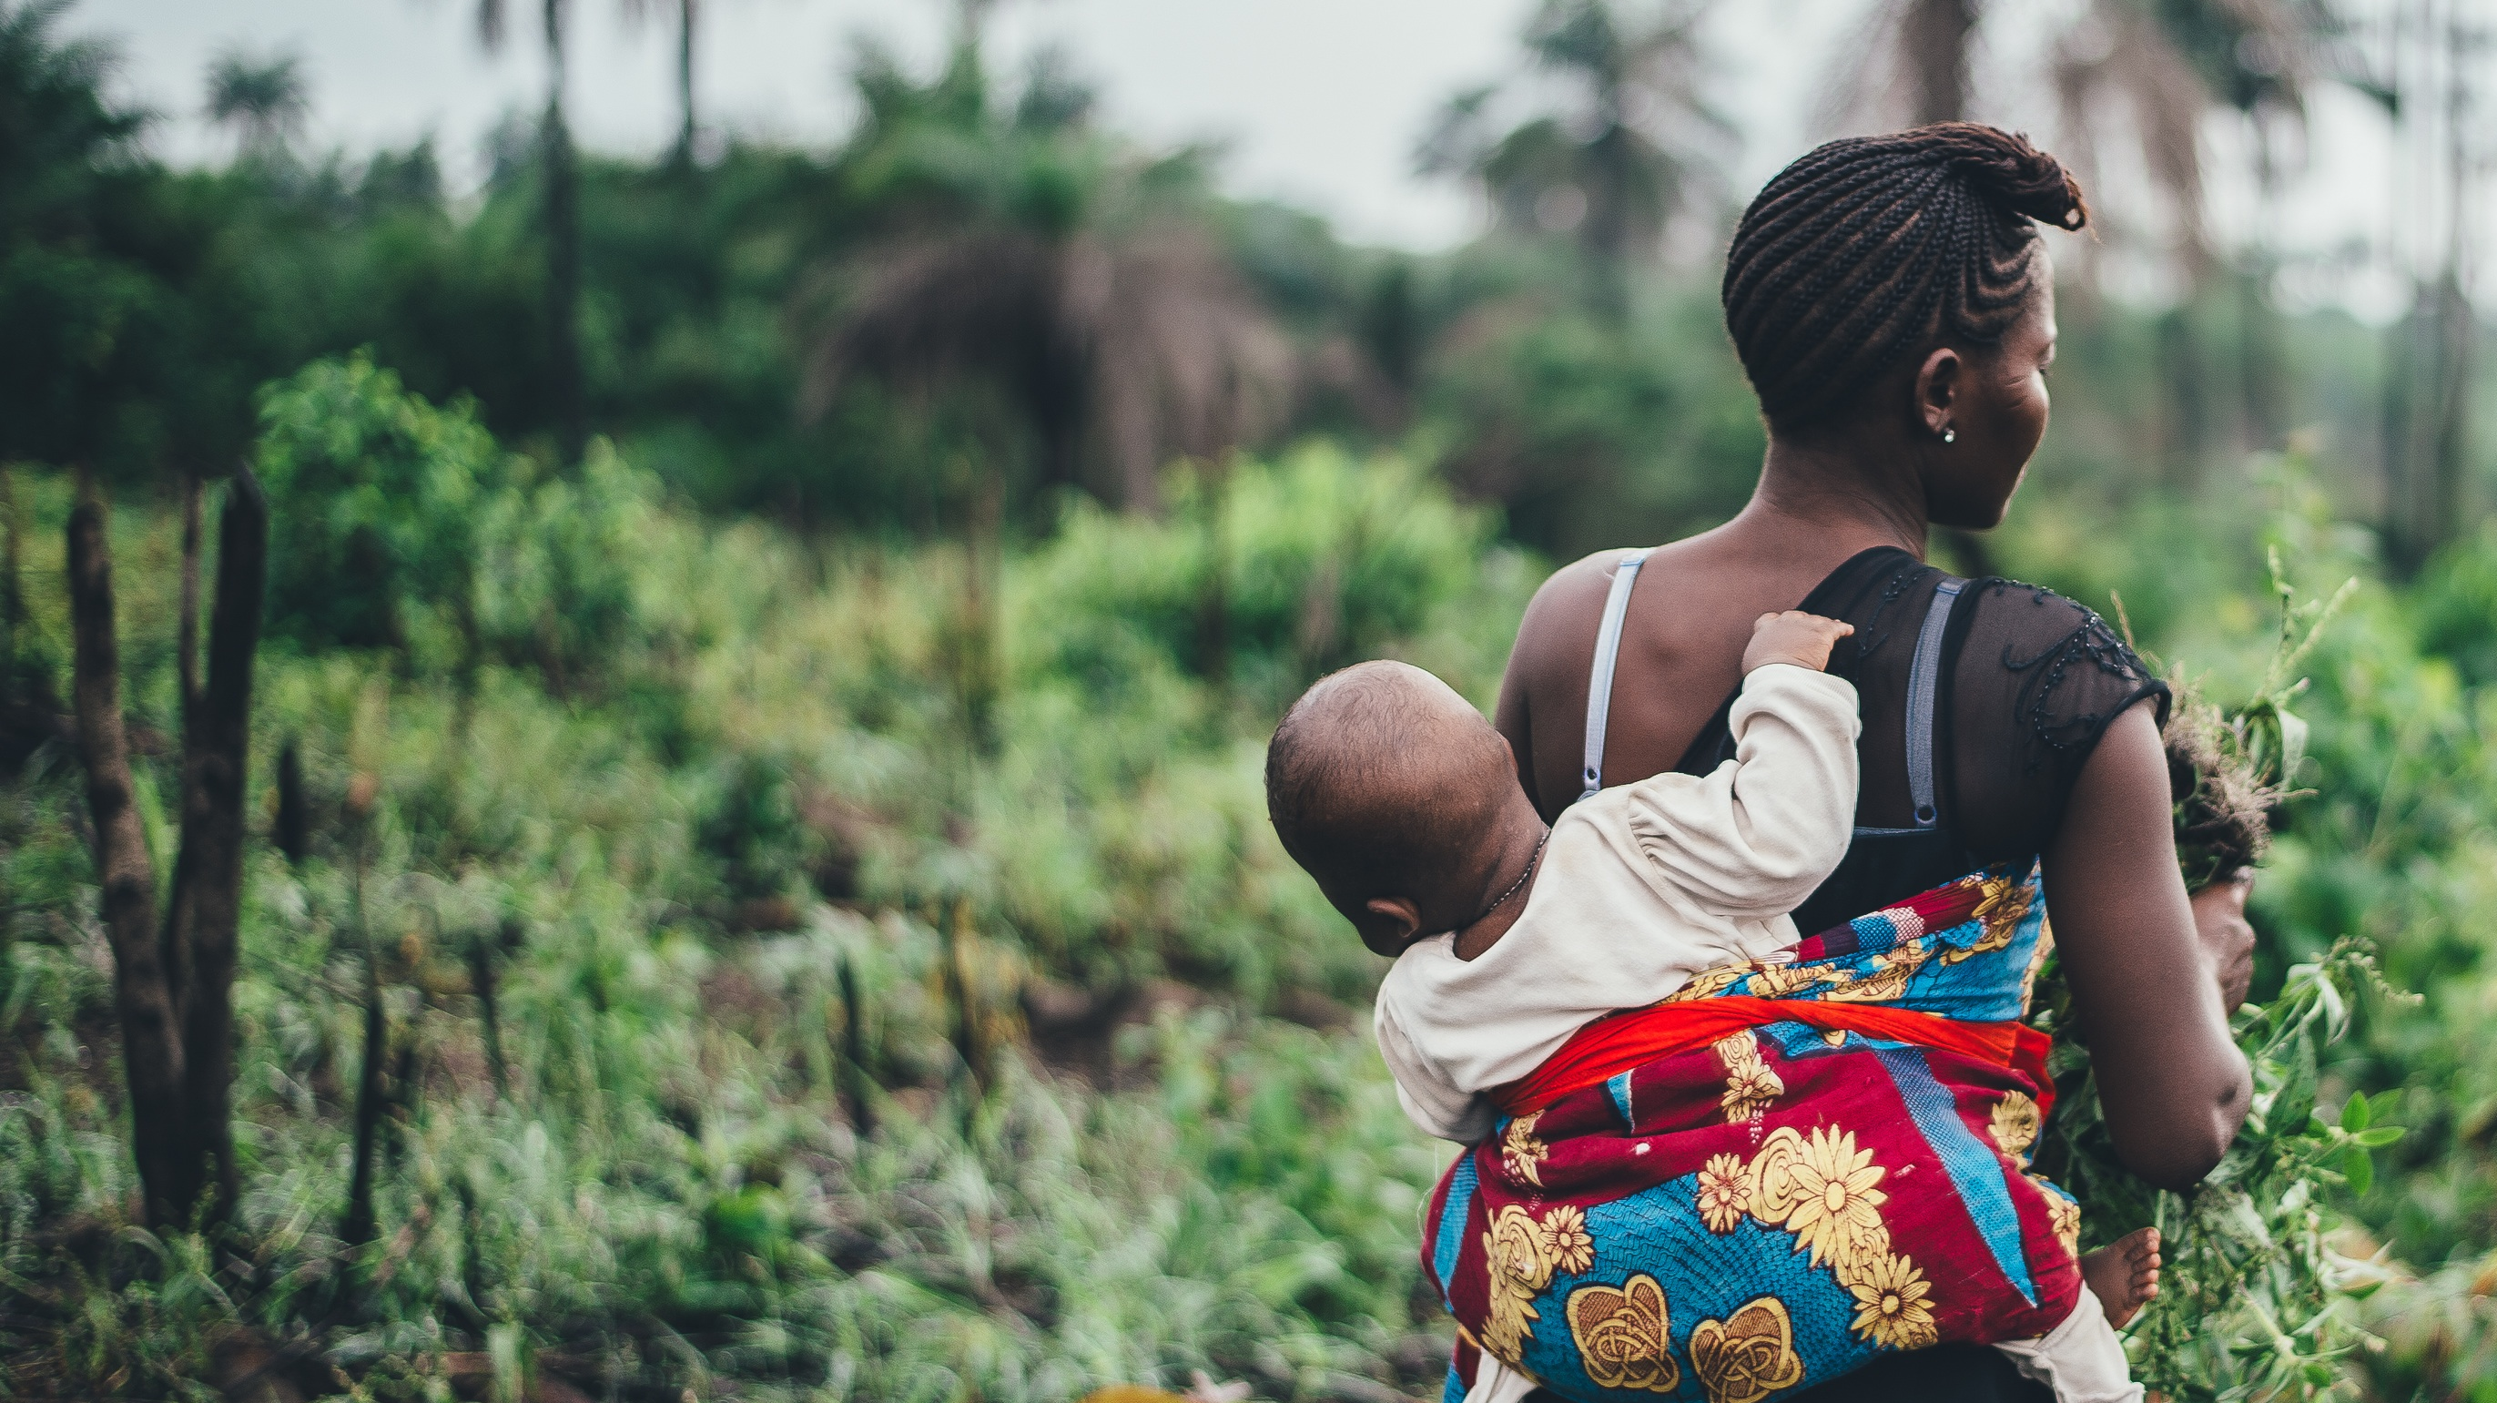

Intercession Group
Africa: Farmers First
An Overview
December 2016
Powered by
Notes:
BC: Changed “Powered by” font to Tahoma to match the Weather Analytics logo

Slide 2
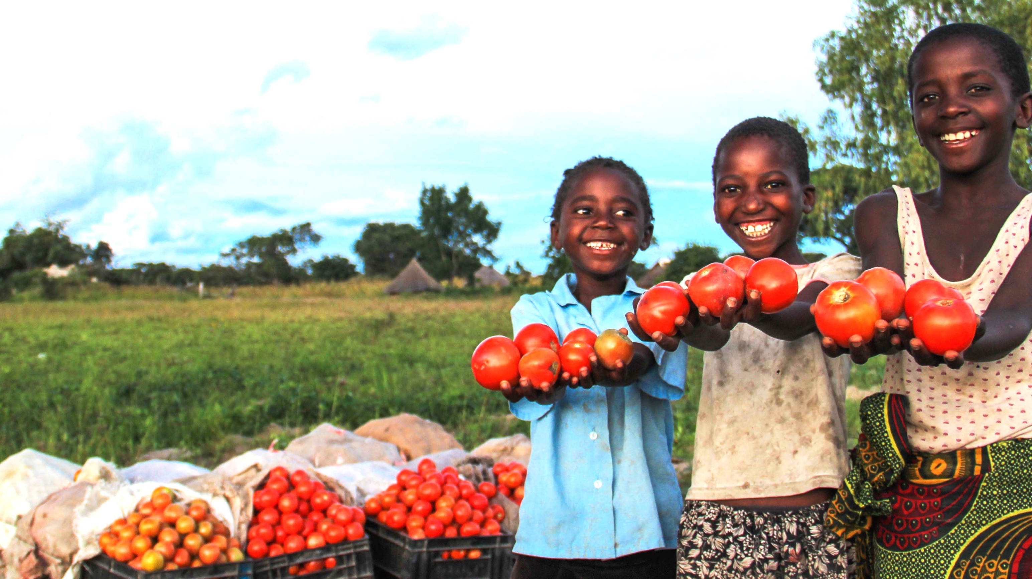
“It is no longer possible to predict with accuracy when to start planting. In most cases, farmers end up replanting."
Denford Chimbwanda, President of Grain & Cereal Producers Association, Zimbabwe
Interviewed after seasons of erratic rainfall.

Slide 3
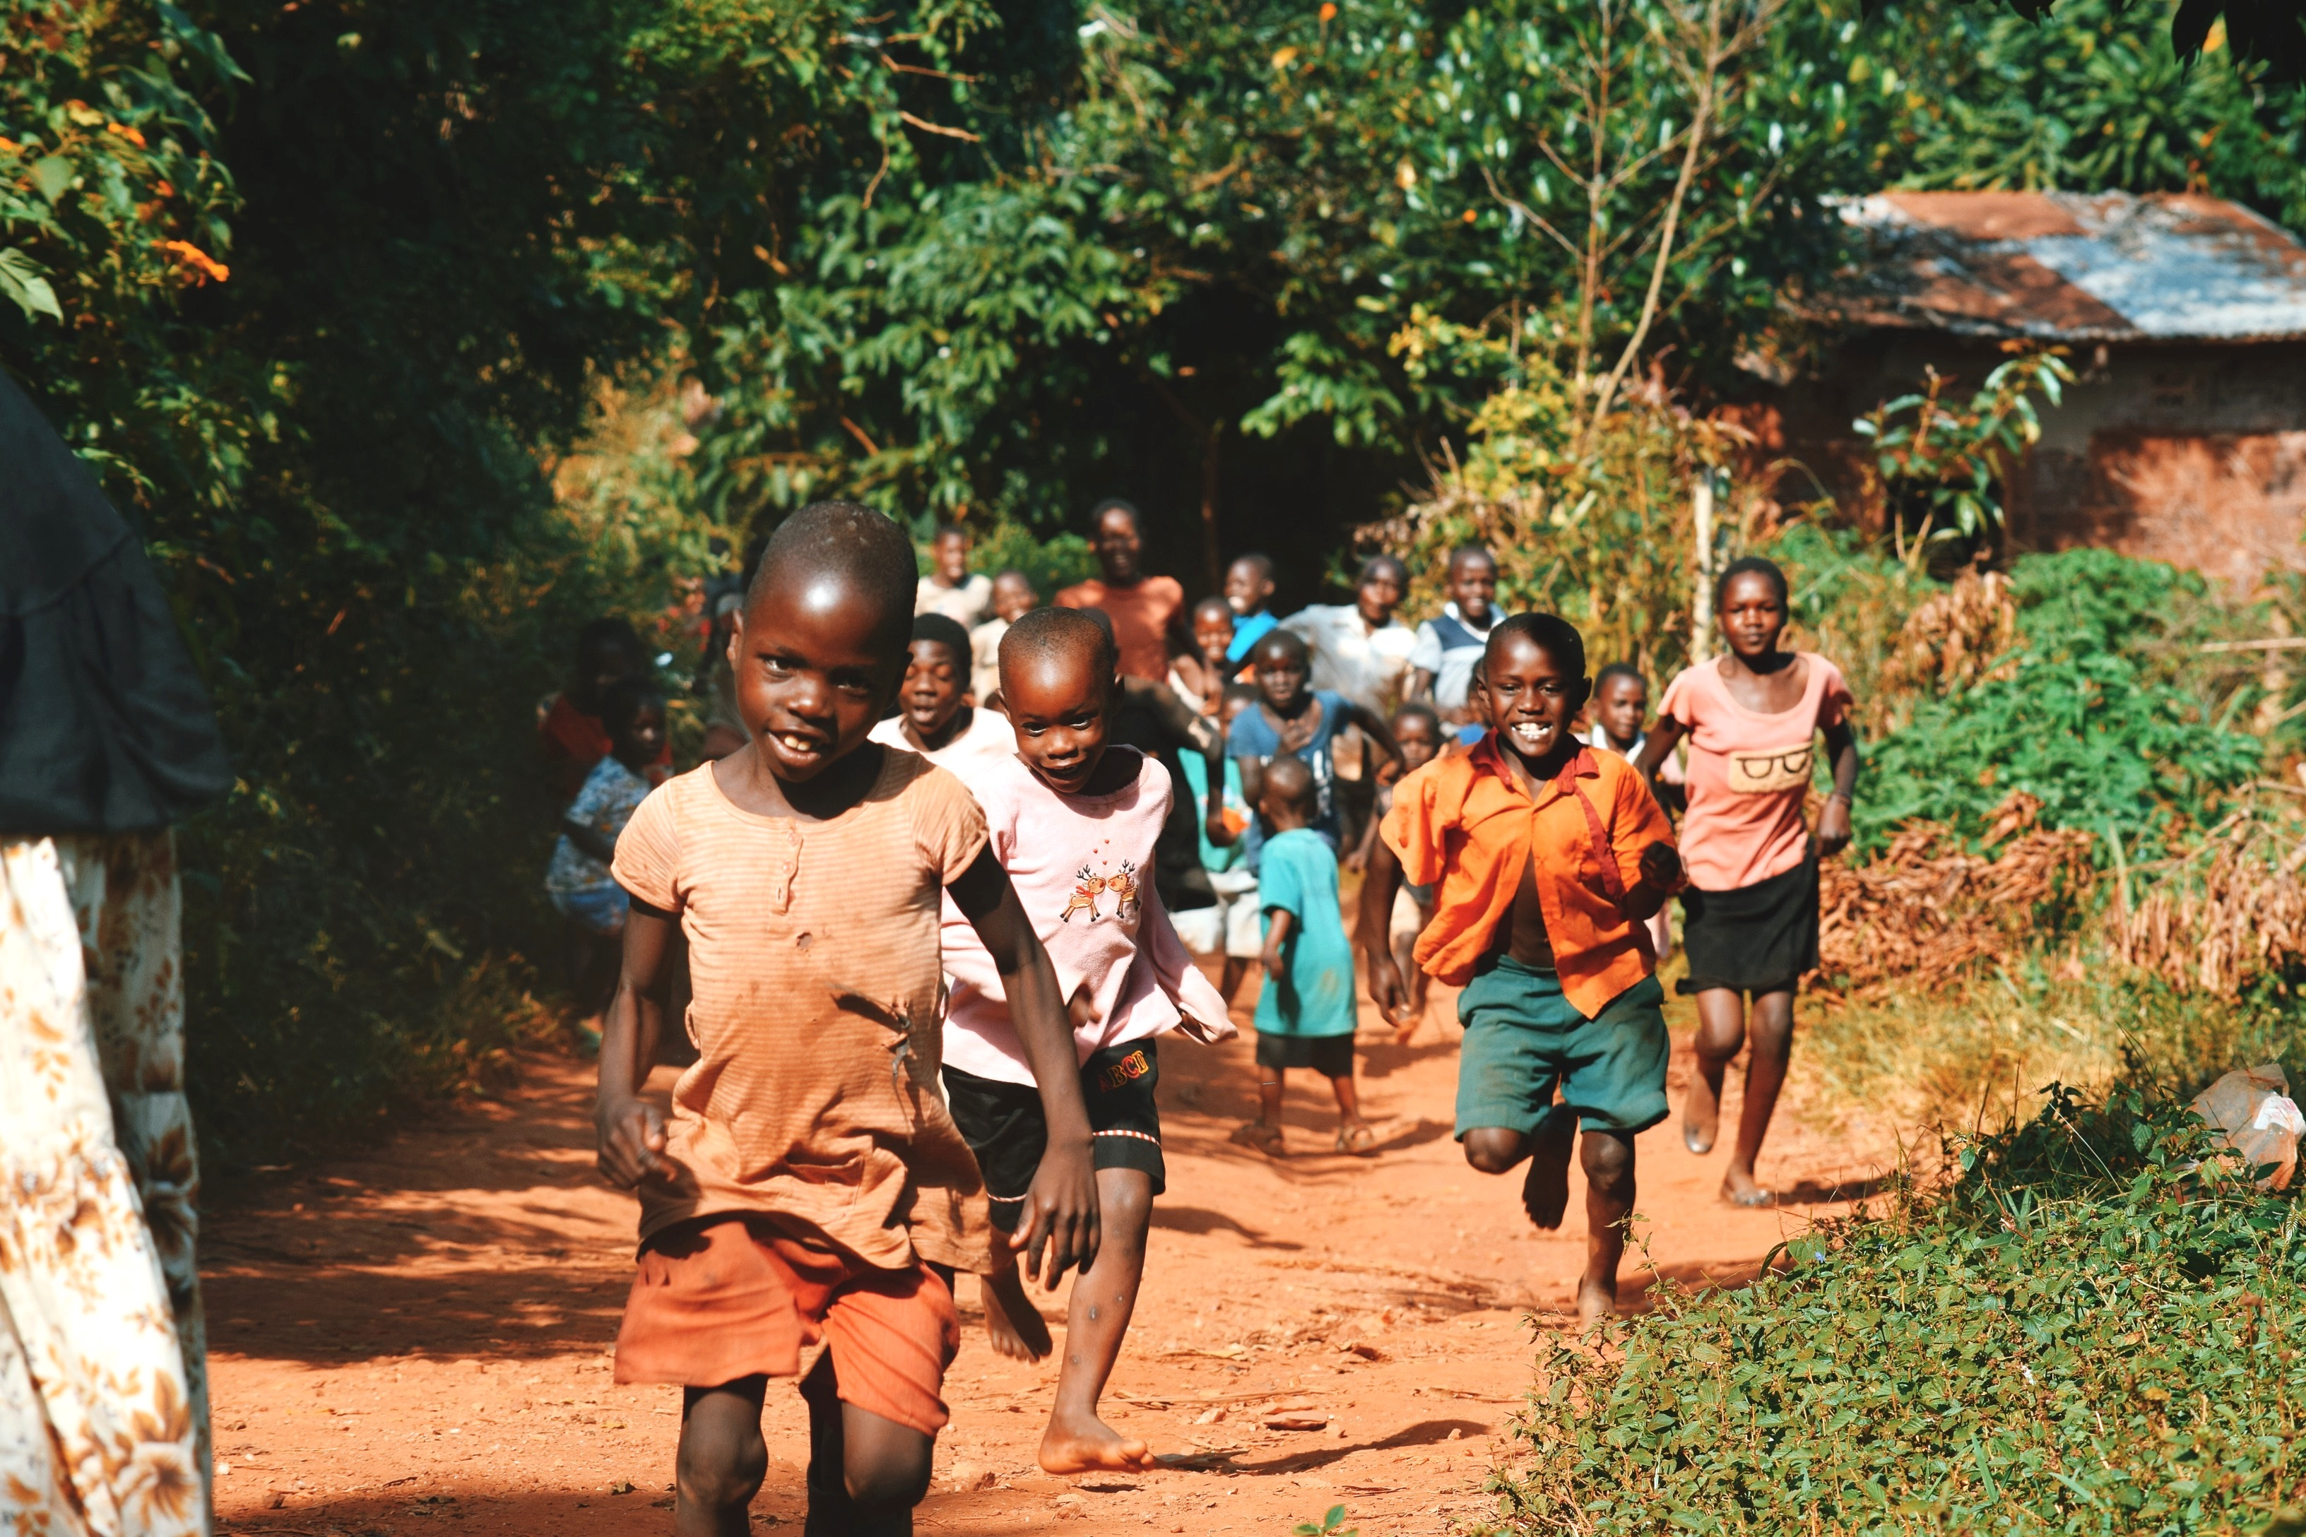
Why Africa?
It’s not complicated . . .
Almost one-fourth of the world’s under-nourished people are in sub-Saharan Africa
Africa will have 2 billion+ more people to feed by 2050
Notes:
Outline for the presentation

Slide 4
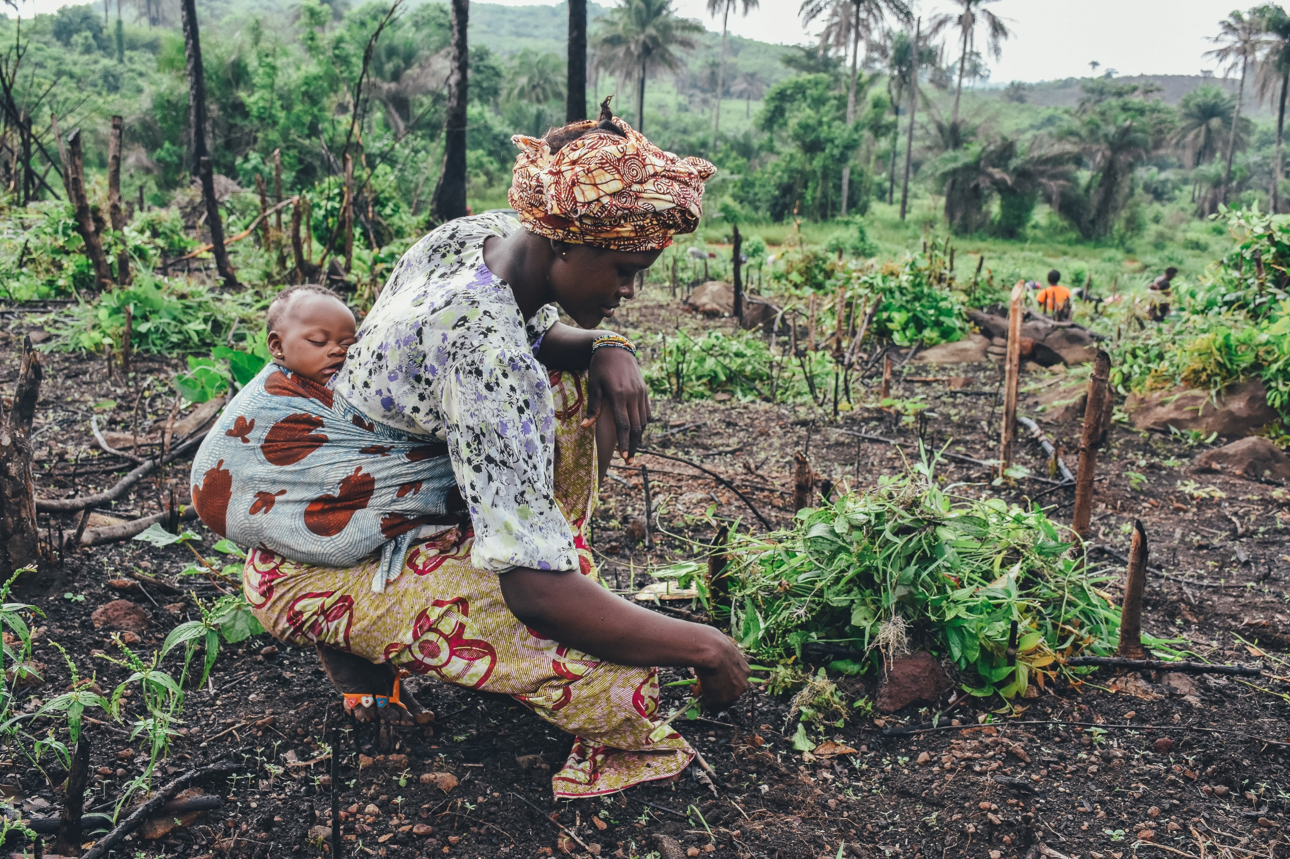
Why Africa?
It’s not complicated . . .
Three-fourths of Africa’s arable land remains uncultivated
Africa is especially vulnerable to climate change
Notes:
Outline for the presentation

Slide 5
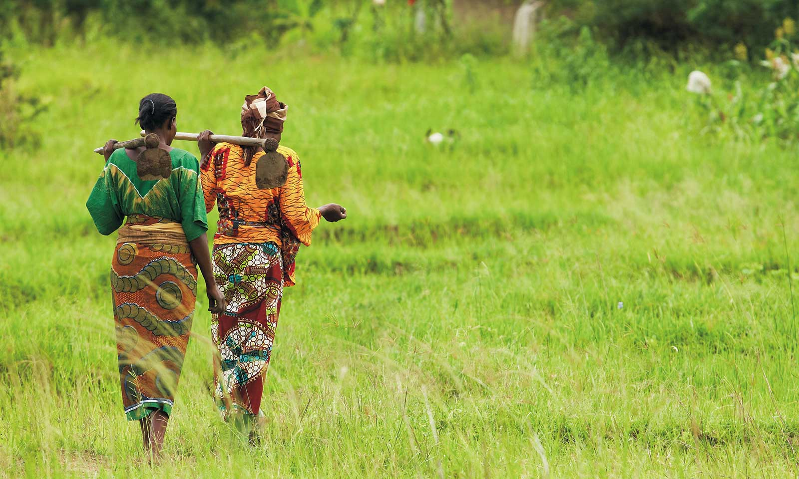
NGOs & GOVERNMENTS ARE MAKING THESE EFFORTS EVEN MORE COSTLY THAN THEY NEED TO BE . . .
Notes:
FIRST: UNDERSTAND

Slide 6

Intercession Group & International Aid
Silveus Insurance Group activated Intercession Group in 2010 in response to a devastating earthquake in Haiti
Since then, Intercession Group has supplied clothing, food, household goods & medical assistance to the people of Haiti
Intercession group founded a boarding school
Notes:
BC: Deleted the period at the end of the last bullet for consistency

Slide 7

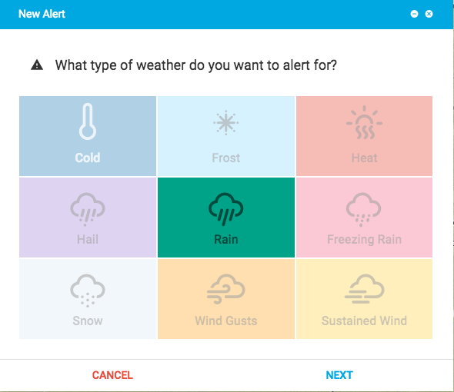
Weather Analytics: Agriculture Intelligence
TOOLS TO FORESEE & MITIGATE WEATHER
IMPACTS ON
AGRICULTURE EXIST

Slide 8

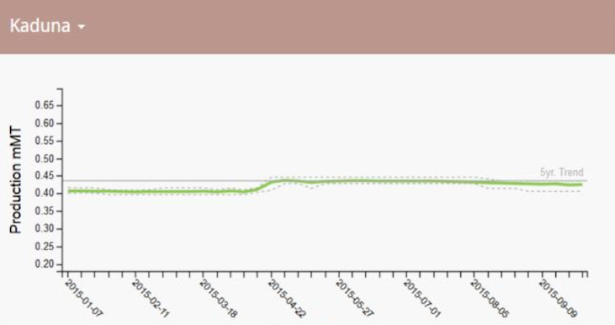
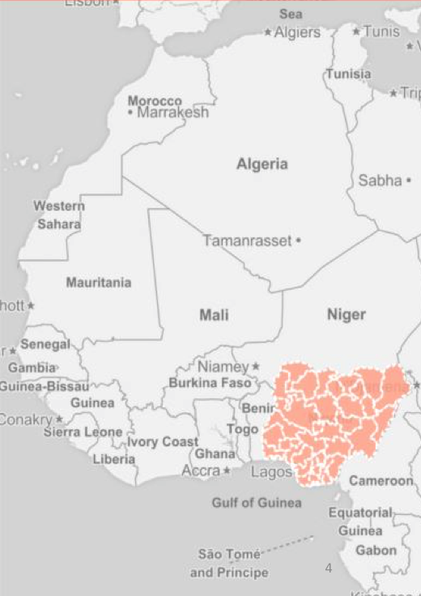
RAIN-FED AGRICULTURE:
THE DOMINATE SOURCE OF FOOD PRODUCTION

Slide 9
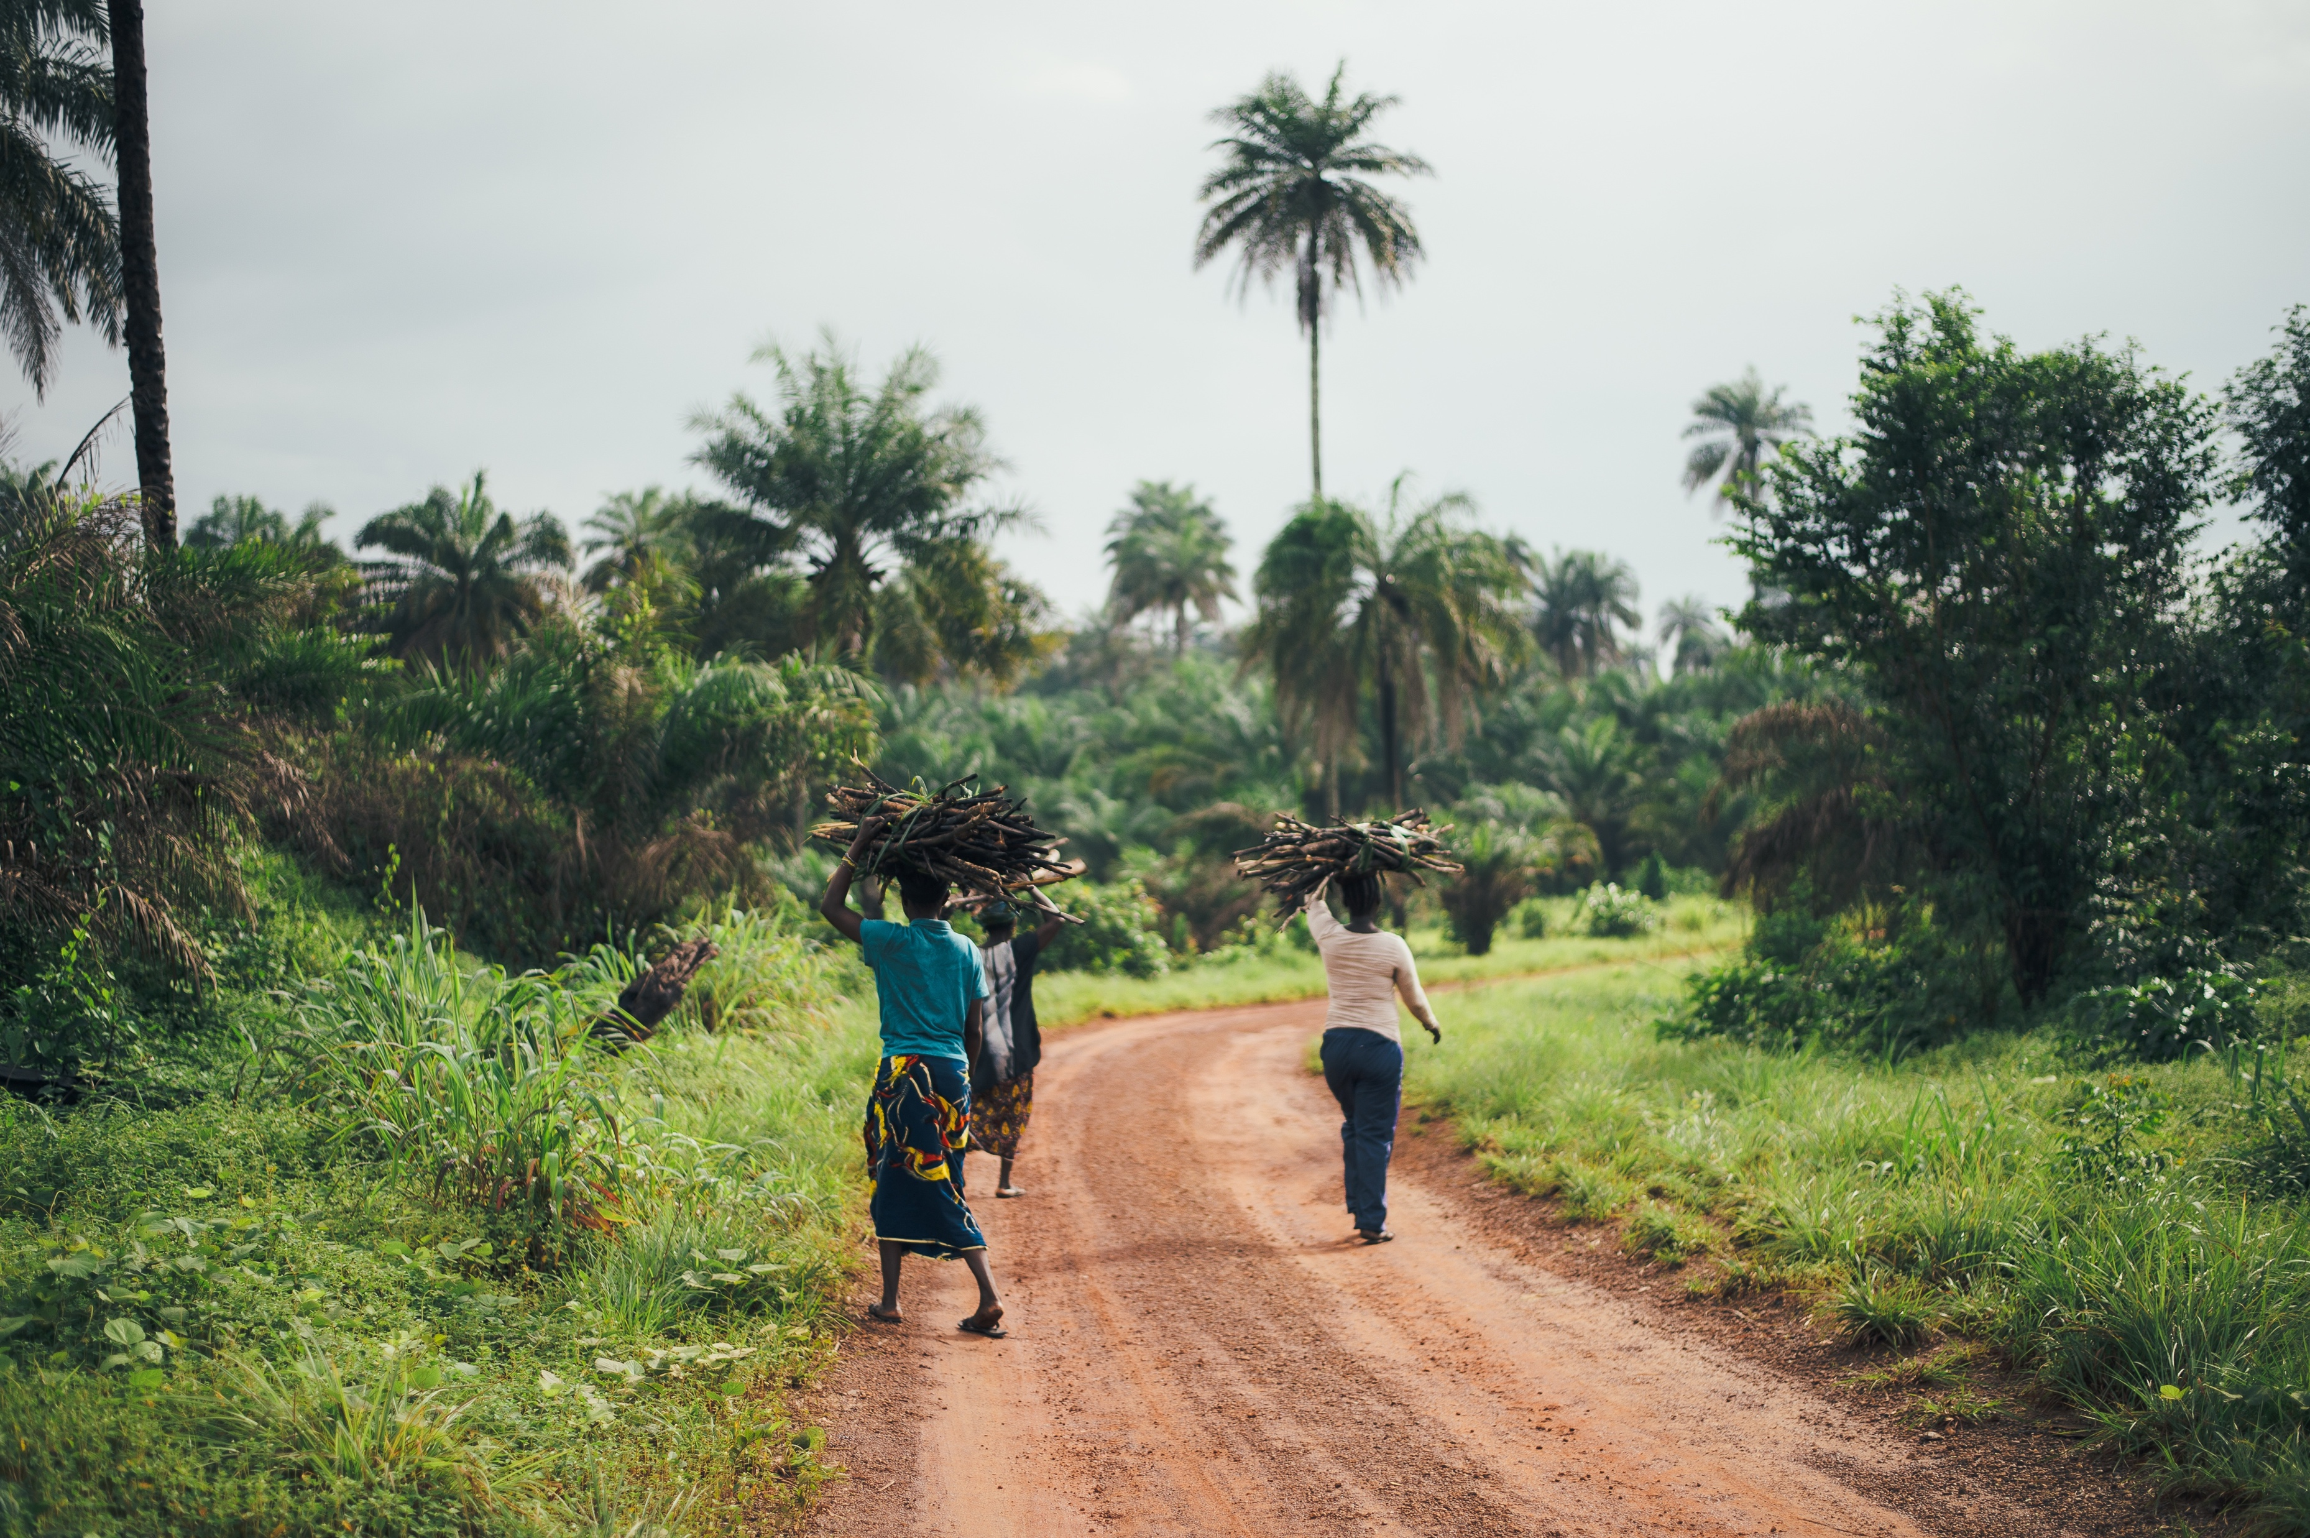
20 Major Crops
Barley
Dry Beans
Cassava
Cocoa
Coffee
Cotton
Cow peas
Groundnuts
Maize
Millett
Oil palm
Plantain
Potato
Rice
Sorghum
Soybeans
Sugar cane
Sweet potato
Wheat
Yam

Slide 10
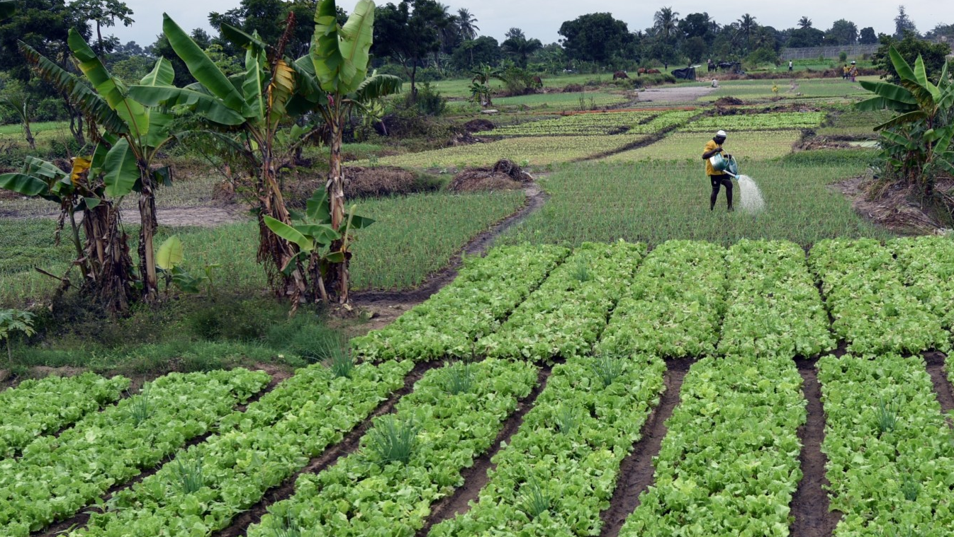
Weather Alerts
Launch Countries
  Central African Republic
  Zambia
  Zimbabwe
Crops
  Millet, maize, cotton, sorghum, soybeans,
  peanuts, cassava
Weather perils
  Temperature (heat/cold), wind & rainfall
Weather disasters
  Hurricane, tropical cyclones, & flooding
Notes:
BC: Updated launch countries with Zambia and Zimbabwe

Slide 11

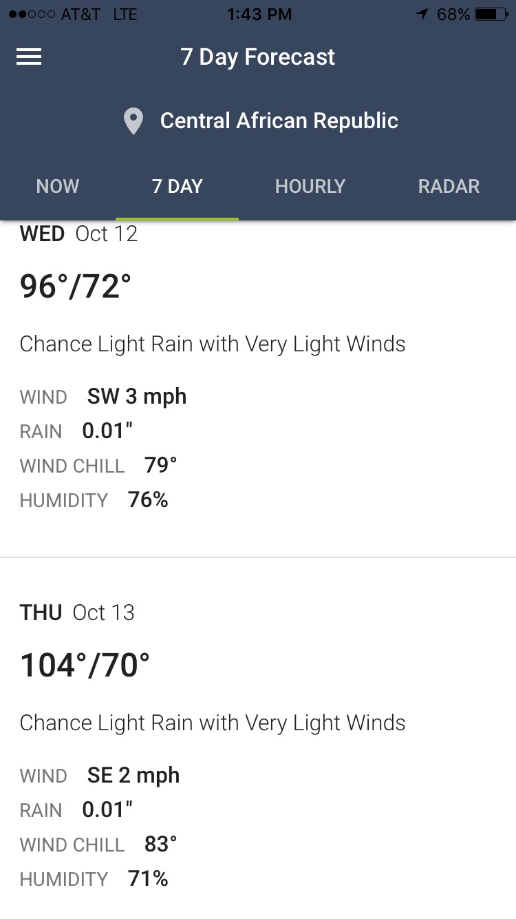
Weather Alerting Solution
Benefits
Farmers and sharecrop managers gain access to high resolution forecasts, allowing them to better understand risk for their local crops
Users can gain access to long-range forecast, allowing them to plan further in advance
Direct SMS alerts can contain links to additional details (on feature/smart phones) and reach emergency services teams
Alerts can be written in any chosen language of literacy
Water 4 Good has local translators available

Slide 12
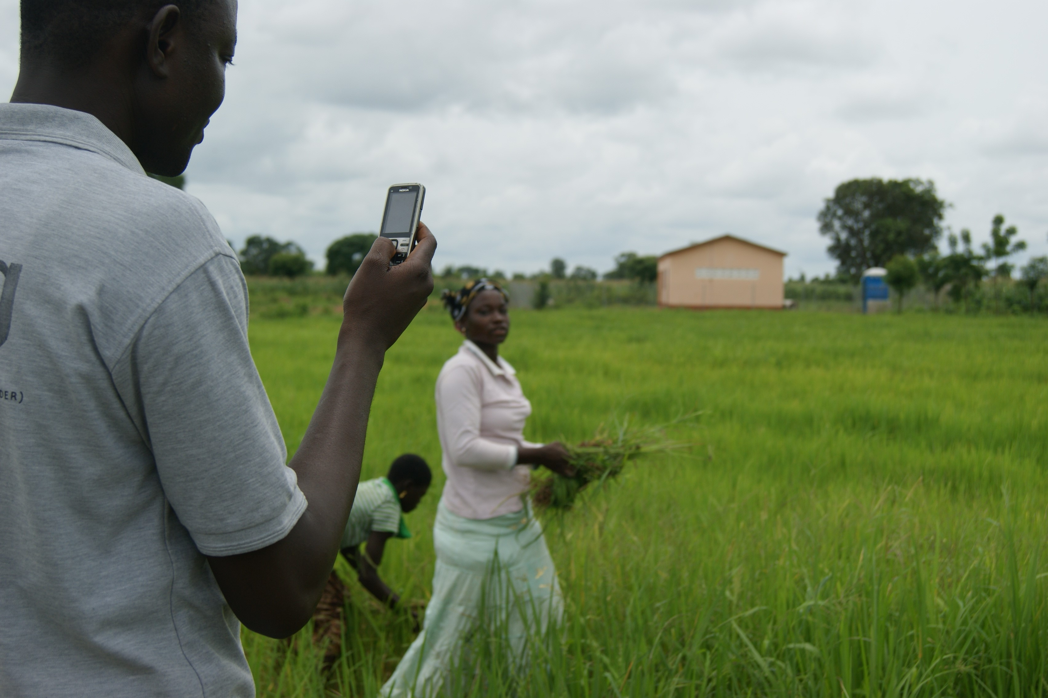

Phase 1: Weather Alerting
Country Candidate Considerations:
Crops and perils, language, phone adoption, partners
Countries:
Central African Republic, Zambia, Zimbabwe
Solution: Beacon Alerts
Key Components:
Alerts of severe weather 1-5 days out
Hyper-local appropriate to locales
High winds, heavy rain, extreme heat/cold
Languages offered are country-specific
Feature phone or above
Iconic & textual information
SMS text or email
Notes:
BC: Updated the countries with Zambia, Zimbabwe

Slide 13
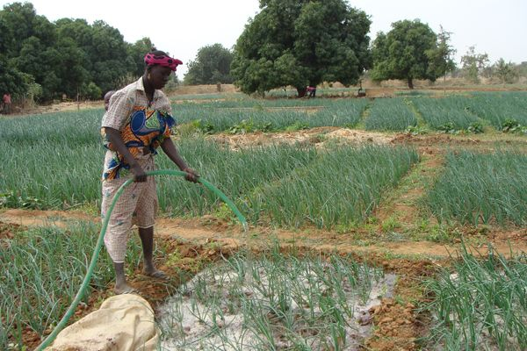
Phase 2: Weather Disaster Warning
Country Candidate Considerations:
Language, timing of growing season, partners
Countries:
Central African Republic, Zambia, Zimbabwe
Disasters: Hurricane, tropical cyclones, flooding
Key Components:
Single crop
One language
Notes:
BC: Updated the countries with Zambia, Zimbabwe

Slide 14
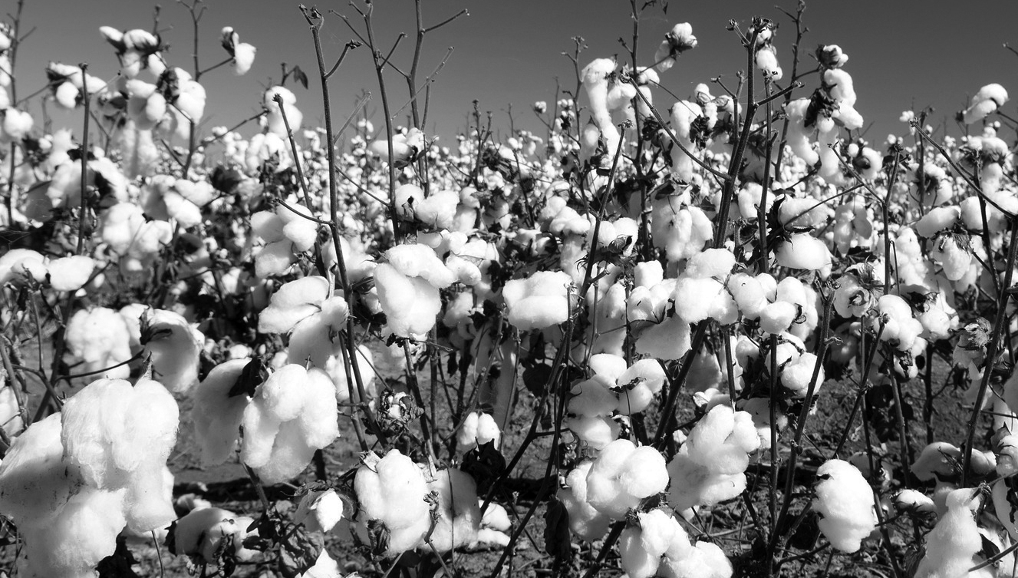
Finances, Delivery & Operations
Due to Weather Analytics repurposing existing solutions, investments to launch Farmers First are extraordinarily low.
  Average launch per nation is estimated at ~ $7,500 each, for 50 nations
  Total expenses estimated at $450,000-$550,000 in first 12 months
  Bulk of costs will pay for tailoring each mobile app & radio broadcast to languages most commonly spoken in each country

Slide 15

