Slide 1






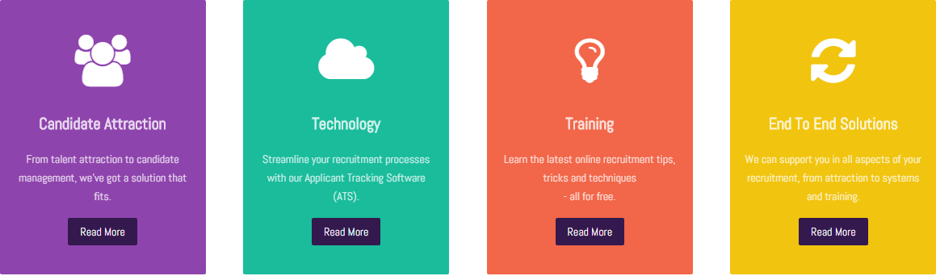






Font Examples
Logo Style & Colour Examples
Clean, fresh & bold non-primary colours. Would consider blend of colours as in top line of colours.
Bold, non-primary colours

