Slide 1

KP Growth Equity
Introduction to Team and Track Record
For US Investors
November 2016
KP Growth Equity

Slide 2
Agenda
Executive Summary
Differentiated Model
Team and Advisory Board
Target Profile
Proprietary Company and Executive Sourcing
Operational Focus
Track Record
Summary of Terms
Appendix
KP Growth Equity

Slide 3
Executive Summary
Differentiated Model
Team and Advisory Board
Target Profile
Proprietary Company and Executive Sourcing
Operational Focus
Track Record
Summary of Terms
Appendix
KP Growth Equity

Slide 4
KP Growth Equity Overview
ABCDEFG
ABCDEFG
20+ years of work history / 12 years solely in growth equity investing
Successful track record
Proven, differentiated sourcing and investment model
Focused on high growth buyout opportunities in North America
New management company and carry ownership held exclusively by the US team and advisors
KP Growth Equity

Slide 5
Executive Summary
Over a Decade of Superior Value Creation
1
2
Achieving Superior Returns
1
2
Repeatable Sourcing Model
Disciplined investment focus targeting companies with:
Revenues of $5M to $50M with revenue growth of 30% to 100%+
First institutional capital; capital efficient businesses
Enterprise values of $15M to $75M, 3x returns at $50M to $150M
Control transactions and growth equity investments
Proprietary predictive model for company and executive sourcing
Building Successful Businesses
Proven, capital efficient Executive CEO/Founders help source and develop companies
Work closely with teams to create high value outcomes
1.The net multiple for US growth investments is pro-forma and has been calculated based on the US growth equity investments gross returns, adjusted for the US proportion of fees and expenses, and a carried interest adjustment based on the resulting post fees and expenses returns of the US portfolio. Calculated as at June 30, 2016 adjusted for expected Recommind proceeds from sale signed in June 2016.
KP Growth Equity

Slide 6
Achieving Superior Returns
US High Growth Buyout/Equity Portfolio 2004 through June 2016 (Adjusted for Recommind sale announced June 2016)
1
2
3
4
5
6
7
8
x.x Total
x.x Unrealized
x.x Realizd
¹ Gross (before fees, expenses and carried interest) investment multiples of US growth equity investments of Kennet II, Kennet III and Kennet IV as at June 30, 2016, adjusted to reflect impact of Recommind sale signed in June 2016, completed July 2016.
² Realized return includes expected initial proceeds from Recommind sale, plus escrow proceeds discounted by 50%,
³ The net multiple for US growth investments is pro-forma and has been calculated based on the US investments gross returns, adjusted for the US proportion of fees and expenses, and a carried interest adjustment based on the resulting post fees and expenses returns of the US portfolio. Calculated at June 30, 2016, adjusted for Recommind proceeds from sale signed in June 2016, completed July 2016.
KP Growth Equity

Slide 7
Lower Middle Market Provides the Majority of Tech Exits…
Larger fund size =
3x hurdle goes up
Fewer deals historically exit above $300m
M&A Private Tech Companies 2006-2015
Exit Range | Total Deals | %
$500M+ | 150 | 8%
$300-500M | 141 | 8%
$150-300M | 272 | 15%
$50-150M | 568 | 32%
$20-50M | 661 | 37%
Total | 1792 | 100%
Nearly half of all exits between $50-300M
KP Growth 3x Exit Hurdles
$50-150M range
KP Growth Proprietary Database 2016
KP Growth Equity

Slide 8
With Strong Upside for Higher Value Outcomes
M&A Private Tech Companies 2006-2015
Exit Range | Total Deals | %
$500M+ | 150 | 8%
$300-500M | 141 | 8%
$150-300M | 272 | 15%
$50-150M | 568 | 32%
$20-50M | 661 | 37%
TA, Vista, Thoma Bravo
JMI, Insight, Accel
Frontier, Battery, Silversmith
KP Growth, Edison, OpenView
Venture, Angel, Seed Funds
Representative examples of Funds
KP Growth Proprietary Database 2016
KP Growth Equity

Slide 9




Lower Middle Market Offers High Value Creation for Growth
Exit
Revenue
Exit
Values
$100m
$165M
Revenue
$70M
$60M
$250M/
$500M*
$50m
$54M
$400M
$25m
$22M
$98M
$5m
Time / Stage
KP Growth Equity

Slide 10
Differentiated Model: Four Pillars for Success
Team and Advisory Board
Team with strong investment and technology backgrounds
Executive & board recruitment from Executive Advisory Board:
Proven Founders/CEOs with capital efficient, high value exits
Target Profile
Growth buyouts / significant minority
Recurring revenue of $5M to $50M with revenue growth of 30% to 100%+
Capital efficient businesses with significant ownership by founder
Proprietary Company / Executive Sourcing
Algorithmic approach evaluates 100K companies every 8 weeks
Companies screened for themes, predicted financials, team profile
Regional high value events with KP Growth’s Executive Advisory Board members
Operational Focus
Team building/Operational focus creates strong alpha
Control investments enable rapid team development: unique for high growth, small tech companies.
Price disciplined on investment, Target 3x return at reasonable outcomes: $50M to $150M exits
KP Growth Equity

Slide 11
Executive Summary
Differentiated Model
Team and Advisory Board
Target Profile
Proprietary Company and Executive Sourcing
Operational Focus
Track Record
Appendix
KP Growth Equity

Slide 12

Differentiated Model: Four Pillars for Success
Team and Advisory Board
Target
Profile
Operational
Focus
Proprietary
Company /
Executive
Sourcing
KP Growth Equity

Slide 13


Joe Wang/Impartner Case Study
Team and Advisory Board
Target Profile
Joe Wang was identified through our proprietary executive sourcing model
As CEO, Joe has delivered 10x+ returns to investors twice (20/20 Software and LANDesk)
We spent a year reviewing deals
Impartner leveraged Joe’s channel experience and local network in Utah (via LANDesk)
Transaction was a growth buyout – founders wanted to sell majority / large secondary component
Kennet III investment, Conversica provided category relevance and Salesforce ecosystem experience
Strong recurring revenue / SaaS metrics
Proprietary Company / Executive Sourcing
Proactive outreach /company was sourced via our Predictive Model
We introduced Joe on the initial discovery calls to assist with diligence and to highlight him as a potential advisor, board member or CEO
Impartner had engaged with a banker and was expecting term sheets within a week. We learned post-deal there were multiple bidders including Battery Ventures and Polaris.
Operational Focus
Joe had multiple offers – We provided a differentiated compensation package and large co-investment opportunity
Joe recruited several executives from previous teams he led (CFO/CMO)
KP Growth Equity

Slide 14
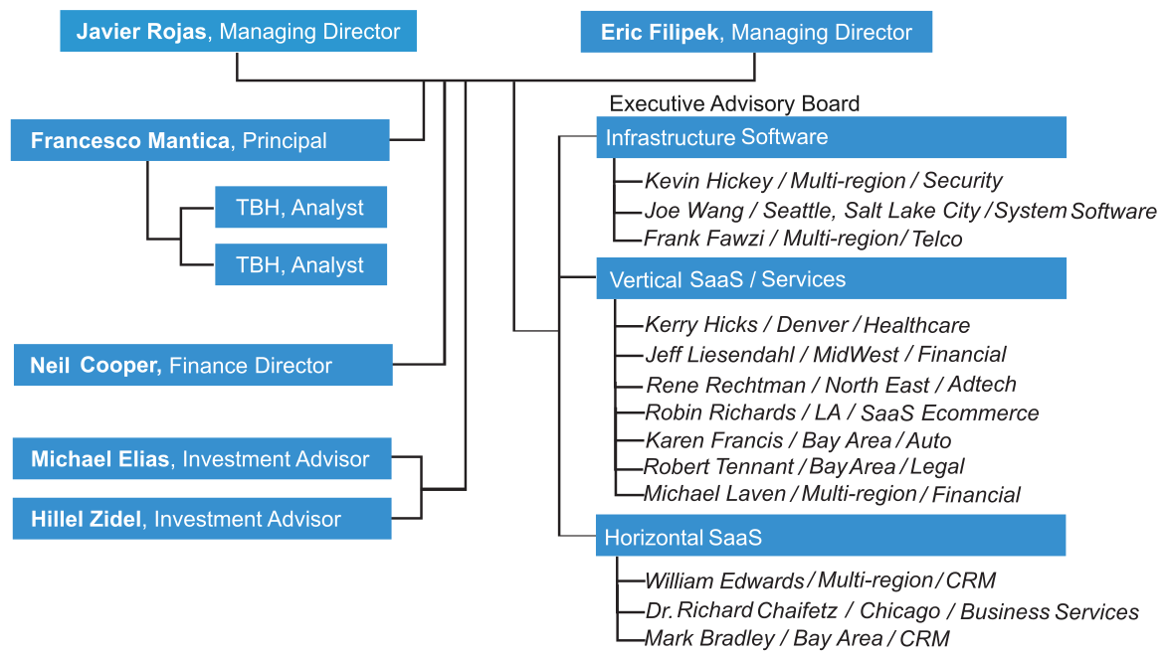
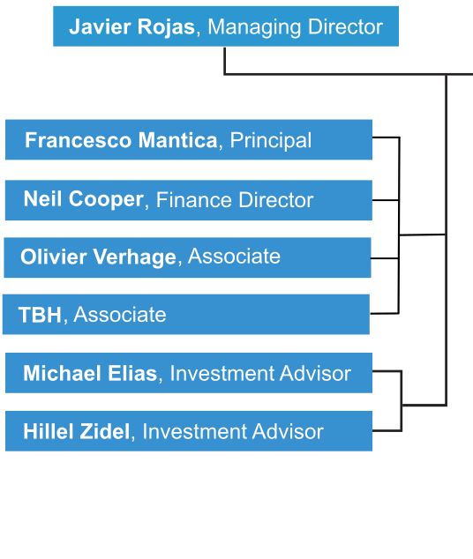
Team with Strong Investment and Technology Background
KP Growth Equity

Slide 15

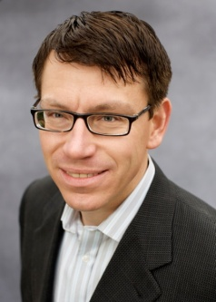
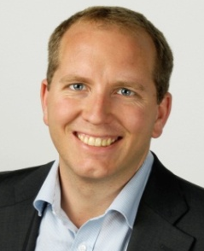
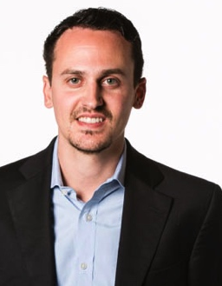
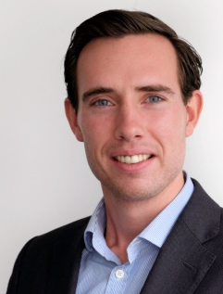
Team: Investors
Javier Rojas
Eric Filipek
Partner
Joined Kennet in 2000
28 years investment banking and technology experience
Broadview, advisor, specializing in high-growth technology companies
MBA, Harvard Business School
BS, Georgetown University
Partner
Joined Kennet in 2000
21 years investment banking and technology experience
Intel, Product Marketing Engineer
BS Degree, Wharton School, University of Pennsylvania
Neil Cooper
Francesco Mantica
Finance Director
Joined Kennet in 2012
Financial Controller, Advent Venture Partners, Baird Capital Partners
KPMG, Chartered Accountant
BSc in Biochemistry, University of Warwick
Principal
Joined Kennet in 2007
Leads Deal Sourcing And Investment Review Process
Data analytics/mining specialist
Kinetic Networks; Google
BA degree University of Pennsylvania
Olivier Verhage
Associate
Joined Kennet in 2014
Nobel Capital Partners
Capitalmind
BA, University of Groningen
and MS in Corporate Finance,
Cass Business School
KP Growth Equity

Slide 16
Lower Middle Market Offers High Value Creation
Revenue
$25m
$5m
Time / Stage
KP Growth Equity

Slide 17
Growth Buyouts/Equity Represent an Attractive Asset Class
Lower end of Growth Equity market is underserved: (sub-$25M)
Early leaders have raised larger funds focusing on bigger transactions: GA, TA, Summit
Next generation funds have followed a similar path: Insight, JMI, TCV
The segment has no established leader and few focused on growth buyouts
Growth equity offers an attractive risk/reward profile:
“Simply put, growth equity offers a similar return profile to leveraged buyouts but without the leverage, and could also be viewed as a low-octane venture proxy, with far less dispersion among company returns given the lower risk of loss, but also little chance for the fabled ten-baggers integral to venture’s long-term success.” *
* Source: Cambridge Associates, June 2013
KP Growth Equity

Slide 18
Growth Buyouts: Attractive Investments Requiring Unique Expertise
Growth buyouts: Require Skills and Experience
Control provides ability to accelerate operational change and strategic value
7 US transactions completed with over $80M invested
3 US transactions completed sub-majority due to capital constraints, nearly $40M
Differ from traditional buyouts
Transactions are primarily equity, with little or no leverage
Typically show revenue growth of 30%-100% at time of investment
Capital efficient but with modest profits, if any (profits reinvested in growth)
Post-investment focus on revenue growth and strategic transformation to build value
Provide downside protection of traditional buyouts with upside of growth equity
Growth buyouts play to our strengths
Bringing in leadership is important. KP Growth’s executive network is a key advantage
Focus on proven teams with a track record of capital efficiency
Sourcing is important as opportunities are often poorly marketed
Attractive alternative to leveraged buyouts
Acceptable base risk with strong upside opportunity
Not dependent on leverage; insulated from volatility in debt markets
KP Growth Equity

Slide 19






Investment Focus on Large, High Growth Markets
Infrastructure
Software
Vertical SaaS/ Services
Horizontal SaaS
Large move to the cloud / stronger security requirements
Realignment of datacenters and network to lower cost and support high performance solutions
Redefinition of business process using software & analytics
Domain knowledge is highly adaptable to analytics
Large revenue opportunity for targeted functional solutions
Large market cap technology companies driving ecosystem
KP Growth Equity

Slide 20
Proprietary Company and Executive Sourcing
Investment Prospect:
Custom built algorithms developed over 7 years
Screen 100K companies every 8 weeks
Revenue size, revenue growth, funding, social connections, and themes
Senior level outreach to prospects through social network contacts
Sourcing efficiencies in team size and processing time
Executive Identification:
KP Growth’s executive advisory board
Screen 15 years of M&A history
High value, capital-efficient exits, geography, market segment
Establish connections early with deal pipeline
Differentiates KP Growth in competitive processes
KP Growth Equity

Slide 21
Identification and Prospect Development
Vectors
Revenue Size
Growth Rate
Market Segment
Capital Raised
Company Status
Engagement
Network introductions
Dinner Series
Frequent Marketing Outreaches
Executive Connections
Need to mine large universe frequently
# of companies
Develop relationships before reach target size
Revenue Range
KP Growth Proprietary Database 2016
KP Growth Equity
Notes:
Part of our secret sause is mining a large universe of companies and identifying the ones that are about to reach $4m run-rate.
This allows the KP growth team to spend more time on relationship development and engagement to these prospects before they get noticed or too big

Slide 22
Top 1000 Prospects by Theme / Growth Rate
Theme | Revenue Estimate 15’ | Average Growth 15’ | % of Top Prospects
Security | 7.2 | 145% | 2%
Healthcare | 7.0 | 77% | 7%
Mobile | 5.7 | 72% | 9%
Other | 6.1 | 69% | 7%
E-commerce | 5.8 | 65% | 4%
Consumer | 4.9 | 62% | 6%
Education | 6.2 | 59% | 2%
Cloud and System Software | 7.2 | 59% | 3%
Adtech | 9.6 | 58% | 3%
Software | 5.9 | 57% | 28%
Data Analytics | 5.4 | 56% | 15%
Financial | 6.3 | 51% | 4%
Services | 7.8 | 50% | 6%
Hardware | 4.9 | 27% | 1%
Total | 6.1 | 62% | 100%
KP Growth Proprietary Database 2016
KP Growth Equity

Slide 23

Executive Sourcing / Mining M&A Database
Segment | Total # Exits | Average Equity Price $m
Adtech | 181 | $149
Cloud and System | 715 | $314
Consumer | 1,855 | $223
Data Analytics | 616 | $196
E-commerce | 488 | $160
Education | 284 | $127
Financial | 805 | $319
Hardware | 1,288 | $213
Healthcare | 461 | $200
Mobile | 1,014 | $272
Security | 446 | $214
Services | 5,995 | $218
Software | 3,684 | $167
Total | 17,832 | $217
Exit Ranges $m | % Total
20-50 | 34%
50-150 | 29%
150-300 | 15%
300-500 | 9%
500+ | 13%
Total | 100%
Jeff Liesendahl
Funding:
Raised ~$4m
Exit:
Accertify acquired by American Express for $150M in 2010
Founder/CEO or Senior Executive: Accertify, RedPrairie, Orbitz
Ratio:
37x
KP Growth Proprietary Database 2016
KP Growth US/Canada M&A Database 2000-2014
KP Growth Equity

Slide 24
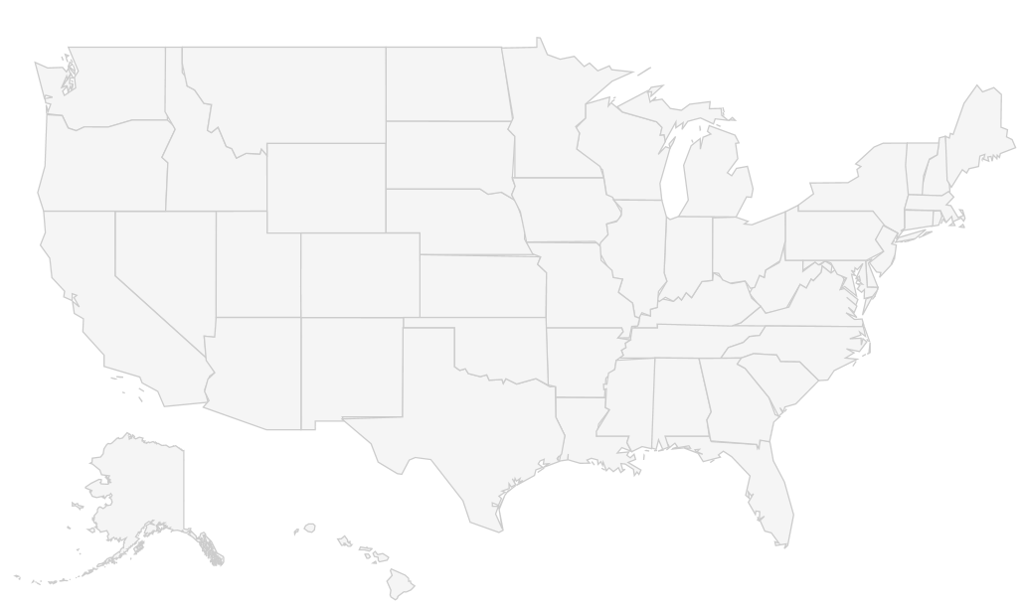
Comprehensive Geographic Coverage
Northwest**
4%
Midwest
13%
Northeast*
26%
Bay Area
19%
Mountain
7%
Mid Atlantic
7%
Southwest
13%
South
5%
Southeast
6%
Region
Investments
Advisory Board
Notes:
*Northeast includes Montreal/Toronto area **Northwest includes Vancouver area
Dinner & Events
More than one location
KP Growth Equity

Slide 25
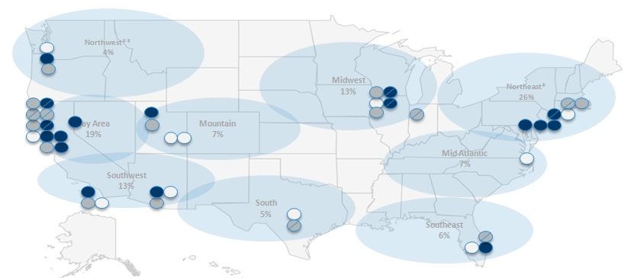
KP Growth’s Sourcing Playbook
Screen Large Universe
Identify Top Prospects
Prospects/Executives by Region
Proprietary technology used to identify best prospects
Outbound / Network Introductions to engage prospects
Screen 100K companies every 8 weeks
1K top prospects predicted by analytical model
Identify Executives from M&A Database
Advisory board / Top Executives
Screen for high value exits, level of capital raised, and market focus
Develop / Source executive talent
US Term Sheet / LOI’s Issued
Results
KP Growth Equity

Slide 26
KP Growth’s Execution Model
Investment
Execution
Exit
Company
$5-50M revenue, 30-100%+ growth
Capital efficient
Scale revenue 3-10x
Professionalize the organization
EBITDA Loss rate < 25% revenue
Maintain 30%+ revenue growth
#1 or 2 in its market
Attractive SaaS Metrics
KP Growth
$15M to $25M primary / secondary
Control / significant minority
Secure venture debt for incremental working capital
Sales and Marketing effectiveness
Strategy and positioning for maximum value
Recruiting and founder transition
Exit planning/execution
Achieve 3x at $75-$150M exit
Downside protection
10x upside potential
Executive
Add CEO / Executive Chairman / Board
Co-invest $500k to $2M
Prior Experience
Wolf-pack / Recruit Team Members from previous companies
Relationships (Investor, Customer, Partners)
Founder economics & risk/reward profile
KP Growth Equity

Slide 27
Equity Protection with Upside Option
5X
STRATEGIC
Competitive repositioning
New innovative technology
Develop high growth markets
Acquisitions
Exit positioning and execution
4X
Target Returns: 3-5x +*
OPERATIONAL
3X
Increase revenue growth
Expand business
Executive & board recruitment
Founder transition
Investment Multiple
2X
FINANCIAL
1X
Preferred instrument structured to produce 1-2x return
Protected equity instrument
Downside
Risk Protection
Base Case
Fundamentals
Game Changing
Opportunities
* Targeted returns presented are not a guarantee. See important information on page 45
KP Growth Equity

Slide 28
Executive Summary
Differentiated Model
Track Record
Summary of Terms
Appendix
KP Growth Equity

Slide 29
Conclusions
Cohesive team with 20+ years of working together
Compelling opportunity in lower-middle market buyouts and growth equity in private, recurring revenue software companies
Repeatable, proprietary, analytics-driven model for sourcing executives and investment prospects
Proven, ability to deliver above market, risk-balanced returns of 3-5x
KP Growth Equity

Slide 30
Executive Summary
Differentiated Model
Track Record
Summary of Terms
Appendix
KP Growth Equity

Slide 31
Important Information
Calculation of Gross Returns
Unless otherwise indicated, (i) any references to “gross IRR” are to the aggregate, annual, compound, gross internal rate of return on investments based on cash realised and Kennet’s valuation policy and (ii) any references to “gross multiple” are to gross multiples of invested capital. All data herein labelled as “gross” data are calculated at the investment level and, accordingly, do not reflect management fees, carried interest , taxes or transaction costs or other expenses to be borne by investors in a Fund, which will reduce returns and in the aggregate are expected to be material. Where aggregated IRRs across more than one private equity fund are shown, cash flows have been zero based to give equal weighting to cash flows across fund vintages.
Calculation of Net Returns
Unless otherwise indicated, any references to “net IRR” or “net multiple” are to the internal rate of return or multiple of invested capital calculated at the relevant Fund level, after payment of all expenses including management fees and the relevant general partner’s carried interest in profits and losses. An individual limited partner’s net IRR may vary based on the timing of capital contributions and distributions.
Aggregated Returns
References to aggregate or composite returns reflect cash flows and performance across multiple Funds, and may not reflect the experience of any limited partner; such returns are provided for illustrative purposes only.
Changes in Unrealised Value
Unless otherwise indicated, any references to changes in fund book value during a particular period are computed as a percentage of the aggregate unrealized gross value of a Fund’s investments at the beginning of the period plus cash invested during the period, and before carried interest and partnership fees and expenses. Such amounts represent unrealized valuations in accordance with Kennet’s valuation policy, and not the proceeds of any disposition. Actual realized returns on any Fund’s unrealized investments will depend on, among other factors, future operating results, the value of the assets and market conditions at the time of disposition, any related transaction costs and the timing and manner of sale, all of which may differ from the assumptions on which the valuations used in the performance data contained herein are based. Accordingly, the actual realized return of these unrealized investments may differ materially from the returns indicated herein.
Forward-looking Information; Projected Returns
This presentation contains forward-looking statements that speak only as of their dates and are based upon certain assumptions. Other events which were not taken into account, including general economic factors which are not predictable, may occur and may significantly affect the actual returns or performance of the Funds and/or any of the companies in which the Funds have invested. Any assumptions should not be construed to be indicative of the actual events which will occur. Actual events are difficult to project and depend upon factors that are beyond the control of any Fund, Kennet or their respective affiliates, members, partners, stockholders, managers, directors, officers, employees or agents. Certain assumptions have been made to simplify the presentation and, accordingly, actual results may differ, perhaps materially, from those presented herein. All information with respect to portfolio companies and industry data has been obtained from sources believed to be reliable and current, but accuracy cannot be guaranteed. No assurance, representation or warranty is made by any person that any projected returns will be achieved, and no recipient of this Presentation should rely on such projected returns. None of the Funds, their affiliates or any of the respective directors, officers, employees, partners, shareholders, advisers and agents of any of the foregoing makes any assurance, representation or warranty as to the accuracy of such projected returns, and no obligation is undertaken to update the forward –looking statements contained herein, whether as a result of new information, further events or otherwise. Nothing contained herein may be relied upon as a guarantee, promise or forecast or a representation as to the future.
Risk of Loss; Past Performance is Not a Guarantee
Prospective investors must be aware that investments in private equity funds such as the Funds are speculative and involve substantial risk of loss. No assurance can be given that any Fund will achieve its investment objectives or avoid substantial losses. Information about any Fund and investments made by such Fund, including past performance of such Funds and investments, is provided solely to illustrate Kennet’s investment experience, and processes and strategies used by Kennet in the past with respect to such Funds. The performance information relating to Kennet’s previous investments is not intended to be indicative of any Fund’s future results. Past performance is not necessarily indicative, or a guarantee, of future results. There can be no assurance that any Fund will achieve comparable results as those presented or that investors in a Fund will not lose any of their invested capital.
No Investment Advice
References to the portfolio companies of the Funds should not be considered a recommendation or solicitation for the portfolio company mentioned, nor should individual portfolio company performance be considered representative of all portfolio companies held by the Funds.
KP Growth Equity

Slide 32
THIS PRESENTATION HAS BEEN PREPARED SOLELY FOR USE BY PROSPECTIVE INVESTORS OF THE FUND AND SHALL BE MAINTAINED IN STRICT CONFIDENCE. ANY REPRODUCTION OR DISTRIBUTION OF THIS PRESENTATION, IN WHOLE OR IN PART, OR THE DISCLOSURE OF ITS CONTENTS, WITHOUT THE PRIOR WRITTEN CONSENT OF THE FUND’S GENERAL PARTNER OR MANAGEMENT COMPANY, IS PROHIBITED. THIS PRESENTATION WILL BE RETURNED TO THE GENERAL PARTNER OR MANAGEMENT COMPANY UPON REQUEST. THE EXISTENCE AND NATURE OF ALL CONVERSATIONS REGARDING THE FUND MUST BE KEPT CONFIDENTIAL.
THIS PRESENTATION HAS BEEN PREPARED IN CONNECTION WITH A PRIVATE OFFERING TO ACCREDITED INVESTORS OF LIMITED PARTNERSHIP INTERESTS IN THE FUND (THE “INTERESTS”). EACH INVESTOR WILL BE REQUIRED TO EXECUTE A LIMITED PARTNERSHIP AGREEMENT, AND A SUBSCRIPTION AGREEMENT TO EFFECT AN INVESTMENT. IF ANY OF THE TERMS, CONDITIONS OR OTHER PROVISIONS OF SUCH AGREEMENTS ARE INCONSISTENT WITH OR CONTRARY TO THE DESCRIPTIONS OR TERMS IN THIS PRESENTATION, SUCH AGREEMENTS SHALL CONTROL.
THIS PRESENTATION DOES NOT CONSTITUTE AN OFFER TO SELL, OR A SOLICITATION OF AN OFFER TO BUY, AN INTEREST IN ANY JURISDICTION IN WHICH IT IS UNLAWFUL TO MAKE SUCH AN OFFER OR SOLICITATION. NEITHER THE U.S. SECURITIES AND EXCHANGE COMMISSION NOR ANY OTHER FEDERAL, STATE OR FOREIGN AGENCY HAS APPROVED AN INVESTMENT IN THE FUND. FURTHERMORE, THE FOREGOING AUTHORITIES HAVE NOT CONFIRMED THE ACCURACY OR DETERMINED THE ADEQUACY OF THIS PRESENTATION. IT IS THE RESPONSIBILITY OF ANY PERSON OR ENTITY WISHING TO PURCHASE AN INTEREST TO SATISFY HIMSELF, HERSELF OR ITSELF AS TO THE FULL OBSERVANCE OF THE LAWS OF ANY RELEVANT TERRITORY IN CONNECTION WITH ANY SUCH PURCHASE, INCLUDING OBTAINING ANY REQUIRED GOVERNMENTAL OR OTHER CONSENTS OR OBSERVING ANY OTHER APPLICABLE FORMALITIES.
THE INTERESTS HAVE NOT BEEN REGISTERED UNDER THE U.S. SECURITIES ACT OF 1933, AS AMENDED, OR ANY STATE SECURITIES LAWS OR THE LAWS OF ANY FOREIGN JURISDICTION. THE FUND WILL NOT BE REGISTERED AS AN INVESTMENT COMPANY UNDER THE U.S. INVESTMENT COMPANY ACT OF 1940, AS AMENDED (THE “COMPANY ACT”). CONSEQUENTLY, INVESTORS WILL NOT BE AFFORDED THE PROTECTIONS OF THE COMPANY ACT.

