Slide 1

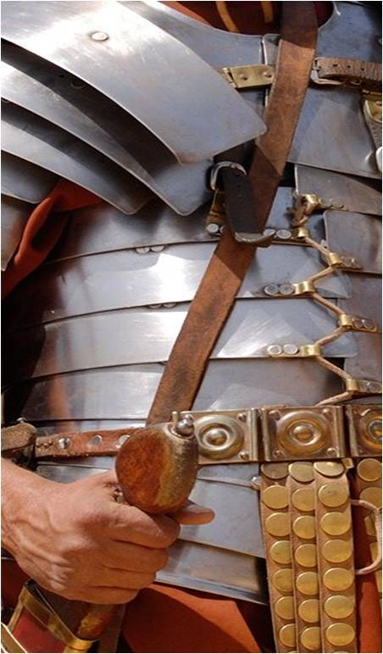

1. STEP ONE
2. STEP UP
3. STEP OUT
Byne
101
Living
Victoriously
Sharing Your
Faith
And let us consider how to stimulate one another to love and good deeds, not forsaking our own assembling together, as is the habit of some, but encouraging one another; and all the more as you see the day drawing near.
Hebrews 10:24–25
But thanks be to God, who gives us the victory through our Lord Jesus Christ.
1 Corinthians 15:57
For I am not ashamed of the gospel, for it is the power of God for salvation to everyone who believes, to the Jew first and also to the Greek.
Romans 1:16

Slide 2
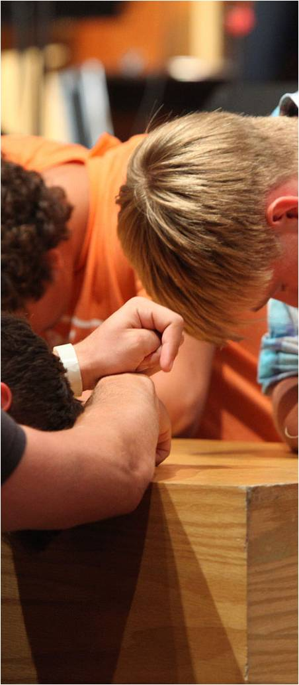


4. STEP TOWARD
5. STEP INTO
6. STEP WITH
Worshiping God
Serving Others
Making Disciples
Therefore I urge you, brethren, by the mercies of God, to present your bodies a living and holy sacrifice, acceptable to God, which is your spiritual service of worship.
Romans 12:1
As each one has received a special gift, employ it in serving one another as good stewards of the manifold grace of God.
1 Peter 4:10
The things which you have heard from me in the presence of many witnesses, entrust these to faithful men who will be able to teach others also.
2 Timothy 2:2

Slide 3

Loving God. . .Loving Others
Step-By-Step
Step With
Step Into
Step Toward
Step Out
Step Up
Step One
BYNE PATHWAY TO PURPOSE

