Slide 1
The 4 Dimensions Framework Level 1
Platform
Dimension
Fast
Agile
Plan
Dimension
People
Dimension
Process Dimension
Repeatable

Slide 2

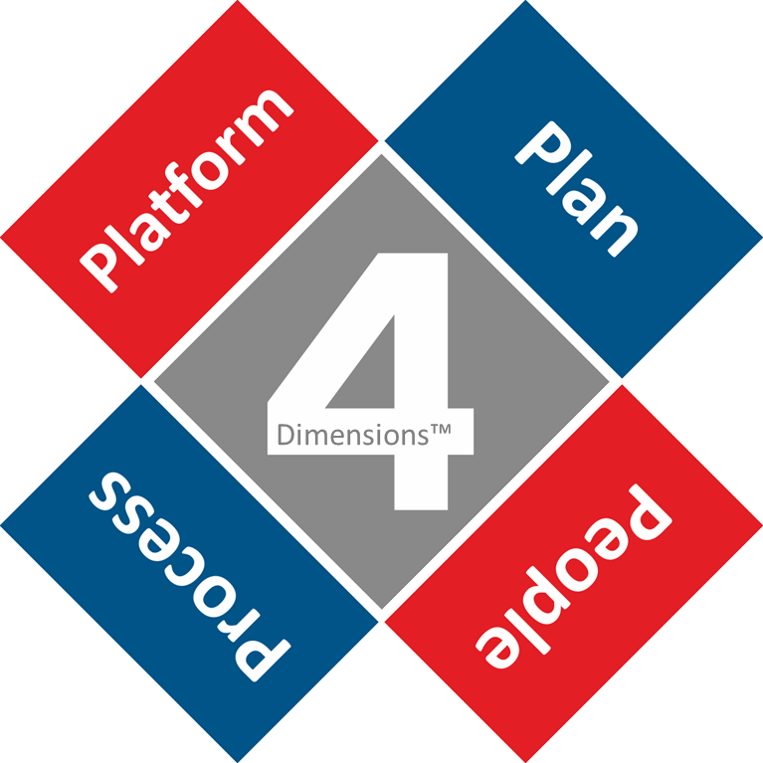



PROCE Design Elements (General design line)
Colour Scheme
Red: 227, 29, 36
Blue: 0, 64, 136
Grey: 137, 137, 137
Plan
Constant customers focus and stay clear of competition
Platform
Evolve an agile business framework – disrupt yourself!
People
Hire change competence and outsource for scalability
Process
Repetitive change execution with use of a common framework

Slide 3
Design of Framework

