Slide 1
Wisean
Moodboard

Slide 2
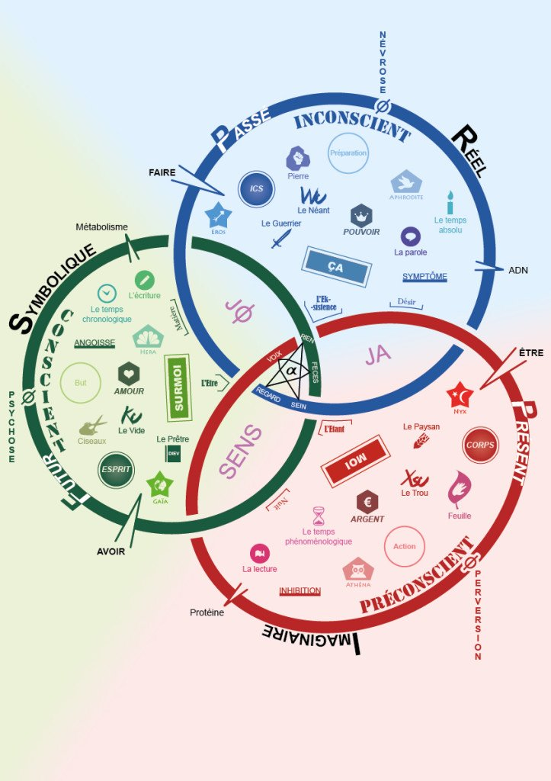





Slide 3



