Slide 1
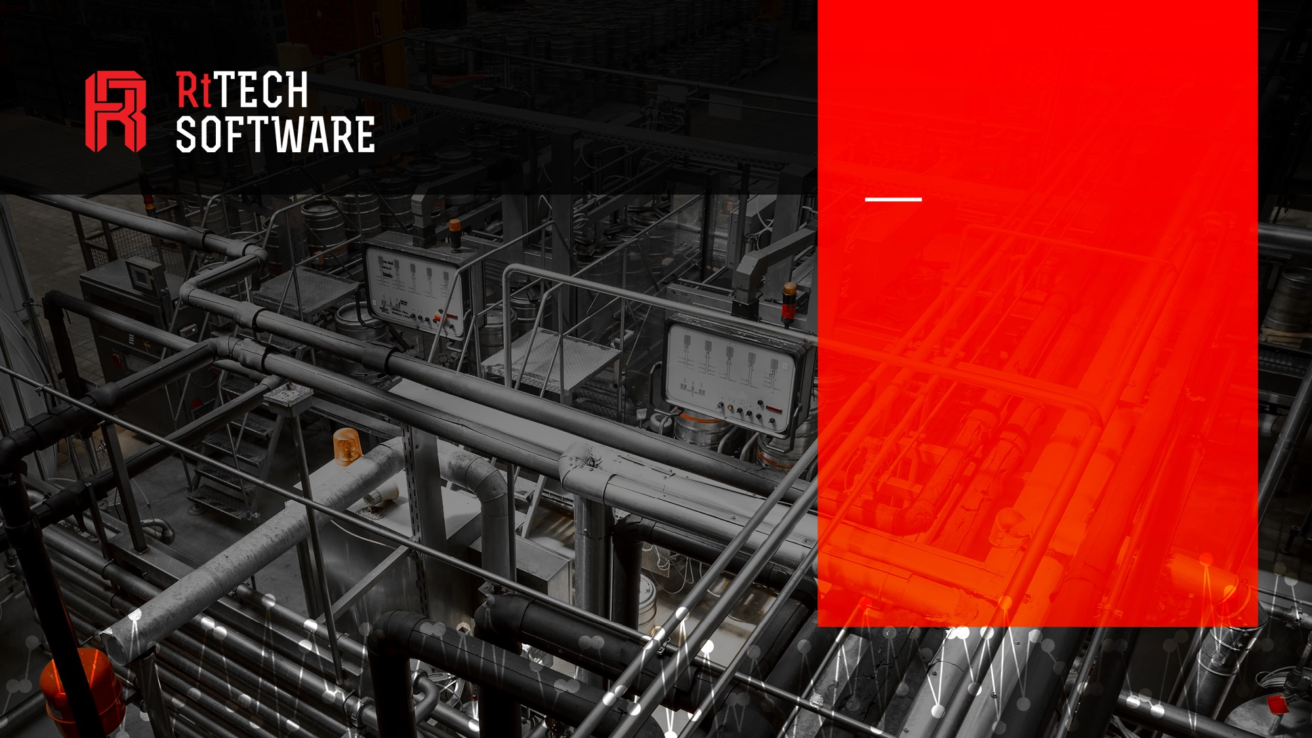

INDUSTRIAL APPS
FOR OPERATIONAL INTELLIGENCE
Be Connected
Be Informed
Be Efficient
Be Competitive
Presented by:
Keith Flynn, President & Founder

Slide 2

“One Canadian IoT technology company that has figured out the ROI from its products is RtTech Software, a Moncton, N.B. firm. The company has developed apps that help industrial clients − ranging from window and door manufacturers and bottling plants to corporate giants such as Michelin, Rio Tinto and Potash Corp − improve their operational efficiency.“
Source: GE Reports, June, 2015
Notes:
Batting above our weight in IIoT / Pat on the back.

Slide 3
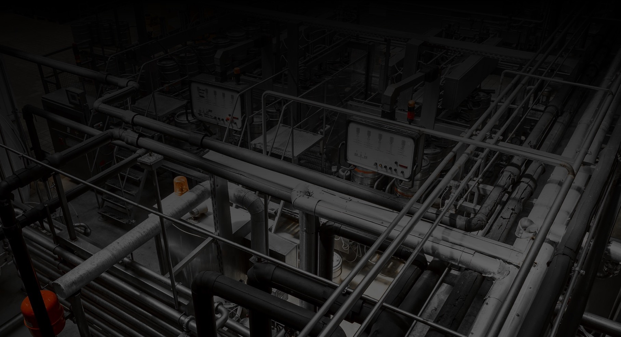
ABOUT RtTECH
RtTech is a company formed in November 2011 as a spin-off of ADM’s Software division formed in 2002.
Based in NB, Canada with offices in UK, and Australia
Develops Industrial Apps to improve asset availability, utilization
and utilities consumption. Apps present operational intelligence on performance and energy consumption of industrial assets.

Slide 4

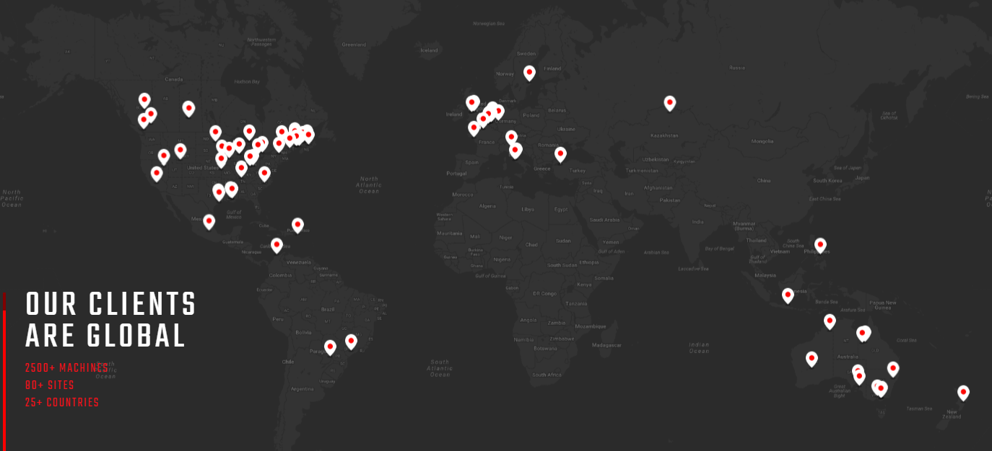


Slide 5


































TIER-1 CLIENT BASE

Slide 6
TIER-1 Client Base (by Industry)

Slide 7
TIER-1 Client Base (by Country)

Slide 8
TIER-1 Client Base (by Product)
** Client Count – Not Licenses Sold

Slide 9
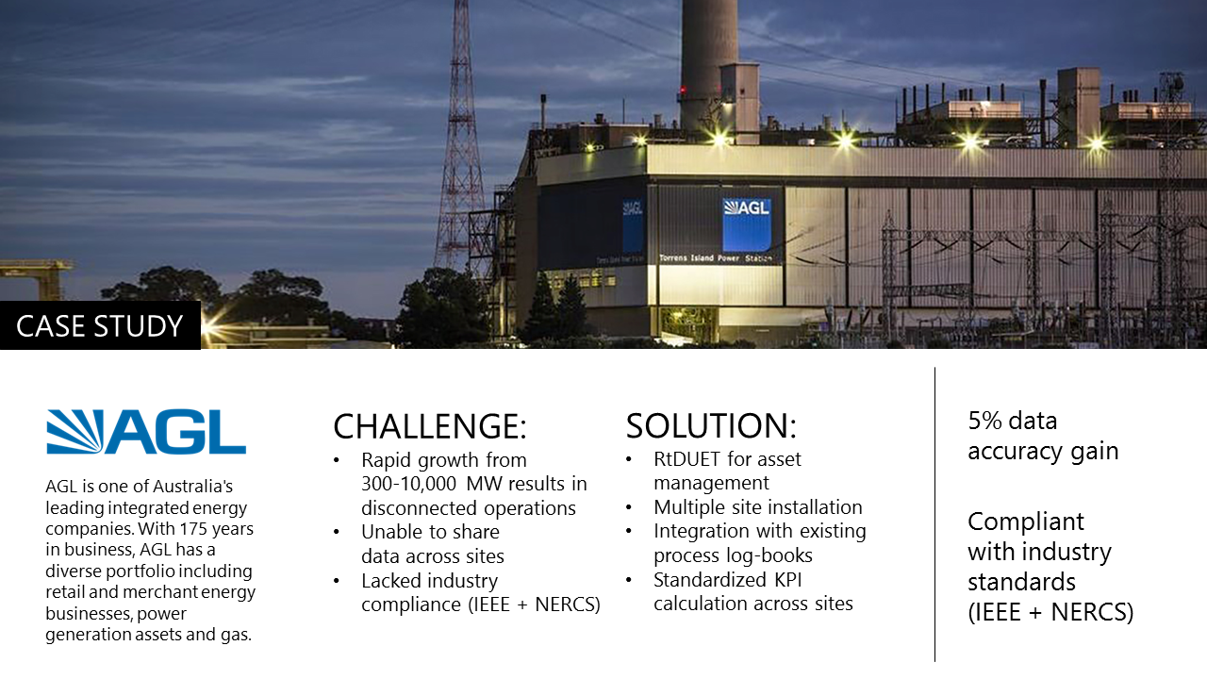
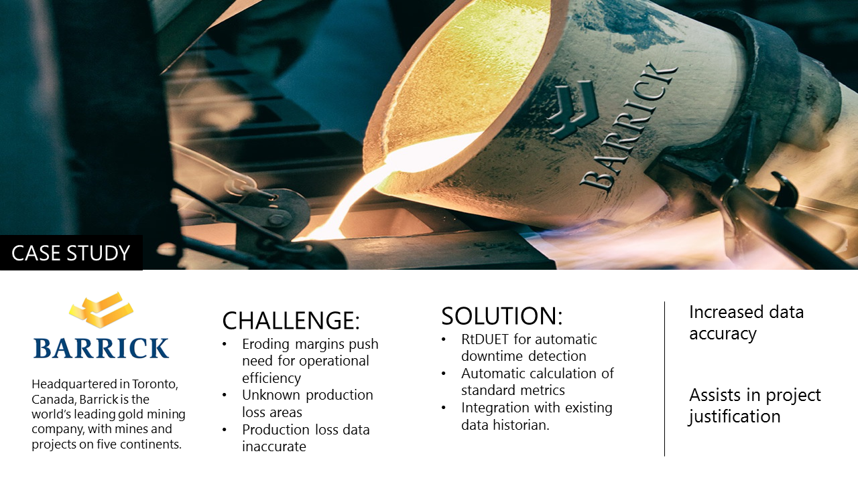
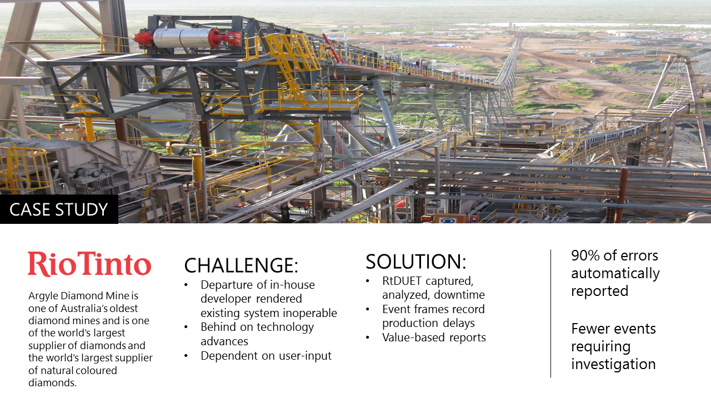
CASE STUDIES

Slide 10

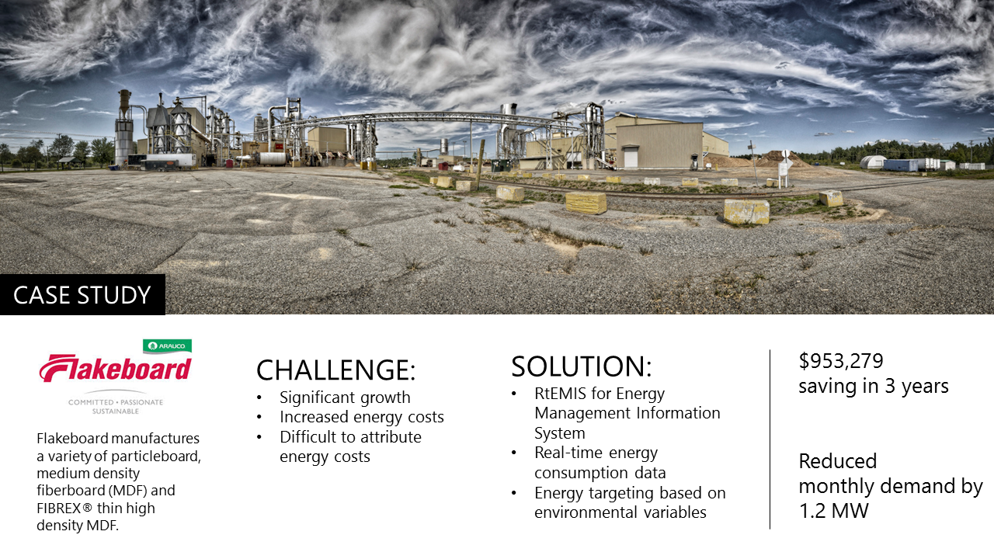
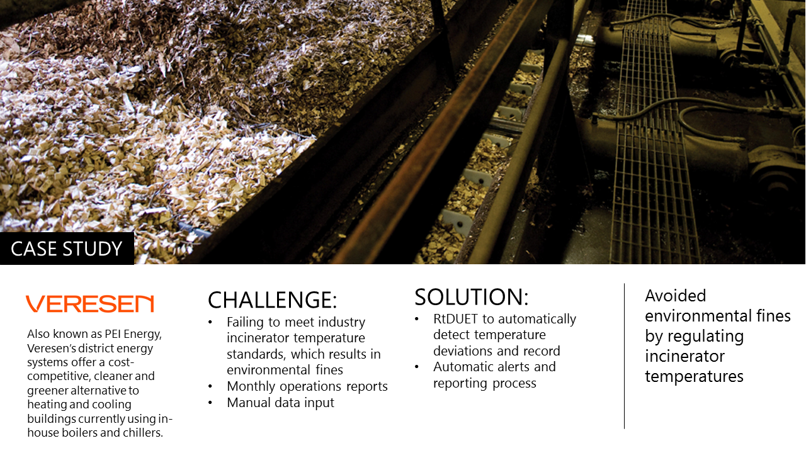
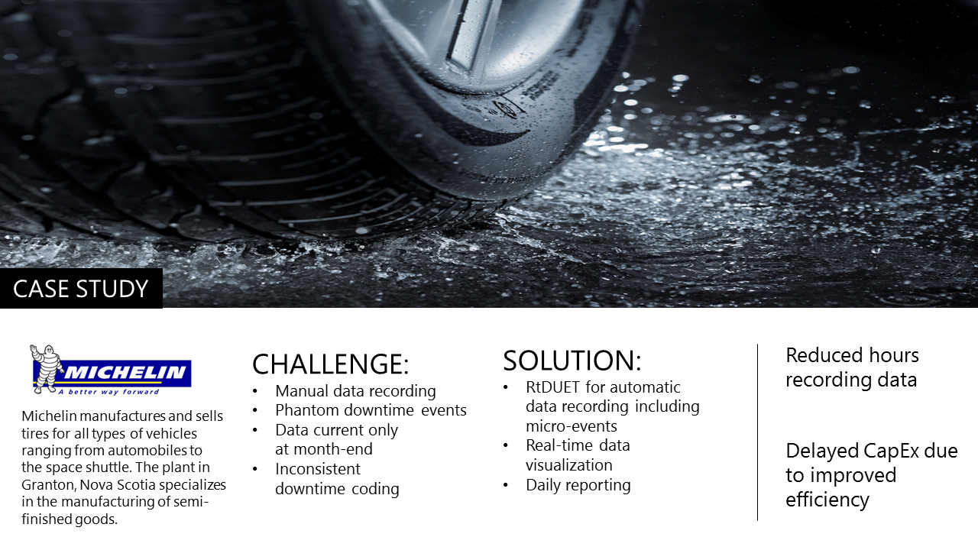

Slide 11










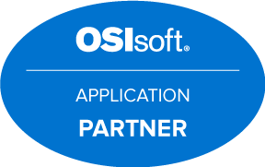













PARTNERSHIPS
TECHNOLOGY
DISTRIBUTION
ASSOCIATION
INTEGRATION

Slide 12
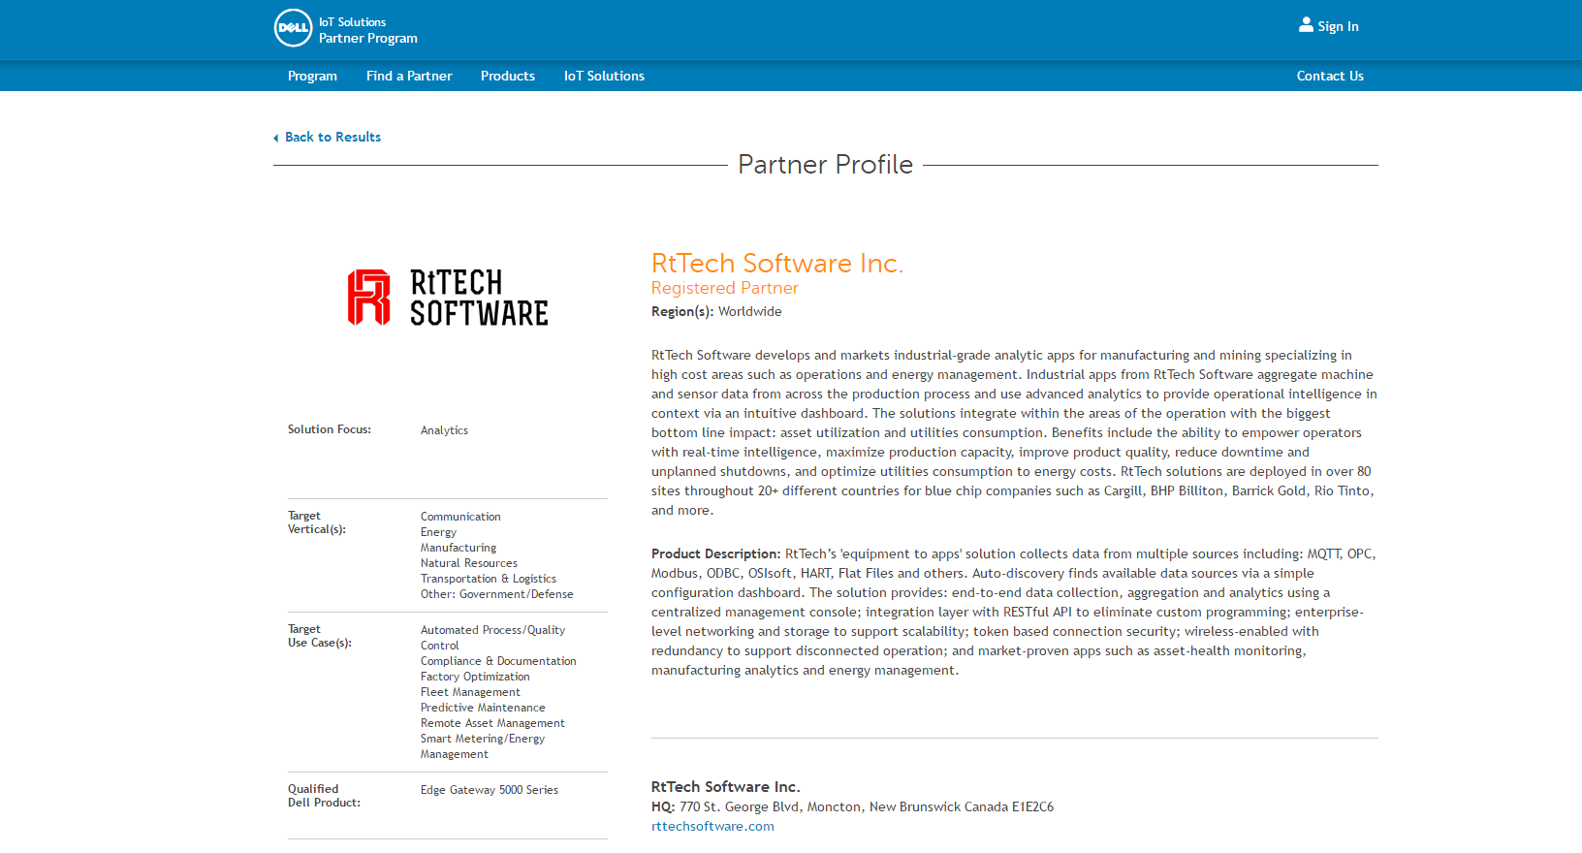

Slide 13
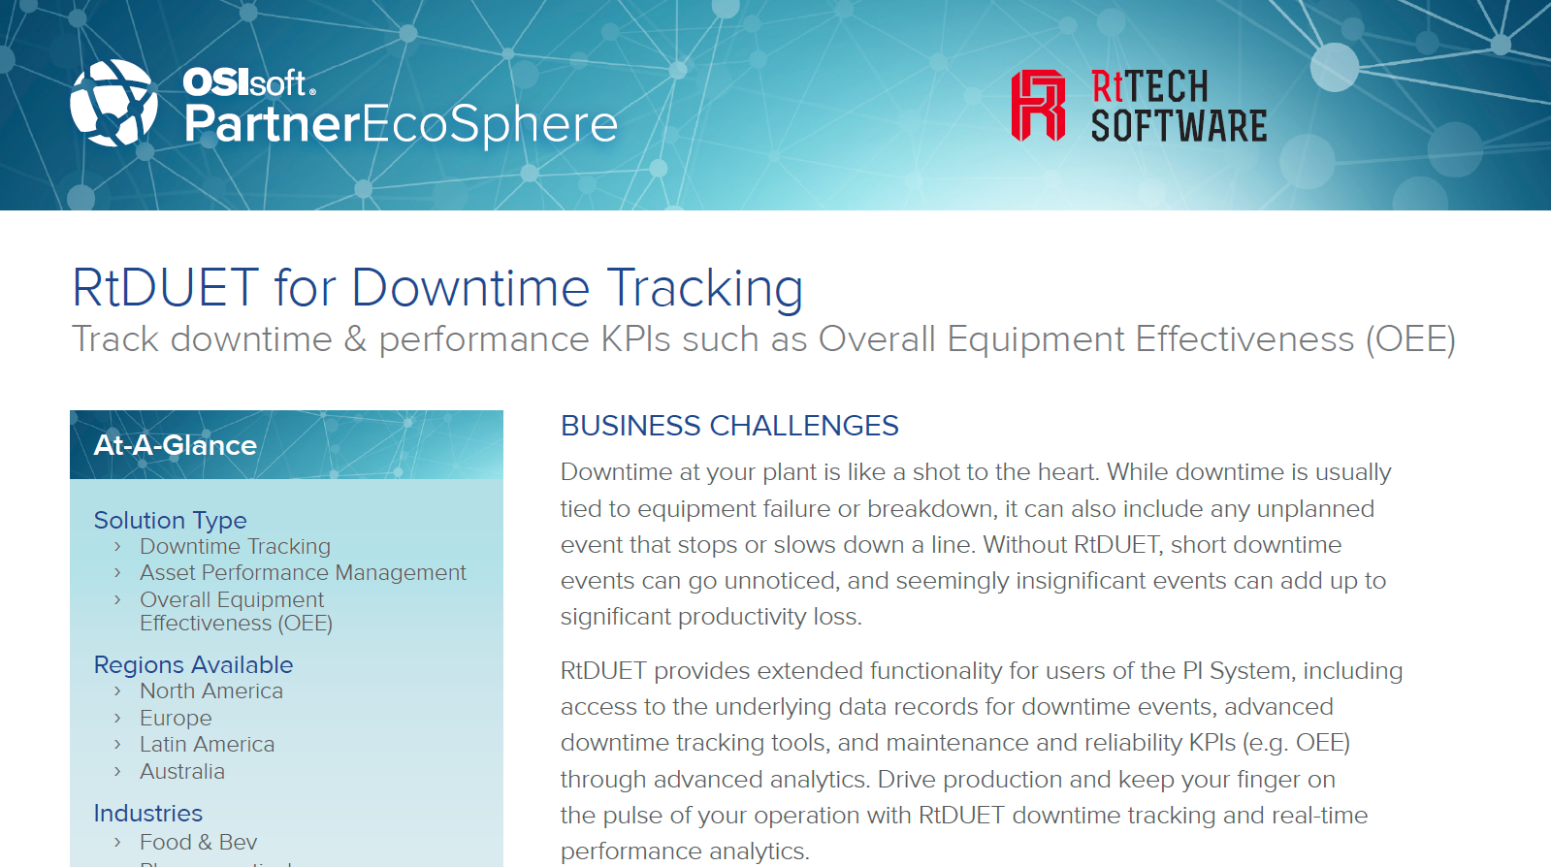

Slide 14
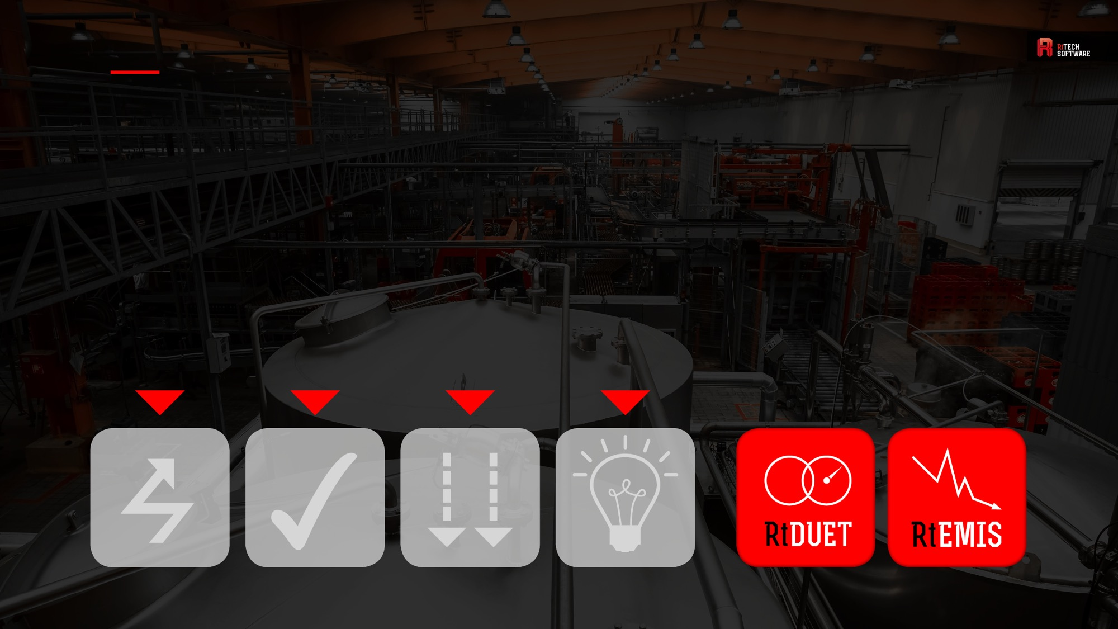
INDUSTRIAL APPS
FOR OPERATIONAL INTELLIGENCE.
OPTIMIZE ASSET UTILIZATION
REDUCE DOWNTIME AND SLOWDOWNS
INCREASE WORKER PRODUCTIVITY
REDUCE ENERGY
COSTS
Notes:
Apps that provide KPIs resulting in stable operations, reduced costs & increased asset utilization.
Apps that provide Operational Intelligence running against live PI data to deliver real-time visibility and insight into operations.
Apps that provide a low level of variation enabling the staff to spend their time on improvement, specifically, increased asset utilization (capacity) rather than constantly firefighting the effects of unstable operation.

Slide 15
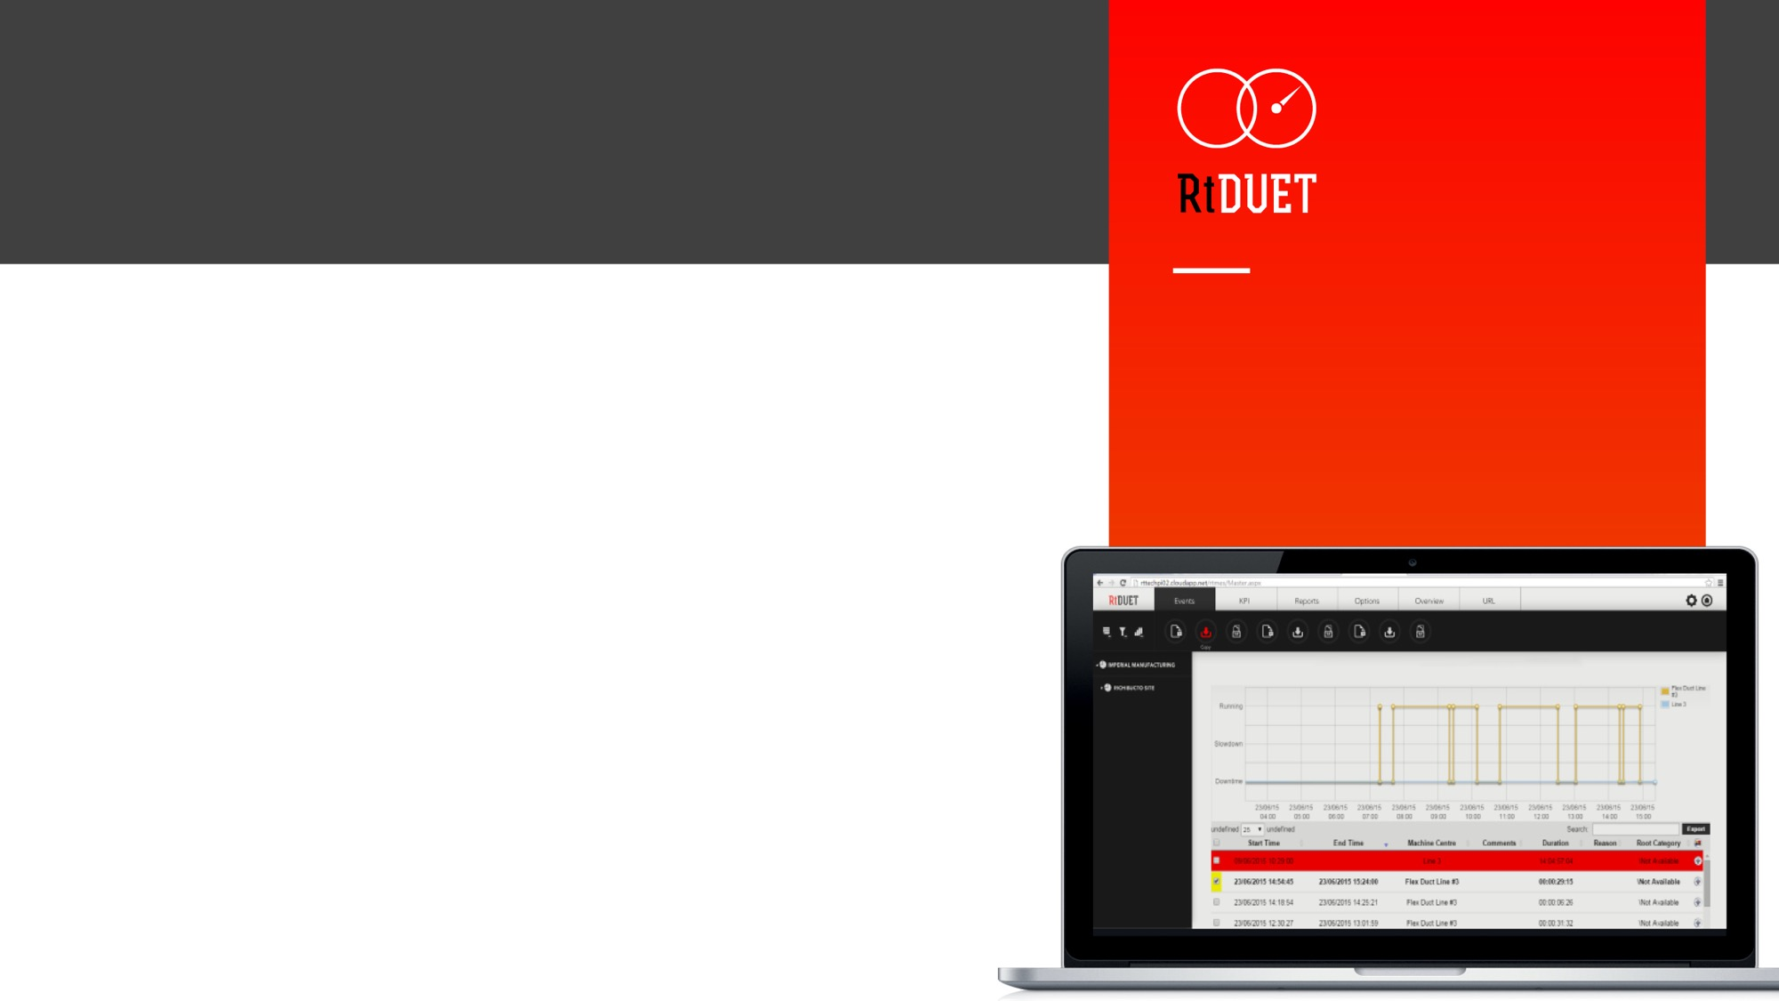

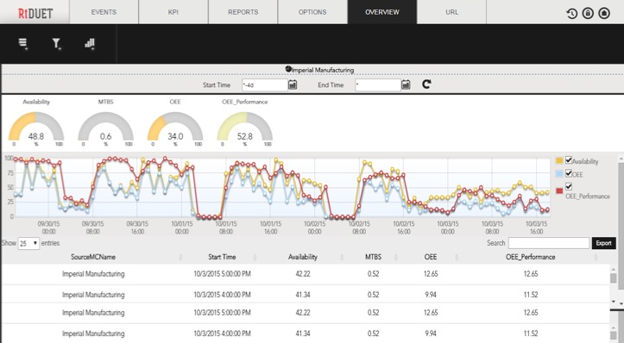
REAL-TIME EQUIPMENT MONITORING
& ASSET PERFORMANCE MANAGEMENT
“RtDUET helps us to determine downtime but also to accurately and easily associate production losses for slowdowns and to quickly drill down to root causes for those production losses.”
- Ron Butler, Nystar
Monitors equipment status
and detects downtime events.
Automatically calculates maintenance and reliability KPIs.
Helps customers to:
Decrease unplanned downtime
Assess maintenance strategies
Meet production targets
Utilization increases of over 8% have been achieved.

Slide 16
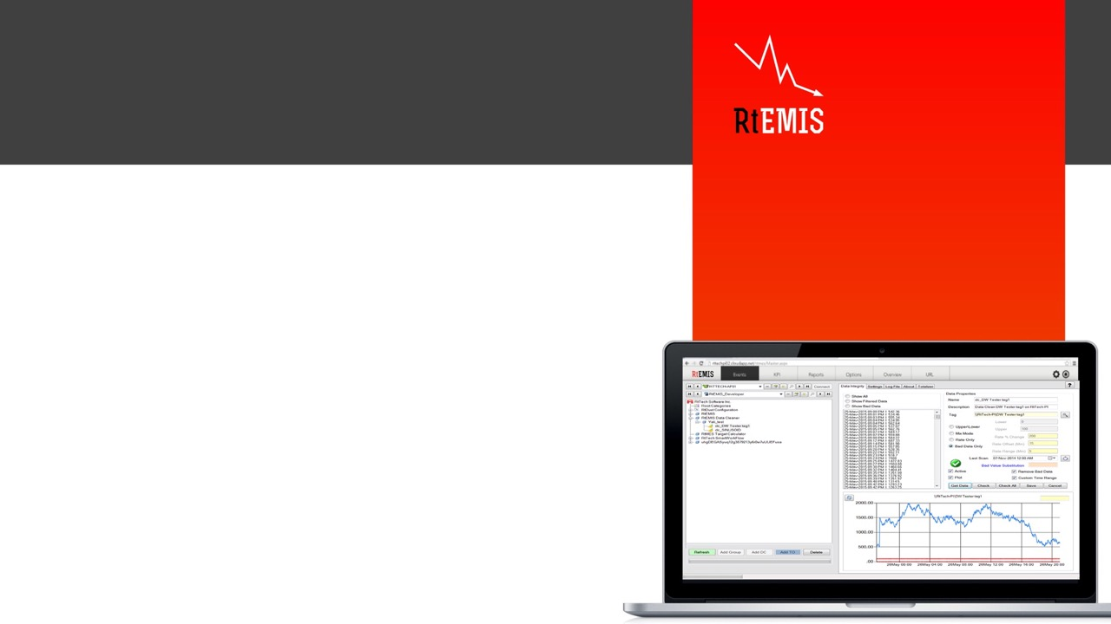

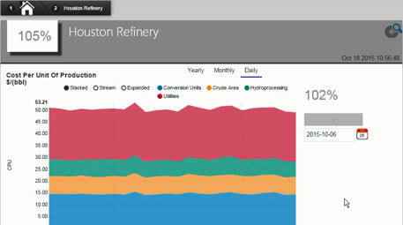
RtDuet: Asset Management
REAL-TIME ENERGY MANAGEMENT INFORMATION SYSTEM
“We have had tangible benefits, for instance, our pebble crusher was down for a short while. Using the information from RtEMIS we found out we were using 17% more energy per tonne when that equipment was down as opposed to when it was running.”
- Andrew Cooper, New Gold Inc.
Industrial Energy Management Information System.
Proven to reduce industrial energy consumption by 5-10%.
Reduce overall energy consumption
Transform energy from a given expense to a controllable item
Manage footprint using Carbon Accounting reports and dashboards

Slide 17
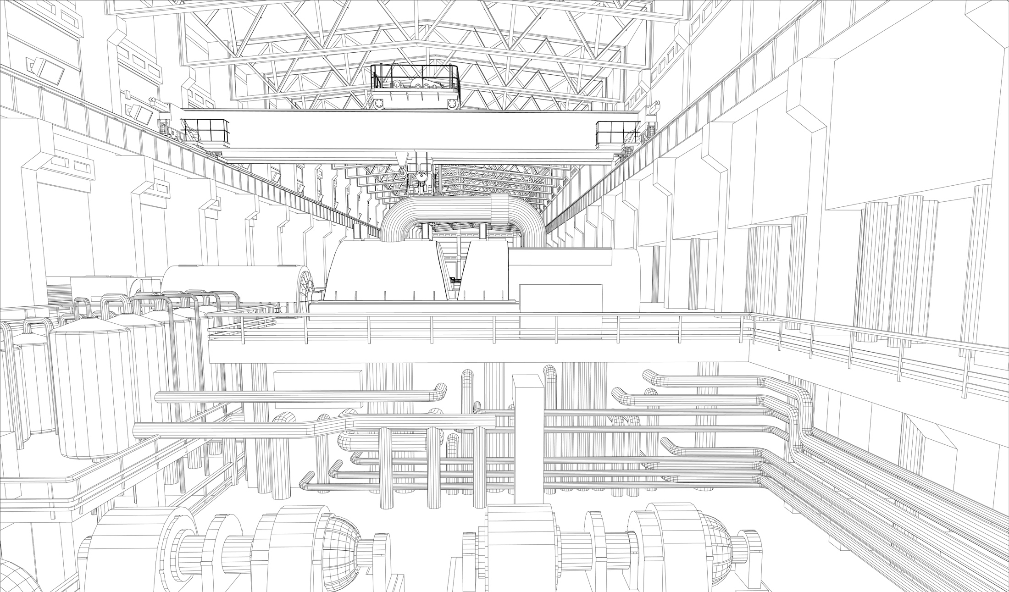


THE SOLUTION:
INDUSTRIAL-GRADE IIoT INFASTRUCTURE

Slide 18










Be Connected
  Bring your production data with you wherever you go. Connect any asset, sensor, MES, or ERP data source that drives your operations with a flexible IIoT infrastructure.
Be Informed
  Get accurate real-time data to any mobile device so you can keep your finger on the pulse of your operation no matter where you are.
Be Efficient
  Recognize trends in your operation and make proactive decisions eliminating unnecessary costs.
Be Competitive
  Making proactive decisions based off accurate real-time data from any asset gives you the competitive advantage

Slide 19
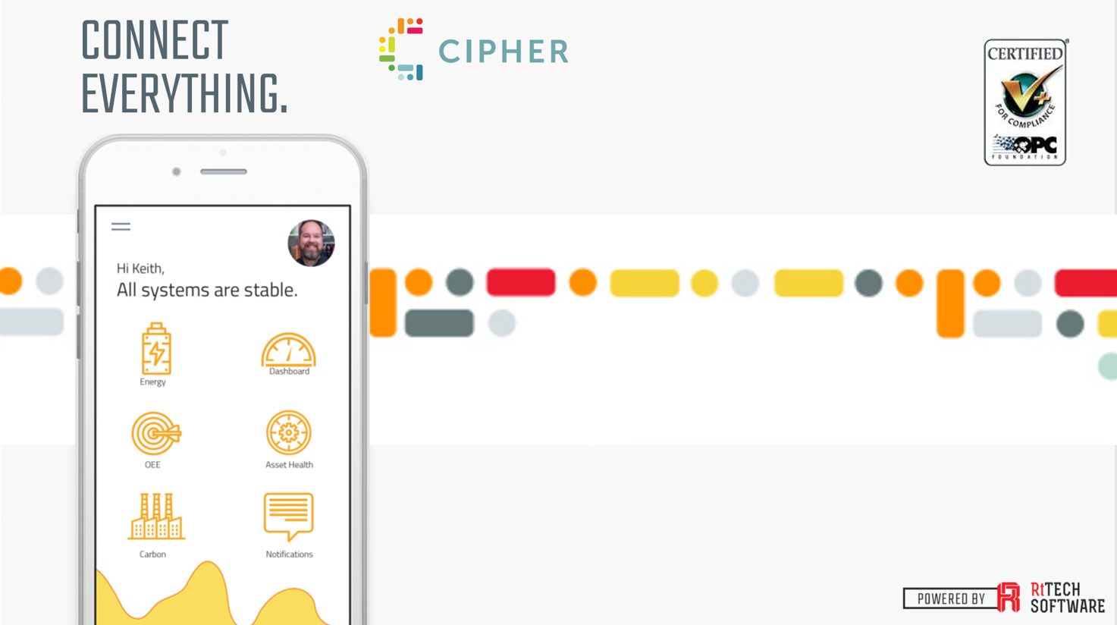


Slide 20
Cipher is RtTech’s NEW fully integrated, flexible IIoT solution that:
  Is not based on any 3rd party platforms
  Is a full Infrastructure and is 100% owned by RtTech
  Delivers Industrial Apps without the historian prerequisite
  Takes advantage of today’s cloud based technology
  Allows traditional on site deployments if required

Slide 21





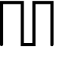





























ASSETS
INSTRUMENTS
DIGITAL
SERVERS
PUBLISH
DATA STORE + MANAGE
INDUSTRIAL APPS
USER INTERFACES
OEE
Dashboard
ASSETS
Digital Signal
INSTRUMENTS
A/D CONVERT
DATA COLLECT
RESTFUL API
RESTFUL API
Controllers
Analog Signal
EMIS
PLCs
Cloud, hosted solution
Native Mobile App
Pressure
or
Asset
Health
Monitoring
DCS
On-premise solution
Power
Integration
Flat File
Environmental Monitoring
Temperature
Workstations
MQTT
Level
Wireless
IIoT
IIoT

Slide 22
Be Connected
  High Connectivity
    Windows and Linux platforms
    Single connector supports simultaneous multi-server connections
    Embedded hardware solutions
      Edge Based Analytics
      Distributed load balancing on edge devices.
    OPC Certification
  Optimize networking and storage to support scalability
    Secure data transport using AMQPs
      AMQPs (Advanced Message Queuing Protocol Secure)
    Advanced compression algorithms
    Token based connection security
    Redundancy on collectors and disconnected data collection
    Continuous integrity monitoring with notifications
  Advanced triggers with dynamic and complex logic
  Centralized management console
  Integration layer (RESTful API)

Slide 23






Cipher Connect
OMF
WEB API
Secure Socket
DATABASE
(ON-SITE)
Flat File
Edge Device
AMQPs
HTTPs
MQTT
MQTT

Slide 24
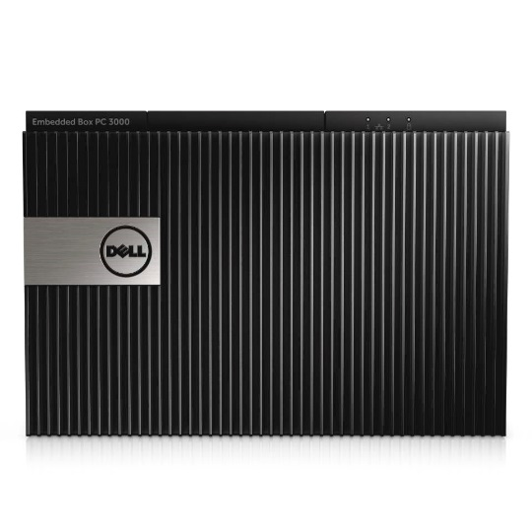
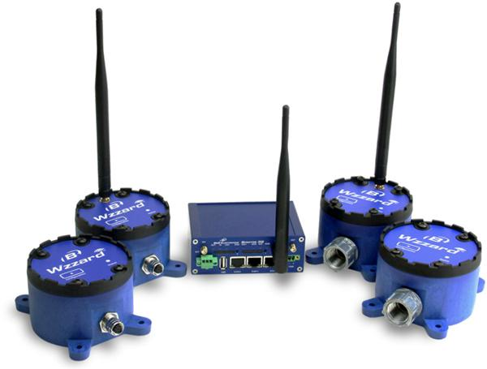
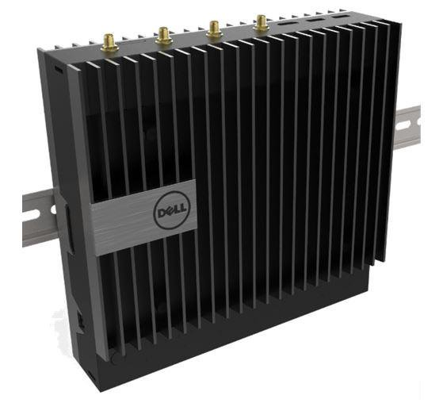
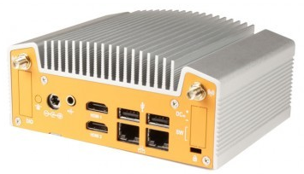
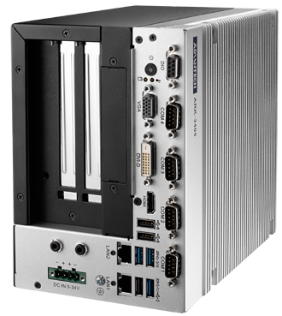
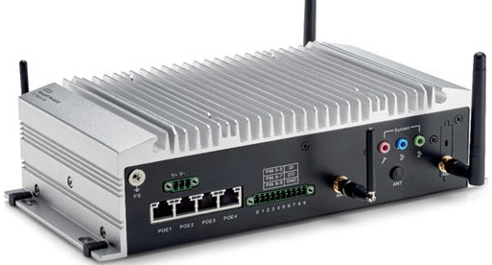
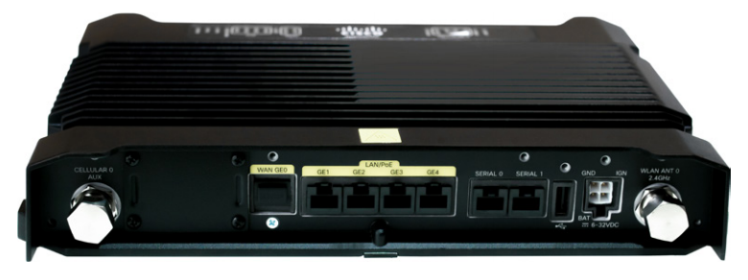

Notes:
Dell 5000 Series
B&B Electronics SmartWorx
HPE Edgeline - HPE IoT System EL10, HPE IoT System EL20
Cisco IR829GW

Slide 25
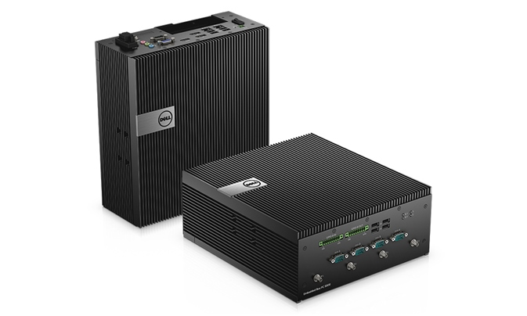
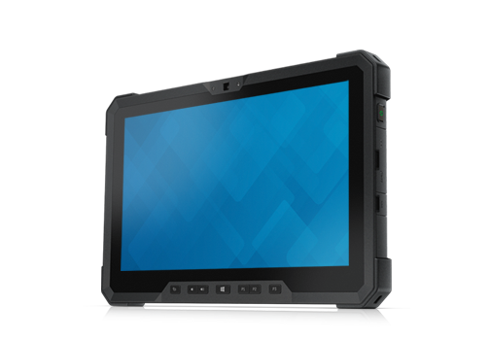
Notes:
Dell GW 5000 Series
Embedded PC 3000 and 5000 Series.

Slide 26

Cipher Mesh
MQTT
Destination(s)
4G/LTE
MQTT
MQTT
MQTT
MQTT
Notes:
DATA COLLECTION SUPPORTS MULTI – HYBRID SOLUTIONS
Distributed Load
Distributed Calcs
Concentrated Data Send – Reduce expense on data transmission
Receiver tools to ensure security even when the transmission does not enforce it.
Data compression

Slide 27
Cipher Wireless Sensors
Notes:
B&B Electronics SmartWorx

Slide 28
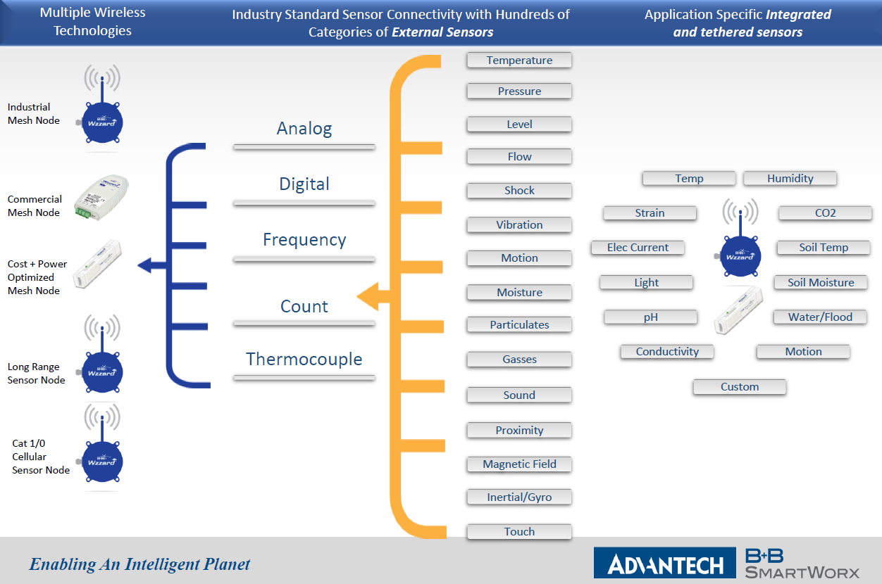
Cipher Wireless Sensors
Notes:
B&B Electronics SmartWorx

Slide 29
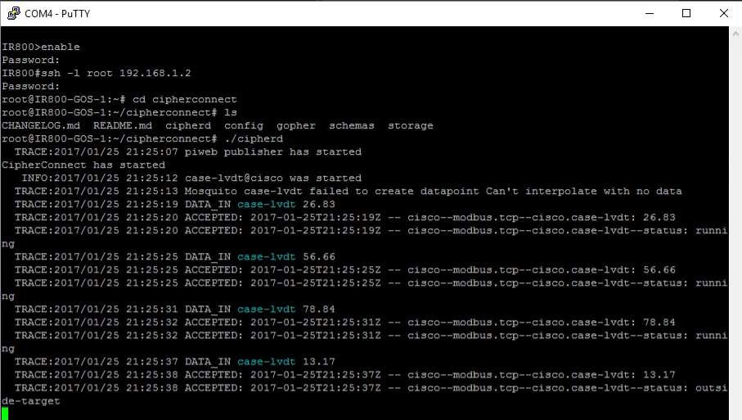
Cipher Connect - Embedded
Notes:
Dell 5000 Series
B&B Electronics SmartWorx
HPE Edgeline - HPE IoT System EL10, HPE IoT System EL20
Cisco IR829GW

Slide 30
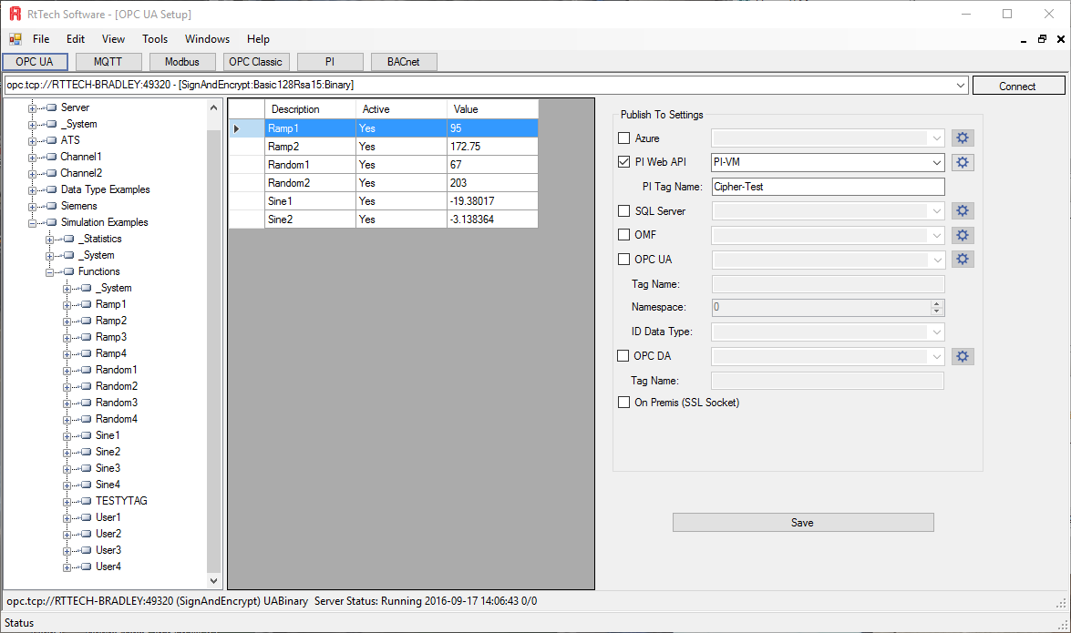
Cipher Connect – Config Tool
Notes:
Dell 5000 Series
B&B Electronics SmartWorx
HPE Edgeline - HPE IoT System EL10, HPE IoT System EL20
Cisco IR829GW

Slide 31
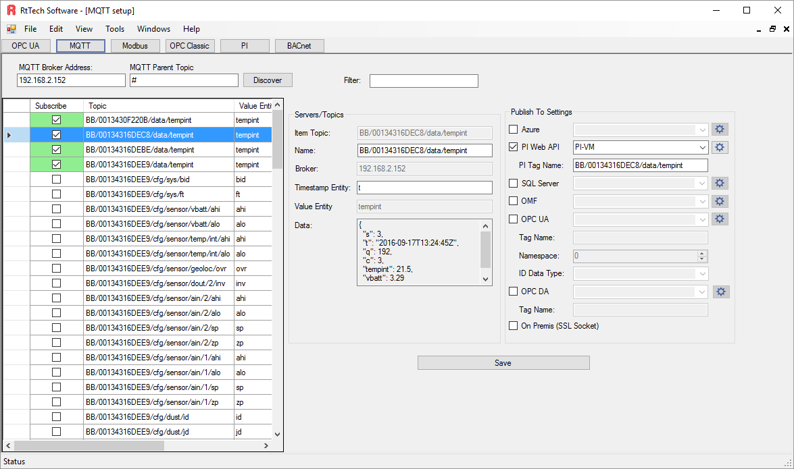
Cipher Connect – Config Tool
Notes:
Dell 5000 Series
B&B Electronics SmartWorx
HPE Edgeline - HPE IoT System EL10, HPE IoT System EL20
Cisco IR829GW

Slide 32
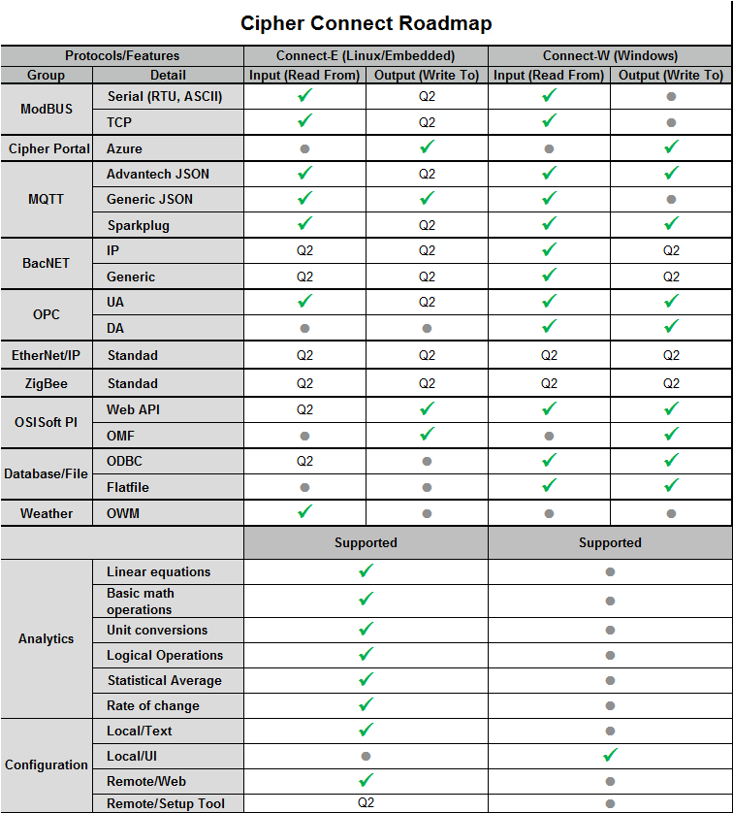

Slide 33
OPC CERTIFICATION
OPC certification provides credibility within the (IIoT) ecosphere
OPC UA is key to enabling interoperability between devices and assets
Critical for plants and factories that are connecting new and legacy systems
Standardized communication, security, and protocols
for a wide range of industrial equipment and software.
"RtTech Software successfully certified their product in the OPC Foundation certification lab, truly meeting and exceeding the high standards of quality that end-users of OPC products have come to expect."
- THOMAS J. BURKE, OPC FOUNDATION PRESIDENT & EXECUTIVE DIRECTOR

Slide 34
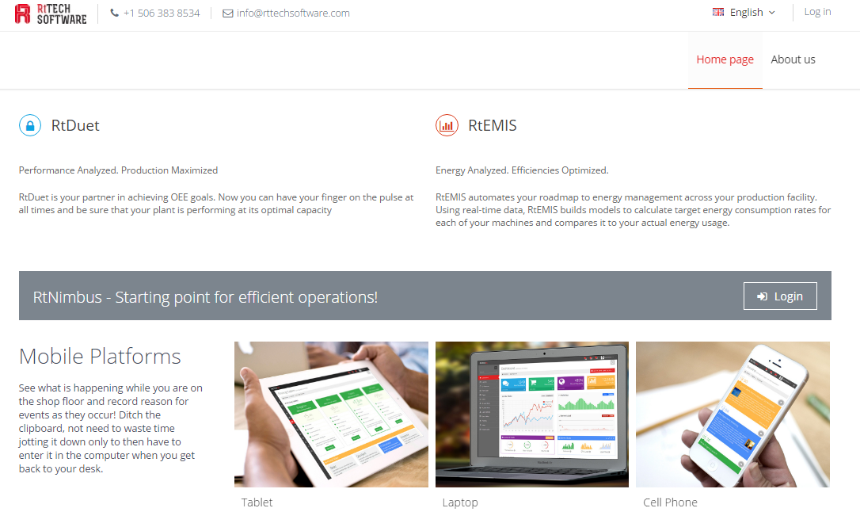
USER INTERFACES
Dashboard
Native Mobile App
Integration
CENTRALIZED MANAGEMENT CONSOLE

Slide 35
Be Informed
  Interactive + adaptable dashboard
  Native iOS + Android mobile apps with push notifications
  Multilingual functionality including complex language definitions
  Login-based security with role definitions
  Embedded diagnostics
    Audit logs
    Application exceptions
    Health checks

Slide 36
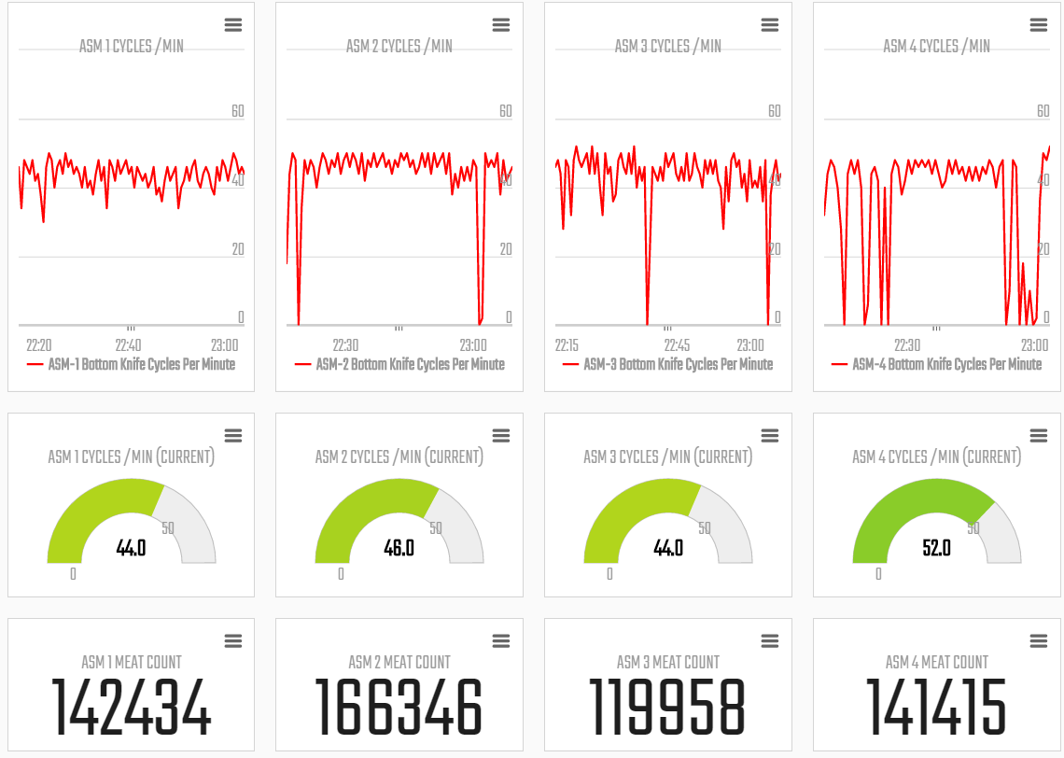
USER INTERFACES
Dashboard
Native Mobile App
Integration
DASHBOARDS

Slide 37
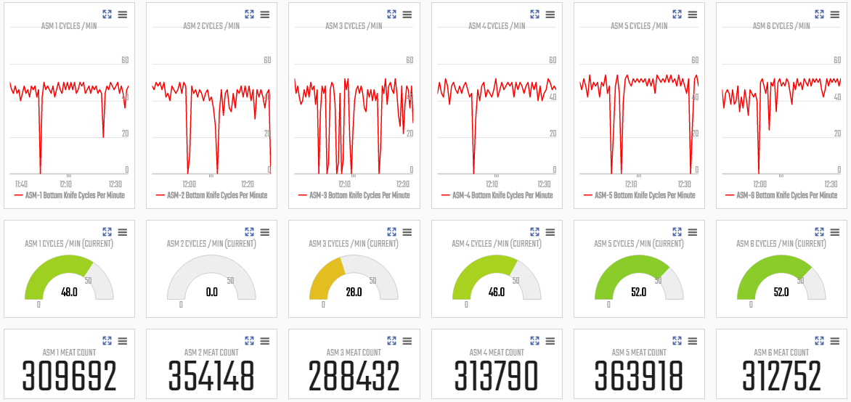

Slide 38
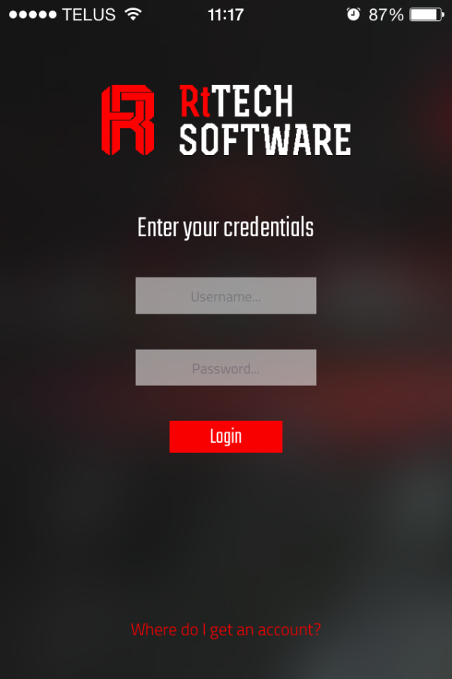
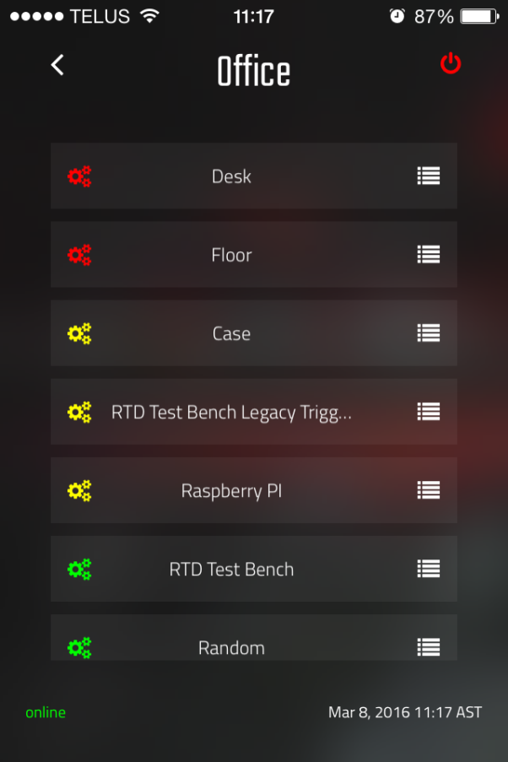
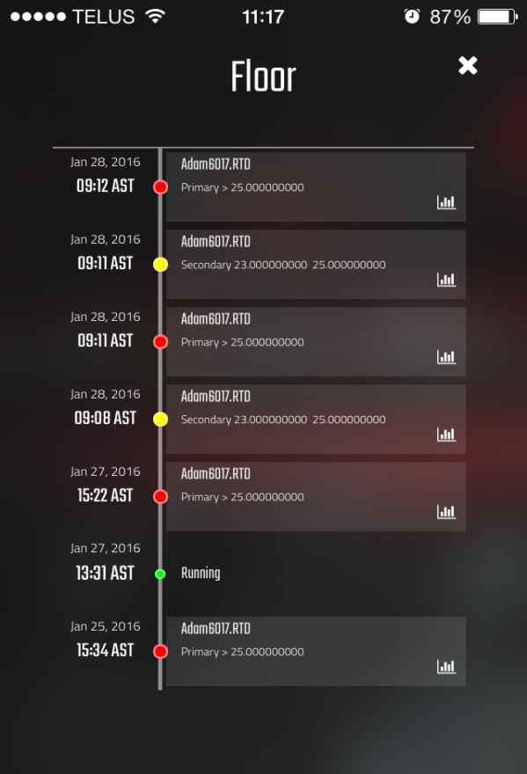
MOBILE APPS
USER INTERFACES
Dashboard
Native Mobile App
Integration

Slide 39









INTEGRATION
USER INTERFACES
Dashboard
Native Mobile App
Integration
Notes:
Infor EAM - is the most configurable enterprise-grade asset management solution on the market.
Oracle EAM - Enterprise asset management enables companies to drive maintenance best practices and manage the full asset lifecycle with a complete view of all types of assets and equipment.
IBM Maximo

Slide 40
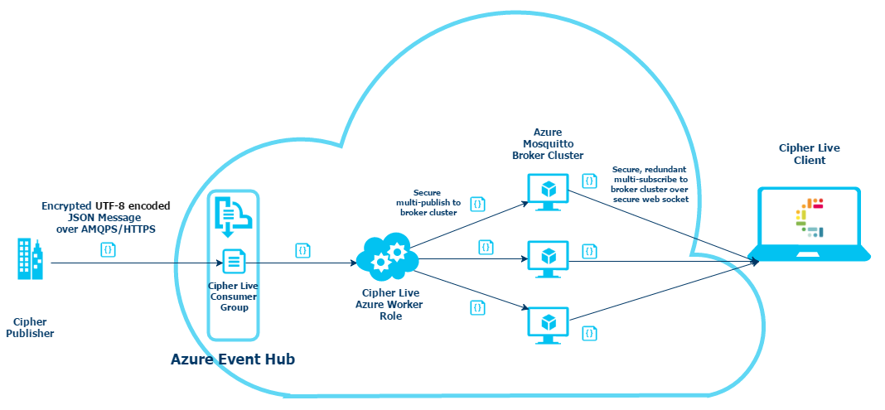
INTEGRATION
MQTT BROKER
3rd Party Apps

Slide 41
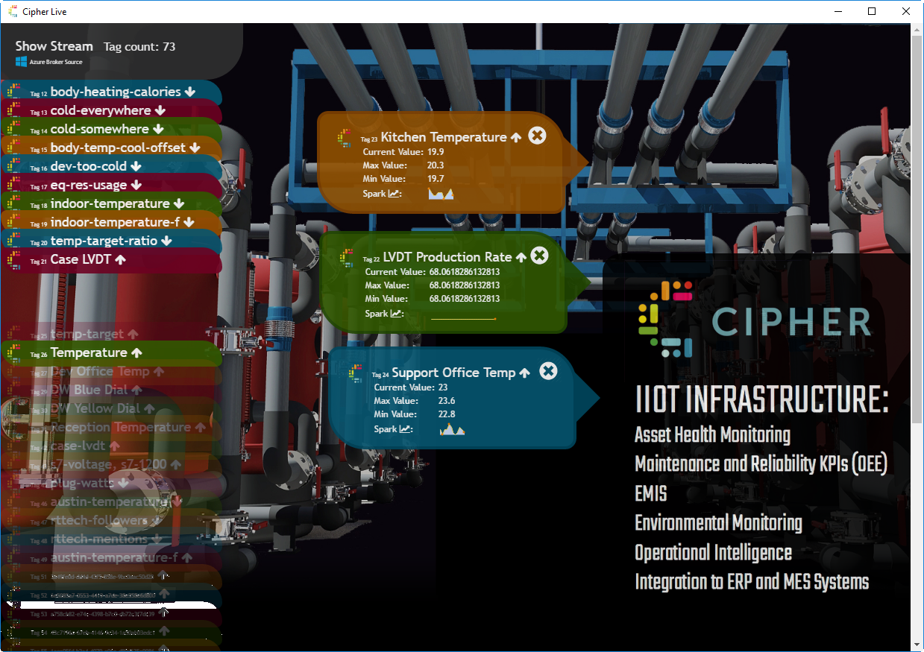
INTEGRATION
MQTT BROKER
3rd Party Apps

Slide 42
THANKS
KILLER APPS FOR INDUSTRIAL ANALYTICS.
Presented by:
Keith Flynn
President and Founder
keith@rttechsoftware.com

