Slide 1



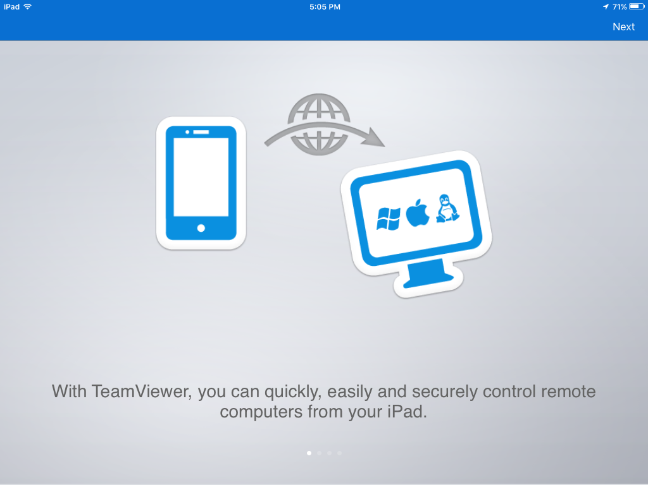

REQUEST FOR THE IMAGE IN LETTER “o” TO DISPLAY “PHONE VIDEO CALL”. BELOW ARE SOME EXAMPLES BUT OPEN TO SUGGESTIONS.

