Slide 1




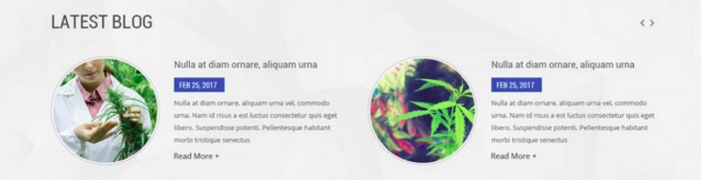
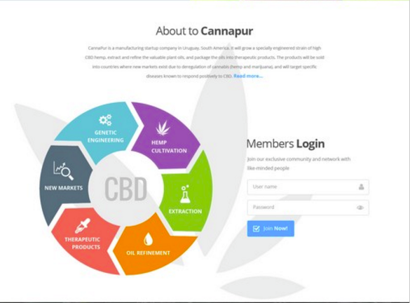





HOME PAGE
CannaPur is not just designing CBD products, it is designed to maximize investor returns.
GET PASSWORD
password
MEMBERS ONLY
+
+
+
+
+
+

