Slide 1


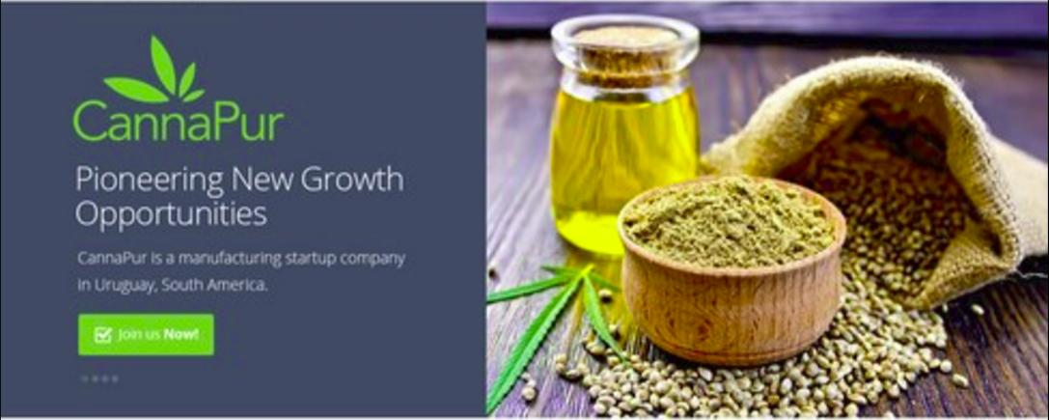
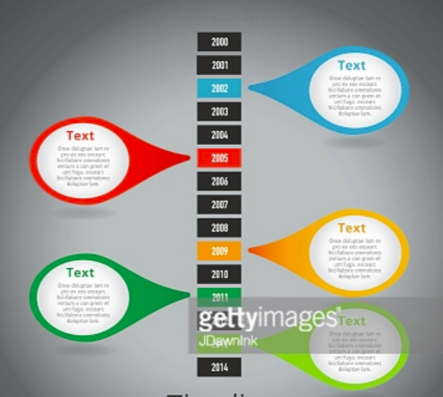
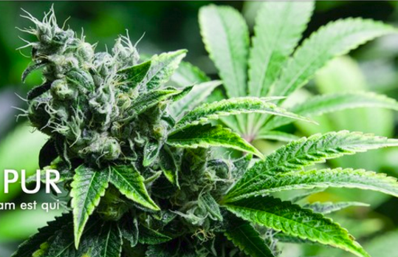
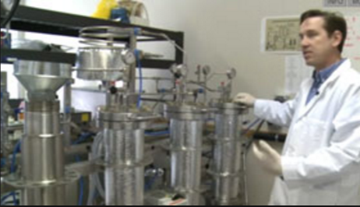
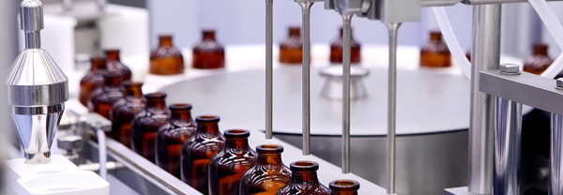
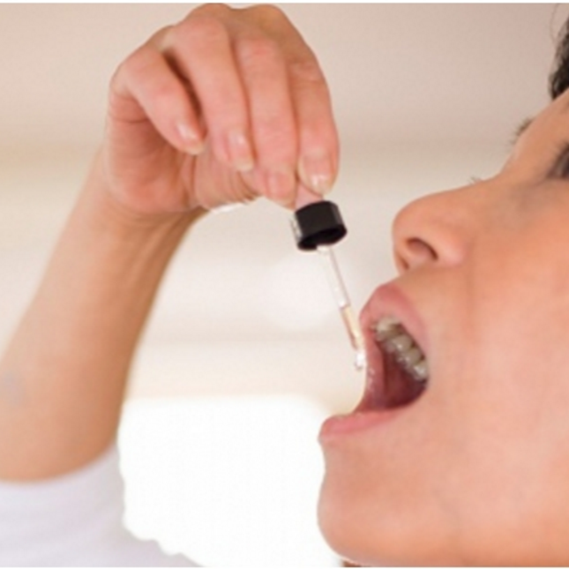


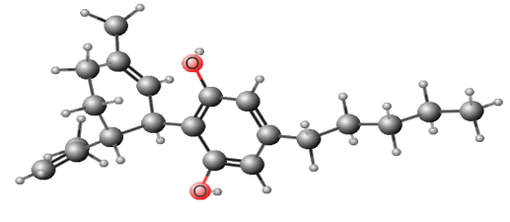
PROTECTED PAGE
Executive Summary
Business Overview
CBD Tutorial
For its for its CBD oil to treat epilepsy patients, CannaPur already has pre-agreements with medical product distributors in Brazil, Argentina and Columbia.
Even though we cultivate and produce 100% legal hemp derived CBD, our growth market opportunities follow wherever marijuana is legalized. We benefit from market awareness generated by government deregulation.
Legal as Medicine
Uruguay
USA*
Canada
Spain
India
Australia
Columbia
Austria
Philippines
Italy
Israel
Macedonia
Poland
Puerto Rico
Turkey
Czech Rep.
Croatia
Cannabis is cannabis because it is comprised of 83 known “cannabinoids.” The two most well known, and important, cannabinoids are “THC” and “CBD.” The THC molecule is psychoactive. The CBD is the “medicine molecule.” All cannabinoids are always present in the plant, yet they exist in different percentages based on how the plant is genetically engineered.
Hemp is defined as cannabis that is used for industrial purposes (not recreationally) and has a low amount of THC. The United States, Canada, and most of the rest of the world including Europe set a limit of < 0.3% THC for the cannabis to be considered hemp.
CBD
Decriminalized
(path to legalization)
Argentina
Chile
Paraguay
Ukraine
Greece
Germany
Costa Rica
US Virgin Isl.
Russia
Ecuador
Switzerland
Belgium
Portugal
Mexico
Luxembourg
Jamaica
Estonia
Cambodia
Bolivia
Peru
Malta
Slovenia
However, only in Uruguay the hemp limit for THC is 1.0% - three times higher than anywhere else in the world.
CannaPur has engineered the genetics of our hemp to take full advantage of the unique Uruguayan hemp law, and our hemp produces up to 30% CBD – twice the amount of valuable extract per plant compared to anywhere else in the world. And in addition, we shall benefit from final processing and export from the Free Trade Zone (FTZ), eliminating many taxes. This gives CannaPur the opportunity to be the most profitable CBD company in the world.
CannaPur is not just designing CBD products, it is designed to maximize investor returns.
Refined CBD Oil sells for $25,000 per kg – 70% the price of gold
Our genetics produces hemp that is 2.5 m tall and 1 m wide, and grows in just four months!

